Slide 1
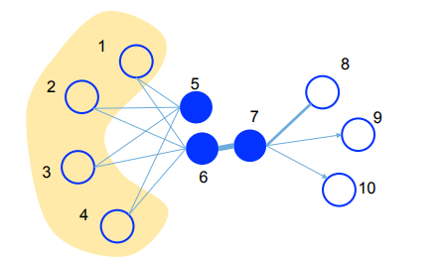
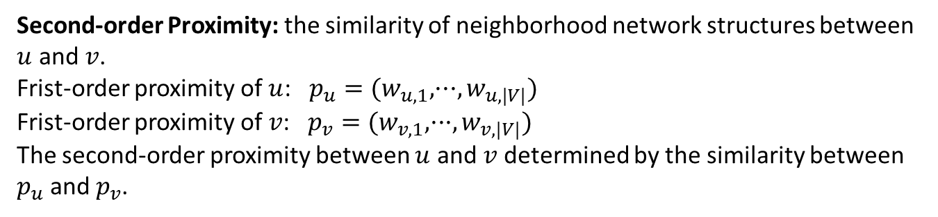
Definitions:
Information Networks: $G=(V,E,W)$, each edge $e=(u,v)∈E$ associated with a weight $w_{uv}>0$, which indicates the strength of the relation. Directed or Undirected.
Frist-order Proximity: $w_{uv}$, local pairwise proximity between two vertices.
Second-order Proximity: the similarity of neighborhood network structures between $u$ and $v$. Frist-order proximity of $u$: $p_{u}=(w_{u,1},···,w_{u,|V|})$
Frist-order proximity of $v$: $p_{v}=(w_{v,1},···,w_{v,|V|})$
The second-order proximity between $u$ and $v$ determined by the similarity between $p_{u}$ and $p_{v}$.
Notes:
信息网络：航线网络、出版网络、社会网络等，主要是在边上定义了权重。
Frist-order proximity observed links
Second-order proximity, legitimate links but actually not observed 可解释为具有共享邻居结构的结点是相似的。

Slide 2
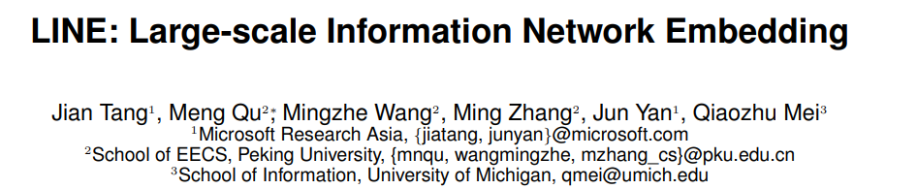
LINE is able to scale to very large, arbitrary types of networks:
Undirected, directed and/or weighted.
The model optimizes an objective which preserves both the local and global network structures.
Local: Frist-order proximity
Global: Second-order proximity
An edge-sampling algorithms for optimizing the objective.
Experiments shows the effectiveness and efficiency of LINE.
Notes:
Local就是网络中可见的边，通过Frist-order Proximity表示：边权
Global是看不见的边，但是能反映全局的玩咯结构，我们通过Second-order Proximity表示：结点之间共享
的邻居结构。

Slide 3
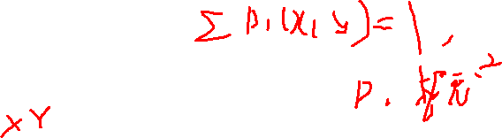



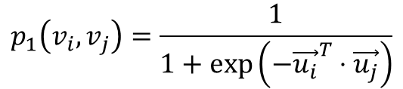
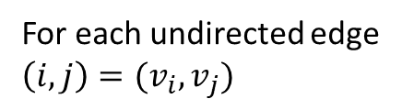
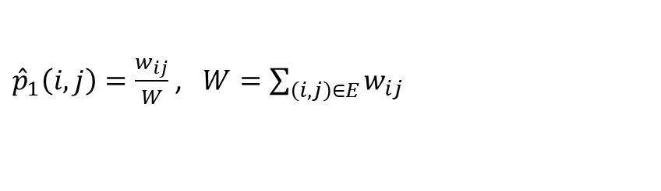
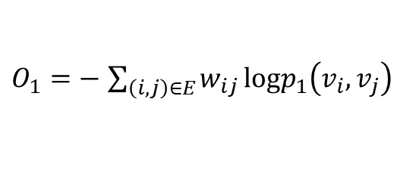
Model Description
1. LINE with Frist-order proximity
Model the first-order proximity, define the joint probability:
$$p_{1}\left(v_{i},v_{j}\right)=\frac{1}{1+\exp\left(−{\vec{u_{i}}}^{T}⋅\vec{u_{j}}\right)}$$
For each undirected edge
$\left(i,j\right)=(v_{i},v_{j})$
$\vec{u_{i}}∈R^{d}$ is the low-dimensional vector representation of vertex $v_{i}$.
empirical probability
${\hat{p}}_{1}\left(i,j\right)=\frac{w_{ij}}{W}$ , $W=\sum_{\left(i,j\right)∈E}{w_{ij}}$
Minimize the following objective function:
$$O_{1}=d({\hat{p}}_{1}\left(·,·\right),p_{1}\left(·,·\right))$$
$d$ is the distance between two distributions.
Replacing $d(·,·)$ with KL-divergence and omitting some constants,
$O_{1}=−$ $\sum_{\left(i,j\right)∈E}{w_{ij}}logp_{1}\left(v_{i},v_{j}\right)$
$$O_{1}=H\left({\hat{p}}_{1},p_{1}\right)−H({\hat{p}}_{1})$$
The first-order proximity is only applicable for undirected graphs, not for directed graphs.
Notes:
分别讨论保持1阶相似性和2阶相似性的LINE model，再结合两种相似性。
1阶相似性只适用于无向图、不适用于有向图。
这里1阶相似性使用sigmoid函数，应该使用softmax函数。

Slide 4
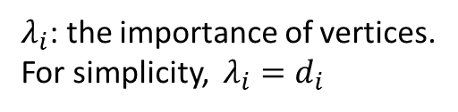
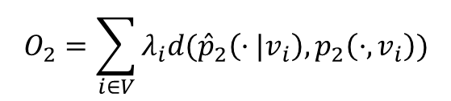
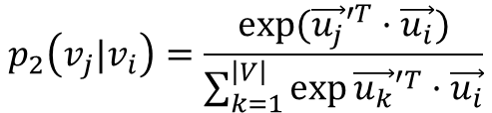
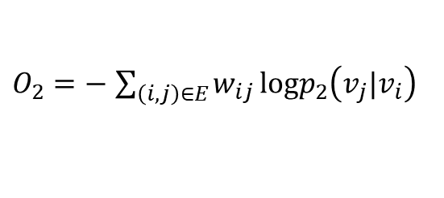
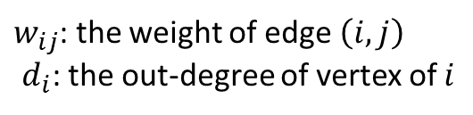
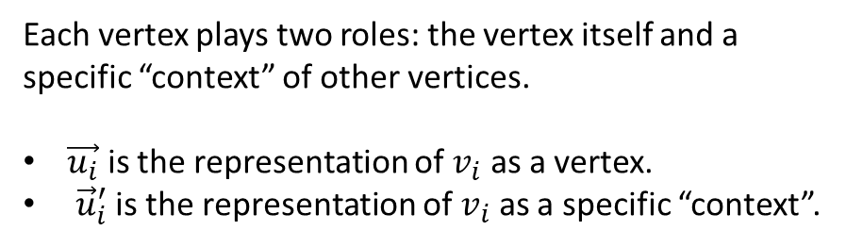
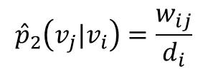
2. LINE with Second-order proximity
The second-order proximity is applicable for both directed and undirected graphs.
The second-order proximity is applicable for both directed and undirected graphs.
Each vertex plays two roles: the vertex itself and a specific “context” of other vertices.
$\vec{u_{i}}$ is the representation of $v_{i}$ as a vertex.
${\vec{u}}_{i}^{′}$ is the representation of $v_{i}$ as a specific “context”.
For each directed edge $\left(i,j\right)$, define the probability of “context” $v_{j}$ generated by $v_{i}$.
$$p_{2}\left(v_{j}|v_{i}\right)=\frac{exp⁡({\vec{u_{j}}′}^{T}·\vec{u_{i}})}{\sum_{k=1}^{\left|V\right|}{\exp{{\vec{u_{k}}′}^{T}·\vec{u_{i}}}}}$$
Minimize the following objective function:
$$O_{2}=\sum_{ⅈ∈V}{λ_{i}d({\hat{p}}_{2}\left(·|v_{i}\right),p_{2}\left(·,v_{i}\right))}$$
$${\hat{p}}_{2}\left(v_{j}|v_{i}\right)=\frac{w_{ij}}{ⅆ_{i}}$$
$λ_{i}$: the importance of vertices.
For simplicity, $λ_{i}=d_{i}$
Replacing $d(·,·)$ with KL-divergence and omitting some constants,
$w_{ij}$: the weight of edge $\left(i,j\right)$
$ⅆ_{i}$: the out-degree of vertex of $i$
$O_{2}=−$ $\sum_{\left(i,j\right)∈E}{w_{ij}}logp_{2}\left(v_{j}|v_{i}\right)$
Notes:
二阶相似性同时适用于有向图和无向图。
vi作为自己顶点和上下文顶点分别由不同的向量表示，上下文就是作为邻居结点。
结点i和结点vi对应，结点j和结点vj对应。

Slide 5
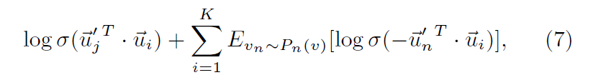
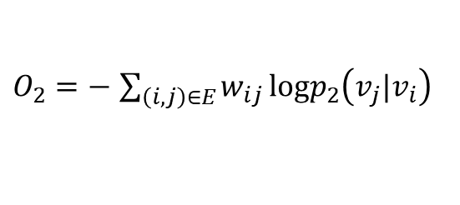

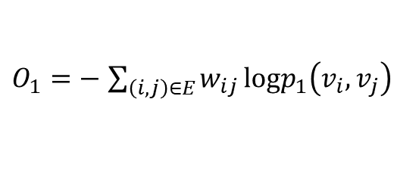
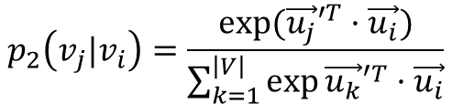
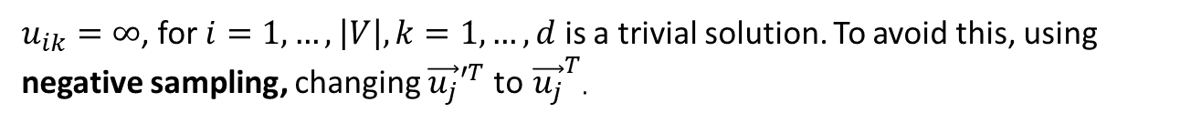
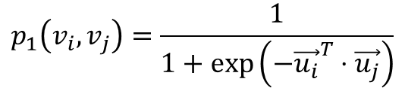
Two objective functions
1. Frist-order proximity
$$p_{1}\left(v_{i},v_{j}\right)=\frac{1}{1+\exp\left(−{\vec{u_{i}}}^{T}⋅\vec{u_{j}}\right)}$$
$O_{1}=−$ $\sum_{\left(i,j\right)∈E}{w_{ij}}logp_{1}\left(v_{i},v_{j}\right)$
By learning ${\left\{\vec{u_{i}}\right\}}_{i=1…|V|}$ to minimize $O_{1}$
$u_{ik}=∞$, for $i=1,…,\left|V\right|,k=1,…,d$ is a trivial solution. To avoid this, using negative sampling, changing ${\vec{u_{j}}′}^{T}$ to ${\vec{u_{j}}}^{T}$.
2. Second-order proximity
$$p_{2}\left(v_{j}|v_{i}\right)=\frac{exp⁡({\vec{u_{j}}′}^{T}·\vec{u_{i}})}{\sum_{k=1}^{\left|V\right|}{\exp{{\vec{u_{k}}′}^{T}·\vec{u_{i}}}}}$$
$O_{2}=−$ $\sum_{\left(i,j\right)∈E}{w_{ij}}logp_{2}\left(v_{j}|v_{i}\right)$
By learning ${\left\{\vec{u_{i}}\right\}}_{i=1…|V|}$ and ${\left\{\vec{u_{i}}′\right\}}_{i=1…|V|}$to minimize $O_{2}$
Using negative sampling, For each edge $\left(i,j\right)$, $logp_{2}\left(v_{j}|v_{i}\right)$ represented by:

Slide 6


Model optimization
1. Asynchronous stochastic gradient descent (ASGD)
Each step, samples a mini-batch of edges randomly and then updates the model parameters. If $\left(i,j\right)$ is sampled,
The weights of edges have a high variance. So it’s very hard to find a good learning rate.
2. Edge Sampling
Unfolding an edge with weight $w$ into $w$ binary edges. Increase the memory…
Each edge is sampled with probability proportional to their weights.
Using alia method, $O(1)$ time.
Alias Method:时间复杂度O(1)的离散采样方法 - 知乎 (zhihu.com)
图嵌入中必备的采样方法|Alias算法介绍 - 知乎 (zhihu.com)
Notes:
Edge sampling将边的所有权值进行排列，并从中采样，这样可以不用增加边数，从而使按权重比例采样。

Slide 7
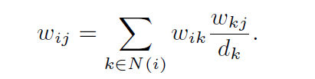

Discussions
1. Low degree vertices
Expanding the neighbors of those vertices by adding higher order neighbors, such as second-order neighbors.
2. New vertices
For new vertex $i$, obtain empirical distribution ${\hat{p}}_{1}\left(·,v_{i}\right)$ and ${\hat{p}}_{2}\left(·|v_{i}\right)$
Notes:
Updating新结点的embedding，保持存在结点的embeddings.

Slide 8
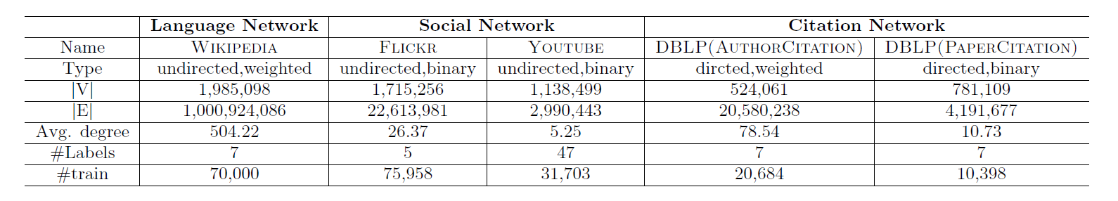

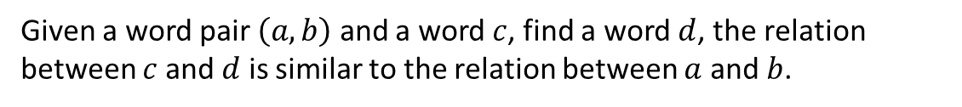
Experiments
Datasets
1. Language Network
Word Analogy.
Given a word pair $\left(a,b\right)$ and a word $c$, find a word $d$, the relation between $c$ and $d$ is similar to the relation between $a$ and $b$.
(“China”, “Beijing”) and a word “France”, $d$ = “Paris”
$$d=argmax_{d} cos(\vec{u_{b}}−\vec{u_{a}}+\vec{u_{c}},\vec{u_{d}})$$
Document Classification.
To obtain document vectors, taking the average of the word vector representations.
Notes:
语言网络是词共现网络（co-occurrence network），每个5-word滑动窗口内的单词被认为是相互共存的，忽略频率小于5的word.

Slide 9
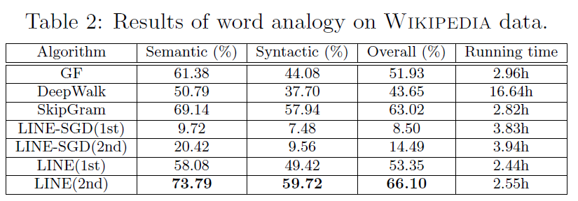
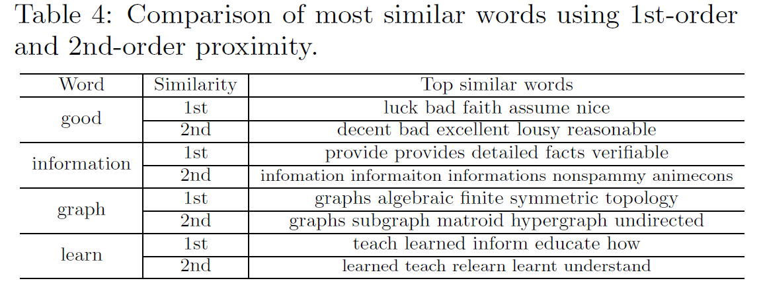
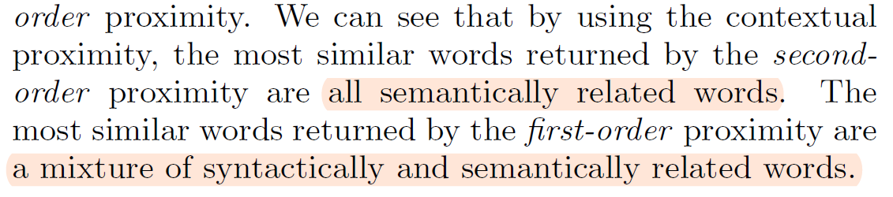
Most similar words to a given word using first-order and second-order proximity.

