Slide 1


Slide 2
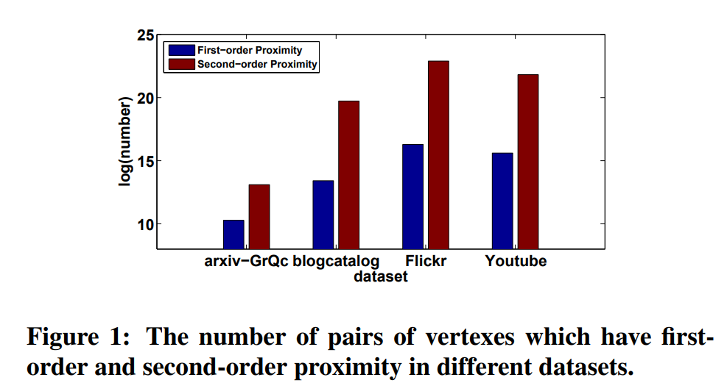
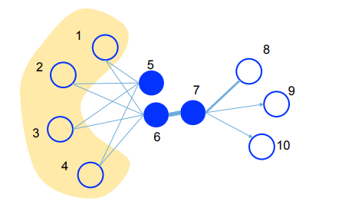
Three great challenges:
Deep learning model
High non-linearity
(2) Structure-preserving
Network embedding is required to preserve the network structure.
(3) Sparsity
Real-networks are so sparse with limited observed links,
not enough to reach a good performance.
First-order and
second-order proximity
jointly into learning process.
First-order proximity
The similarity between two linked vertices.
Local network structure.
Second-order proximity
The similarity of neighborhood structure between two vertices.
Global network structure.
Second-order proximity could alleviate the sparsity problem.

Slide 3
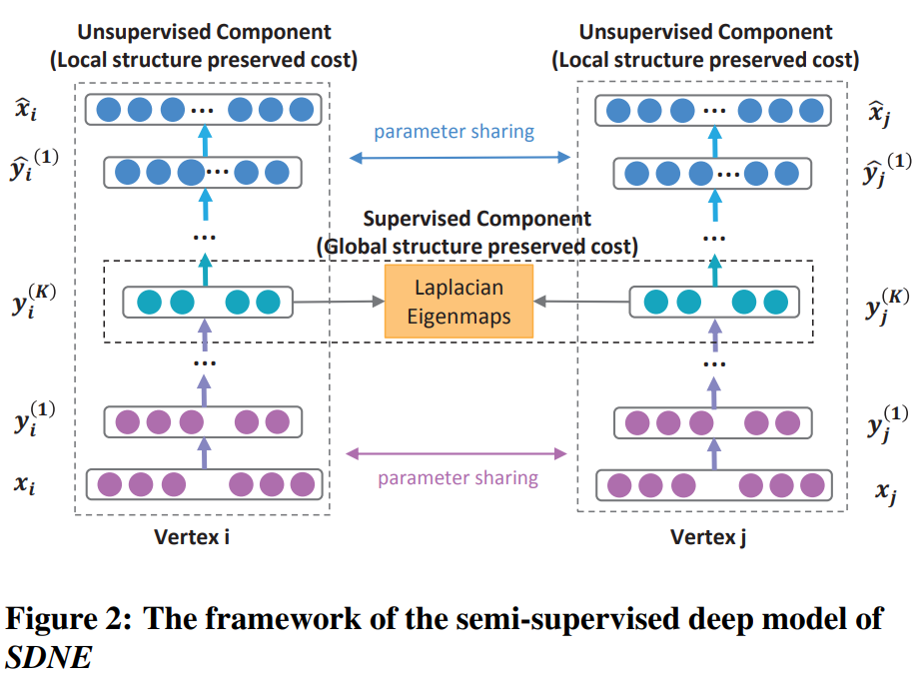


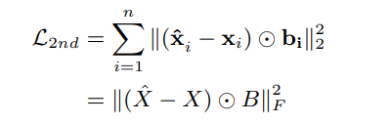

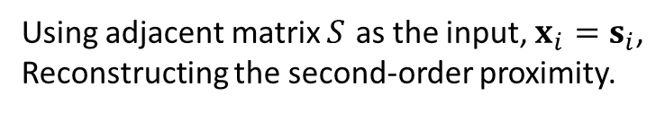
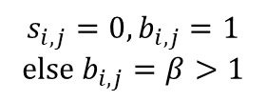
Using adjacent matrix $S$ as the input, $x_{i}=s_{i}$,
Reconstructing the second-order proximity.
Due to the sparsity, neural networks are more prone to reconstruct zero elements.
Network embedding: learn a mapping function $f:v_{i}→y_{i}∈R^{d}$
Unsupervised component: Autoencoder
Encoder: Map the input data to the representation space
Decoder: Map the representation space to reconstruction space
$$b_{i}={\left\{b_{i,j}\right\}}_{j=1}^{n}$$
$$s_{i,j}=0, b_{i,j}=1$$
$$else b_{i,j}=β>1$$
Notes:
si能够刻画结点vi的邻居结构，实际上我们重构了结点的2阶相似性。
有边相连则意味着有相似性，没边相连并不意味着没有相似性，因为可能一些合理(legitimate)的边没有被观测(observed)到。
于是对non-zero element的error施加比zero element的error更多的惩罚，此时也可以允许重构zero element.

Slide 4
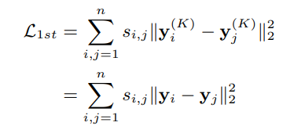
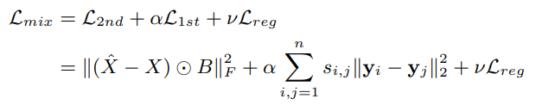

Supervised component
Constrain the similarity of the latent representation of paired vertices.
Notes:
一阶相似性采用了Laplacian Eigenmap的idea，在嵌入空间中两个向量应该尽量接近。

Slide 5

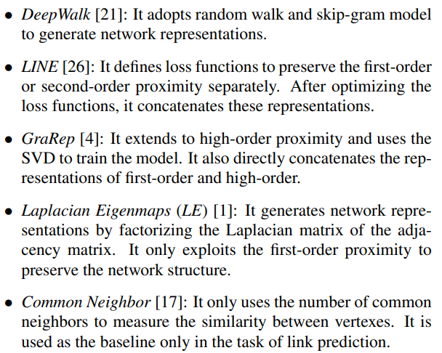
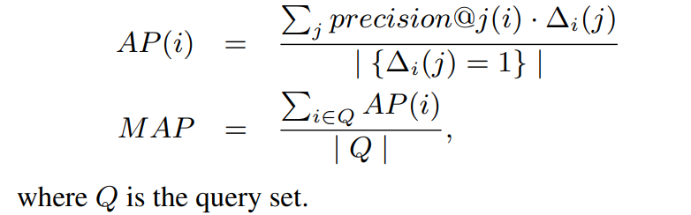
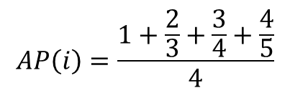
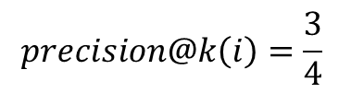


Baseline Algorithms
$$k=4$$
$$i$$
$$precision@k\left(i\right)=\frac{3}{4}$$
$$AP\left(i\right)=\frac{1+\frac{2}{3}+\frac{3}{4}+\frac{4}{5}}{4}$$
Notes:
与i连边的只有绿色的4个点，按照点积相似性对rank(j)进行排序

Slide 6
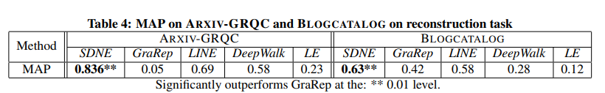
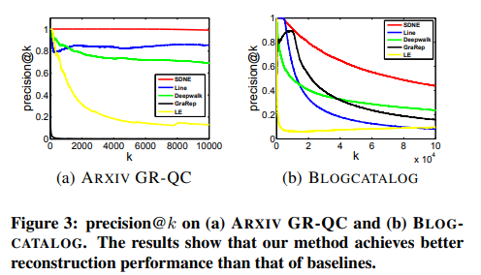
Experiment
Network Reconstruction
Multi-label Classification
Link Prediction
Visualization

Slide 7
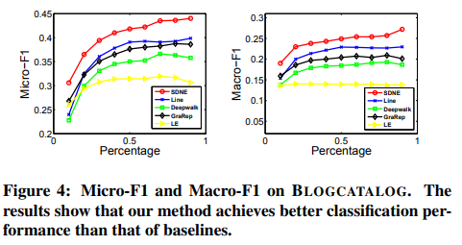
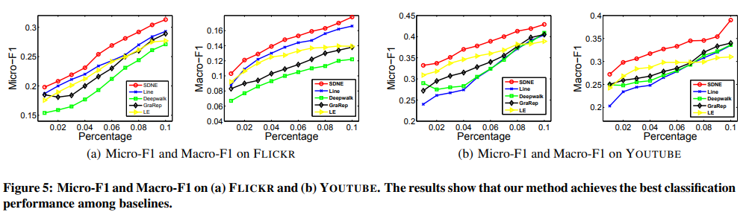
Multi-label Classification
Notes:
通过图嵌入学习到结点向量表示（特征）后，用LIBLINEAR package 训练分类器。
训练时，随机选择一部分label nodes作为training data，其他作为test。
这里的percentage为选择训练结点的比例。

Slide 8
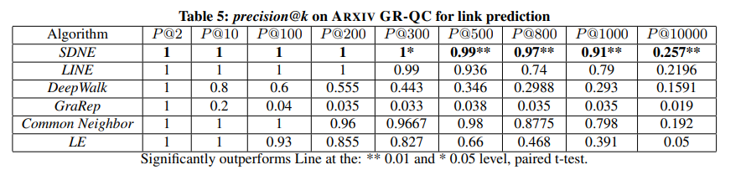
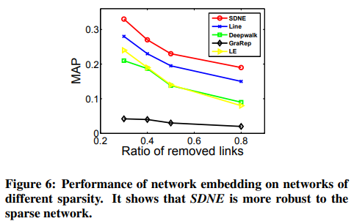
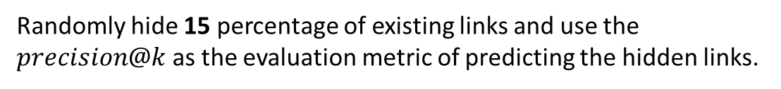
Link Prediction
Randomly hide 15 percentage of existing links and use the $precision@k$ as the evaluation metric of predicting the hidden links.
Overall performance
Different sparsity of networks

Slide 9
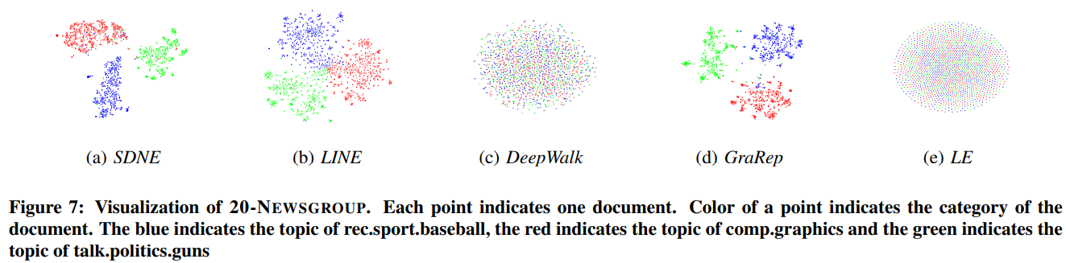
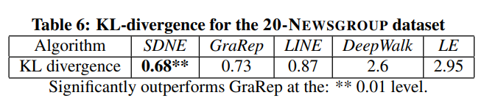
Visualization

Slide 10
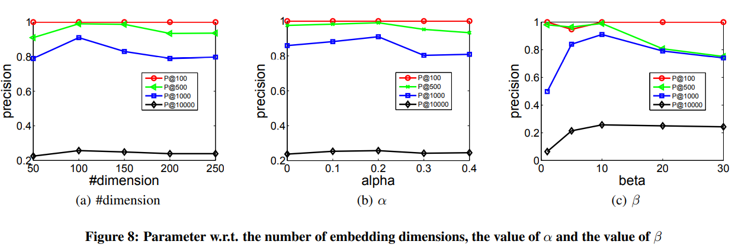
Parameter Sensitivity
Embedding dimensions.
Balance between first-order and second-order proximity.
Balance between reconstruct nonzero and zero elements.

