Slide 1
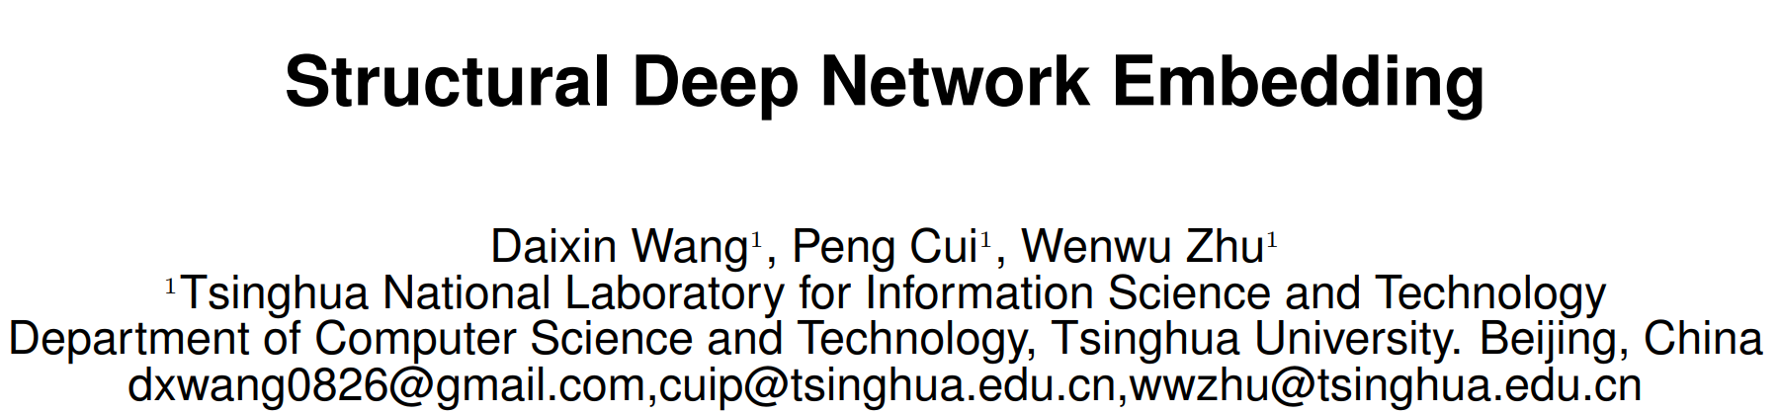

Slide 2
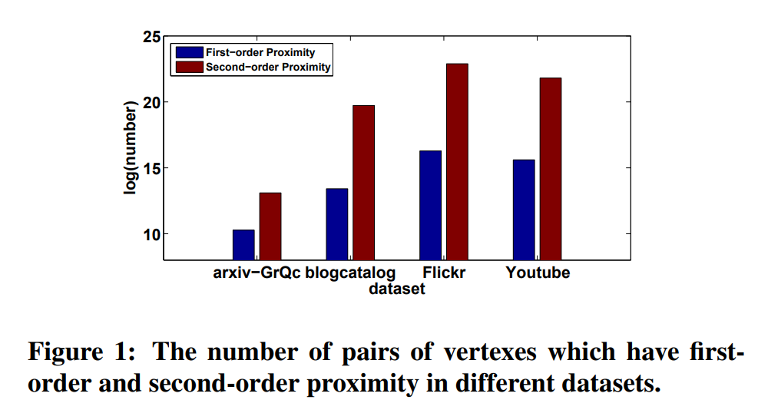
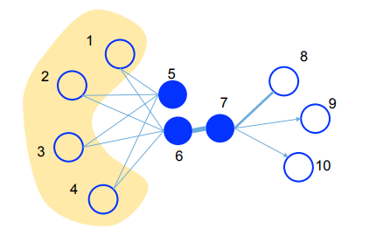
Three great challenges:
Deep learning model
High non-linearity
(2) Structure-preserving
Network embedding is required to preserve the network structure.
(3) Sparsity
Real-networks are so sparse with limited observed links,
no enough to reach a good performance.
First-order and
second-order proximity
jointly into learning process.
First-order proximity
The similarity between two linked vertices.
Local network structure.
Second-order proximity
The similarity of neighborhood structure between two vertices.
Global network structure.
Second-order proximity could alleviate the sparsity problem.

Slide 3
