Slide 1
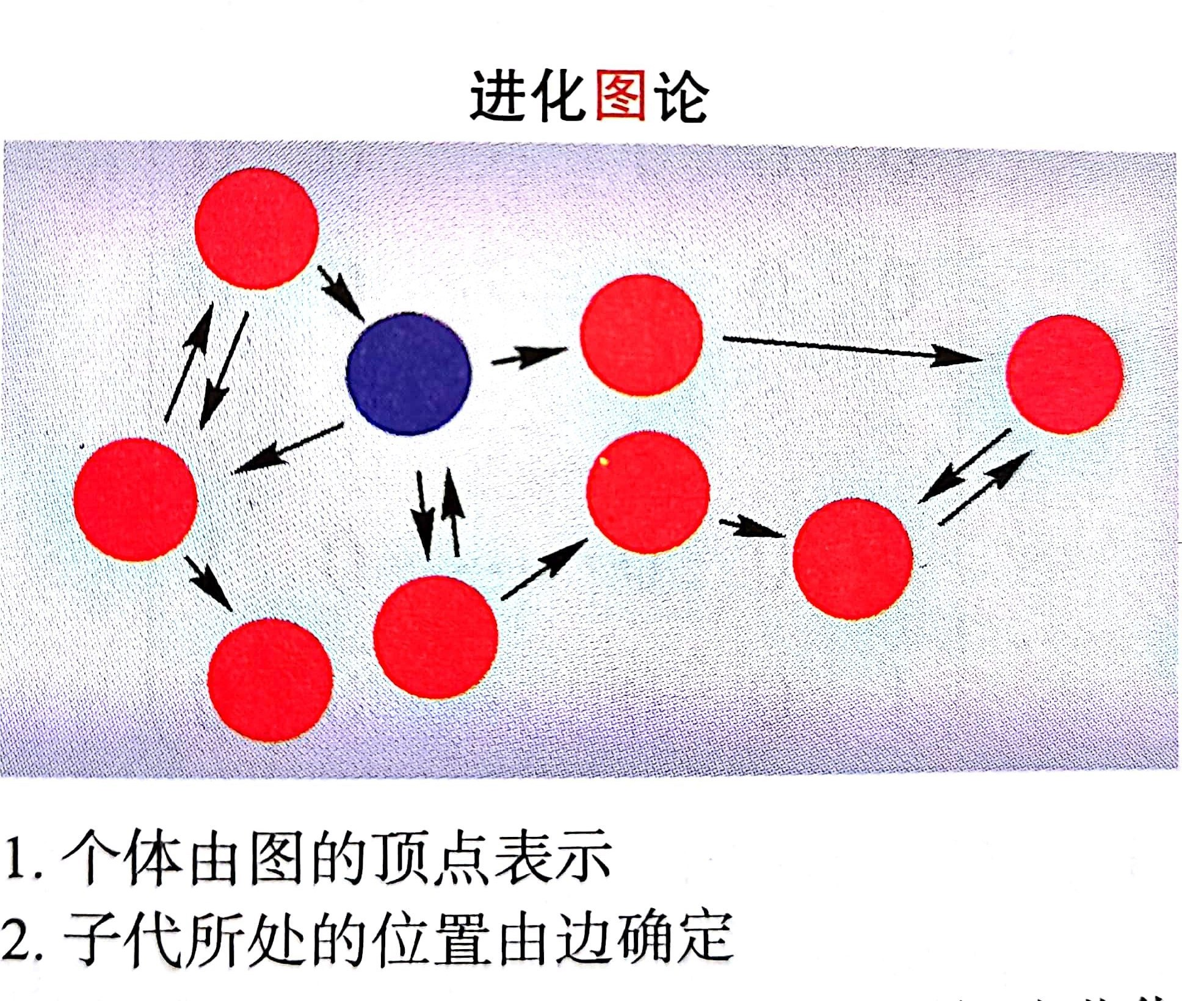
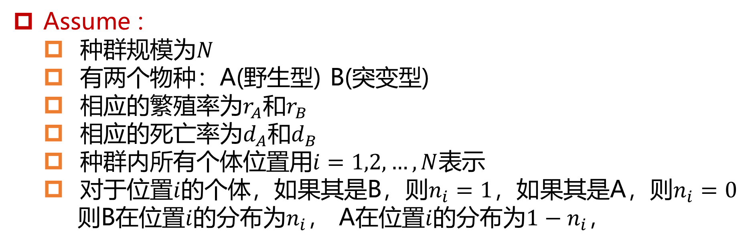
Death-birth and birth-death processes on a graph
Goal : 研究考虑种群空间结构的有限种群的进化动态
Framework : 图上的
生灭过程(Birth-Death process, BD process)
死生过程(Death-Birth process, DB process)
Assume :
种群规模为$N$
有两个物种：A(野生型) B(突变型)
相应的繁殖率为$r_{A}$和$r_{B}$
相应的死亡率为$d_{A}$和$d_{B}$
种群内所有个体位置用$i=1,2,…,N$表示
对于位置$i$的个体，如果其是B，则$n_{i}=1$，如果其是A，则$n_{i}=0$
则B在位置$i$的分布为$n_{i}$， A在位置$i$的分布为$1−n_{i}$，
Notes:
通常个体间会存在相互作用，组成了不同的空间结构。

Slide 2
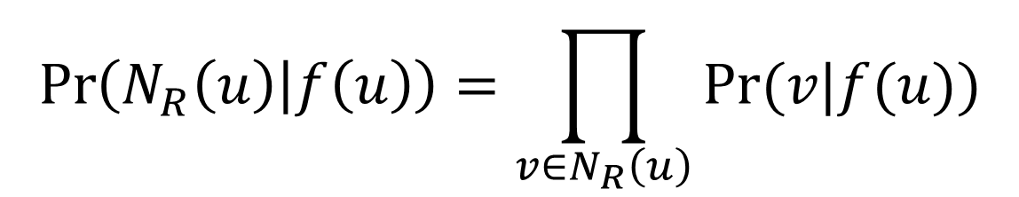

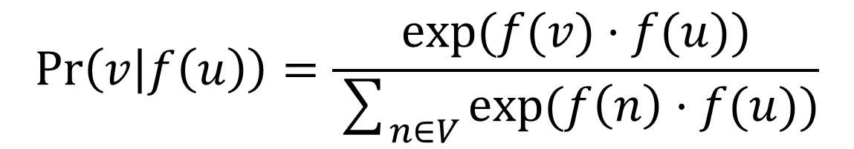
Random Walk Optimization
Two standard assumptions
Conditional independence
$$\operatorname{Pr}\left(N_{R}\left(u\right) | f\left(u\right)\right)=\prod_{v∈N_{R}\left(u\right)}{Pr⁡(v|f(u))}$$
Symmetry in feature space
$$\operatorname{Pr}\left(v | f\left(u\right)\right)=\frac{exp⁡(f(v)·f(u))}{\sum_{n∈V}{exp⁡(f\left(n\right)·f(u))}}$$
Parameterize $\operatorname{Pr}\left(v | f\left(u\right)\right)$ using softmax

Slide 3
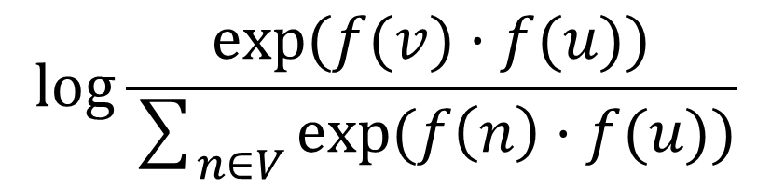
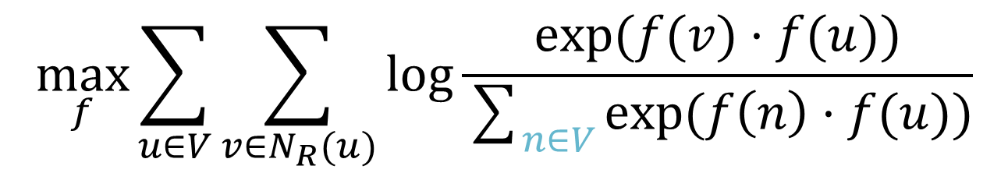
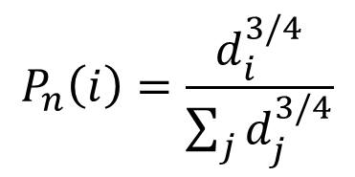
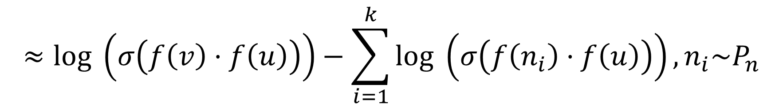
Negative sampling
Too expensive!
$$\max_{f}\sum_{u∈V}{\sum_{v∈N_{R}(u)}{log\frac{exp⁡(f(v)·f(u))}{\sum_{n∈V}{exp⁡(f\left(n\right)·f(u))}}}}$$
Approximate solution:
$$log\frac{exp⁡(f(v)·f(u))}{\sum_{n∈V}{exp⁡(f\left(n\right)·f(u))}}$$
$$≈log \left(σ\left(f\left(v\right)·f\left(u\right)\right)\right)−\sum_{i=1}^{k}{log \left(σ\left(f\left(n_{i}\right)·f\left(u\right)\right)\right)},n_{i}\sim P_{n}$$
sigmoid function
noise distribution over nodes
$$P_{n}\left(i\right)=\frac{d_{i}^{3/4}}{\sum_{j}{d_{j}^{3/4}}}$$

Slide 4
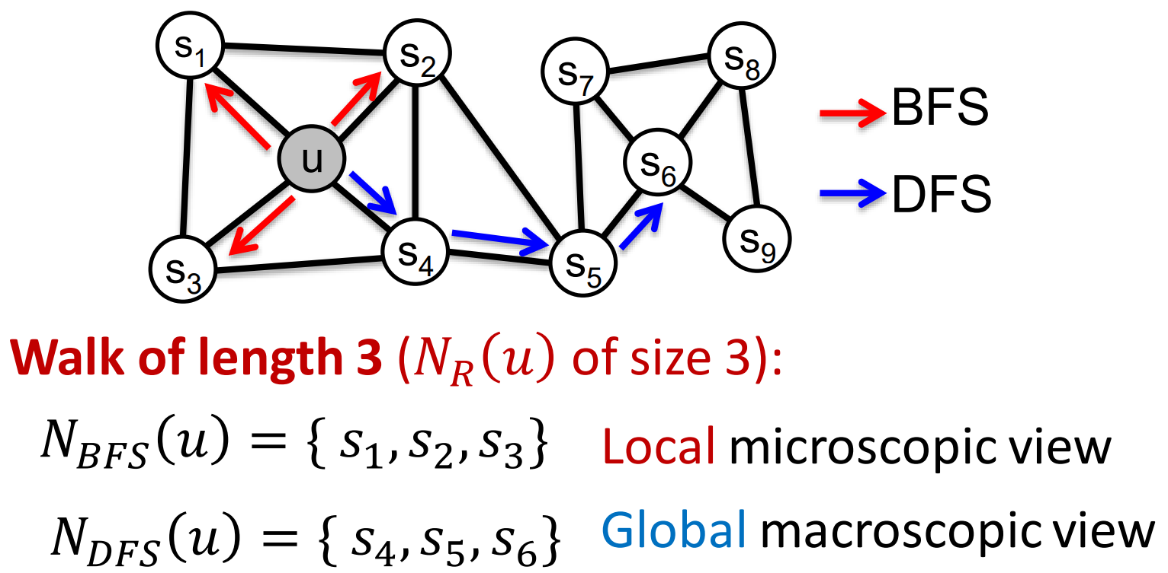
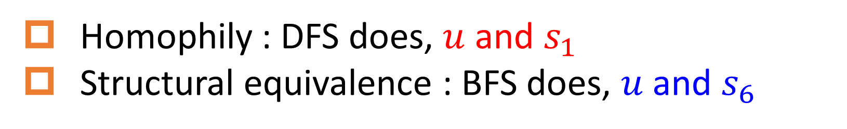
Classic search strategies
Two kind of similarities
Real networks exhibits both similarities!
Homophily : DFS does, $u$ and $s_{1}$
Structural equivalence : BFS does, $u$ and $s_{6}$

Slide 5
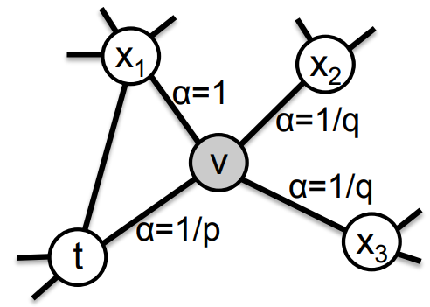
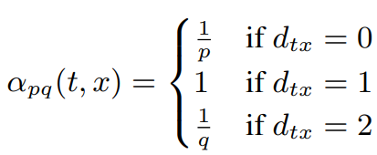
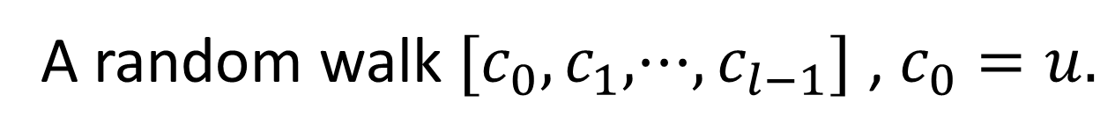

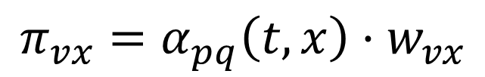
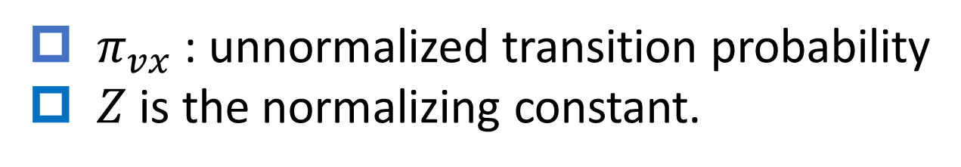
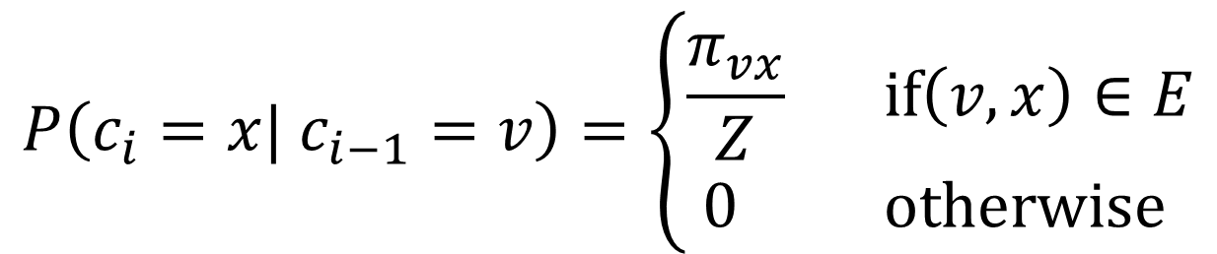
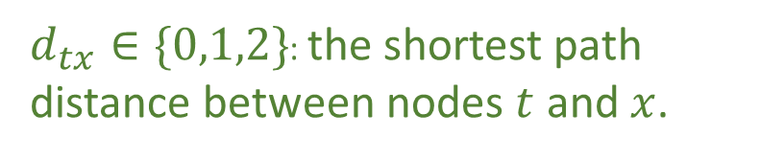
Biased $2^{nd}$-order Random Walks
A random walk $[c_{0},c_{1},···,c_{l−1}]$ , $c_{0}=u.$
$$P\left(c_{i}=x| c_{i−1}=v\right)=\left\{\begin{matrix}\frac{π_{vx}}{Z} if\left(v, x\right)∈E \\ 0 otherwise \end{matrix}\right.$$
$π_{vx}$ : unnormalized transition probability
$Z$ is the normalizing constant.
$$π_{vx}=α_{pq}\left(t,x\right)·w_{vx}$$
$d_{tx}∈\{0,1,2\}$: the shortest path distance between nodes $t$ and $x$.

Slide 6
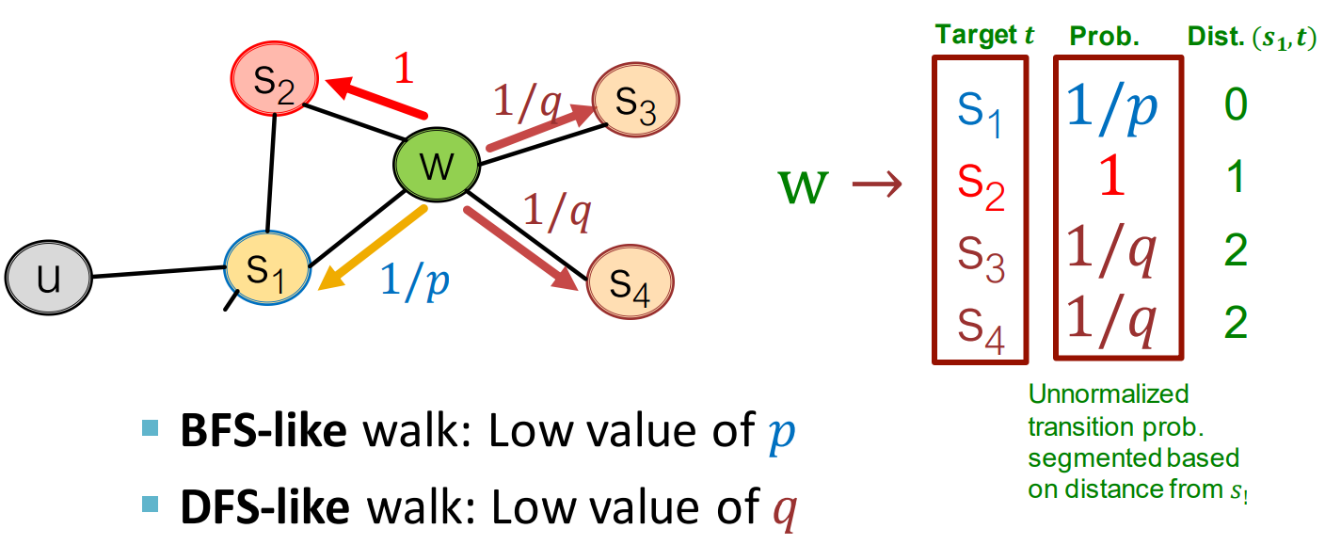
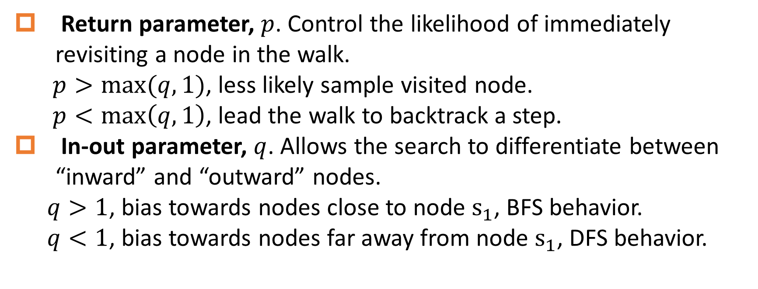
Biased $2^{nd}$-order Random Walks
Return parameter, $p$. Control the likelihood of immediately revisiting a node in the walk.
$p>max⁡(q,1)$, less likely sample visited node.
$p<\max\left(q,1\right)$, lead the walk to backtrack a step.
In-out parameter, $q$. Allows the search to differentiate between “inward” and “outward” nodes.
$q>1$, bias towards nodes close to node $s_{1}$, BFS behavior.
$q<1$, bias towards nodes far away from node $s_{1}$, DFS behavior.

Slide 7
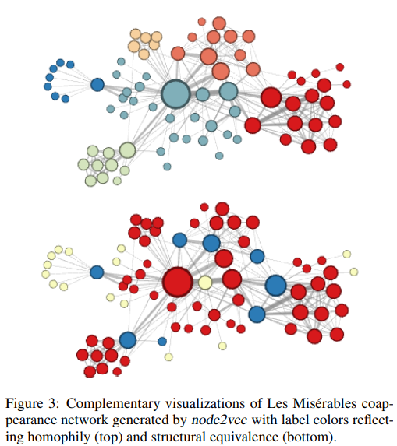


Experiments
$$p=1,q=0.5$$
$$p=1,q=2$$
Notes:
蓝色可能是一些桥梁结点作为novel中的不同sub-plot
黄色代表很小有联系的结点

Slide 8
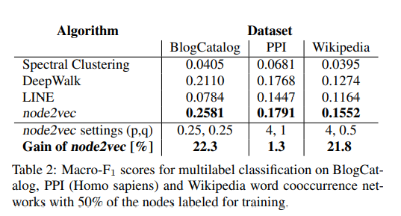
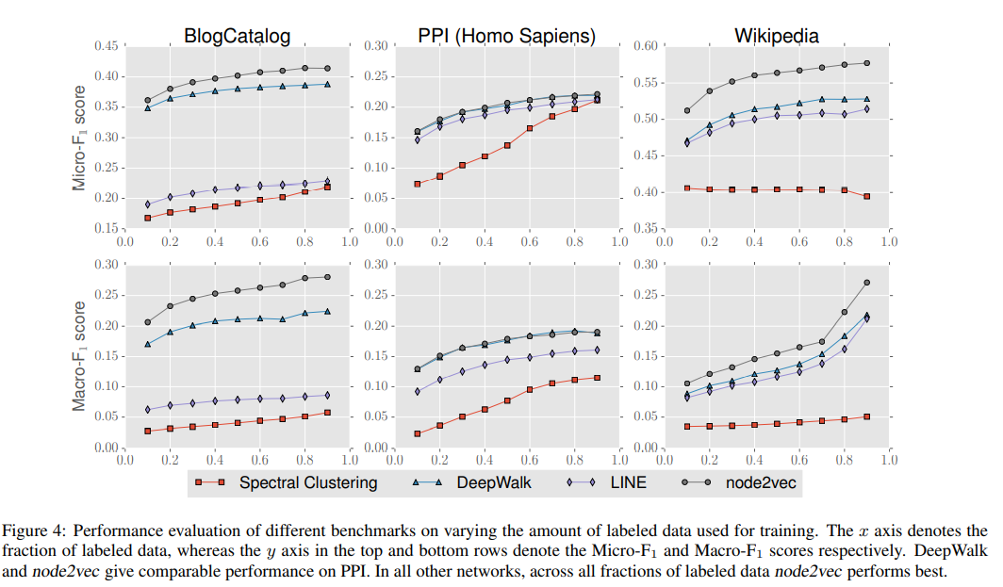
Multi-label Classification
Notes:
分类器是one-vs-rest logistic regression with L2 regularization.

Slide 9
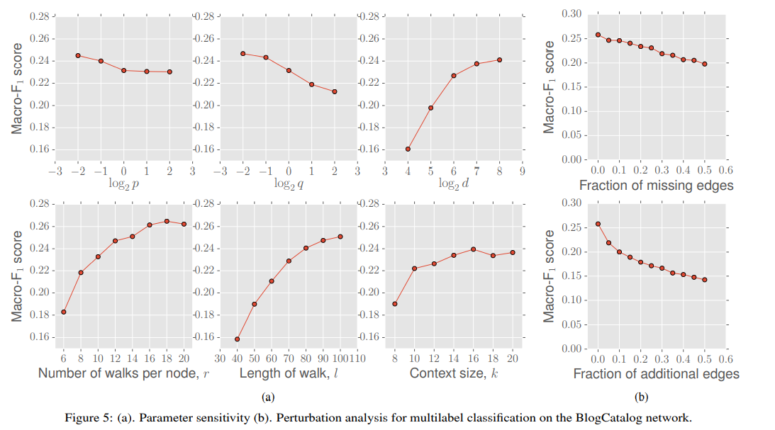

Parameter Sensitivity
Perturbation Analysis
Default $p=1,q=1$

Slide 10
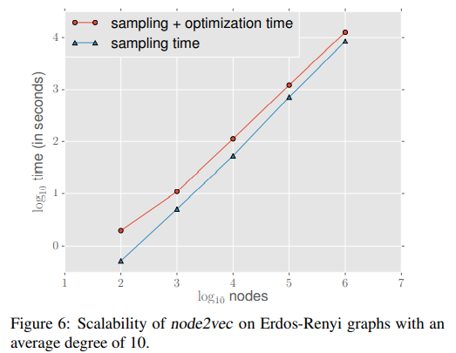

Scalability
Sampling:
transition probabilities
alias sampling
simulation of random walks
reuse sampled nodes
Optimization:
Negative sampling
Asynchronous SGD

Slide 11
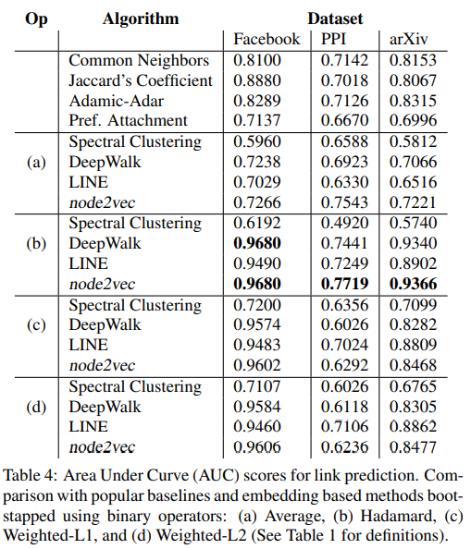
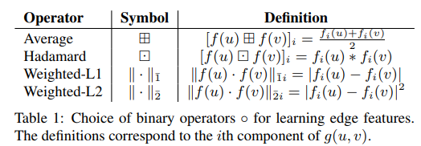
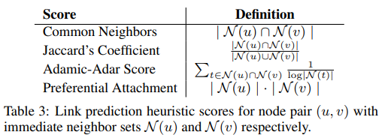
Link Prediction
Labeled dataset of edges:
Positive examples:
removed 50% of edges in the original network, and ensure the residual network is connected.
Negative examples:
A equal number of node pairs from the original network which have no edge.
Hadamard operator is best.
Notes:
删除50%的边保持连通性，因为random walk天然基于连通性来采样。
正样本就是移除的那些边，剩下的边用来node2vec训练得到嵌入。
负样本就是在原网络中没有边的那些node pair。
正负样本个数相等，然后用来做link prediction。
选好的节点对利用operator生成边的features。

Slide 12
References
CS224W | Home (stanford.edu)
【Graph Embedding】node2vec：算法原理，实现和应用 - 知乎 (zhihu.com)

