Slide 1
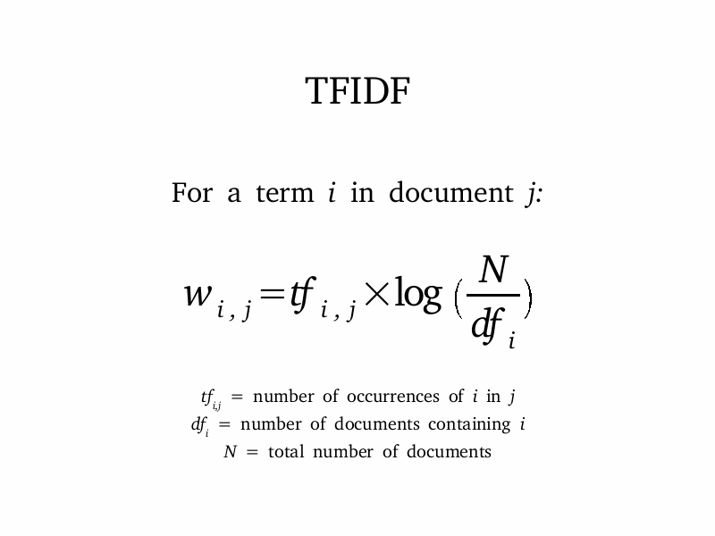
TFIDF Hadoop Mapreduce and YCSB testing on Hbase
Tigist Abebaw
University of Trento
YCSB on Hbase
The YCSB Benchmarking tool will be done on Hbase storage
System.
  It has a data generator and a workload generator.
  It is written in Java is programmed to load data to data sys-
  tem and perform operations called workloads.
  It tries to check the performace characteristics and
  reports the statistical Results.
Tested on workloads a-f on Hbase10 Binding.
CoreWork Loads
WorkLoads – First the data is loaded
Load() - Insert Data Records
Run() - Perform OPerations
  Read()
  Insert()
  update()
  Delete()
  Scan()
As latency which is the time to do a single operation increases the through put that is the number of operations per time period decreases and a good system must be able to balance it.
Inaddition editing of workloads is done to check extensi-
bility. Changing records to 10000 and was able to get results
as expected.
YCSB work-loada which loads only 1000 records to check on read and update operations
show that the total excecution time for loading the data is
3209.0 sec, it has a through put of 311.6 operations/ sec and an avarage latency of 2015.0 sec.
Extensibelity
Users can define their own workloads by editing the core workloads I.e changing parameter values or
Or by writing their own workloads.
TFIDF on Hadoop Parallel Processing
TF-IDF weghting
Customized IO class,
extend the FileInputFormat <Text, IntWritable> class
RecordReader <Text, IntWritable>. From
the file, But reading every line as string separated by tabs from it converts it to a Text, Intwritable format suitable for
Mapping.
TF-IDF weighting which stands for Term Frequency Inverse Document Frequency,
TF – The number of terms in a document.
IDF – the inverse of the number of documents in a corpus.
The IDF is logarithmically scaled.
The formula is as follows
Similary after the IDF Job is done it passes ar-
guuments to TFIDF class . 7
Here We need both text inputs as Key and value so we extend the FileInputFormat <Text,Text>
RecordReader <Text,Text> instead. Another method used is since we have only <key,value> pairs,
Examples:
Parallel Map Reduce Implementation
Term Frequency
Mapper<object, Text, Text, Intwrittable>
<term, one>
Reducer<Text, Intwrittable,Text, Intwrittable>
< docCodeterm, frequency >
Inverse Document Frequency
Mapper<Text, IntWritable, Text, Text>
< term, docCodetermF req >
Reducer<Text, Text, Text, Text>
< term, docCountdocIdcountInDoc >
Term Frequency – Inverse Document Frequency
Mapper<Text, Text, Text, DoubleWritable>
< noDoctermdocCodetermsInDoc[1]key, tf idf[1] >
Reducer<Text, DoubleWritable, Text, DoubleWritable>
<key,tfidf>

