Slide 1
JAVASCRIPT COURSE
ECMAScript Editions
JavaScript was invented by Brendan Eich in 1995, and became an ECMA standard in 1997.
ECMAScript is the official name of the language.
From 2015 ECMAScript is named by year (ECMAScript 2015).

Slide 2
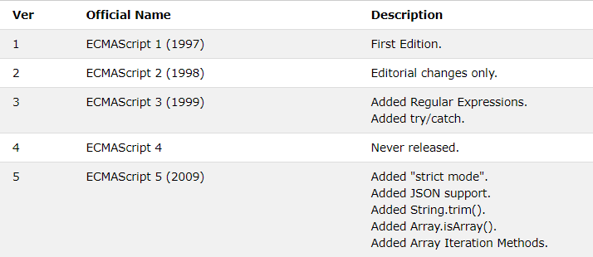
JAVASCRIPT COURSE

Slide 3
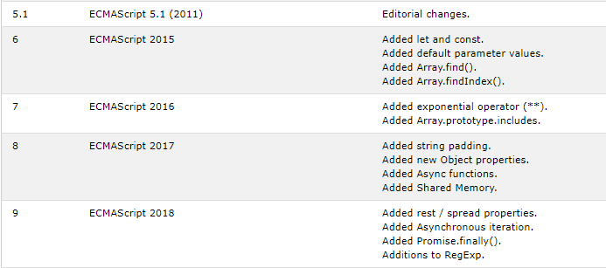
JAVASCRIPT COURSE

Slide 4
JAVASCRIPT COURSE
ECMAScript 6
ECMAScript (ES) is a scripting language specification created to standardize JavaScript. The Sixth Edition, initially known as ECMAScript 6 (ES6) and later renamed to ECMAScript 2015, adds significant new syntax for writing complex applications, including classes and modules, iterators and for/of loops, generators, arrow functions, binary data, typed arrays, collections (maps, sets and weak maps), promises, number and math enhancements, reflection, and proxies. In other words, ES6 is a superset of JavaScript (ES5). The reason that ES6 became so popular is that it introduced new conventions and OOP concepts such as classes.

Slide 5
JAVASCRIPT COURSE
JavaScript rest parameters
ES6 provides a new kind of parameter so-called rest parameter that has a prefix of three dots (...). The rest parameter allows you to represent an indefinite number of arguments as an array. See the following syntax:
function fn(a,b,...args) {
//...
}
The last parameter ( args) is prefixed with the three-dots ( ...) is called the rest parameter ( ...args) All the arguments that you pass in the function will map to the parameter list. In the syntax above, the first argument maps to a, the second one maps to b, and the third, the fourth, etc., will be stored in the rest parameter args as an array. For example:
fn(1,2,3,'A','B','C');
The args array stores the following values:
[3,'A','B','C']

Slide 6
JAVASCRIPT COURSE
JavaScript spread operator
ES6 provides a new operator called spread operator that consists of three dots (...). The spread operator allows you to spread out elements of an iterable object such as an array,a map, or a set.
const odd = [1,3,5];
const combined = [2,4,6, ...odd]; console.log(combined);
In this example, the three dots ( ...) located in front of the odd array is the spread operator. The spread operator unpacks the elements of the odd array.
Note that ES6 also has the three dots ( ...) which is a rest parameter that collects all remaining arguments of a function into an array.

Slide 7
JAVASCRIPT COURSE
function f(a, b, ...args) {
console.log(args);
}
f(1,2,3,4,5);
Output:
[ 3, 4, 5 ]
Here are the main differences:
The spread operator unpacks elements.
The rest parametr packs elements into an array.

Slide 8
JAVASCRIPT COURSE
String is iterable
Arrays and strings are most widely used built-in iterables.
For a string, for..of loops over its characters:
for (let char of "test") {
// triggers 4 times: once for each character
alert( char ); // t, then e, then s, then t
}
And it works correctly with surrogate pairs!

Slide 9
JAVASCRIPT COURSE
The "use strict" Directive
"use strict" defines that the JavaScript code should be executed in "strict mode".
With strict mode you can, for example, not use undeclared variables.

Slide 10
Array destructuring
An example of how the array is destructured into variables:
// we have an array with the name and surname
let arr = ["Ilya", "Kantor"]
// destructuring assignment
// sets firstName = arr[0]
// and surname = arr[1]
let [firstName, surname] = arr;
alert(firstName); // Ilya
alert(surname); // Kantor
Now we can work with variables instead of array members.
It looks great when combined with split or other array-returning methods:
let [firstName, surname] = "Ilya Kantor".split(' ');

Slide 11
Object destructuring
The destructuring assignment also works with objects.
The basic syntax is:
let {var1, var2} = {var1:…, var2:…}
We have an existing object at the right side, that we want to split into variables. The left side contains a “pattern” for corresponding properties. In the simple case, that’s a list of variable names in {...}.
For instance:
let options = {
title: "Menu",
width: 100,
height: 200
};
let {title, width, height} = options;
alert(title); // Menu
alert(width); // 100
alert(height); // 200

Slide 12
Properties options.title, options.width and options.height are assigned to the corresponding variables. The order does not matter. This works too:
// changed the order in let {...}
let {height, width, title} = { title: "Menu", height: 200, width: 100 }
The pattern on the left side may be more complex and specify the mapping between properties and variables.
If we want to assign a property to a variable with another name, for instance, options.width to go into the variable named w, then we can set it using a colon:
let options = {
title: "Menu",
width: 100,
height: 200
};
// { sourceProperty: targetVariable }
let {width: w, height: h, title} = options;
// width -> w
// height -> h
// title -> title
alert(title); // Menu
alert(w); // 100
alert(h); // 200

Slide 13
Map and Set
Now we’ve learned about the following complex data structures:
Objects for storing keyed collections.
Arrays for storing ordered collections.
But that’s not enough for real life. That’s why Map and Set also exist.
Map
Map is a collection of keyed data items, just like an Object. But the main difference is that Map allows keys of any type.
Methods and properties are:
new Map() – creates the map.
map.set(key, value) – stores the value by the key.
map.get(key) – returns the value by the key, undefined if key doesn’t exist in map.
map.has(key) – returns true if the key exists, false otherwise.
map.delete(key) – removes the value by the key.
map.clear() – removes everything from the map.
map.size – returns the current element count.

Slide 14
let map = new Map();
map.set('1', 'str1'); // a string key
map.set(1, 'num1'); // a numeric key
map.set(true, 'bool1'); // a boolean key
// Map keeps the type, so these two are different:
alert( map.get(1) ); // 'num1'
alert( map.get('1') ); // 'str1'
alert( map.size ); // 3
Map can also use objects as keys.
let john = { name: "John" };
// for every user, let's store their visits count
let visitsCountMap = new Map();
// john is the key for the map
visitsCountMap.set(john, 123);
alert( visitsCountMap.get(john) ); // 123

Slide 15
Iteration over Map
For looping over a map, there are 3 methods:
map.keys() – returns an iterable for keys,
map.values() – returns an iterable for values,
map.entries() – returns an iterable for entries [key, value], it’s used by default in for..of.
let recipeMap = new Map([
['cucumber', 500],
['tomatoes', 350],
['onion', 50]
]);
// iterate over keys (vegetables)
for (let vegetable of recipeMap.keys()) {
alert(vegetable); // cucumber, tomatoes, onion
}

Slide 16
Set
A Set is a special type collection – “set of values” (without keys), where each value may occur only once.
Its main methods are:
new Set(iterable) – creates the set, and if an iterable object is provided (usually an array), copies values from it into the set.
set.add(value) – adds a value, returns the set itself.
set.delete(value) – removes the value, returns true if value existed at the moment of the call, otherwise false.
set.has(value) – returns true if the value exists in the set, otherwise false.
set.clear() – removes everything from the set.
set.size – is the elements count.

Slide 17
let set = new Set();
let john = { name: "John" };
let pete = { name: "Pete" };
let mary = { name: "Mary" };
// visits, some users come multiple times
set.add(john);
set.add(pete);
set.add(mary);
set.add(john);
set.add(mary);
// set keeps only unique values
alert( set.size ); // 3
for (let user of set) {
alert(user.name); // John (then Pete and Mary)
}
The alternative to Set could be an array of users, and the code to check for duplicates on every insertion using arr.find. But the performance would be much worse, because this method walks through the whole array checking every element. Set is much better optimized internally for uniqueness checks.

Slide 18
Iteration over Set
We can loop over a set either with for..of or using forEach:
let set = new Set(["oranges", "apples", "bananas"]);
for (let value of set) alert(value);
// the same with forEach:
set.forEach((value, valueAgain, set) => {
alert(value);
});
Note the funny thing. The callback function passed in forEach has 3 arguments: a value, then the same value valueAgain, and then the target object. Indeed, the same value appears in the arguments twice.
That’s for compatibility with Map where the callback passed forEach has three arguments. Looks a bit strange, for sure. But may help to replace Map with Set in certain cases with ease, and vice versa.
The same methods Map has for iterators are also supported:
set.keys() – returns an iterable object for values,
set.values() – same as set.keys(), for compatibility with Map,
set.entries() – returns an iterable object for entries [value, value], exists for compatibility with Map.

Slide 19
WeakMap
The first difference from Map is that WeakMap keys must be objects, not primitive values:
let weakMap = new WeakMap();
let obj = {};
weakMap.set(obj, "ok"); // works fine (object key)
Now, if we use an object as the key in it, and there are no other references to that object – it will be removed from memory (and from the map) automatically.
let john = { name: "John" };
let weakMap = new WeakMap();
weakMap.set(john, "...");
john = null; // overwrite the reference
// john is removed from memory!
Compare it with the regular Map example above. Now if john only exists as the key of WeakMap – it will be automatically deleted from the map (and memory).
WeakMap has only the following methods:
weakMap.get(key)
weakMap.set(key, value)
weakMap.delete(key)
weakMap.has(key)

Slide 20
WeakSet
WeakSet behaves similarly:
It is analogous to Set, but we may only add objects to WeakSet (not primitives).
An object exists in the set while it is reachable from somewhere else.
Being “weak”, it also serves as an additional storage. But not for an arbitrary data, but rather for “yes/no” facts. A membership in WeakSet may mean something about the object.
For instance, we can add users to WeakSet to keep track of those who visited our site:
let visitedSet = new WeakSet();
let john = { name: "John" };
let pete = { name: "Pete" };
let mary = { name: "Mary" };
visitedSet.add(john); // John visited us
visitedSet.add(pete); // Then Pete
visitedSet.add(john); // John again

Slide 21
// visitedSet has 2 users now
// check if John visited?
alert(visitedSet.has(john)); // true
// check if Mary visited?
alert(visitedSet.has(mary)); // false
john = null;
// visitedSet will be cleaned automatically
The most notable limitation of WeakMap and WeakSet is the absence of iterations, and inability to get all current content. That may appear inconvenient, but does not prevent WeakMap/WeakSet from doing their main job – be an “additional” storage of data for objects which are stored/managed at another place.

Slide 22
Object.keys, values, entries
Let’s step away from the individual data structures and talk about the iterations over them.
We saw methods map.keys(), map.values(), map.entries().
These methods are generic, there is a common agreement to use them for data structures. If we ever create a data structure of our own, we should implement them too.
They are supported for:
Map
Set
Array
Plain objects also support similar methods, but the syntax is a bit different.
Object.keys, values, entries
For plain objects, the following methods are available:
Object.keys(obj) – returns an array of keys.
Object.values(obj) – returns an array of values.
Object.entries(obj) – returns an array of [key, value] pairs.

Slide 23
let user = {
name: "John",
age: 30
};
Object.keys(user) = ["name", "age"]
Object.values(user) = ["John", 30]
Object.entries(user) = [ ["name","John"], ["age",30] ]

Slide 24
Error handling, "try..catch"
No matter how great we are at programming, sometimes our scripts have errors. They may occur because of our mistakes, an unexpected user input, an erroneous server response, and for a thousand other reasons.
Usually, a script “dies” (immediately stops) in case of an error, printing it to console.
But there’s a syntax construct try..catch that allows us to “catch” errors so the script can, instead of dying, do something more reasonable.

Slide 25
The try..catch construct has two main blocks: try, and then catch:
try {
// code...
} catch (err) {
// error handling
}
It works like this:
First, the code in try {...} is executed.
If there were no errors, then catch(err) is ignored: the execution reaches the end of try and goes on, skipping catch.
If an error occurs, then the try execution is stopped, and control flows to the beginning of catch(err). The err variable (we can use any name for it) will contain an error object with details about what happened.
So, an error inside the try {…} block does not kill the script – we have a chance to handle it in catch.

Slide 26
try..catch only works for runtime errors
For try..catch to work, the code must be runnable. In other words, it should be valid JavaScript.
It won’t work if the code is syntactically wrong, for instance it has unmatched curly braces:
try {
{{{{{{{{{{{{
} catch(e) {
alert("The engine can't understand this code, it's invalid");
}
The JavaScript engine first reads the code, and then runs it. The errors that occur on the reading phase are called “parse-time” errors and are unrecoverable (from inside that code). That’s because the engine can’t understand the code.
So, try..catch can only handle errors that occur in valid code. Such errors are called “runtime errors” or, sometimes, “exceptions”.

Slide 27
let json = '{ "age": 30 }'; // incomplete data
try {
let user = JSON.parse(json); // <-- no errors
if (!user.name) {
throw new SyntaxError("Incomplete data: no name"); // (*)
}
alert( user.name );
} catch(e) {
alert( "JSON Error: " + e.message ); // JSON Error: Incomplete data: no name
}
In the line (*), the throw operator generates a SyntaxError with the given message, the same way as JavaScript would generate it itself. The execution of try immediately stops and the control flow jumps into catch.

Slide 28
try…catch…finally
Wait, that’s not all.
The try..catch construct may have one more code clause: finally.
If it exists, it runs in all cases:
after try, if there were no errors,
after catch, if there were errors.
The extended syntax looks like this:
try {
... try to execute the code ...
} catch(e) {
... handle errors ...
} finally {
... execute always ...
}

Slide 29
Introduction: callbacks
Many functions are provided by JavaScript host environments that allow you to schedule asynchronous actions. In other words, actions that we initiate now, but they finish later.
For instance, one such function is the setTimeout function.
There are other real-world examples of asynchronous actions, e.g. loading scripts and modules (we’ll cover them in later chapters).
Take a look at the function loadScript(src), that loads a script with the given src:
function loadScript(src) {
// creates a <script> tag and append it to the page
// this causes the script with given src to start loading and run when complete
let script = document.createElement('script');
script.src = src;
document.head.append(script);
}

Slide 30
It appends to the document the new, dynamically created, tag <script src="…"> with given src. The browser automatically starts loading it and executes when complete.
We can use this function like this:
// load and execute the script at the given path
loadScript('/my/script.js');
The script is executed “asynchronously”, as it starts loading now, but runs later, when the function has already finished.
If there’s any code below loadScript(…), it doesn’t wait until the script loading finishes.
loadScript('/my/script.js');
// the code below loadScript
// doesn't wait for the script loading to finish
// ...
Let’s say we need to use the new script as soon as it loads. It declares new functions, and we want to run them.

Slide 31
Naturally, the browser probably didn’t have time to load the script. As of now, the loadScript function doesn’t provide a way to track the load completion. The script loads and eventually runs, that’s all. But we’d like to know when it happens, to use new functions and variables from that script.
Let’s add a callback function as a second argument to loadScript that should execute when the script loads:
function loadScript(src, callback) {
let script = document.createElement('script');
script.src = src;
script.onload = () => callback(script);
document.head.append(script);
}
Now if we want to call new functions from the script, we should write that in the callback:
loadScript('https://cdnjs.cloudflare.com/ajax/libs/lodash.js/3.2.0/lodash.js', script => {
alert(`Cool, the script ${script.src} is loaded`);
alert( _ ); // function declared in the loaded script
});

Slide 32
That’s called a “callback-based” style of asynchronous programming. A function that does something asynchronously should provide a callback argument where we put the function to run after it’s complete.

Slide 33
Handling errors
In the above examples we didn’t consider errors. What if the script loading fails? Our callback should be able to react on that.
Here’s an improved version of loadScript that tracks loading errors:
function loadScript(src, callback) {
let script = document.createElement('script');
script.src = src;
script.onload = () => callback(null, script);
script.onerror = () => callback(new Error(`Script load error for ${src}`));
document.head.append(script);
}
It calls callback(null, script) for successful load and callback(error) otherwise.
The usage:
loadScript('/my/script.js', function(error, script) {
if (error) {
// handle error
} else {
// script loaded successfully
}
});

Slide 34
Once again, the recipe that we used for loadScript is actually quite common. It’s called the “error-first callback” style.
The convention is:
The first argument of the callback is reserved for an error if it occurs. Then callback(err) is called.
The second argument (and the next ones if needed) are for the successful result. Then callback(null, result1, result2…) is called.
So the single callback function is used both for reporting errors and passing back results.

Slide 35
Promise
Imagine that you’re a top singer, and fans ask day and night for your upcoming single.
To get some relief, you promise to send it to them when it’s published. You give your fans a list. They can fill in their email addresses, so that when the song becomes available, all subscribed parties instantly receive it. And even if something goes very wrong, say, a fire in the studio, so that you can’t publish the song, they will still be notified.
This is a real-life analogy for things we often have in programming:
A “producing code” that does something and takes time. For instance, some code that loads the data over a network. That’s a “singer”.
A “consuming code” that wants the result of the “producing code” once it’s ready.
A promise is a special JavaScript object that links the “producing code” and the “consuming code” together. The “producing code” takes whatever time it needs to produce the promised result, and the “promise” makes that result available to all of the subscribed code when it’s ready.

Slide 36
The constructor syntax for a promise object is:
let promise = new Promise(function(resolve, reject) {
// executor (the producing code, "singer")
});
The function passed to new Promise is called the executor. When new Promise is created, the executor runs automatically. It contains the producing code which should eventually produce the result. In terms of the analogy above: the executor is the “singer”.
Its arguments resolve and reject are callbacks provided by JavaScript itself. Our code is only inside the executor.
When the executor obtains the result, be it soon or late, doesn’t matter, it should call one of these callbacks:
resolve(value) — if the job finished successfully, with result value.
reject(error) — if an error occurred, error is the error object.

Slide 37
So to summarize: the executor runs automatically and attempts to perform a job. When it is finished with the attempt it calls resolve if it was successful or reject if there was an error.
The promise object returned by the new Promise constructor has these internal properties:
state — initially "pending", then changes to either "fulfilled" when resolve is called or "rejected" when reject is called.
result — initially undefined, then changes to value when resolve(value) called or error when reject(error) is called.

Slide 38
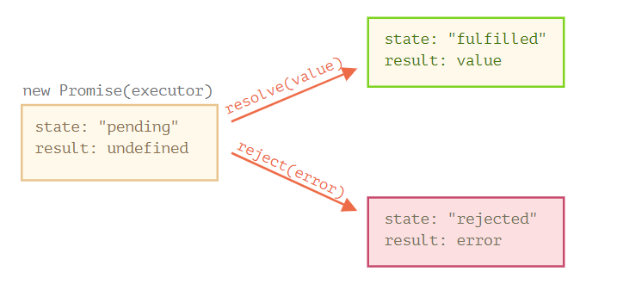
So the executor eventually moves promise to one of these states:

Slide 39
let promise = new Promise(function(resolve, reject) {
// the function is executed automatically when the promise is constructed
// after 1 second signal that the job is done with the result "done"
setTimeout(() => resolve("done"), 1000);
});
That’s called a “callback-based” style of asynchronous programming. A function that does something asynchronously should provide a callback argument where we put the function to run after it’s complete.

Slide 40
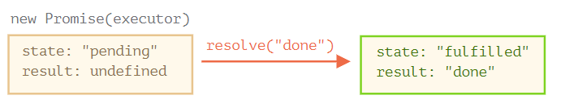
We can see two things by running the code above:
The executor is called automatically and immediately (by new Promise).
The executor receives two arguments: resolve and reject. These functions are pre-defined by the JavaScript engine, so we don’t need to create them. We should only call one of them when ready.
After one second of “processing” the executor calls resolve("done") to produce the result. This changes the state of the promise object:
That was an example of a successful job completion, a “fulfilled promise”.

Slide 41
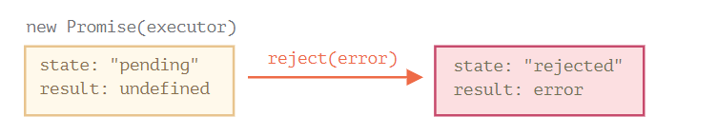
And now an example of the executor rejecting the promise with an error:
let promise = new Promise(function(resolve, reject) {
// after 1 second signal that the job is finished with an error
setTimeout(() => reject(new Error("Whoops!")), 1000);
});
The call to reject(...) moves the promise object to "rejected" state:
To summarize, the executor should perform a job (usually something that takes time) and then call resolve or reject to change the state of the corresponding promise object.

Slide 42
Consumers: then, catch, finally
A Promise object serves as a link between the executor (the “producing code” or “singer”) and the consuming functions (the “fans”), which will receive the result or error. Consuming functions can be registered (subscribed) using methods .then, .catch and .finally.
then
The most important, fundamental one is .then.
The syntax is:
promise.then(
function(result) { /* handle a successful result */ },
function(error) { /* handle an error */ }
);
The first argument of .then is a function that runs when the promise is resolved, and receives the result.
The second argument of .then is a function that runs when the promise is rejected, and receives the error.

Slide 43
For instance, here’s a reaction to a successfully resolved promise:
let promise = new Promise(function(resolve, reject) {
setTimeout(() => resolve("done!"), 1000);
});
// resolve runs the first function in .then
promise.then(
result => alert(result), // shows "done!" after 1 second
error => alert(error) // doesn't run
);
catch
If we’re interested only in errors, then we can use null as the first argument: .then(null, errorHandlingFunction). Or we can use .catch(errorHandlingFunction), which is exactly the same:
let promise = new Promise((resolve, reject) => {
setTimeout(() => reject(new Error("Whoops!")), 1000);
});
// .catch(f) is the same as promise.then(null, f)
promise.catch(alert); // shows "Error: Whoops!" after 1 second
The call .catch(f) is a complete analog of .then(null, f), it’s just a shorthand.

Slide 44
finally
Just like there’s a finally clause in a regular try {...} catch {...}, there’s finally in promises.
The call .finally(f) is similar to .then(f, f) in the sense that f always runs when the promise is settled: be it resolve or reject.
finally is a good handler for performing cleanup, e.g. stopping our loading indicators, as they are not needed anymore, no matter what the outcome is.
Like this:
new Promise((resolve, reject) => {
/* do something that takes time, and then call resolve/reject */
})
// runs when the promise is settled, doesn't matter successfully or not
.finally(() => stop loading indicator)
.then(result => show result, err => show error)
It’s not exactly an alias of then(f,f) though. There are several important differences:
1.A finally handler has no arguments. In finally we don’t know whether the promise is successful or not. That’s all right, as our task is usually to perform “general” finalizing procedures.

Slide 45
2.A finally handler passes through results and errors to the next handler.
For instance, here the result is passed through finally to then:
new Promise((resolve, reject) => {
setTimeout(() => resolve("result"), 2000)
})
.finally(() => alert("Promise ready"))
.then(result => alert(result)); // <-- .then handles the result
And here there’s an error in the promise, passed through finally to catch:
new Promise((resolve, reject) => {
throw new Error("error");
})
.finally(() => alert("Promise ready"))
.catch(err => alert(err)); // <-- .catch handles the error object
That’s very convenient, because finally is not meant to process a promise result. So it passes it through.
We’ll talk more about promise chaining and result-passing between handlers in the next chapter.
3.Last, but not least, .finally(f) is a more convenient syntax than .then(f, f): no need to duplicate the function f.

Slide 46
Async/await
There’s a special syntax to work with promises in a more comfortable fashion, called “async/await”. It’s surprisingly easy to understand and use.
Async functions
Let’s start with the async keyword. It can be placed before a function, like this:
async function f() {
return 1;
}
The word “async” before a function means one simple thing: a function always returns a promise. Other values are wrapped in a resolved promise automatically.
For instance, this function returns a resolved promise with the result of 1; let’s test it:
async function f() {
return 1;
}
f().then(alert); // 1

Slide 47
So, async ensures that the function returns a promise, and wraps non-promises in it. Simple enough, right? But not only that. There’s another keyword, await, that works only inside async functions, and it’s pretty cool.
Await
The syntax:
// works only inside async functions
let value = await promise;
The keyword await makes JavaScript wait until that promise settles and returns its result.
Here’s an example with a promise that resolves in 1 second

Slide 48
async function f() {
let promise = new Promise((resolve, reject) => {
setTimeout(() => resolve("done!"), 1000)
});
let result = await promise; // wait until the promise resolves (*)
alert(result); // "done!"
}
f();
The function execution “pauses” at the line (*) and resumes when the promise settles, with result becoming its result. So the code above shows “done!” in one second.
Let’s emphasize: await literally suspends the function execution until the promise settles, and then resumes it with the promise result. That doesn’t cost any CPU resources, because the JavaScript engine can do other jobs in the meantime: execute other scripts, handle events, etc.
It’s just a more elegant syntax of getting the promise result than promise.then, easier to read and write.

