Slide 1

Stereo Matching: Tigran Melkonian, Wei Jiang, Mingrui Yang
DEPARTMENT OF COMPUTER SCIENCE BOSTON UNIVERSITY
CS 585 IMAGE AND VIDEO COMPUTING – FALL 2017
12/12/2017
Notes:
introductions …. and today we will be presenting on stereo detection and tracking

Slide 2
Outline
What is Stereo Vision
Stereo Setup and Terminology
Stereo Vision Applications
Problem Definition
Datasets: Stereo Sequences
Results of Algorithms Used / Discussion
Conclusion
Questions
Notes:
so here is an outline of what we will be covering throughout our presentation today: First off we are going to talk about what stereo vision is , then define some terminology central to understanding this topic, highlighting real world applications of stereo vision, Understand the core problems in stereo matching, and the datasets, algorithms, and methods used to solve this core problem. Finally we will end off with a QA at the end for whatever questions or comments you may have.

Slide 3
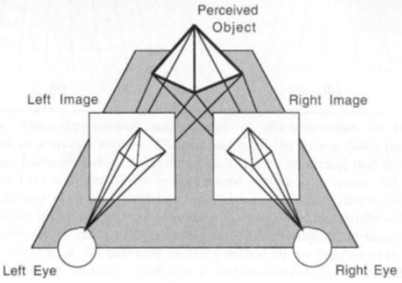
What is Stereo Vision
The recovery of the 3D structure of a scene using two or more images of the 3D scene, each acquired from a different viewpoint in space
The term binocular vision is used when two cameras are employed
Notes:
Stereo vision is the recovery of the 3d structure of a scene using two or more images from a perceived scene, where the output of the stereo computation is a disparity map. which tells us how far each point in the physical scene was from the camera when the images were captured.

Slide 4
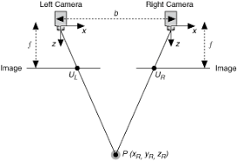
Stereo Setup and Terminology
Notes:
This Diagram describes the relationship of image displacement to depth with stereoscopic images
In simple binocular stereo vision, two cameras, displaced horizontally from one another are used to obtain two differing views on a scene, in a manner similar to human binocular vision. By comparing these two images, the relative depth information can be obtained in the form of a disparity map, which encodes the difference in horizontal coordinates of corresponding image points.
The disparity is the difference between the x coordinate of two corresponding points
Stereo Terminology
FIxation point: The point of intersection of the optical axes
Baseline: the distance between the centers of the projection
Conjugate pair : any point in the scene that is visible in both cameras will be projected to a pair of image points in the two images
Disparity: the distance between corresponding points when the two images are superimposed
Disparity map: the disparities of all points from the disparity map

Slide 5
Stereo Vision Applications
Augmented and Virtual Reality
Mars Rover
IPhone portrait mode
High-speed tracking
Mobile robots
Object recognition and navigation
Biometrics
Three-dimensional modelling
The list goes on!
Notes:
Stereo displays finds many applications in entertainment, information transfer and automated systems. Stereo vision is highly important in fields such as robotics, to extract information about the relative position of 3D objects in the vicinity of autonomous systems. Some specific applications for robotics include object recognition, where depth information allows for the system to separate occluding image components, such as one chair in front of another, which a robot may not be able to distinguish as a separate object by any other means.

Slide 6
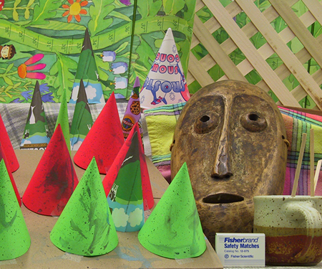
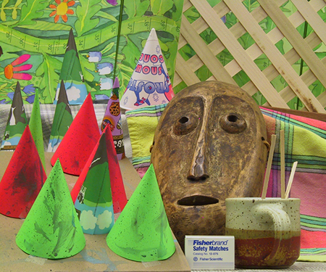
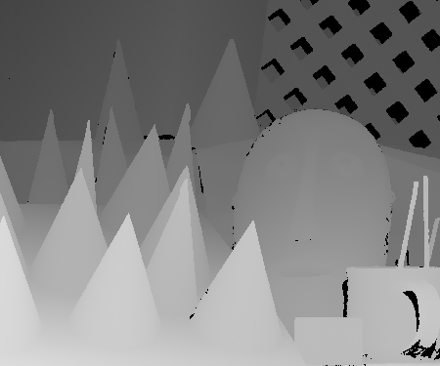
Problem Definition
The correspondence problem
The reconstruction problem
Finding pairs of matched points such that each point in the pair is the projection of the same 3D point
Now, given the corresponding points we must compute a disparity map of the scene assuming that the stereo geometry is known
Notes:
so throughout our research, we agreed that there were two main problems to be tackled. First The correspondence problem : which was to find pairs of matched points such that each point in the pair s the projection of the same 3d point. Hoening in a better correspondence was crucial to eliminating any ambiguity which may cause inconsistent interpretations of the scene.
Next is the Reconstruction problem. Now given the correspondence points, we want to compute the disparity map which can later be converted to a 3d map of the given scene.
handing over to mingrui to talk about the datasets we used and our first approach

Slide 7
Datasets: Stereo Sequences
Image Sequences acquired with stereo cameras were acquired from Middlebury site. These datasets include:
• rectified sequences
• scanned depth maps
Notes:
The middlebury stereo evaluation site provides a framework and a dataset for benchmarking novel algorithms
Talk about this site and what it has to offer

Slide 8
Datasets: Stereo Sequences
Left view
Right view

Slide 9

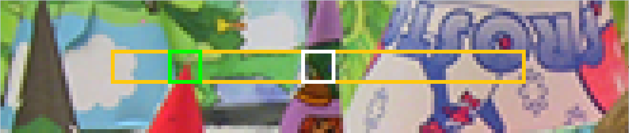
Block Matching Approach
Since we have the rectified images, we only need to scan the horizontal line at the same level for the correspondence.
The idea is that: Defined a search range and a block size, we then calculate the Sum of Absolute Difference(SAD) for every location inside the search range, and assign the offset of the lowest SAD as the disparity value.
To improve the accuracy, we also introduced the sub-pixel estimation. The idea is using 3 points to estimate the minimum of a parabola.
Notes:
Draw illustration on blackboard

Slide 10
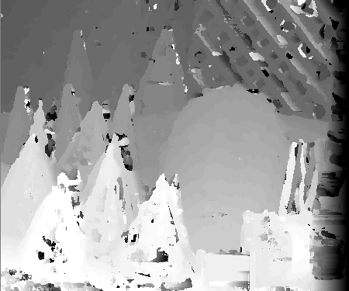

Block Matching / Sub-Pixel Estimation Result
Basic Block Matching
Basic Block Matching with Sub-Pixel Estimation
Notes:
In our result, the basic block matching approach does well, as the correct shape of the stereo scene is recovered. However, there are noisy patches and bad depth estimates everywhere especially on the cones.

Slide 11
Dynamic Programming Approach
In order to keep the disparity smooth, we introduced a penalty for high variance between two adjacent disparity values. Then we find the path with minimum cost across the cost matrix as the final results.
To improve the results, we considered to use the RGB channels and the adaptive window methods. Our window sizes are based on the Canny edge density. These two improvements give us a cost matrix with more accurate cost values.

Slide 12
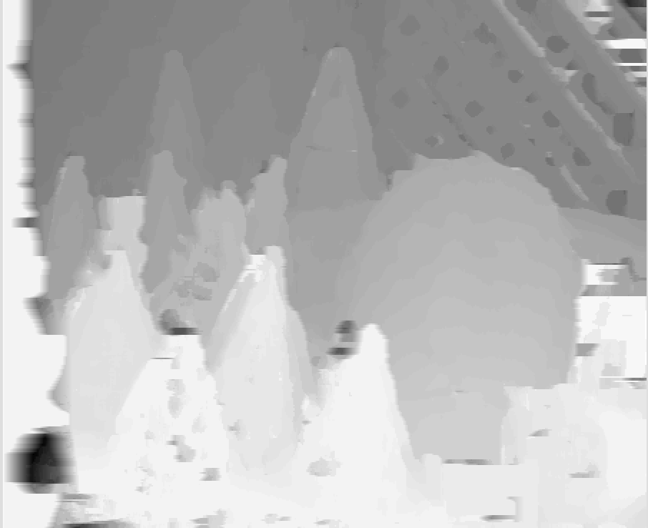
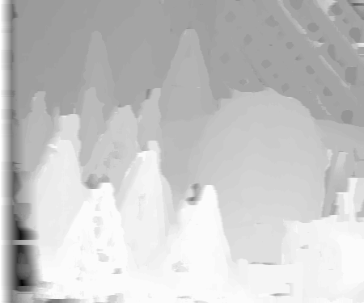
Dynamic Programming Results
Brightness VS RGB channels:
Full usage of RGB channels helped to find better correspondence.
Improvement
Brightness
RGB
Notes:
Dynamic programing

Slide 13
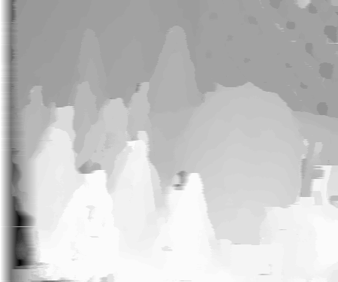
Dynamic Programming
Adaptive Window:
The window size will change due to the density of the Canny edges.
Loss of details
Improvement
RGB dynamic programming
RGB DP with adaptive window
Notes:
changed how we built the cost matrix. in previous approaches we fixed block sizes.

Slide 14
Image Pyramid Approach
Use image pyramid to accelerate the matching process. First do the matching in lower layer, then do the matching use the estimated disparity value with a smaller search range to get the final disparity map.
The multi-scale method runs faster, has a smoother results compared to basic block matching. But it also suffers from loss of details.
We used full size and half size(2 scales) in this experiment.

Slide 15
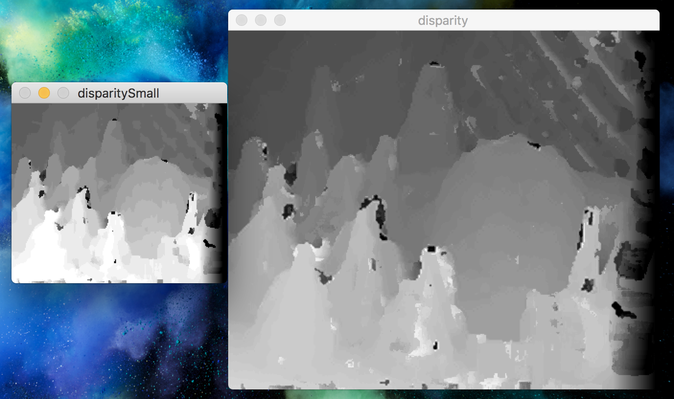
Image Pyramid Result

Slide 16

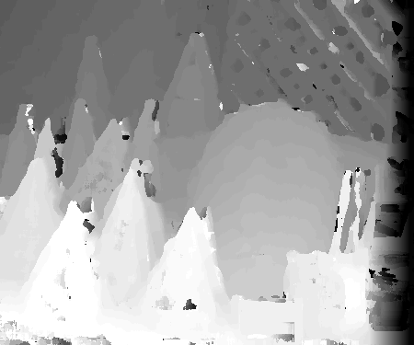
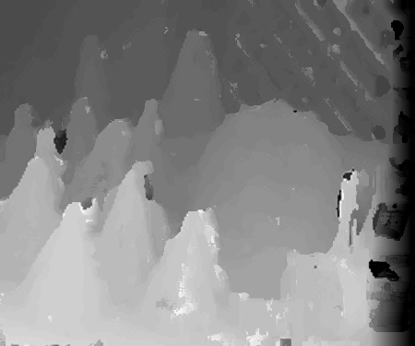
Results & Runtime Comparison
On a pair of 450 * 375 RGB images:
Ground Truth
Basic Block Matching: 72.3s
Dynamic Programming: 163.4s
Image Pyramiding: 26.4s
Notes:
There is always a trade off between disparity map accuracy and speed.

Slide 17
Conclusion
We believe the corresponding problem is core problem in stereo matching.
Nowadays, people start to use deep learning to solve the problem, and achieve good result.
In this project, we used traditional computer vision tech to solve the correspondence problem. The traditional method achieved acceptable quality.
The basic block matching algorithm is the most simple one and has many artifacts like the black holes in the disparity map.
The dynamic programming method aimed to solve the artifacts. It works but also introduced the line artifacts. Additional tricks also improve the results, like adaptive window and RGB cost.
The pyramid method aimed to accelerate the matching process. We found it also reduced the noise in the results.

Slide 18
Thank You For Listening!
Questions?

