Slide 1
Structure
What is an
algorithm?
Quick sort
Linked lists
Trees
Binary heap
Hash tables
Problem solving patterns
Big O
Recursion
Data structures
Stack and queue
Binary
search tree
Priority queue
Graphs

Slide 2
Introduction to Algorithms
Algorithm is a finite sequence of well-defined, computer-implementable instructions, typically to solve a class of problems or to perform a computation.
Algorithm properties
Various definitions of an algorithm, explicitly or implicitly, contain the following set of general requirements
The algorithm must represent the process of solving the problem as an orderly execution of some simple steps
The algorithm should be applicable to different sets of initial data.
The algorithm should produce the same result for the same input data.

Slide 3
Algorithms efficiency
One of the most important aspects of algorithm design is resource (run-time, memory usage) efficiency
Imagine how much implementations we have of the same function, how know witch one of them is best?
Need numeric presentation of that.
Excellent
Pretty good
Only ok
Ehhh
Awful

Slide 4
Imagine spaceship problem
Bob is writing a search algorithm for Elon Musk’s. Its algorithm will work when the rocket flies up to the moon, and will help calculate the landing point. Bob has only 10 seconds to choose a landing site, if it does not meet this time, then the moment for landing will be missed
 | Simple search | Binary search
100 elements | 100ms | 7ms
1 000 elements | 10s | 14ms
1 000 000 elements | 11day | 32ms

Slide 5
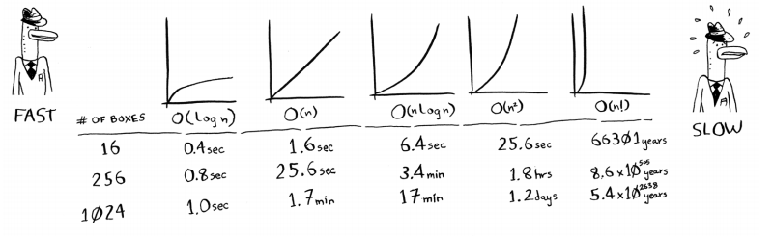
What is Big O
The special big O notation describes the speed of the algorithm
Write as O(n) – where n is operations count
Big O describes the speed of algorithms not in seconds, but in the rate of growth of the number of operations.
Big O describes how quickly the algorithm execution time increases with an increase in the size of the input data.
Big O examples

Slide 6
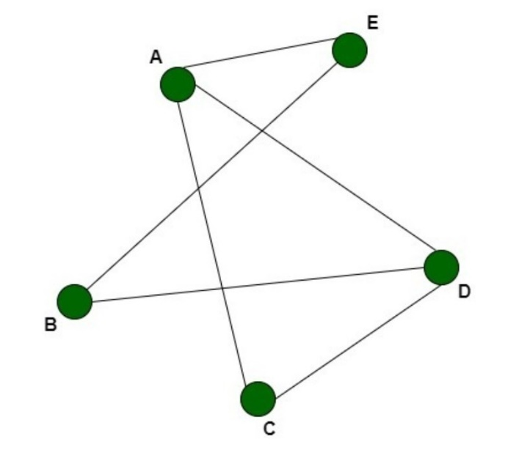
n! – who need this algorithm?
Travelling salesman problem. He must go around N cities. One possible solution - you need to iterate over all possible combinations of the order of detouring cities. In the general case, to calculate the result for n elements, it will be required n! (n-factorial) operations.
This is one of the famous unsolved problems in the field of computation theory.
At it’s best case, you can look for an approximate solution with dynamical programming.

Slide 7
Recursion
When a function calls itself, it is called recursion.
Each recursive function should there are two cases: base and recursive.
Problem solving patterns
Divide-and-conquer - This paradigm, divide-and-conquer, breaks a problem into subproblems that are similar to the original problem, recursively solves the subproblems, and finally combines the solutions to the subproblems to solve the original problem.
Merge sort and quicksort employ a common algorithmic paradigm based on recursion.

Slide 8
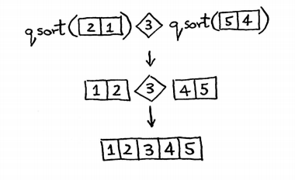
Quick sort
Quicksort is a divide-and-conquer algorithm. It works by selecting a 'pivot' element from the array and partitioning the other elements into two sub-arrays, according to whether they are less than or greater than the pivot and recursive continue before until you get to the base case.
The most commonly asked question, witch has best performance, quick sort or merge sort. There are certain reasons why the quick sort has better performance.
Merge sort uses extra space, quicksort requires little space and exhibits good cache locality
Quick sort is constant is smaller than merge sort
But merge sort can be easily adapted to operate on linked lists and very large lists with slow access

Slide 9
Most popular sort algorithms Big O
Sorting algorithms | Speed |  |  | Memory
 | Best | Average | Worst | Worst
Bubble sort | n | n^2 | n^2 | 1
Selection sort | n^2 | n^2 | n^2 | 1
Insertion sort | n | n^2 | n^2 | 1
Merge sort | n * log(n) | n * log(n) | n * log(n) | n
Quick sort | n * log(n) | n * log(n) | n^2 | log(n)

Slide 10
Data structures
Data structures in PHP
In computer science, a data structure is a data organization, management, and storage format that enables efficient access and modification. More precisely, a data structure is a collection of data values, the relationships among them, and the functions or operations that can be applied to the data.
The essence of creating custom data structures optimization of certain parts of the code
Array
Object
In PHP 7, using
Ds\ namespace we can use 3 interfaces namely
Collection
Sequence
Hashable
And 8 classes namely
Vector
Deque
Queue
PriorityQueue
Map
Set
Stack
Pair
Data structures in JavaScript
Array
Object
Set(unique elements)
Map
WeakMap (keys are not enumerable)
WeakSet (keys are not enumerable)

Slide 11
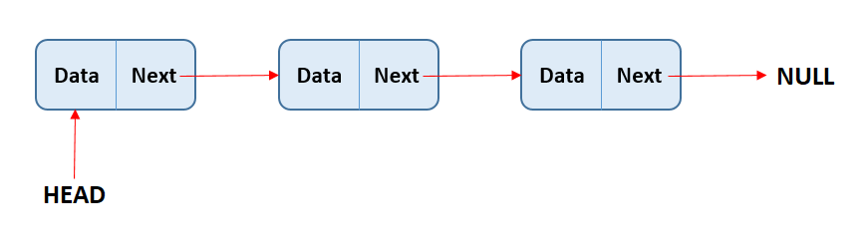
Linked list ( singly, doubly)
A linked list is a linear data structure, but unlike arrays, they are not stored at contiguous memory locations. The elements in a linked list are linked using pointers.
Unlike a doubly linked list, a singly linked list item does not know its previous item.
Operation | Array | Linked list
Query | O(1) | O(n)
Insert/Delete at beginning | O(n) | O(1)
Insert/Delete at end | O(1) | O(n)
Insert/Delete at middle | O(n) | O(n)
Main methods
append
prepend
Other methods
size
toArray
search
getLast( by recursive call )
deleteNode

Slide 12
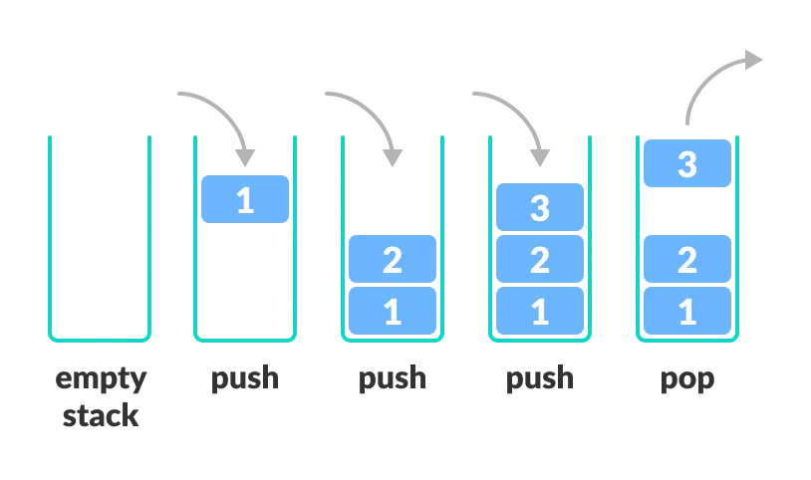
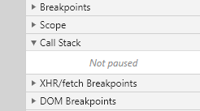
Stack
Stack is data structure witch uses LIFO( Last In, First Out ) algorithm.
Stack allows operations at one end only. Where stack uses? For example nested functions calls are stored on the Call Stack.
When a function makes a nested call, the following happens
The execution of the current function is suspended
The execution context associated with it is stored in execution context stack
Nested calls are executed, for each of which its own execution context is created
After their completion, the old context is popped off the stack, and the execution of the external function resumes where it left off.
Main methods
push
pop
peek
Other methods
size
isEmpty

Slide 13
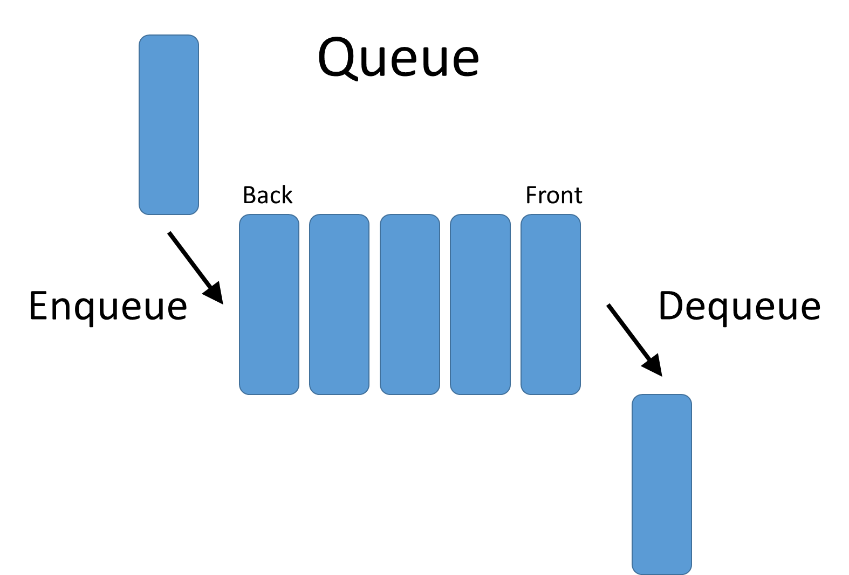
Queue
Queue is data structure witch FIFO( First In, First Out ) algorithm.
Unlike stacks, a queue is open at both its ends. One end is always used to insert data (enqueue) and the other is used to remove data (dequeue).
Main methods
enqueue
dequeue
peek
Other methods
size
isEmpty

Slide 14

Trees
Unlike linear lists, trees is nonlinear.
Several facts about trees
A tree’s node can have several child nodes.
Singly linked list is special case of tree.
Tree node can point only child ( parent <> child relationship )
We can not have node pointing to sibling
Only one root element(top of tree)
Trees lot of different examples
Html DOM
Network Routing unicast<-broadcast<-multicast<-anycast<-geocast
Folder structure
JSON
And more, and more

Slide 15
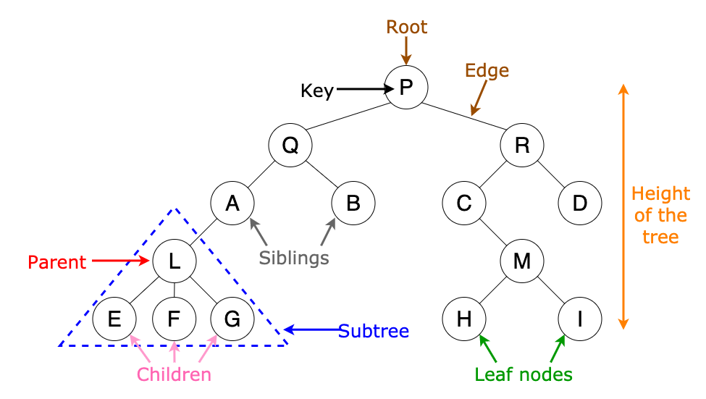
Trees
Basic terminology
Root – the top of tree
Parent – the converse notion of a child
Edge – connection between one node and another( parent <> child )
Siblings – nodes with same parents
Child – a node directly connected to another node when moving away from the root
Leaf a node who has no child
Main methods
insert
find
contains
delete

Slide 16
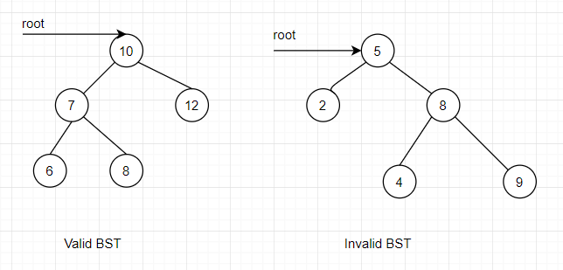
Binary search tree
Binary Search Tree is a node-based binary tree data structure which has the following properties:
The left subtree of a node contains only nodes with keys lesser than the node’s key.
The right subtree of a node contains only nodes with keys greater than the node’s key.
The left and right subtree each must also be a binary search tree.
Binary search trees are collections that can efficiently maintain a dynamically
changing dataset in sorted order.
Tree
Binary tree
Binary search tree
Simulates a hierarchical tree structure
No more 2 child at node
Left child is smaller than right
Sorted binary tree – parent greater that child
Any count of child
Operation | BST
Insert | O(log(n))
Search | O(log(n))
Delete | O(log(n))
NOT guaranteed!

Slide 17
Binary search tree
Inserting a Node
Start at the root
Check if there is the root, if not- the root now becomes that new node
If there is a root, check if value of the new node is greater than or less than the value of the root
If it is greater
Check to see if there is a node to the right
If there is – move to that node and repeat these steps
If there is not, add that node as the right property
If it is less
Check to see if there is a node to the left
If there is – move to that node and repeat these steps
If there is not, add that node as the left property
Dublikati momenty karanc index avelacnenq,
ete petq a imananq qani angam a krknvum tivy

Slide 18
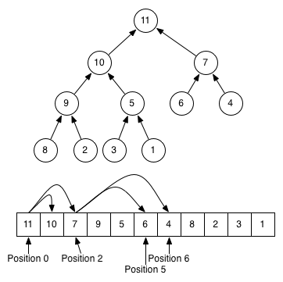
Binary heaps
Binary heap is a complete tree (All levels are completely filled except possibly the last level and the last level has all keys as left as possible). This property of Binary Heap makes them suitable to be stored in an array.
No implied ordering between siblings like BST
Can be
Max Binary Heap ( parent > child )
Min Binary Heap ( parent < child )
Since it is binary, parent cannot have more than 2 child
Main methods
insert
bubbleUp
extractMax
sinkDown
Why do we need to know this?
Binary heaps are used to implement Priority Queues, which are very commonly used data structure

Slide 19
Binary Heap
Define what a binary heap is
Compare and constrast min and max heaps
Implement basic methods on heaps
Understand where heaps are used in real word and what other data structures can be constructed from heaps
Very similar to a binary search tess but with some different rules
In MaxBinaryHeap, parent nodes are always larger than child nodes. In a MinBinaryHeap, pare nodes are always smaller than child nodes
Most 2 children, but unlike BST, there is no order left or right
MaxBinaryHeap
Each parent has at most two child nodes
The value of each parent node is always greater than its chid node
In a max binary heap the paren is greater than the children, but there are no guarantees between sibling nodes
A binary heap is as compact as possible unlike BST, all the children of each node are as full as they can be and left children are filled out first
No implied ordering between siblings
Same idea for Min Binary heap
Why do we need to know this?
Binary heaps are used to implement Priority Queues, which are very commonly used data structure
Set up importants level | used quite a bit, with graph traversal algorithms

Slide 20
Binary Heap - storing
41
39 33
27 12 7
Easy way of ording a binary heap … tadada!! List / array
41 - 39 –- 33 –-- 18 –-- 27 –-- 12 –-- 7
For any index of an array n…
The left child is stored at 2n + 1
The right child is stored at 2n + 2
Backward solution -> ( n - 1 ) / 2 floor
Class Name:
MaxBinaryHeap
Properties:
values = []
Adding to a MaxBinaryHeap
Add to the end
Bubble up(compare with paent) - > while less than parent – bubble
Insert pseudocode
Push the value into the values property on the heap
Bubble up
Create a variable called index which is the length of the values property – 1
Create a variable called parentIndex which is the floor of (index – 1) / 2
Keep looping as long as the values element at the parentIndex is less than the values element at the child index
Swap the value of the values element at the parentIndex with the value of the element property at the child index
Set the index to be the parentIndex and start over

Slide 21
Binary Heap - removing
Remove the root
Replace with the most recently added
Adjust( sink down )
SINK DOWN? The procedure for deleting the root from the heap (effectively extracting the maximum element in a max-heap or the minimum element in a min- heap) and restoring the properties is called down-heap (also known as bubble-down, percolate-down, sift-down, trickle-down, heapify-down, cascade-down, and extract-min/max).
REMOVING (also called extract Max)
Swap the first value in the values property with the last one
Pop from the values property, so you can return the value at the end.
Have the new root "sink down" to the correct spot...
Your parent index starts at 0(the root)
Find the index of the left child: 2* index + 1 (make sure its not out of
bounds)
Find the index of the right child: 2*index + 2 (make sure its not out of
bounds)
If the left or right child is greater than the element...swap. If both left and
right children are larger, swap with the largest child.
The child index you swapped to now becomes the new parent index.
Keep looping and swapping until neither child is larger than the element.
Return the old root!

Slide 22
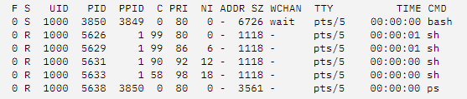
Priority Queues
WHAT IS A PRIORITY QUEUE - A data structure where each element has a priority. Elements with higher priorities are served before elements with lower priorities. Easy to convert Binary heap to Priority queue.
Our Priority queue
Write a Min Binary Heap( lower number means higher priority )
Each Node has a value and a priority. Use the priority to build the heap.
Enqueue method accepts a value and priority, makes a new node, and puts it in the right spot based off of its priority.
Dequeue method removes root element, returns it, and rearranges heap using priority.
Main methods
enqueue
dequeue
In unix programs/processes
run priority called niceness
In wordpress action’s priority setup with priority queues
The procedure for deleting the root from the heap and restoring the properties is called sink-down(bubble-down, percolate-down, sift-down, trickle-down, heapify-down, cascade-down)

Slide 23
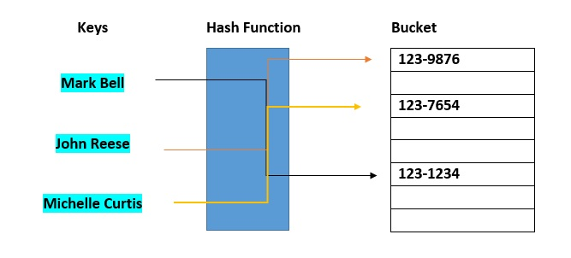
Hash tables
Objectives
Explain what hash table is
Basics
Discuss what makes a good hashing algorithm
Understand how collisions occur in a hash table
Handle collision using separate chaining or linear probing
What is a hash tables?
Hash tables are used to store key-value pairs
The hash tables like arrays, but keys is not ordered
Unlike arrays – hash tables are super fast for all operations(find, add, remove)
Why we don’t use hash tables instead of arrays or linked list if there is so fast? It doesn’t store its elements in any particular order, you need big array( memory ) and great hash function for small count of collisions

Slide 24
Hash tables - basics
Main methods
_hash
set
get
values
keys
delete
Hash tables in programming languages
Python – dict
JS – Objects and Maps
Java – Maps
Ruby - Hashes
Imagine we need to store colors(hex) to array
colors = [ “ff69b4”, “00ffff”, “ffffff” ]
And we need human readable keys
colors[‘cyan’] match better than colors[1]
how to combine human readable with computer readable(array does not index like pink)?
In order to look up values by key, we need a way to convert values to valid array indices. A function that performs this task is called a hash function

Slide 25
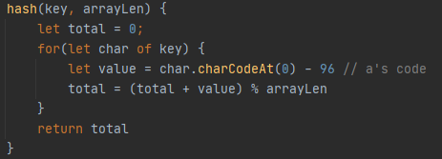
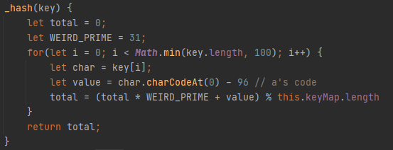
Hash functions
What makes hash function to a good hash function?
Fast(constant time)
Doesn’t cluster outputs at specific indices, but distributes uniformly
Deterministic( same input -> same output )
Problems
This work only with strings( we don’t worry about it )
Not constant time – linear in key length
Collisions
Solutions
Add iteration max count ( 100 )
Prime number( what? )

Slide 26
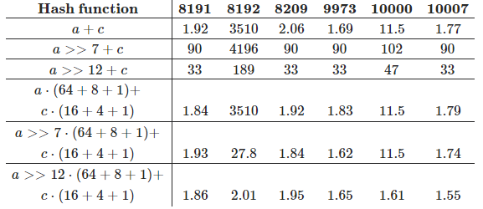
Hash function / table with prime number
The prime number in the hash is helpful in spreading out the keys more uniformly. It's also helpful if the array that you're putting values into has a prime length. You don't need to know why. (Math is complicated!) But here are some links if you're curious. Why do hash functions use prime numbers? Does making array size a prime number help in hash table implementation?
Hash function / table with prime number
Stack overflow
Quora
You don't really need to know why, just set the prime number in the hash function and the size of the array

Slide 27
Dealing with collision
Even with a large array and a great hash function, collisions are inevitable
Two strategy, for handle collisions
Separate chaining
Linear probing
Separate chaining – we store multiply key-values in same index
Linear probing – search through the array to find the next empty slot, unlike separate chaining, we store only one key-value at one index

Slide 28
Hash tables recap
In short, if you have data that doesn’t use too many inserts or deletes, and access the items frequently out of order, use an array. If you need data that can be quickly inserted and deleted into and is accessed mostly in sequential order, use a linked list. If you need a fast traversal then a hash table with a good hash function will be a better choice.
Operation | Hash table | Big hash table with great hash function
Insert | O(log(n)) | O(log(1))
Query | O(log(n)) | O(log(1))
Delete | O(log(n)) | O(log(1))

Slide 29
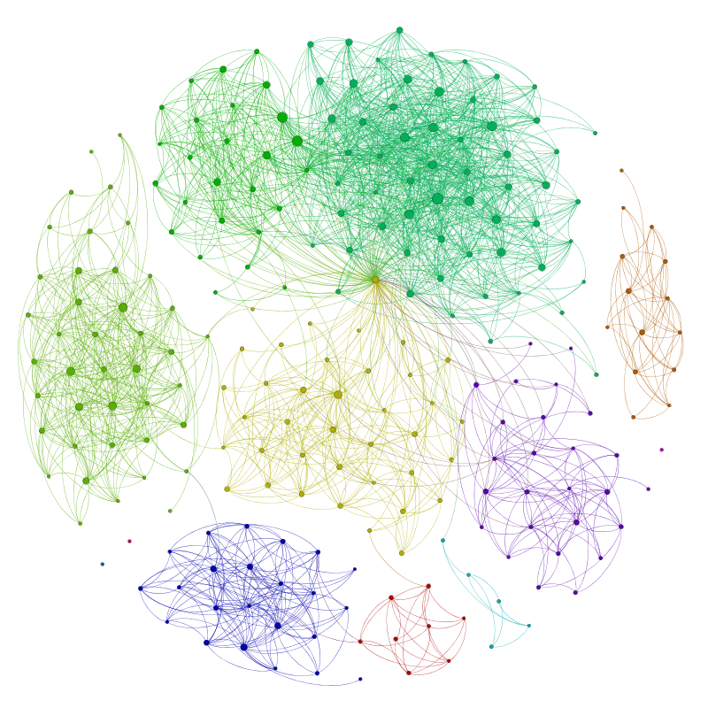
Graphs
Objectives
Explain what a graph
Basics
Compare | contrast different types of implementations
Implement a graph using adjacency list
Graph traversal
What is a hash tables?
Graph is a data structure consists of a finite (and possibly mutable) set of vertices, together with a set of unordered pairs of these vertices for an undirected graph or a set of ordered pairs for a directed graph.
Tree is a type of graph, but graph ha no root element, or child nodes, there are just nodes, connected with each other
In graph theory, a tree is an undirected graph in which any two vertices are connected by exactly one path

Slide 30

Graphs - basics
Terminology
Vertex – a node
Edge – connection between nodes
Weighted / Unweighted – values assigned to distances between vertices ( map / Instagram followers )
Directed / Undirected – directions assigned to distanced between vertices (one way street / friends on Facebook )
Usage
Any social network – friend
Recommendation engines(people also watched, You might also like…, music recommendations)
Routing algorithms( cities are nodes and routes between there is edges)
Web – pages linked to other pages
Vertex

Slide 31
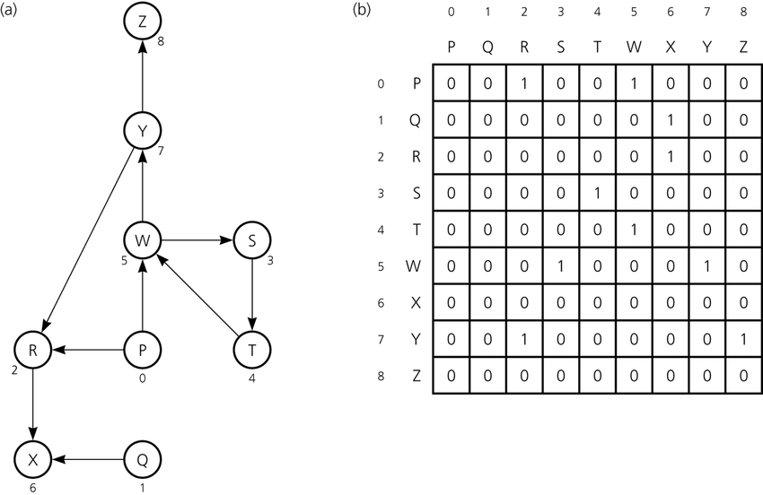
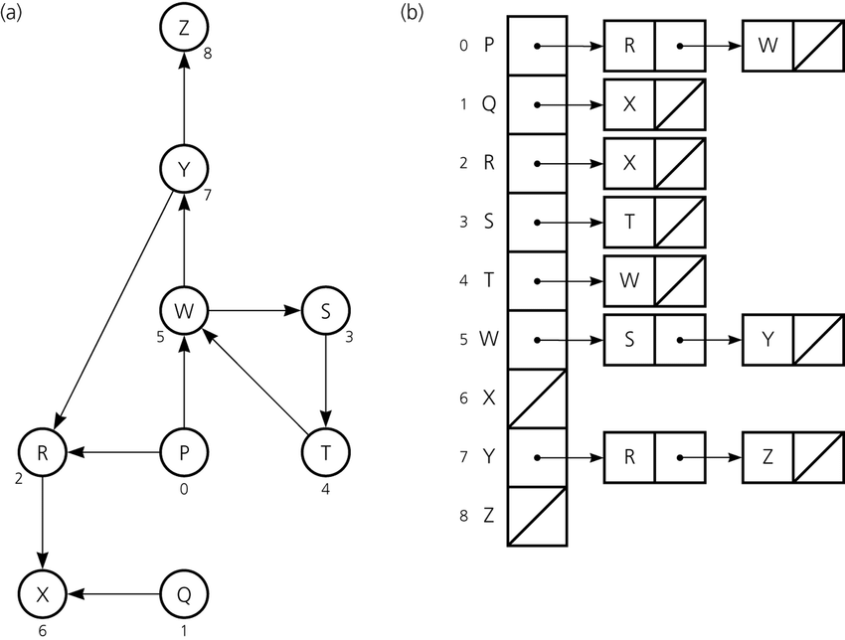
Graph implementing types
Terminology
Adjacency matrix
Adjacency lists(can use hash tables if keys in not numbers)
Operation | Adjacency lists | Adjacency matrix
Add vertex | O(1) | O( | V^2 | )
Add edge | O(1) | O(1)
Remove vertex | O( | V | + | E | ) | O( | V^2 | )
Remove edge | O( | E | ) | O(1)
Query | O( | V | + | E | ) | O(1)
Storage | O( | V | + | E | ) | O( | V^2 | )
List | Matric
Can take up less space | Takes up more space
Faster to iterate over edges | Slow to iterate over al edges
Slow to lookup specific edge | Fast to lookup specific edge

Slide 32
Graph traversal
Depth first graph traversal – visiting the first neighbor, then his first neighbor, etc., until the neighbors run out, then the second, etc.
Breadth first graph traversal – visit all neighbors, after that, visit all neighbors of the first, etc.

Slide 33
Graphs
Задача о семи мостах
Dracula for graph visualization

Slide 34
notes
Open all depends
Kapy algoneri u ds neri mej
Need recap???? Add it to google keep

