Slide 1
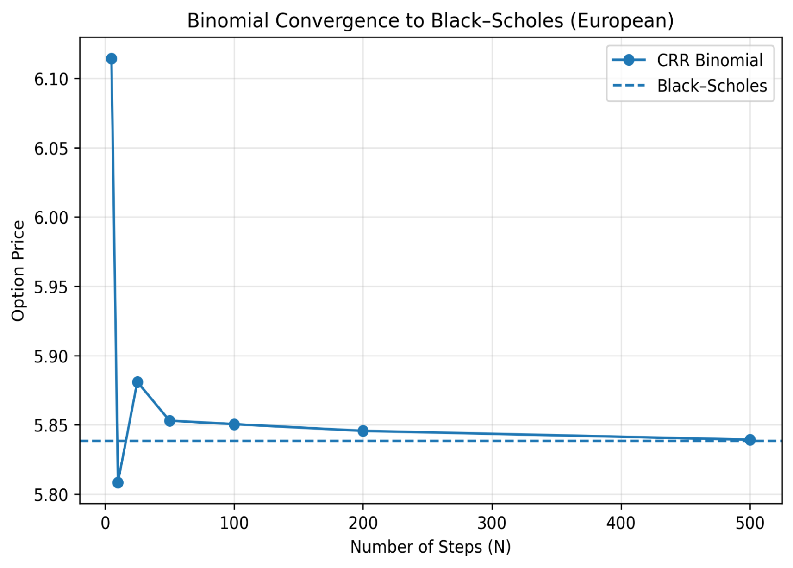
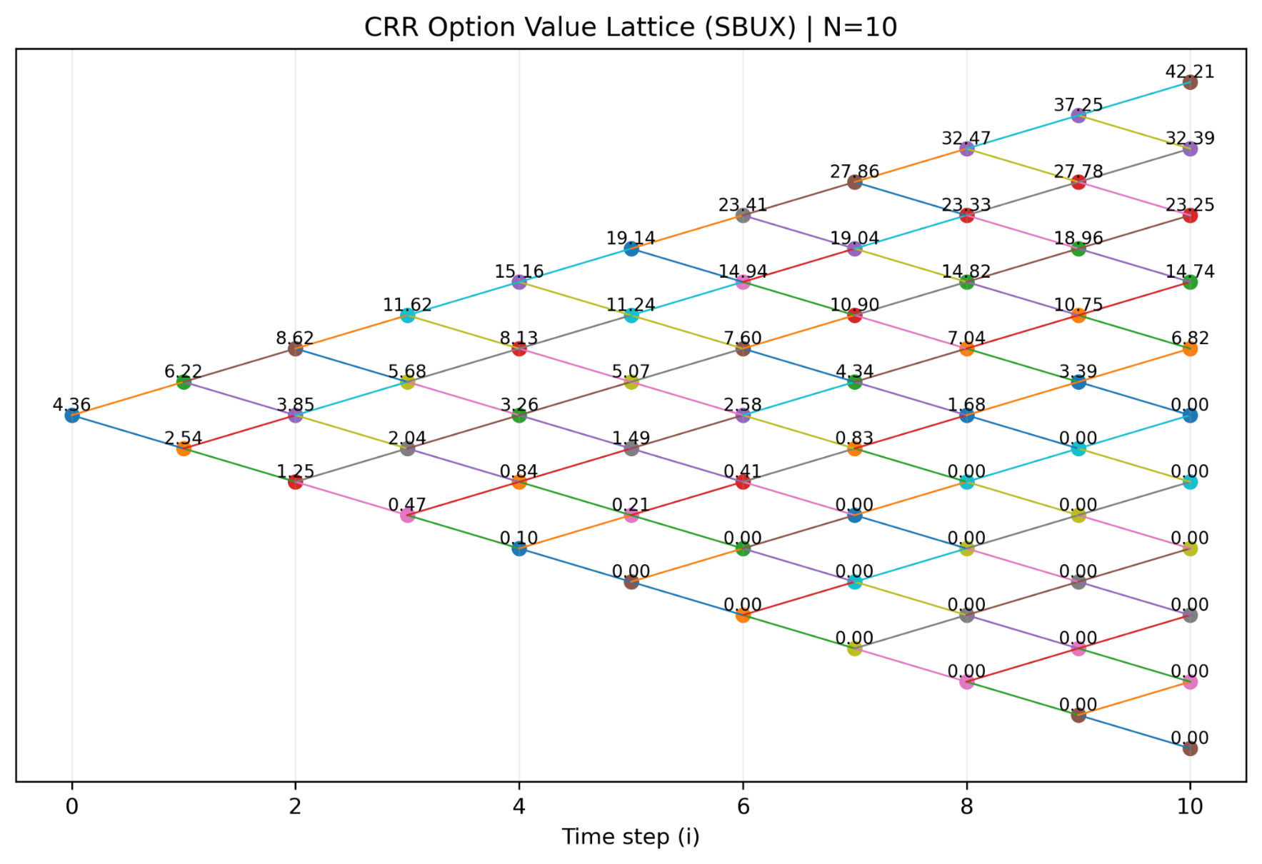

Interactive Option Pricing and Hedging Dashboard
Turning Market Data into Smarter Financial decisions
Daron Baltazar, Christina Davis PHD
Belmont University – Finance & Computer Science
Support prototype using CRR Binomial trees, Black-Scholes, and live market data
Objective
MODELS & METHODS
RESULTS
Build an interactive system to price financial options using real market data
CRR Binomial Model
BLACK-SCHOLES MODEL
1. Pricing Comparison
Discrete-time simulation of stock price paths
Recombining tree structure
Backward induction for pricing
Handles American options
Continuous-time closed-form solution
Used as a Benchmark
European option assumptions
Binomial ~ Black-Scholes
Very low error (<1%)
Confirms numerical convergence
Compare numerical (Binomial) vs. Theoretical (Black-Scholes) models.
Translate model outputs into risk management insights (hedging)
Model | Option Price (USD) | Abs. Error | % Error
CRR Binomial (N=100) | 5.1187 | 0.0131 | 0.26%
Black-Scholes | 5.1056 | -- | --
V = max(hold, exercise)
Data & Inputs
American Option Decision Rule
2. Scenario Analysis (Put Option)
Stock Data: Yahoo Finance
Risk-free rate: FRED (Treasury yields)
Volatility: Historical estimation from returns
Hold → Expected future value
|
Exercise → Immediate payoff
Sensitivity: Option Value vs. Stock Price
PIPELINE
Spot Shock | Shocked Spot | Binomial Price | P&L vs Base
-10% | 88.54 | 22.5561 | 8.2813
-5% | 93.46 | 18.1634 | 3.8786
0% (Base) | 98.38 | 14.2849 | 0.0000
+5% | 103.29 | 10.9339 | -3.3509
+10% | 108.21 | 8.1727 | -6.1122
Key Inputs
Estimate Volatility
Build
Binomial Tree
Run Scenario Analysis
Spot price (S₀)
Strike Price (K)
Time to Maturity (T)
Volatility (σ)
Risk-Free Rate (r)
Dividend Yield (q)
Fetch Market Data
Compute
Option Value
Compare vs.
Black-Scholes
Key Takeaways
CONVERGENCE INSIGHT
Binomial model converges to Black-Scholes.
American options enable early exercise decisions.
Early exercise appears frequently for put options.
Option pricing is nonlinear and path-dependent.
Delta provides a direct hedge ratio for risk management.
Example Inputs (PUT OPTION)
As the number of steps (N)
Increases:
Spot price (S₀) 98.3
Strike Price (K) 111.00
Time to Maturity (T) 121 days
Volatility (σ) 26.5%
Risk-Free Rate (r) 4.50%
Dividend Yield (q) 0.00%
Binomial price
→ Black-Scholes price
PRACTICAL INSIGHT: HEDGING WITH DELTA
Example (from Dashboard):
Delta = -0.5437
Shares to Hedge = -54.37 shares
(Short position to hedge a long put)
Limitations
REFERENCES & RESOURCES
VIEW
PROJECT
Delta Measures the sensitivity of the option price to changes in the underlying stock price
Uses Historical Volatility (not implied volatility)
Black-Scholes Assumes European Exercise
Simplified Market Assumptions
Black, F. & Scholes, M. (1973). The Pricing of Options and corporate Liabilities. Journal of Political Economy.
Cox, J., Ross, S., & Rubinstein, M, (1979), Option Pricing:
A Simplified Approach. Journal of Financial Economics.
Yahoo Finance API
FRED Economic Data
https://github.com/Tigranasouras/PricingFinancialOptionsBT-BS
Shares to Hedge = △ * 100

