Slide 1
ITECH1502 CYBERSECURITY FUNDAMENTALS
KC7
Tracing a phishing-led
account compromise
CYBER
KC7 Cyber: A Rap Beef
Connor Reid | Student ID 30347026
Security investigation portfolio presentation
Notes:
Good morning. My project used KC7 Cyber and its A Rap Beef investigation. I followed a targeted phishing attack from early reconnaissance through a successful account compromise and the theft of information. I will explain the goal, the method I used, the evidence I found, and how it connects to the cybersecurity concepts from ITECH1502.

Slide 2
Challenge and investigation goals
A guided security investigation using realistic network, email and authentication logs
The challenge
01
Identify the adversary
KC7 placed me in the role of a security analyst investigating suspicious activity at the fictional OWL Records company. The case required me to connect evidence across several log sources rather than solve one isolated question.
Trace infrastructure, sender details and the target account.
02
Reconstruct the attack
Build an evidence-based sequence from reconnaissance to impact.
03
Recommend controls
Link the findings to IAM, human factors, SOC practice and NIST CSF 2.0.
ITECH1502 | KC7 A Rap Beef
02
Notes:
KC7 is a story-driven platform that simulates the kind of evidence a SOC analyst would examine. My main goal was to identify who was behind the activity and then reconstruct the sequence using only the available logs. I also wanted to explain why each finding mattered and recommend controls that could interrupt the same attack in a real organisation. Source: ITECH1502 Final Project Brief and KC7 A Rap Beef case.

Slide 3
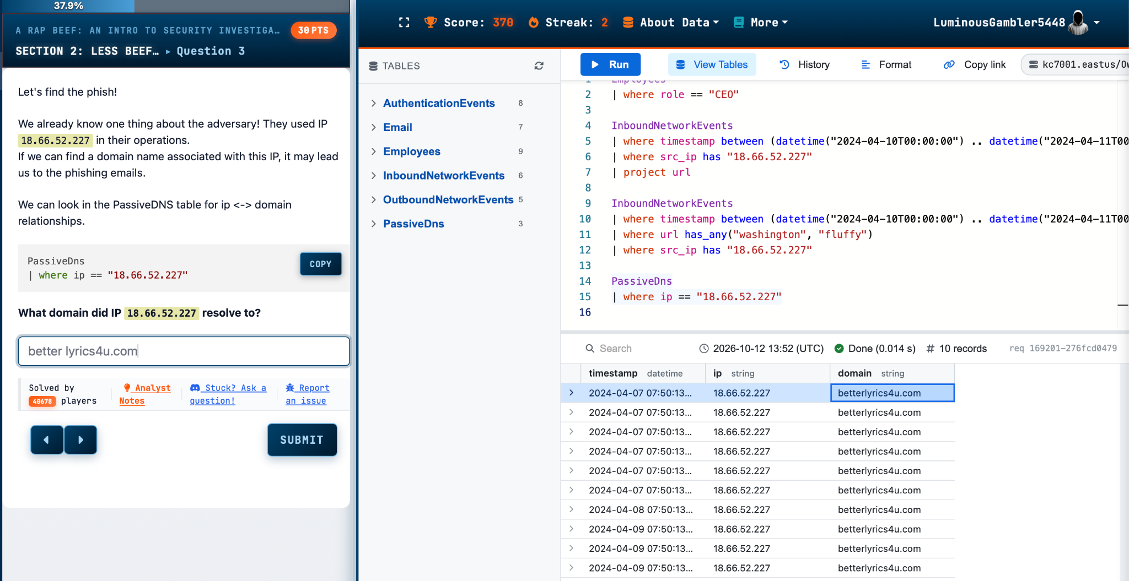
Investigation method
I pivoted between indicators, accounts and timestamps instead of reading every record
1
Start with the known IP
18.66.52.227
2
Resolve infrastructure
PassiveDns identified betterlyrics4u.com
3
Follow the target
Email and Employees linked the lure to Dwake
4
Confirm impact
Outbound, authentication and inbound logs verified the sequence
KQL filters reduced the data by table, time window, source IP, URL and username.
ITECH1502 | KC7 A Rap Beef
03
Notes:
My method followed a series of pivots. I began with the IP address supplied in the case. Passive DNS associated that IP with betterlyrics4u.com. I then searched the email table for that domain and joined the recipients to employee records. From there, I used outbound network logs to confirm the click, authentication logs to test whether the credentials worked, and inbound network logs to examine the activity after compromise. I restricted each query with relevant time windows and indicators. This reflects the unit's SIEM principle of correlating separate events into one incident. Sources: KC7 evidence; ITECH1502 Week 10 SIEM, SOAR and XDR notes.

Slide 4
Verified attack timeline
The evidence shows a multi-stage attack rather than a single suspicious event
07 APR
10 APR
15 APR
15 APR
30 APR
1
2
3
4
5
Infrastructure
Recon and reset
Delivery
Compromise
Exfiltration
IP linked to
betterlyrics4u.com
Dwake researched;
security answers used
11:07 email arrived
with a CLEAN verdict
12:03 click; 13:03
successful login
ZIP download returned
HTTP status 200
The sequence is supported by timestamps, source IPs, usernames, URLs, status codes and authentication results.
ITECH1502 | KC7 A Rap Beef
04
Notes:
The timeline starts on 7 April when the suspicious IP resolved to betterlyrics4u.com. On 10 April, the adversary researched Dwake and used the names Washington and Fluffy in the password reset process. On 15 April, the phishing email arrived at 11:07. Dwake clicked the link at 12:03, and the adversary successfully logged in at 13:03 from 18.66.52.227. Later account activity produced ten matching results, and on 30 April a request downloaded DwakesDirtySecrets.zip with status code 200. I treated a stage as confirmed only when the logs contained a clear result.

Slide 5
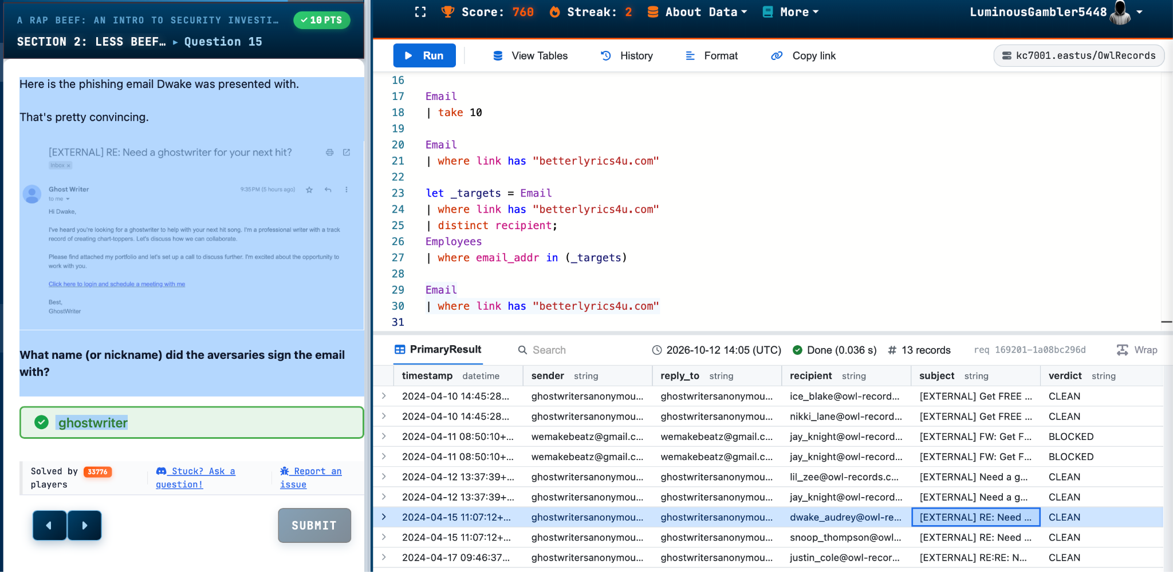
The phishing message reached Dwake
A targeted ghostwriter offer passed the email control and led to a credential-harvesting page
Evidence: sender ghostwritersanonymous@protonmail.com | verdict CLEAN | target dwake_audrey@owl-records.com
ITECH1502 | KC7 A Rap Beef
05
Notes:
The attacker sent a personalised message offering ghostwriting help. The subject and wording were relevant to Dwake's role, which made it more convincing than a generic phishing email. The email record shows Dwake as the recipient and marks the message CLEAN, so the email security product did not block it. Outbound network data then recorded Dwake's internal IP accessing the link at 12:03 on 15 April. This connects directly to the Week 3 human factors material: attackers exploit relevance, trust and curiosity to persuade a user to act.

Slide 6
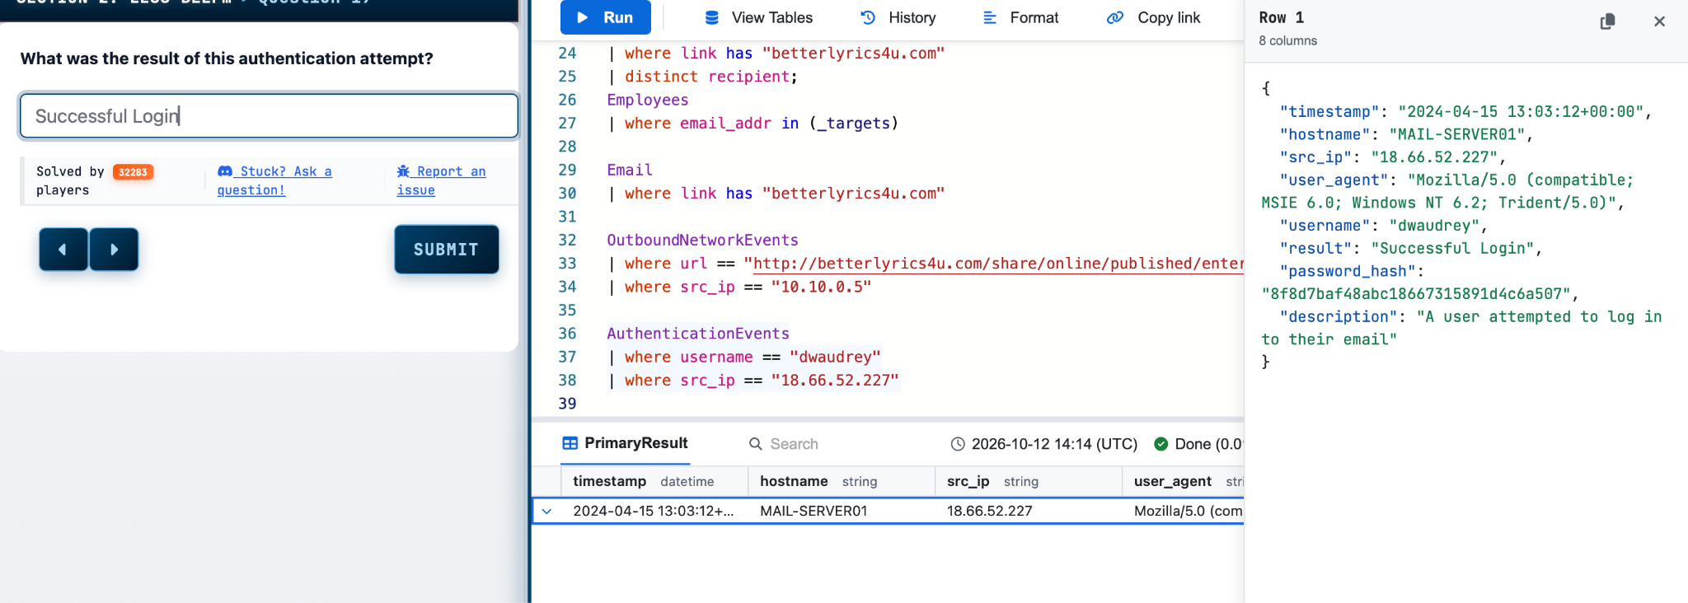
Authentication logs confirmed compromise
The reset attempt became a confirmed incident when the stolen credentials produced a successful login
15 April 2024, 13:03:12 UTC | username dwaudrey | source 18.66.52.227 | Successful Login
ITECH1502 | KC7 A Rap Beef
06
Notes:
This was the decisive piece of evidence. The password reset URL suggested an attempt, but the authentication event confirmed that the account was actually compromised. The record contains Dwake's username, the same adversary IP, the exact timestamp and the result Successful Login. This distinction matters in an investigation because an analyst should separate attempted activity from verified impact. It also shows the weakness of knowledge-based authentication when the answers are public.

Slide 7
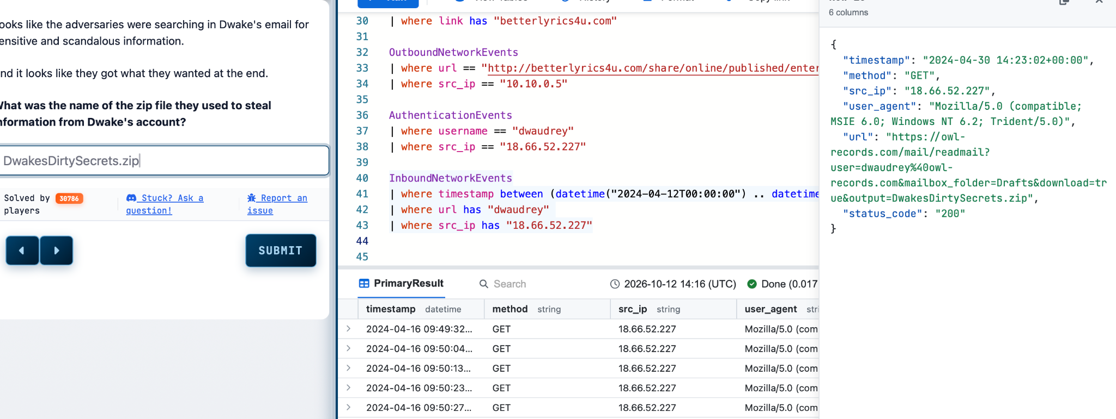
The intruder accessed and downloaded sensitive data
Post-compromise activity culminated in a successful ZIP download from Dwake's mailbox
Outcome: 10 account-related results | DwakesDirtySecrets.zip | HTTP 200
ITECH1502 | KC7 A Rap Beef
07
Notes:
After the successful login, I filtered inbound network events for Dwake's username and the adversary IP. The query returned ten results showing activity against the mailbox. The final record contains download=true and the output filename DwakesDirtySecrets.zip. The HTTP status code is 200, supporting the conclusion that the download request succeeded. This moves the incident from account compromise to data exfiltration. I would still avoid claiming exactly what information was inside the file because the logs show the transfer, not the file contents.

Slide 8
Course concepts and recommended controls
The case combined human behaviour, weak identity controls and gaps in monitoring
Concepts demonstrated
Controls that would reduce risk
Human factors
01
Replace knowledge-based recovery with stronger identity verification.
A personalised lure and public information influenced the victim.
02
Require phishing-resistant MFA for email and account recovery.
Identity and access
Security questions allowed public facts to support account recovery.
03
Inspect links and isolate suspicious external email content.
SOC and SIEM
Correlated logs revealed the attack sequence and confirmed impact.
Centralise identity, email and network logs with compromise playbooks.
04
NIST CSF 2.0
Protect, Detect and Respond controls could interrupt the chain.
05
Use current phishing exercises and clear reporting procedures.
ITECH1502 | KC7 A Rap Beef
08
Notes:
The case connects several weeks of the unit. Week 3 explains why tailored phishing and public personal information are effective. Week 8 shows that authentication needs more than weak security questions and supports MFA and least privilege. Weeks 7 and 10 explain the SOC process and how centralised logs allow analysts to correlate evidence. Under NIST CSF 2.0, stronger identity controls and training belong to Protect, central monitoring belongs to Detect, and an account compromise playbook supports Respond. My recommended controls therefore combine people, process and technology instead of relying on one product. Sources: ITECH1502 Weeks 3, 6, 7, 8 and 10 notes.

Slide 9
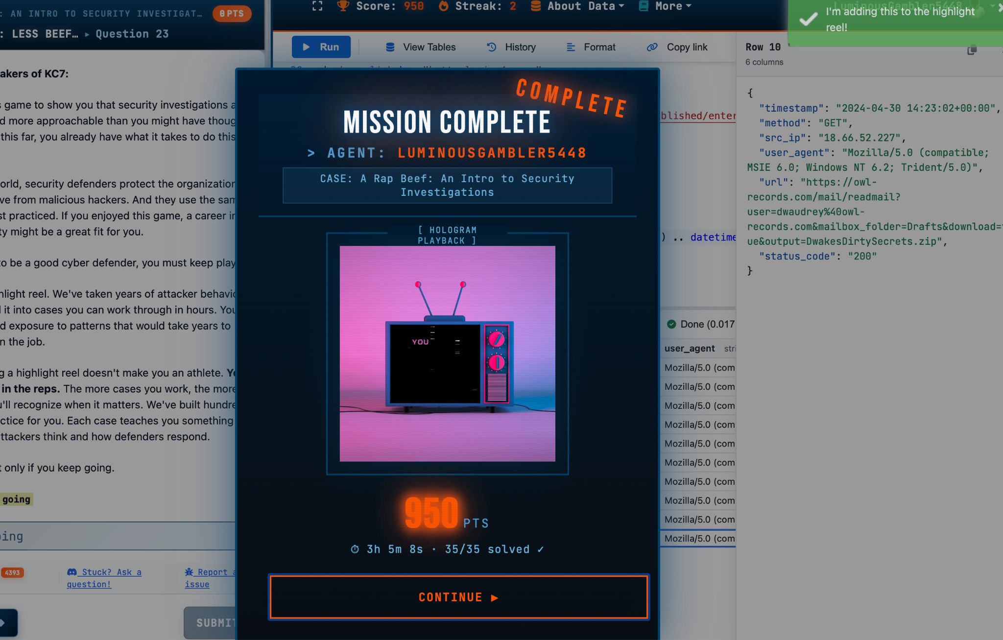
Reflection and professional growth
The main lesson was to build claims from connected evidence, not assumptions
What I learned
1
KQL becomes practical when each query answers one clear investigative question.
2
A reset URL suggests intent, while an authentication result proves compromise.
3
Timestamps and repeated indicators turn separate logs into a defensible timeline.
4
If I repeated the task, I would record each query, result and interpretation as I worked.
Professional value
The exercise developed SOC-style log analysis, evidence handling and incident communication skills.
35/35 solved | 950 points | 3h 5m
ITECH1502 | KC7 A Rap Beef
09
Notes:
The most important lesson was the difference between an indicator and proof. A suspicious URL or password reset attempt is not the same as a confirmed compromise. By following the same IP, target and timestamps across several tables, I could make a defensible conclusion. The exercise also improved my confidence with KQL and with explaining technical findings in plain language. If I repeated it, I would keep a structured evidence log as I worked, with the query, result, interpretation and screenshot together. Completing all 35 questions showed me that repeated investigation practice builds the pattern recognition needed for future SOC work.

