Slide 1

Who am i?
What things can express myself?

Slide 2

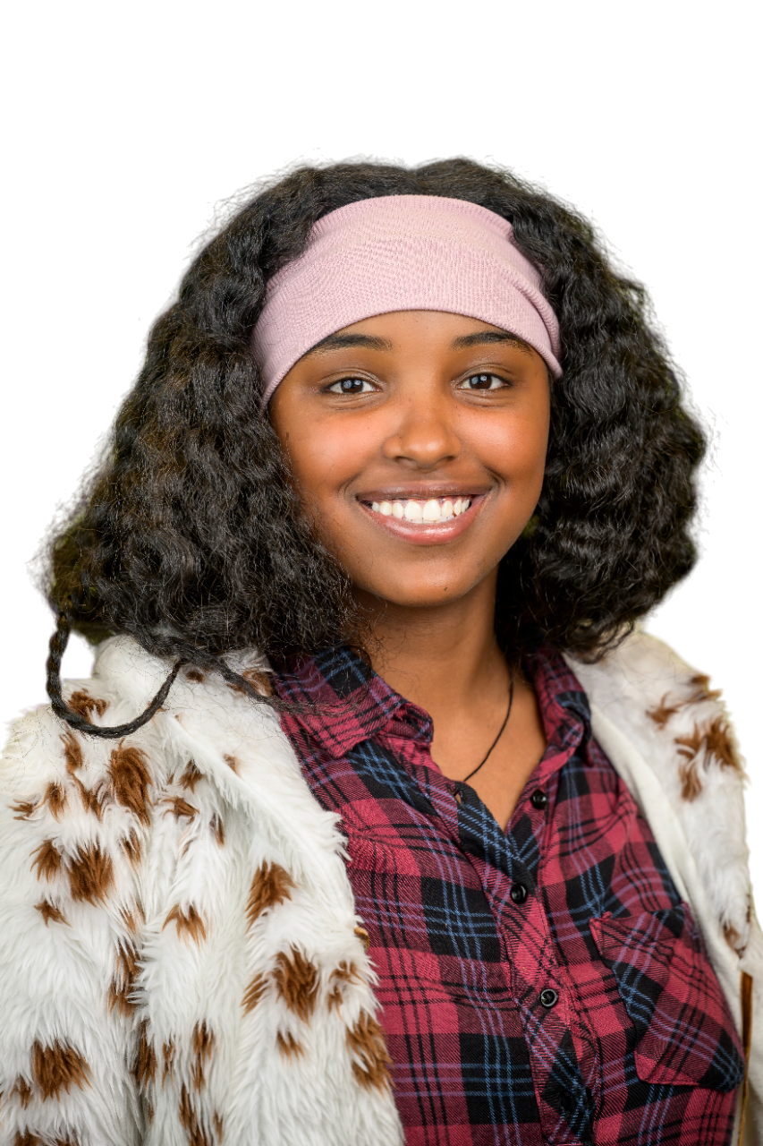
My name is Tihitna yohannes.
I’m from ethiopia.
I’m the only child for my mother.
I’m 20 years old.
I'm graduated from high school.

Slide 3


Educational background
Four-eight nursery,7-15 primary school,15-19 high school.
I’m in Akirachix to be a good woman software engineer.
I'm here to be an intelligent girl from the code hive program.

Slide 4

Fun fact
Doing physical exercise .
Participating in social environments.
I like helping people who can't afford basic needs.
Since I was 14 years old,I have served as a leader.

Slide 5

“I can do all this through him who gives me strength.”
Philippians 4:13.

Slide 6
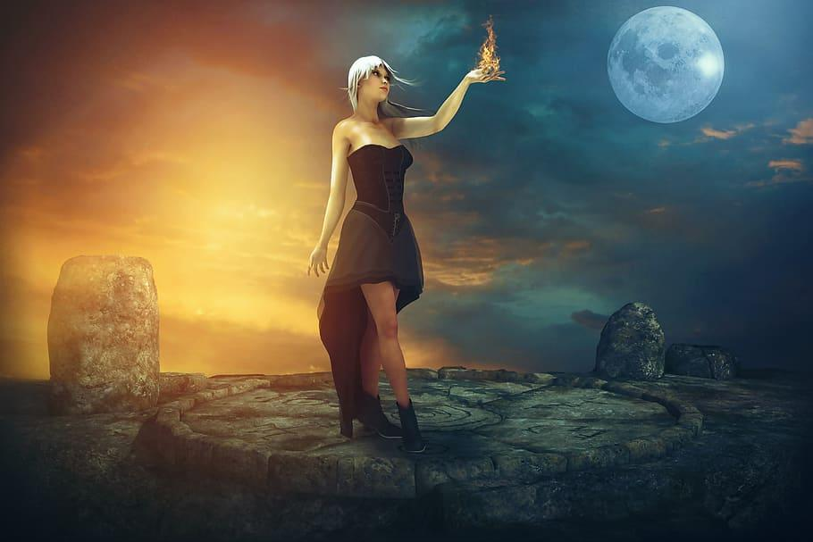
My Vision
I want to be part of (AI )artificial intelligence
I hope i will get knowledge that make me to solve many problem.
specially, I have the dream to protect girls and children from sexual abuse.

Slide 7


