Slide 1

Book Mood
Reader
Tihomira Miteva
Notes:
TIME: 10 seconds
My project is Book Mood Reader. I wanted to connect the feeling of a book with music. This is a small, self-collected classification project, so the main aim is to demonstrate the process and evaluate it honestly.
Visual: AI-generated illustrative book and headphones still life.

Slide 2
Table of contents
01
Introduction
06
Modeling
02
Domain understanding research
07
Training vs testing
03
Data collection
08
Evaluation and confusion matrix
04
Cleaning and classification targets
09
Demo
05
Exploratory data analysis
10
Reflection
02
Notes:
TIME: 15 seconds
I will introduce the question and the domain, explain how I collected and cleaned the data, and show the exploratory analysis. Then I will compare the models and their training and testing performance, explain the evaluation, show the demo, and reflect on what I learned.

Slide 3
Introduction
Can a book description help us find songs
with a similar emotional mood?
Goal: explore whether shared emotion labels
can connect books and music.
03
Notes:
TIME: 25 seconds
My research question is: can a book description be used to predict emotions and recommend songs with similar emotions? I am using multi-label classification because a book or song can have several emotions at once. The book model uses a description and the song model uses audio features. The project connects the two datasets through shared emotion names. It is a small learning project, so I evaluate its limitations as well as its results.

Slide 4
Domain understanding research
Research focus
Target group
I explored the connection between emotions in books and the feelings music can create.
People who enjoy listening to music while reading.
Project idea
A playlist that fits the mood may strengthen
the feeling of a story while reading.
04
Notes:
TIME: 30 seconds
For my domain understanding, I researched the connection between the emotions in a book and the feelings created by music. This led to the idea that a playlist with a similar mood could reinforce the feeling of the story and make the reading experience more engaging. My target group is people who enjoy listening to music while reading. This is the motivation for the project, rather than a benefit my model results prove. I have not yet conducted a listener study to test whether the suggested playlists improve the reading experience. Source: my project research and motivation, as described in the presentation brief.

Slide 5
Data collection
15 books
80 usable songs
Questionnaire
Description + 25 ratings
Scale: 1–5
Personal music research
Audio + emotion labels
Small samples and provisional song labels limit reliability.
05
Notes:
TIME: 35 seconds
I collected the book data through a questionnaire and researched and downloaded the music myself. The book dataset has 15 books with descriptions and 1–5 ratings for 25 emotions. The usable song dataset has 80 tracks with audio and selected emotion labels. Two empty audio files were removed. Some song labels were suggested with AI assistance, so they are provisional rather than independently verified. Collecting enough varied examples and consistent labels was a major difficulty. Sources: data/raw/book_moods_clean_ratings.csv; data/raw/songs.xlsx; original downloaded song archive.

Slide 6
Cleaning and classification targets
Inspect
Display both tables; check nulls, duplicates and audio files.
Standardize
Fix column names and emotion spelling; keep 25 shared labels.
Book targets
Ratings 4–5 = strong; ratings 1–3 = not strong.
Song targets
Selected label = 1; unselected label = 0.
06
Notes:
TIME: 35 seconds
I displayed both datasets, checked missing values and duplicates, and standardized columns and emotion spelling, including Peaceful and Melancholic. I checked that song paths referred to readable audio and removed two empty files. There were no missing book emotion ratings or duplicate book identities. For classification, book ratings of 4 or 5 become strong-emotion targets. Ratings 1 to 3 mean not strongly present, rather than absent. Song labels become selected or unselected targets. These targets share names but come from different annotation methods.

Slide 7
EDA: emotion frequency across both datasets
Common moods
Emotional • Intense • Dark
Uneven coverage
Rare emotions are harder to learn.
Frequency comparison; books and songs use different annotation methods.
07
Notes:
TIME: 35 seconds
This chart compares percentages because there are 15 books and 80 songs. Emotional, Intense and Dark are common in both datasets, while Adventurous is much more common in books. The labels are uneven, which gives the model fewer examples for rare emotions. This compares frequency, not a correlation between paired books and songs. Also, only books have strength ratings; selected song labels do not measure strength. In the book ratings, Emotional and Sad have a correlation of about 0.61, but this is uncertain with only 15 books. Source: results/tables/book_song_emotion_frequency.csv; book_emotion_correlation.png.

Slide 8
EDA: average book emotion ratings
Strongest averages
Intense and Emotional:
about 3.9 out of 5.
Model implication
Lower-rated moods provide fewer strong positive examples.
Four highest and four lowest averages · 15 books · original questionnaire ratings
08
Notes:
TIME: 35 seconds
This graph shows the four highest and four lowest average emotion ratings. Intense and Emotional are highest at about 3.9 out of 5. Peaceful and Cozy have much lower averages. These are original ratings, before turning them into classification targets. With the strong-emotion threshold at 4, low-rated moods tend to produce fewer positive training examples. This imbalance makes them harder to learn. Source: data/books_clean.csv; means calculated from the 15 book ratings.

Slide 9
EDA: audio feature correlation heatmap
 | Tempo | Energy | Brightness | Zero- crossing rate
Tempo | 1.00 | 0.12 | 0.00 | 0.01
Energy | 0.12 | 1.00 | 0.39 | 0.26
Brightness | 0.00 | 0.39 | 1.00 | 0.90
Zero-crossing rate | 0.01 | 0.26 | 0.90 | 1.00
Correlation: +0.90
Brighter recordings tend to have more zero crossings.
The features overlap; more measurements do not always mean more information.
80 songs · darker cells = stronger correlation · diagonal = each feature with itself
09
Notes:
TIME: 35 seconds
This heatmap compares all four audio features: tempo, energy, brightness and zero-crossing rate. Each cell shows the correlation between a pair of features. The diagonal is always 1 because a feature is compared with itself. The strongest relationship between different features is brightness and zero-crossing rate, about 0.90. These features contain overlapping information. Tempo has very weak relationships with the other measurements. This helps us understand the inputs, but correlation between audio features does not prove that they identify an emotion. Source: data/simple_audio_features.csv, Pearson correlations across 80 songs.

Slide 10
Modeling: the classifiers used
Dataset | Numerical features | Classifiers compared
Books | TF-IDF word features | One-vs-Rest Logistic Regression One-vs-Rest Linear SVM
Songs | Tempo, energy, brightness, zero-crossing rate | One-vs-Rest Logistic Regression Random Forest
Training
Validation
Testing
10 books / 56 songs
2 books / 8 songs
3 books / 16 songs
10
Notes:
TIME: 50 seconds
I compared two classifiers for each dataset. The book models use TF-IDF, which turns words into numerical features, followed by Logistic Regression or Linear SVM. The song models use four Librosa features: tempo, energy, brightness and zero-crossing rate. Zero-crossing rate counts how often the waveform crosses zero; it can give a clue about sound texture. The classifiers are Logistic Regression and Random Forest. One-vs-Rest Logistic Regression and SVM learn a separate yes/no decision for each mood. The split is approximately 70 percent training, 10 validation and 20 testing: 10, 2 and 3 books; 56, 8 and 16 songs. Preprocessing is fitted using training data only.

Slide 11
Training versus testing: signs of overfitting
Selected: Logistic Regression for both pipelines, using validation micro F1.
11
Notes:
TIME: 45 seconds
The chart shows micro F1, where higher is better. Linear SVM gets a perfect training score but only 0.36 on unseen books. Random Forest drops from about 0.83 to 0.41. These gaps show overfitting: fitting the training examples much better than new examples. Logistic Regression performs less dramatically on training, and its song result changes less on testing. I selected Logistic Regression in both pipelines using validation micro F1. The book models tied on validation, so I kept the preferred Logistic Regression baseline. With only three test books, these results are very uncertain. Sources: results/tables/book_model_performance.csv; song_model_performance.csv.

Slide 12
Evaluation: F1 and accuracy
Selected model: Logistic Regression | Books: 3 test items | Songs: 16 test items
Precision | 0.78 | 0.64
Recall | 0.24 | 0.35
Micro F1 | 0.37 | 0.45
Exact-match accuracy | 0% | 0%
F1 balances correct predictions and missed moods.
Accuracy asks for the entire emotion-label set to match exactly.
12
Notes:
TIME: 40 seconds
F1 combines precision and recall. Precision asks: of the moods I predicted, how many were correct? Recall asks: of the true moods, how many did I find? Micro F1 combines all label decisions across the dataset and balances these two measures. The book model has micro F1 0.37 and the song model 0.45. Exact-match accuracy is stricter: all 25 yes/no mood decisions must be correct for one item. It is zero for both selected models on testing, meaning no complete label set was correct. It does not mean every individual mood prediction was wrong. Low recall shows that many target moods were missed. Sources: model performance CSVs.

Slide 13
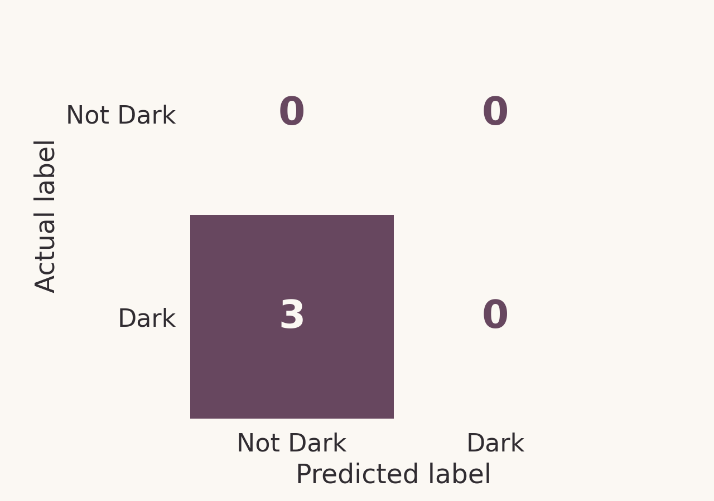
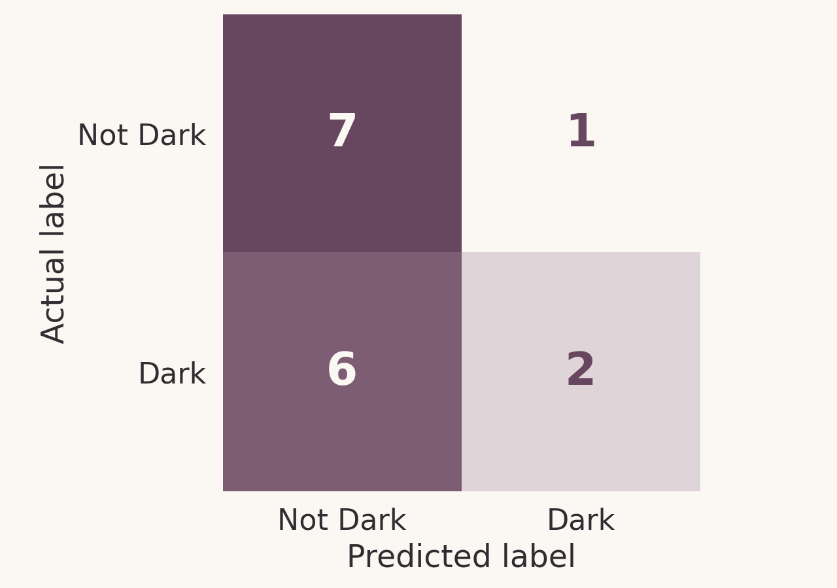
Confusion matrix: the emotion Dark
Books · 3 test items
Songs · 16 test items
3 false negatives = 3 Dark books missed.
6 false negatives = 6 Dark songs missed.
Rows = actual labels · columns = predicted labels · numbers = test examples
13
Notes:
TIME: 45 seconds
These are confusion matrices for one emotion, Dark. Rows are the actual target and columns are the prediction. For books, all three held-out books had a strong Dark rating, but the model predicted not Dark for all three. That gives three false negatives: three missed Dark labels. There are no true negatives because no test book was actually not Dark. For songs, the model correctly finds two Dark songs and seven not-Dark songs. It misses six Dark songs and wrongly labels one other song as Dark. This helps us understand errors, but one mood does not summarize performance across all 25. Sources: book_dark_confusion_matrix.png and song_dark_confusion_matrix.png.

Slide 14
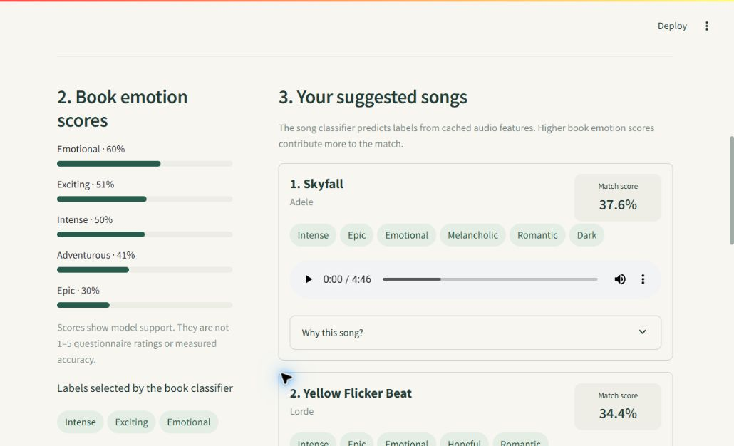
Demo: description to a song list
1 Enter a description
2 Predict book moods
3 Match song moods
4 Return a playlist
A working demonstration; playlist quality still needs listener testing.
14
Notes:
TIME: 30 seconds
In the demo, I enter a book description. The book classifier produces a score for each emotion. The song classifier predicts emotion labels from audio features. The matching rule ranks songs that cover emotions with higher book scores. I can also inspect a song prediction and play the audio. The displayed match score is a ranking score, not a measured percentage of listener satisfaction. The library contains training songs, and I have not separately tested playlist quality with listeners. If the live app is unavailable, this screenshot shows the actual interface. Source: demo_preview.jpg and demo_engine.py. Run RUN_DEMO.bat before presenting; optional live demonstration: paste a prepared description, click recommend, show one result.

Slide 15
Reflection: what I learned
Data work
A short collection period limited the amount
and variety of data I could gather.
Modeling
Turn text and audio into features; compare classifiers fairly.
Evaluation
Separate train, validation and test; explain F1, accuracy and errors.
Application
Connect predicted moods to a simple, usable song recommendation.
15
Notes:
TIME: 40 seconds
I learned that collecting enough varied data takes time. The short collection period limited the amount and variety of data I could gather. I organized my own data, checked missing values and duplicates, and used a little AI assistance to fix emotion columns and suggest some song labels. EDA helped me notice imbalance and relationships rather than assuming every label had enough examples. I learned to convert text and audio into numerical features, train multiple classifiers and keep validation separate from testing. I now understand why a perfect training score can be misleading, why accuracy and F1 tell different stories, and how a confusion matrix reveals missed labels. Finally, I connected the two pipelines in a simple working interface. These are learning outcomes, even though the predictions remain limited.

Slide 16
Reflection
The workflow runs.
Reliable matching needs better evidence.
Main difficulty
Few books, uneven moods and provisional song labels.
Next steps
Collect more varied data, review labels, retest models
and ask listeners to evaluate the playlists.
16
Notes:
TIME: 40 seconds
My main difficulty was collecting enough suitable and consistently labeled data. With just 15 books, rare emotions and provisional song annotations, reliable learning is difficult. The large training-to-testing gaps in SVM and Random Forest show overfitting; limited data likely contributed, but it is not the only possible explanation. The simple audio features also miss lyrics and musical context. Next, I would collect more diverse books and songs, ask people to review labels, and repeat the evaluation with more unseen examples. I would also ask listeners whether the playlists fit the book. My conclusion is that the workflow can run, but the current evidence is not strong enough to claim reliable emotional matching.

Slide 17
THE END
Notes:
TIME: 5 seconds
Thank you for listening. I am happy to answer questions.

