Slide 1
SOX9-dependent fibrosis drives renal function in nephronophthisis A comparison of the proteomics analysis
Team 1: Leticia, Milda and Mai

Slide 2

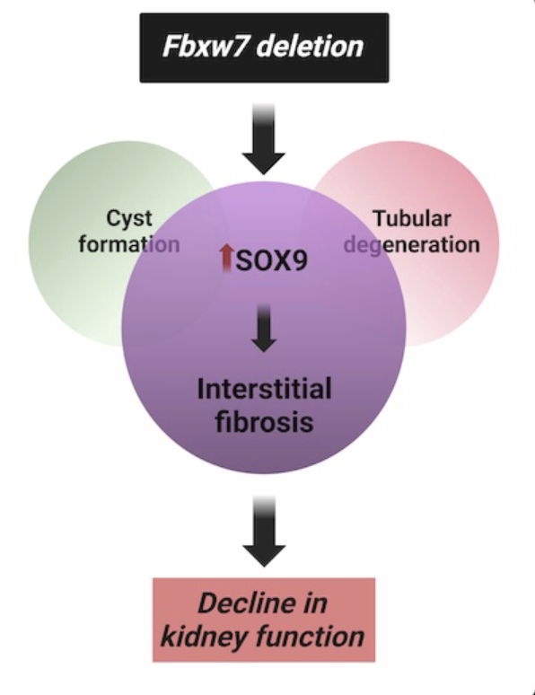
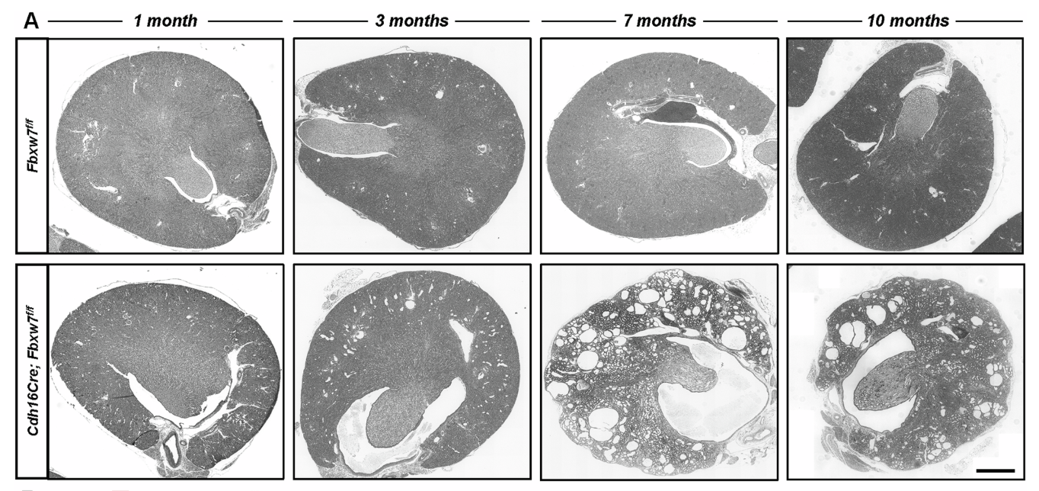
Background
What are the molecular mechanisms underlying renal fibrosis?
Fibrosis is an important pathological feature and outcome prediction marker for many renal diseases.
Deletion of Fbxw7 in the mouse renal epithelium recapitulates nephronophthisis (NPHP) pathology (A)
Fbxw7 KO induces the Sox9-Wnt axis, which appears as an important driver of fibrosis.

Slide 3
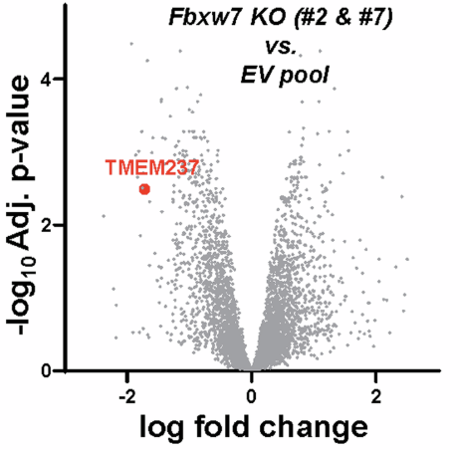
Background
Proteomics analysis:
Cas9-mediated Fbxw7 deletion in mIMCD3 cells
2 clones:
Fbxw7-KO #2
Fbxw7-KO #7
Controls:
Parental cell lines
EV controls

Slide 4
Technical details
Dataset: PXD061542
Organism/Model: For the proteomics analysis, Fbxw7 KO IMCD-3 cell lines (mouse).
Technology: Orbitrap Exploris 480 mass spectrometry
Source: PRIDE repository (ProteomeXchange Consortium)
Experiment Type: Data-independent Acquisition (DIA)

Slide 5
Data acquisition and PSM creation and pre-processing
Accessed via R package: rpx
No .mzID files provided by authors
mzML files containing raw data → encyclopeDIA
EncyclopeDIA:
Generate chromatogram library,
PSM files and integrated quantification
Used the outputs of EncyclopeDIA for downstream analysis
(.features.txt files to create PSM object)
Mus musculus reference FASTA file
Prosit-generated library as scaffold

Slide 6
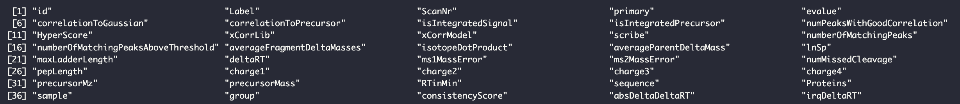
Data acquisition and PSM creation and pre-processing
.features.txt files column names
HyperScore as Score to consider best fit
Manually adding rank by grouping per spectrum and based on HyperScore
Filtered for rank == 1
No multi-matching spectrum
No FDR correction because the peptide / protein identification in EncyclopeDIA already FDR < 0.01

Slide 7
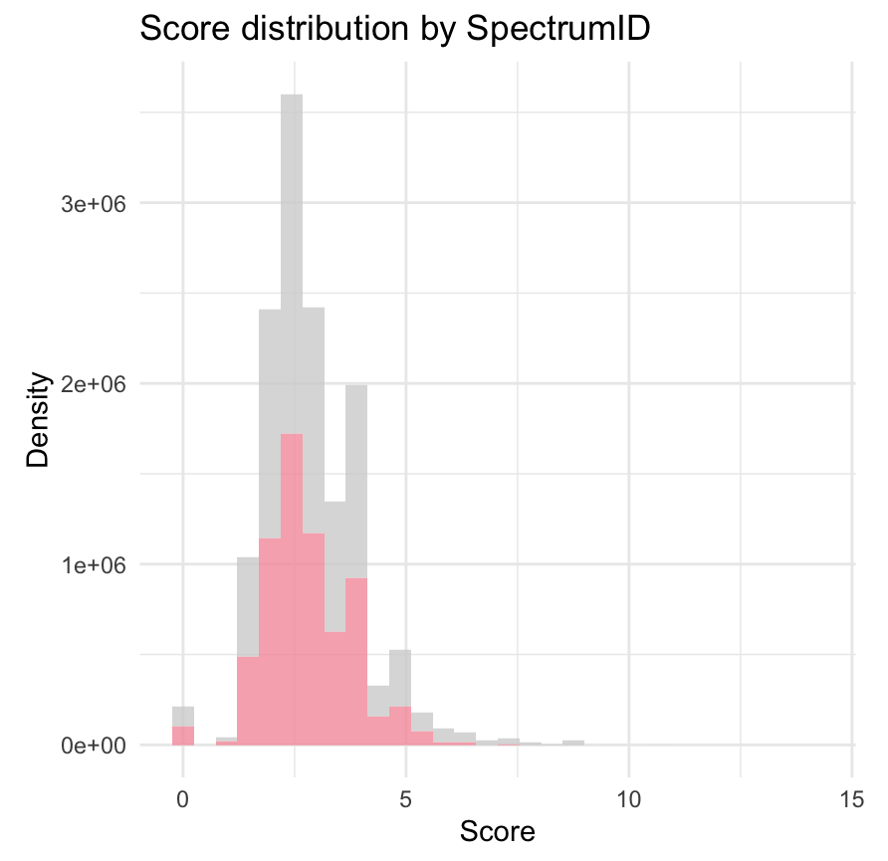
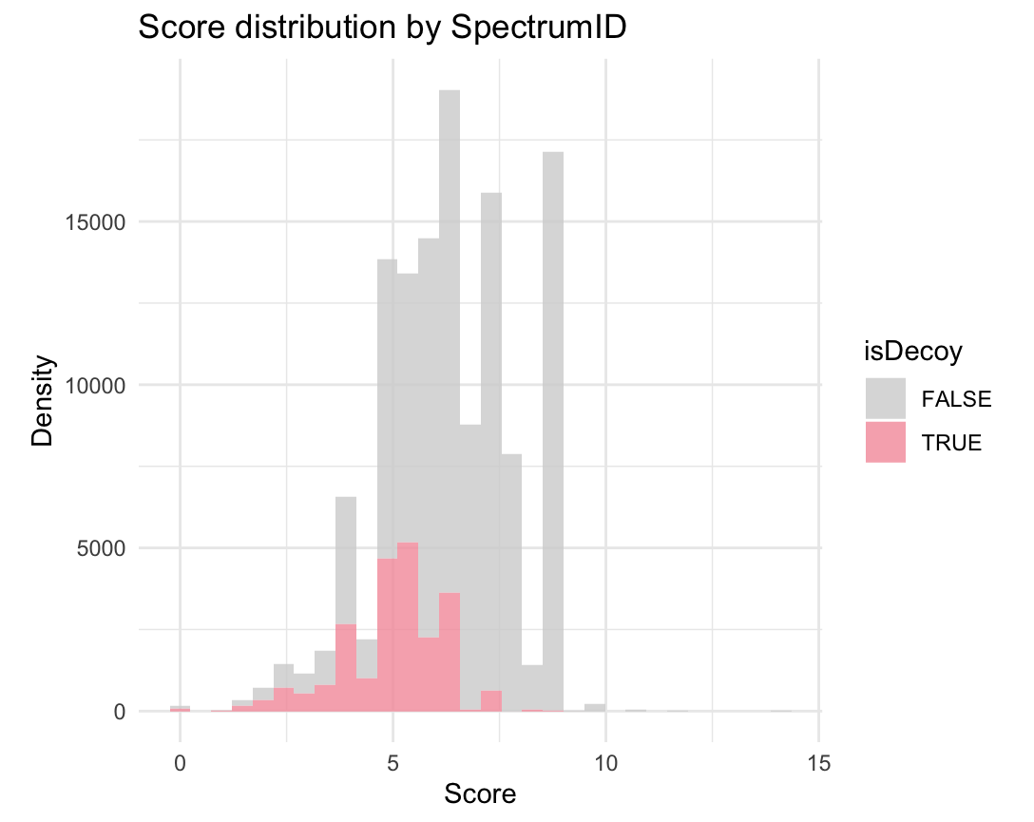
Score distribution before and after rank filtering
→ Before
After

Slide 8
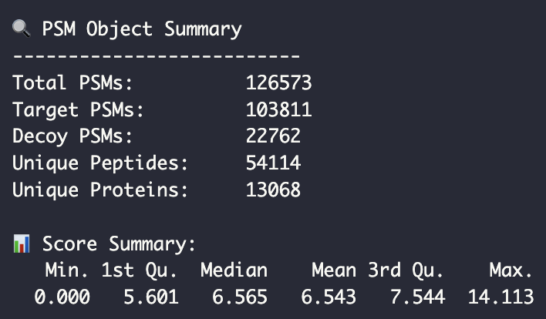
PSM object summary

Slide 9
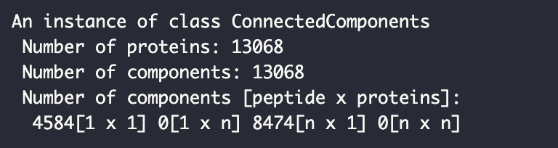
Razor peptides and protein groups
8464 proteins identified by multiple peptides
No single peptide shared by multiple proteins → no “razor” peptides

Slide 11
Differential expression analysis

Slide 12
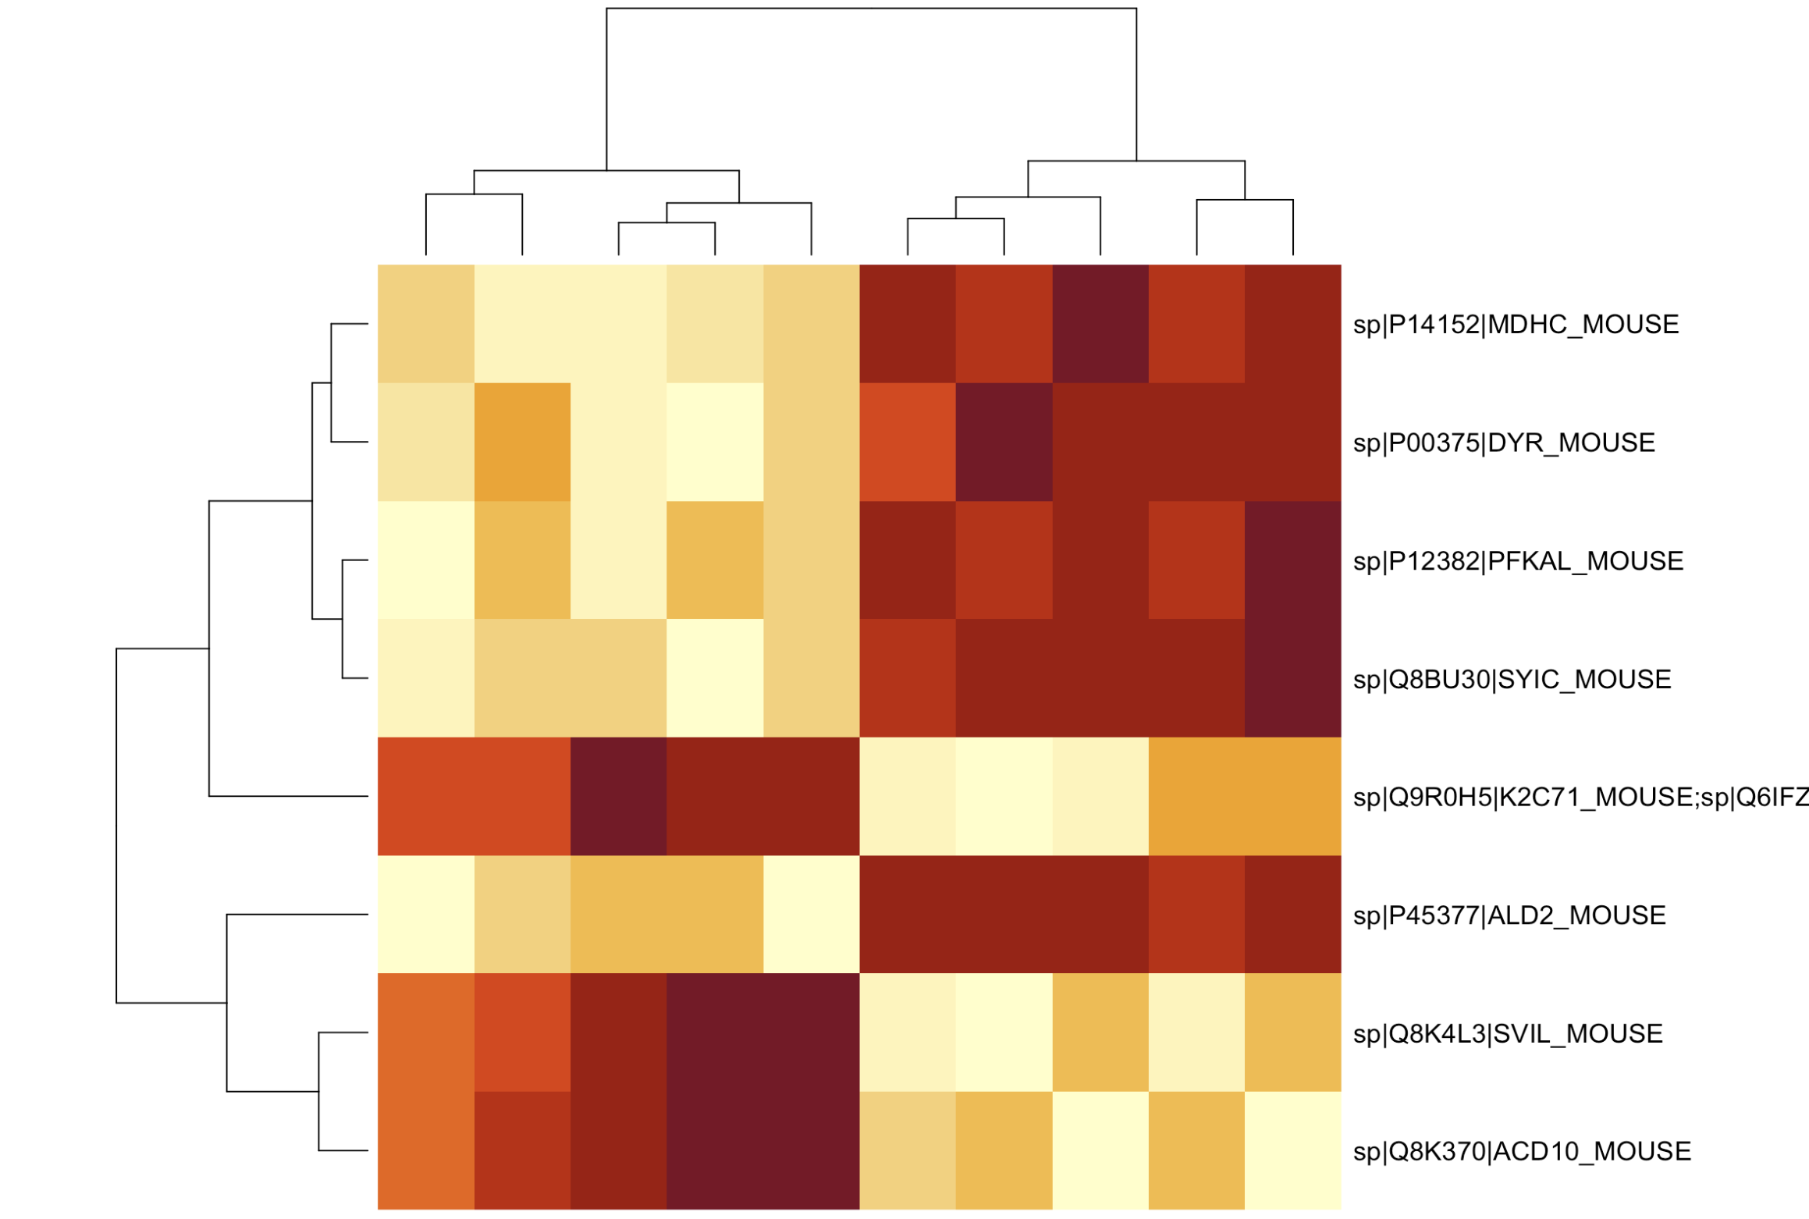
Differential expression analysis

