Slide 1
Data-parallelism for plant disease detection
Tijana Atanasovska - 196014

Slide 2
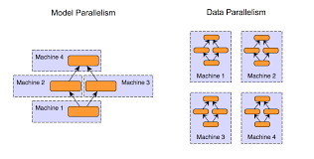
Decentralization in ML ?
Types of parallelization
DATA ← PARALLELISM → MODEL
Alex Krizhevsky → combination of both ?
Distributed Machine Learning

Slide 3


GOAL
Implement data-parallelism approach for plant disease classification model and compare performances
One CPU core
Two CPU cores
GPU

Slide 4

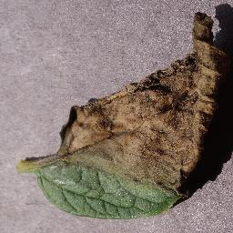
Intertwined sciences ?
Plant disease dataset
Plant images of 14 species, 38 diseases → 20.639 images ;
Preprocessing - 128px ;
Train test division → 80% - 20% ;
Random selection of images to increase robustness ;
Organized folders by bread ;
https://github.com/spMohanty/PlantVillage-Dataset/tree/master/raw/color

Slide 5
Job splitting …
MPI (Message Passing Interface) Standardized and portable message passing standard for parallel computer architectures
Mpi4Py Python version
Number of training epochs: 25
Steps per epoch: 32
Batch size: 32

Slide 6
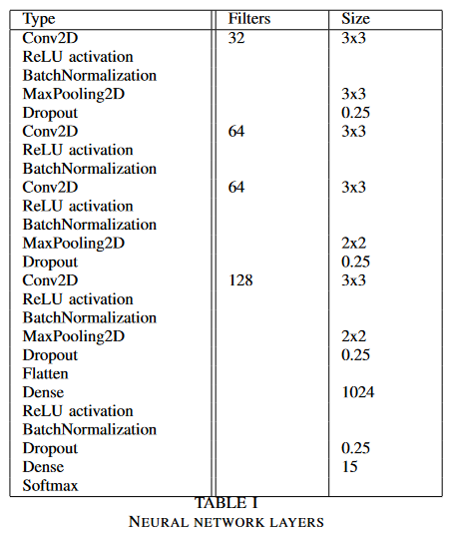
Meet the architecture.
Frameworks used: TensorFlow + Keras

Slide 7
System specification of the hardware
It has 4 cores (8 threads)
Installed physical memory (RAM) → 16GB
GPU → NVIDIA GeForce RTX 3050Ti
CPU Intel Core i7-11370H, 11th gen
4 Cores 8 threads
GPU
NVIDIA GeForce RTX 3050Ti

Slide 8
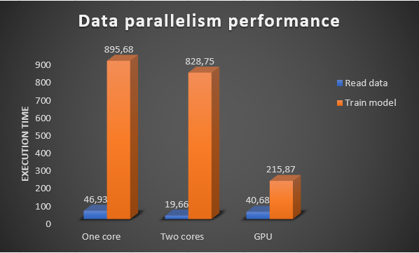
DATA LOADING
One core → 46.93s
Two cores → 19,66s
GPU → 40.68s
Google COLAB ?
As Colab is very popular platform for neural network training, we tried the same process using it.
Results: 1m 32s
*GPU has to pass data from RAM to GRAM in a ‘costly’ manner

Slide 9
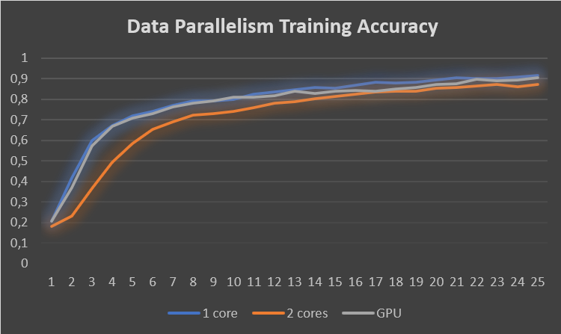
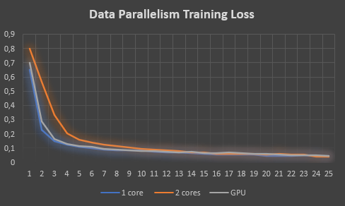
Training process
It has 4 cores (8 threads)
Installed physical memory (RAM) → 16GB
GPU → NVIDIA GeForce RTX 3050Ti
One Core 895,68s
Two Cores Equals → One core - 66,87 s
GPU
Equals → 3 times faster than two cores
TEST ACCURACY:
One core - 55%, two cores - 54,9% and GPU - 52,6%

Slide 10

Just the inception …
THANK YOU
for your attention!
Future work
Many GPUs?
Different environment parameters ?
Separated training and averaging the results at the end of the process
?

