Slide 1
Seriously Delinquent
April, Endalkachew, Matt, Ryan
March 23, 2021
Notes:
Matt

Slide 2
Motivation
Financial institutions receive an overwhelming amount of credit card and loan applications. Going through each request manually is time consuming and prone to human error. With Machine Learning, we can build a model that can aid decision making for lenders and borrowers to predict potential future financial delinquency.
Notes:
Matt

Slide 3
Objective
Build a ML model that can predict whether borrowers will experience financial distress in the next two years
Financial distress: experience >90 days past due delinquency
Build a robo adviser

Slide 4
Data Dictionary
Variable Name | Description
SeriousDlqin2yrs (target) | Person experienced 90 days past due delinquency or worse
RevolvingUtilizationOfUnsecuredLines | Total balance on credit cards and personal lines of credit except real estate and no installment debt like car loans divided by the sum of credit limits
age | Age of borrower in years
NumberOfTime30-59DaysPastDueNotWorse | Number of times borrower has been 30-59 days past due but no worse in the last 2 years
DebtRatio | Monthly debt payments, alimony, living costs divided by monthly gross income
MonthlyIncome | Monthly income
NumberOfOpenCreditLinesAndLoans | Number of Open loans (installment like car loan or mortgage) and Lines of credit (e.g. credit cards)
NumberOfTimes90DaysLate | Number of times borrower has been 90 days or more past due
NumberRealEstateLoansOrLines | Number of mortgage and real estate loans including home equity lines of credit
NumberOfDependents | Number of dependents in family excluding themselves (spouse, children etc.)

Slide 5
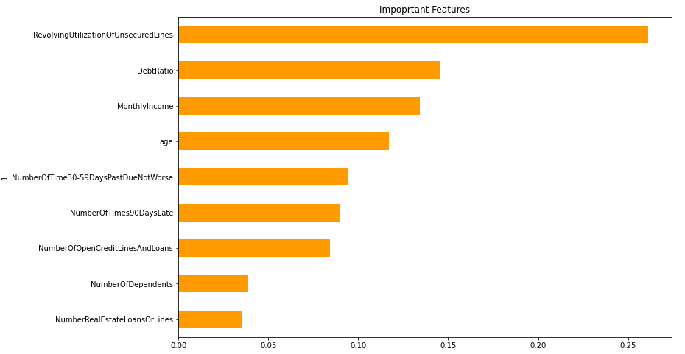
Important Features via RandomForestClassifier

Slide 6

Bot Demo
Notes:
For the sake of the presentation, do we want to take screen shots?
Cheat and create a credit score function and assign risks (eg. . High, Medium, Low risk )
Ryan

Slide 7
ML Model Evaluation
Sklearn libraries
Data preparation:
Imputed the data (for NA, NAN, NULL values)
Imbalanced data - synthesized the minority class data using SMOTE technique and adaptive synthetic sampling technique on the training data
Removed the highly correlated columns
Parameter tuning:
Applied Grid search cross validation technique to search for model selection and parameter tuning
Notes:
Desta’s Top 3 plus XGBoost?

Slide 8
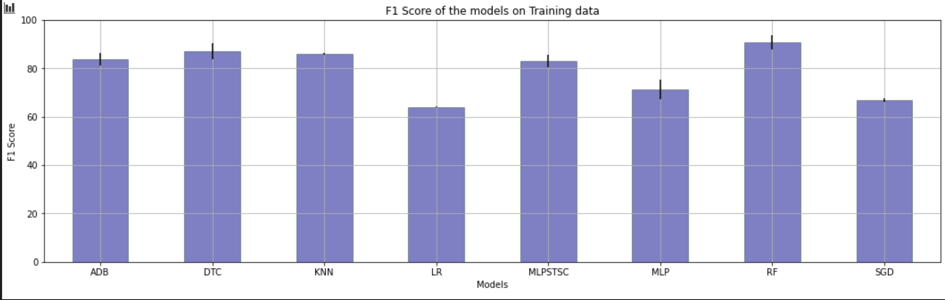
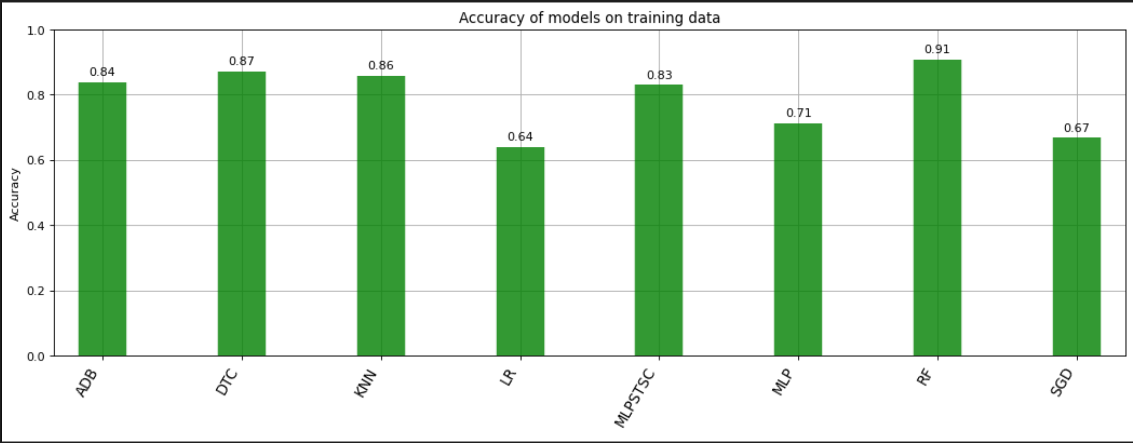
Summary

Slide 9
Summary ...
Based on the grid search result, selected models with f1 and accuracy scores > 80 (Random forest, Decision tree, AdaBoost, KNN, Multilayer perception and XGBoost models)
Tested selected models and evaluated models based on classification report - Weighted f1 avg >= 85 (Random forest, Decision tree, AdaBoost, Multilayer perception and XGBoost models)
Applied ensemble classifiers (stacking, Voting soft and voting hard)
Run the ensemble models and found Weighted f1 avg of 91 and accuracy of 90.45 using the Voting Hard ensemble classifier
Selected Voting Hard classifier as the final model.

Slide 10
Postmortem
Better data set that contain additional features:
Credit score, prior default, education level, years employed, race and ethnicity, zip code etc.
Polish bot design and execution
Get Lambda Running
Get API connected
Difference between Binary outcome vs probability
Notes:
Ryan

Slide 11
Q & A

