Slide 1
PingRoom
Real time chat for project groups
Database Systems final implementation
Tijil Sharma · 20 October 2026
01 PINGROOM
Notes:
Opening: PingRoom is a self-hosted MERN chat application for project groups. Explain the working product, then the database choices. Author: Tijil Sharma. Final class demonstration: 20 October 2026. Source: README.md and reviewed implementation.

Slide 2
A shared space for project conversations
Small teams need a place to keep the conversation going.
Find people and start a direct chat.
Keep group discussions and their history together.
Return later without losing the conversation.
A local web app with a database you can inspect and explain.
02 PINGROOM
Notes:
Problem framing comes from the supplied Review 1 PDF. These are product goals, not market research or measured customer claims. The classroom implementation focuses on project groups and self-hosted use.

Slide 3
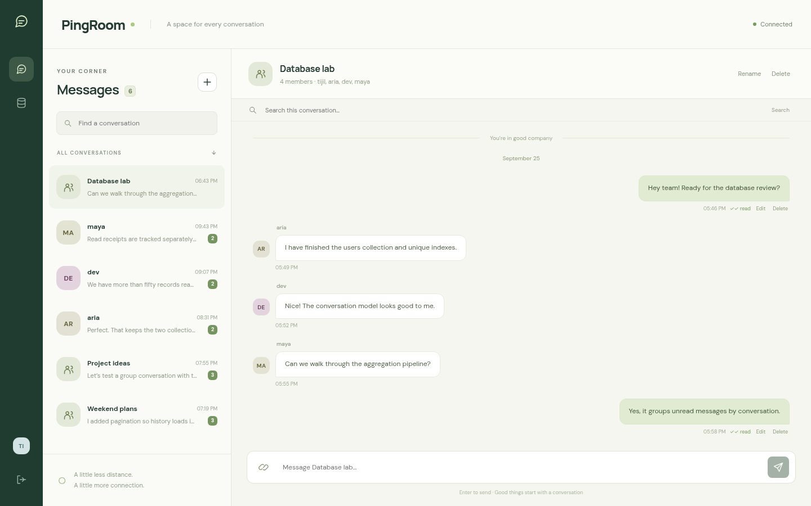
The working product
03 PINGROOM
Notes:
Live screenshot captured on 19 October 2026 from the running React application. Source: docs/screenshots/chat.png. Point out the conversation list, members, message history, actions, search and composer.

Slide 4
One flow for direct and group chat
01
Connect
Search users or create a named group.
02
Talk
Send text and share an image or file link.
03
Follow up
See presence, typing and per-recipient receipts.
04
Return
Search history, edit a message or load an older page.
04 PINGROOM
Notes:
Demonstrate these actions live. Groups require a title and at least three participants. Attachments are HTTP(S) links, not uploaded binaries. Sources: client/src/main.jsx, server/app.js.

Slide 5
MERN in one local application
React
Conversation UI, request state and live event listeners
Express + Node
JWT validation, authorization and transactional API writes
Socket.IO
Committed message events, typing and connection presence
MongoDB
Users, conversations, message history and query indexes
05 PINGROOM
Notes:
React is already implemented, so Next.js is unnecessary for this client-heavy chat. The production server serves the built Vite assets, REST endpoints and Socket.IO on one port. MongoDB is a Docker single-member replica set. Sources: server/index.js, vite.config.js, compose.yaml.

Slide 6
Three collections with clear boundaries
Users
Conversations
Messages
Shared identity
Bounded membership
Growing history
Unique username and email
Hashed password
Presence and last seen
Participant ObjectIds
Direct or group type
Cached lastMessage
Conversation and sender refs
Text or attachment link
Per-user receipt arrays
Messages stay separate so a conversation document does not grow without bound.
06 PINGROOM
Notes:
Conceptual user-to-conversation membership is many-to-many, represented by a bounded participant array. Messages reference both user and conversation. References are not MongoDB-enforced foreign keys. The API handles integrity. Source: server/models.js.

Slide 7
A message and its preview commit together
Validate membership
Insert the message and update lastMessage in one transaction
Commit, then notify conversation participants
A failure before commit leaves both collections unchanged.
07 PINGROOM
Notes:
Walk through POST /api/conversations/:cid/messages. The member check, message insert and snapshot update share the session. Events publish after commit. The rollback test throws after two writes and checks that both original states survive. Sources: server/app.js, tests/api.test.js.

Slide 8
Queries shaped around the conversation
History
conversationId + createdAt + _id
Stable pages, including tied timestamps
Conversation list
participants + updatedAt
Recent chats for a member
Direct chat identity
unique directKey
One record for each pair of users
Message search
text index
Search within an authorized conversation
08 PINGROOM
Notes:
Read the actual index definitions in server/models.js. History uses a compound index and an ObjectId tie-breaker. Text search uses a separate text index. Unique directKey prevents concurrent duplicates. Explain output verifies one query, not all workload performance.

Slide 9
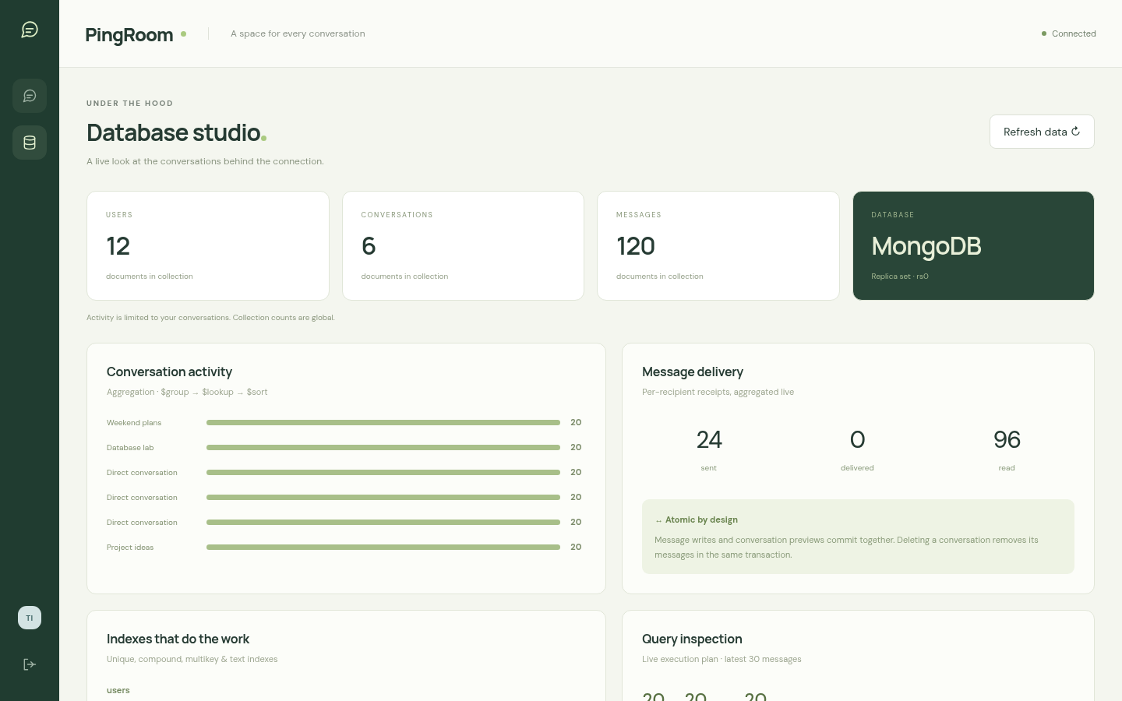
Database behavior you can inspect
09 PINGROOM
Notes:
Live Database Studio capture. Counts are global, while activity aggregation is filtered to user membership. The panel exposes indexes and explain execution statistics. Seed baseline is 12 users, 6 conversations and 120 messages. Source: docs/screenshots/database.png and server/app.js.

Slide 10
Verified in the API and in the browser
13
4
API and database tests
Browser tests
Authorization, CRUD, rollback,
index use and stable pagination
Live messaging, mobile layout,
dialogs and read visibility
Production build and source formatting checks pass.
10 PINGROOM
Notes:
Executed 19 October 2026. npm test: 13 passed, 0 failed. Browser suite: 4 passed, 0 failed with system Chrome. Build and format check passed. npm audit reports no known vulnerabilities at verification time. Sources: tests/api.test.js and tests/browser/chat.spec.js. These results do not establish load or failover performance.

Slide 11
A complete classroom scope
Delivered
Next production phase
Persistent direct and group chat
Authenticated CRUD and receipts
Search and paginated history
Inspectable database behavior
Multi-member replica set
Shared presence across servers
Load tests and operational monitoring
Managed uploads and recovery flows
No claim of measured latency, failover or end-to-end encryption.
11 PINGROOM
Notes:
Be explicit: the local replica set has one member and does not provide failover. The original 300 ms target is not benchmarked. Attachments are URL links. Socket presence assumes one Node process. Production follow-up would include HTTPS, controlled diagnostics, removal of demo accounts, backups and monitoring. Sources: compose.yaml, README.md, Review 1.

Slide 12
Ready for the live demonstration
Two browser sessions.
One shared conversation.
localhost:3100
github.com/TijilSharma/PingRoom
12 PINGROOM
Notes:
Suggested route: log in in two browser profiles, send/edit/delete a message, create a group, inspect MongoDB indexes and explain output, then show the rollback test. The code guide supports direct function questions. Run npm ci, npm run setup, npm start. Demo accounts: tijil@vitstudent.ac.in and aria@vitstudent.ac.in, synthetic password PingRoom@123. Source: docs/DEMO.md.

