Slide 1
PINGROOM
Working prototype
Review 2
Real time chat built with MongoDB, Express, React, and Node.js
Database Systems • 13 October 2026

Slide 2
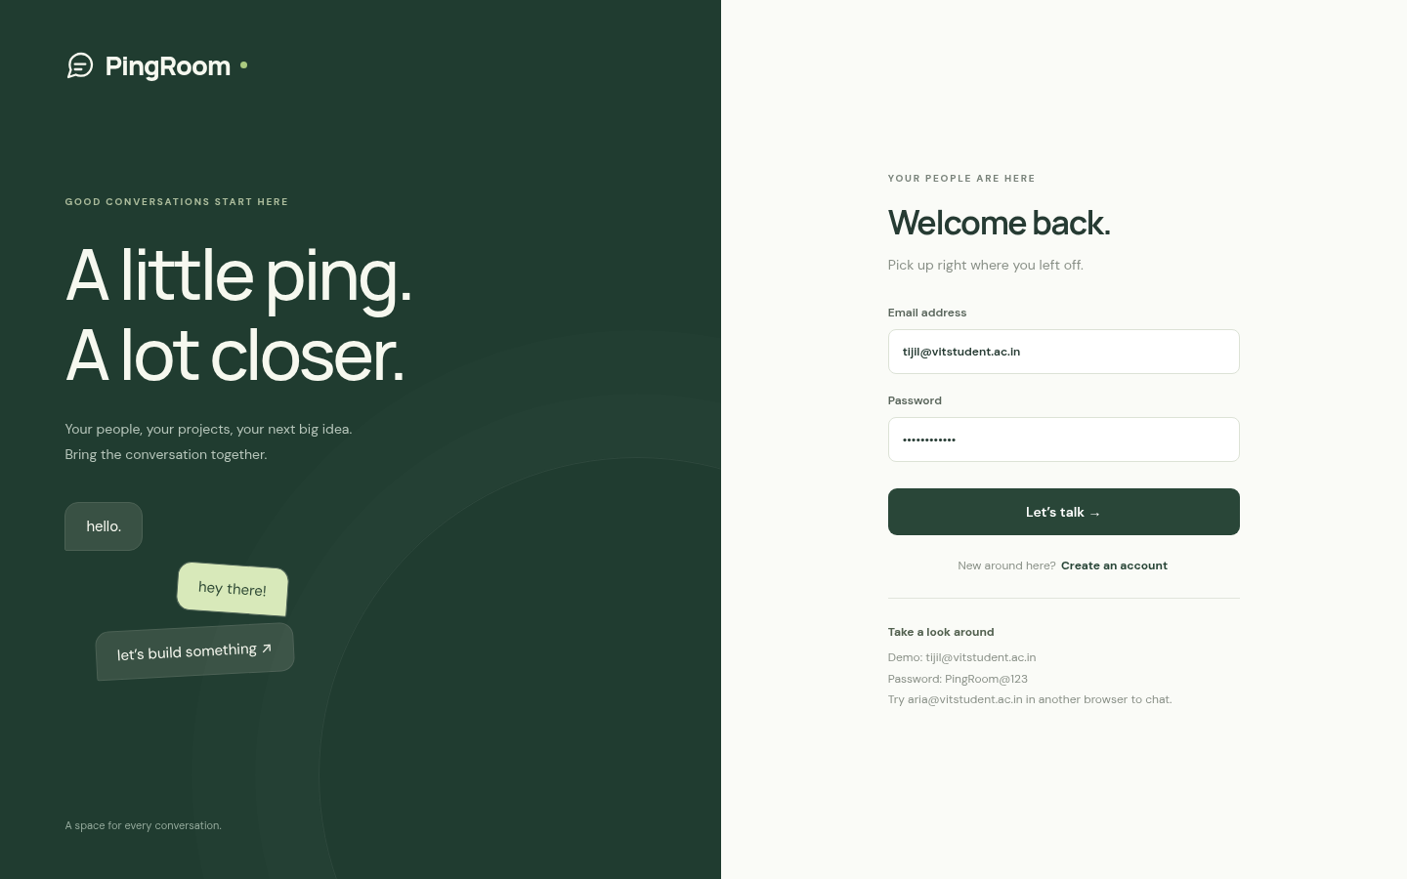
Working prototype
A usable app is ready to demonstrate.
Users can register and log in. They can start direct or group chats, send messages, search history, and see presence and read receipts.
Live app: localhost:3100
Captured from the running application

Slide 3
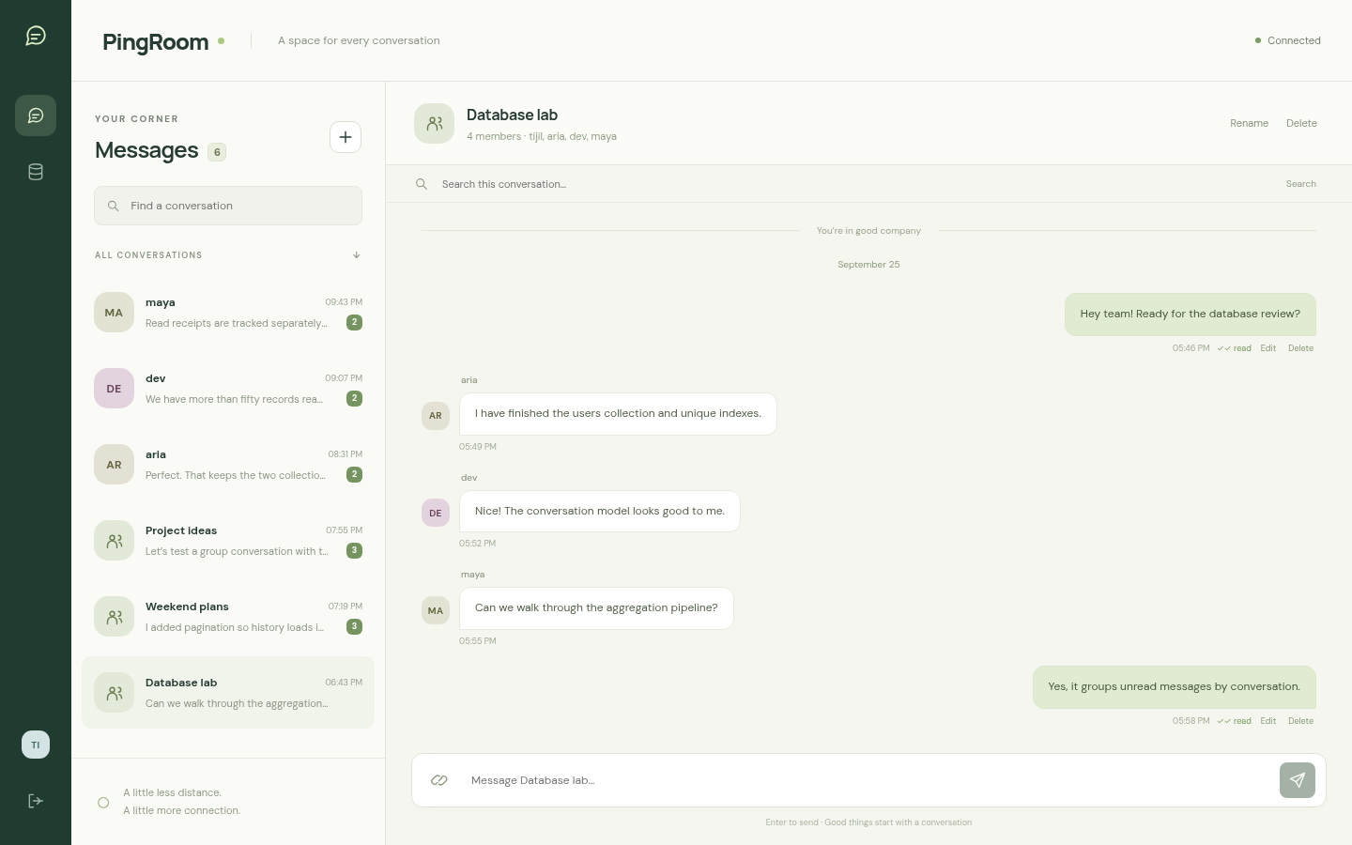
Chat interface
Direct and group chat
Send, edit, and delete messages.
Search within a conversation.
Load older messages with cursor pagination.
Watch typing and presence update live.

Slide 4
MongoDB data model
USERS
CONVERSATIONS
MESSAGES
12 records
Unique username and email
Hashed passwords
Presence and last seen
6 records
Direct or group
Participant ID array
Cached last message
120 records
Sender and conversation references
Text or attachment link
Delivery and read arrays
138 sample records in total
The sample dataset exceeds the required minimum of 50 records.

Slide 5
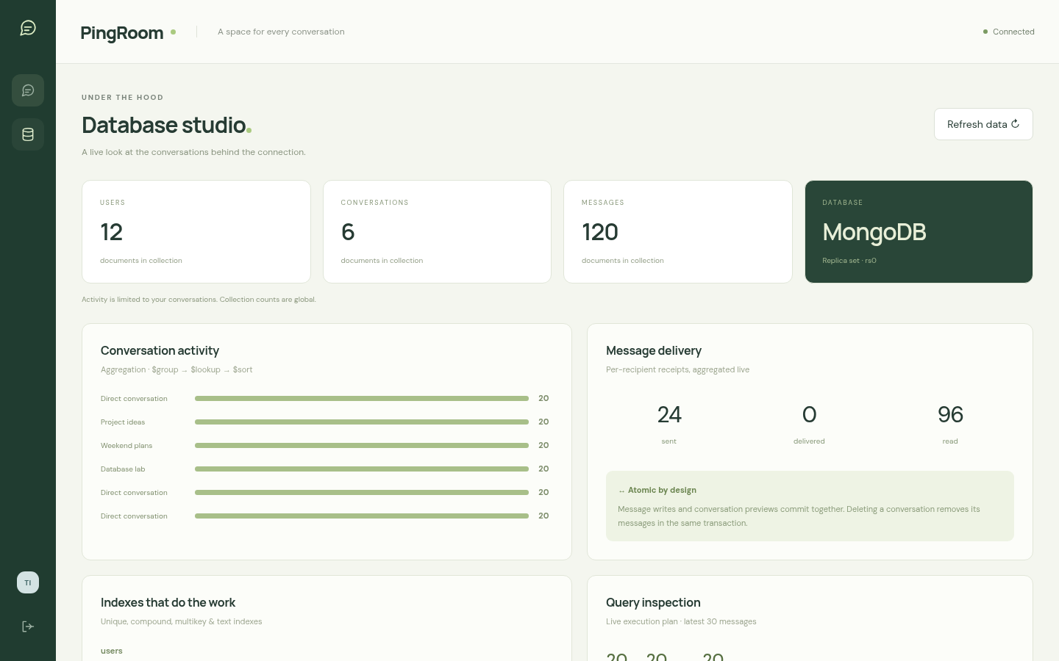
Advanced MongoDB features
Indexes
Unique user indexes, conversation list index, message history index, and text search index.
Aggregation
Unread counts, message activity, and daily volume use MongoDB pipelines.
Transactions
Message writes and conversation previews commit together.

Slide 6
Live demonstration
1
Log in and open a seeded conversation
2
Send, edit, delete, and search messages
3
Open Database Studio to show indexes and aggregation
10 integration tests passed
Demo login: tijil@vitstudent.ac.in Password: PingRoom@123

