Slide 1
Dominos -Predictive Purchase Order System
Domain-Food Industry

Slide 2
PROBLEM STATEMENT
Dominos wants to optimize the process of ordering ingredients by predicting future sales and creating a purchase order.
By accurately forecasting sales, Dominos can ensure that it has the right amount of ingredients in stock, minimizing waste and preventing stock outs.
project aims to leverage historical sales data and ingredient information to develop a predictive model and generate an efficient purchase order system for next one week.

Slide 3
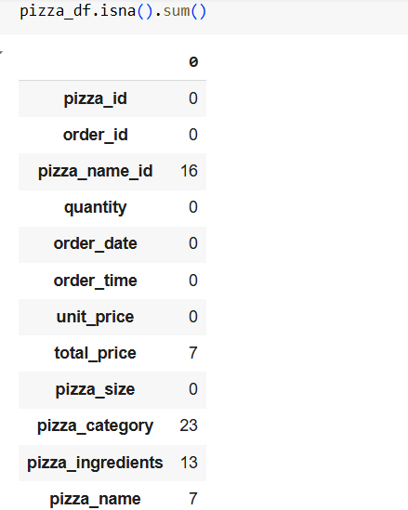
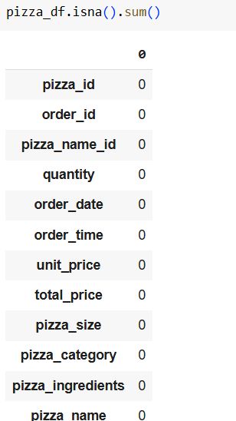
DATA CLEANING Handling missing Data: Delete all null values

Slide 4
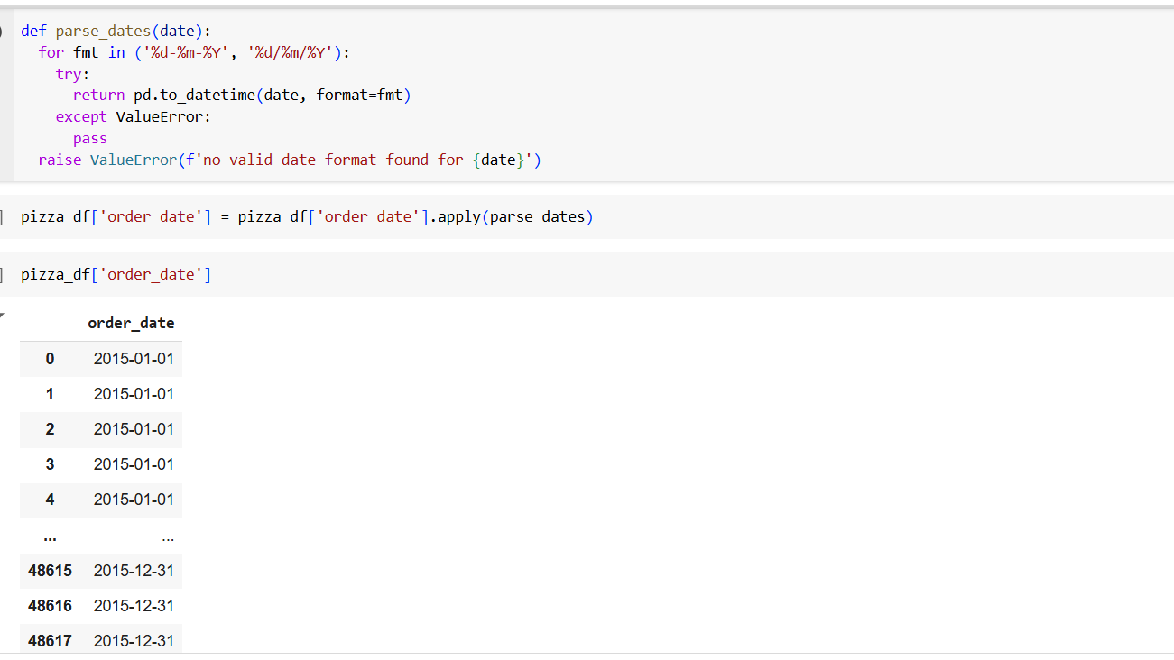
FEATURE ENGINEERING
Modify the ‘order_date’ column data type from string to the appropriate date time format.

Slide 5
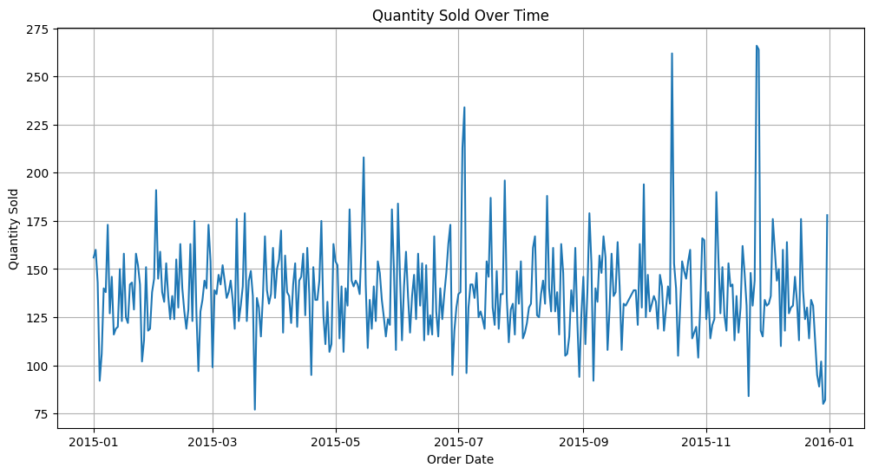
EDA

Slide 6
ARIMA MODEL
ARIMA(AutoRegressive Integrated Moving Average) model is used for forecasting and analyzing time series data.
Components:
AR(AutoRegressive): Uses past values to forecast future values.
I(Integrated: Diffs(subtracts) consecutive values to make the series stationary.
MA(Moving Average): Uses errors(residuals) from past forecasts to improve future forecasts.
Parameters:
1.p(AR terms): Number of autoregressive terms.
2.d(Integration: Number of differences required for stationarity.
3.q(MA terms): Number of moving average terms.

Slide 7
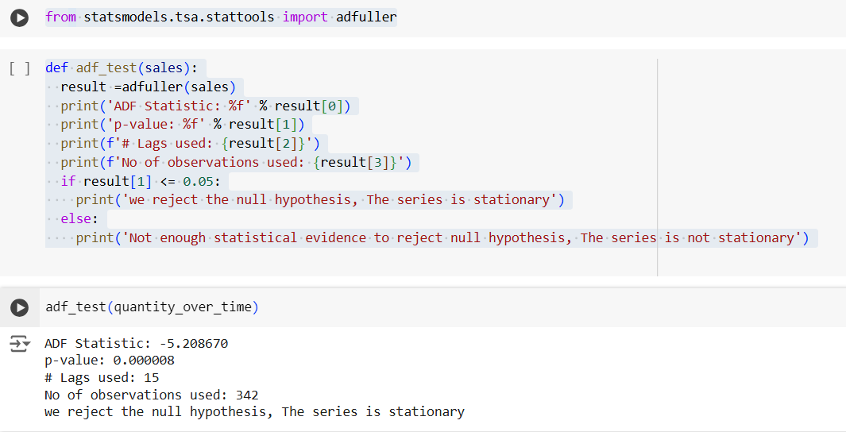
AUGMENTED DICKEY FULLER TEST-ADF TEST
ADF test is used to determine if a time series is stationary or non-stationary.
It checks the presence of a unit root in a time series, which indicates non-stationarity.

Slide 8
ACF AND PACF
Autocorrelation Function(ACF):
ACF measures the correlation between a time series and its lagged values.
It helps identify patterns, such as trends, seasonality and cycles.
Partial Autocorrelation Function(PACF):
PACF measures the correlation between a time series and its lagged values, controlling for the effects of intermediate lags.
PACF differs from ACF function which doesn’t control for other lags.

Slide 9
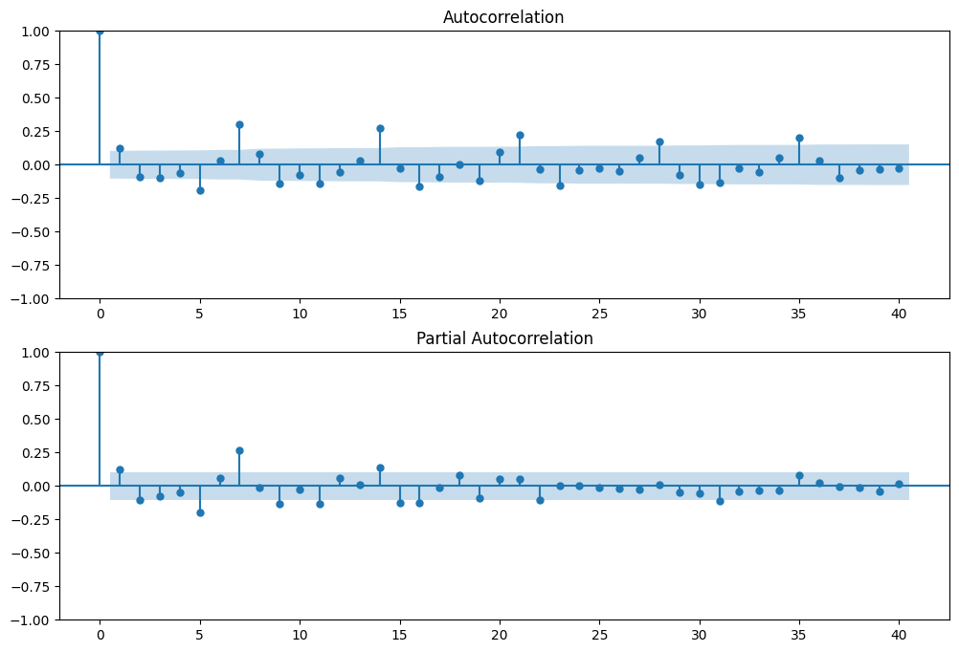
ACF AND PACF - EVALUATION

Slide 10
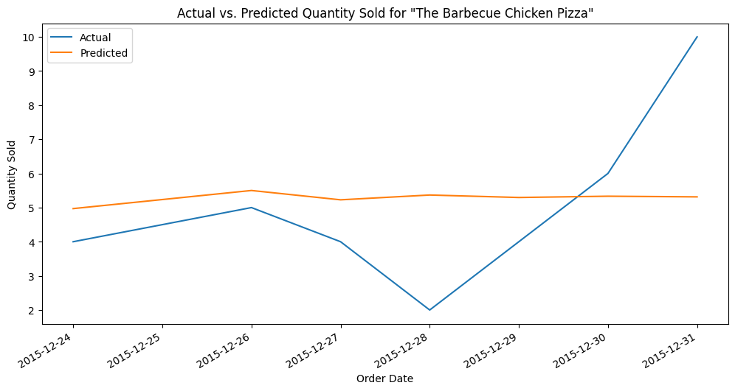
ARIMA MODEL-EVALUATION

Slide 11
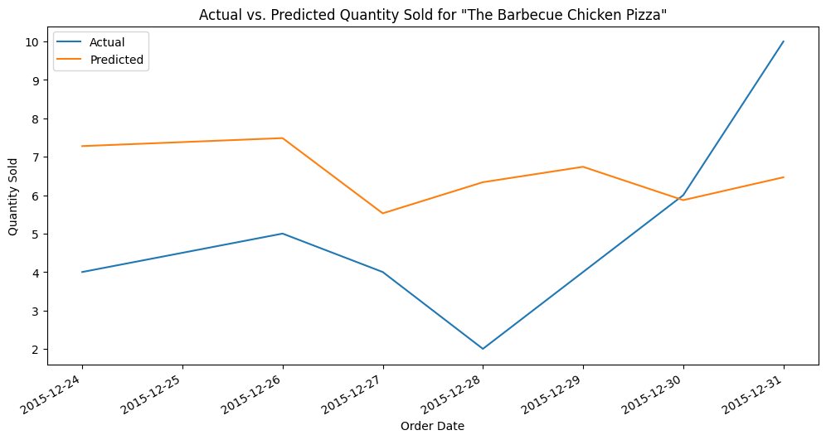
SARIMA MODEL

Slide 12
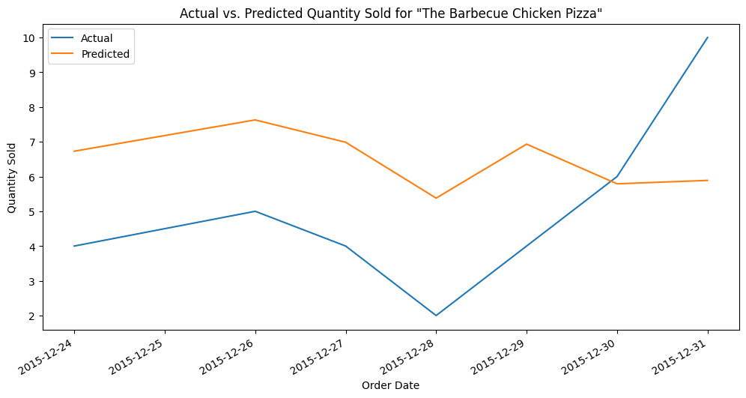
PROPHET

Slide 13
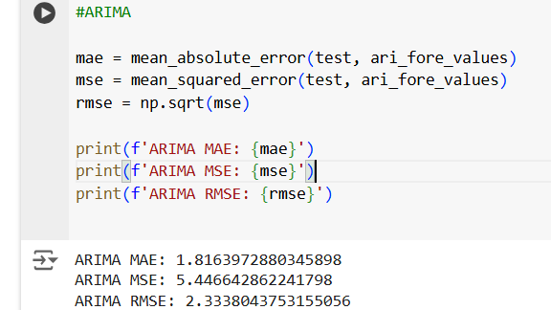
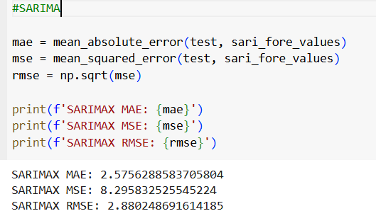
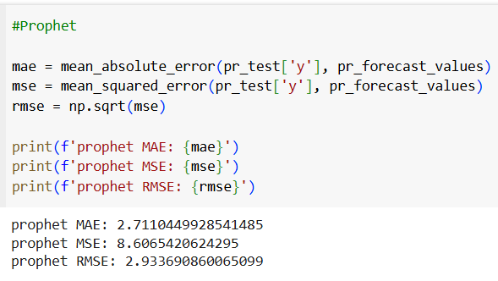
COMPARISION OF ERRORS

Slide 14
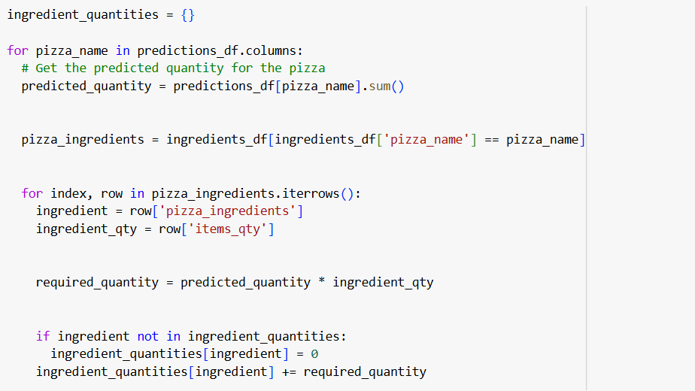
INGREDIENT CALCULATION

Slide 15
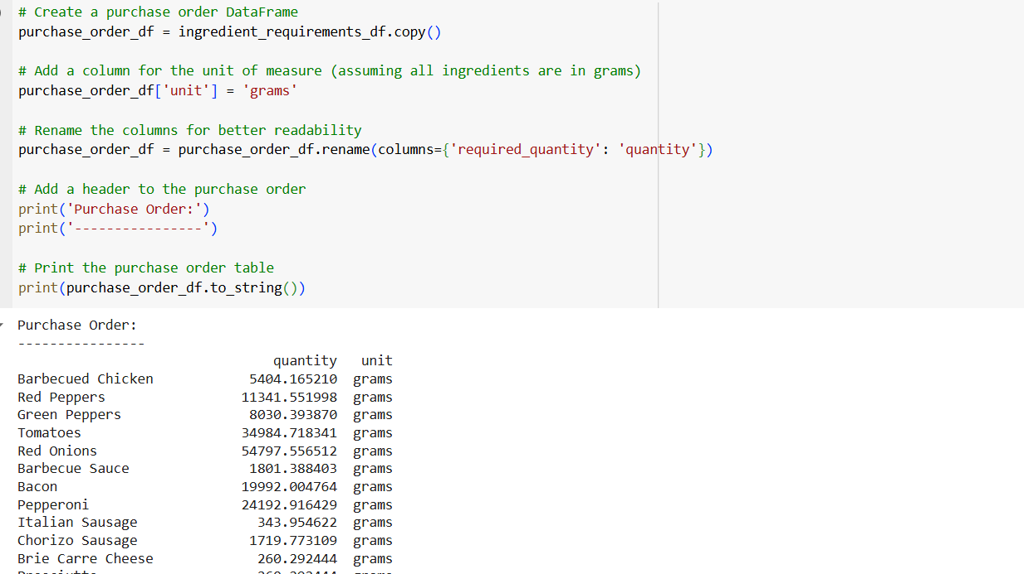
PURCHASE ORDER GENERATION

Slide 16
THANK YOU

