Slide 1
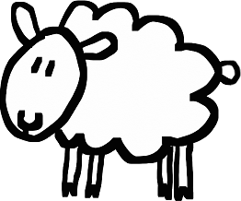
Theory of the sheep
By Plergux, the sheep person

Slide 2
Theory of the sheep:
The sheep is smooth at one end

Slide 3
Theory of the sheep:
very very fluffy in the middle

Slide 4
Theory of the sheep:
and then smooth
again at the other end.

Slide 5
Teh end

