Slide 1
ReCONSIDER: Re-Ranking using Span-Focused Cross-Attention for Open Domain Quesetion Answering
김주찬

Slide 2
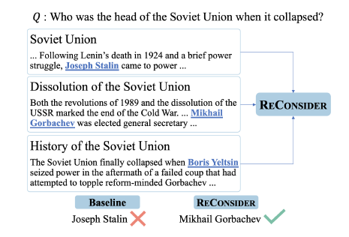
Purpose
S-O-A MRC models for Open Domain QA achieved high recall but low accuracy
So need answer re-ranking

Slide 3


Re-Ranking Model
Span focused re-ranking model R, that learn a distribution p over top-K (pj, sj) pairs 1<=j<=K, given question q
Model scores every (q, pj, sj) triplet and normalize
Notes:
E(q,sj,rj) in R^H is a dense representation of triplet
Question : q
Passage corpus : p
Passage pair: pj
Span within pj : sj

Slide 4
Re-Ranking Model(R)
Span-focused tuple encoding
Compute E using representation of [CLS] token of a BERT model applied to span-focused encoding
1. Marking the tokens of sj with special start/end symbol [A]/[/A],
2. Followed by concatenating [CLS] and question token using [SEP]
Training
Obtain top K predictions (pj, sj) of model M for each question qi in training set
Divide into pos if sj is definitive groundtruth, else neg
Train R using mini-batch gradient descent
For each iter, for q, include 1 random pos and m-1 random neg
Maximize likelihood of pos

Slide 5
Baseline Model(M)
Used S-O-A model of Karpukhin et al. (2020)
Dense passage retriever
Use Passage encoder fp, question encoder fq to represent all passages and question as densee vector in same space
Retrieves top 100 passage similar to q base on their inner product
Span extractive BERT reader
Input: question q + pos & neg passages pj from retriever (q, pj)
Tuples encoded as q[SEP]pj, without spans being marked
Distribution over passage ps computed
Start-span prob and end-span prob computed for every token in encoded tuples
Trained to maximize likelihood of ps*ssp*esp for each correct answer span
Output top-K scoring passage-span pairs

Slide 6
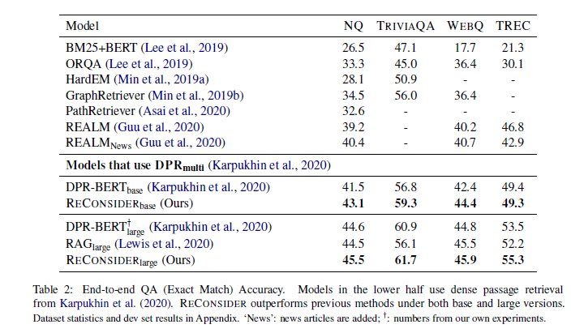
Experiment
Our model showed improved performance
How this model obtained improvement
Training using hard false-positive style negatives
Answer-span annotation
K=5 showed best performance

