Slide 1
A Computational Model of the Islets of Langerhans
UF Department of CISE
Summa Cum Laude
Tikahari Khanal
07/31/2020

Slide 2
Goals
Clarify details glossed over by the paper
Show components of the project that were not mentioned in the paper
Demonstrate deliverables/show working product
Ensure everybody is on the same page regarding the project

Slide 3
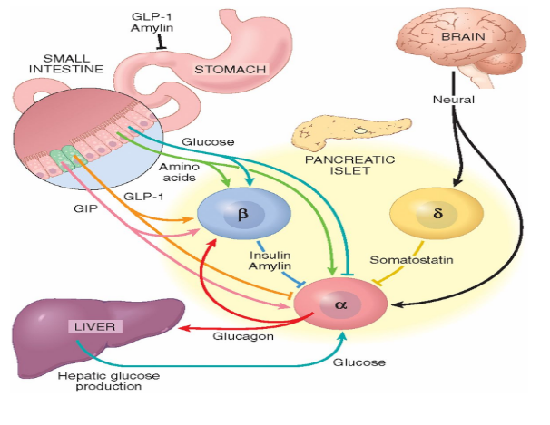
Significance
The pancreas plays an important role in an intricate system with a low tolerance for deviance
  Glucose regulation, digestion, feedback regulation and more
Can be modeled:
  Superphysiological data collection
  Treatment efficacy
  Depth of understanding

Slide 4
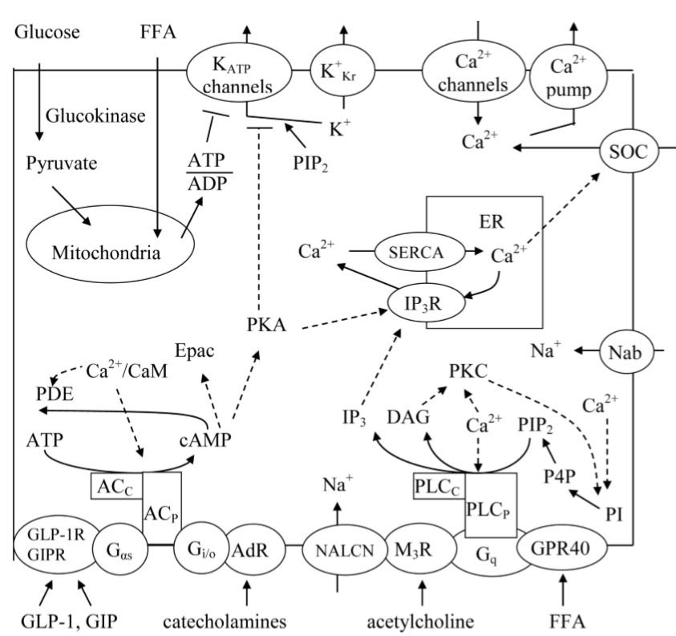
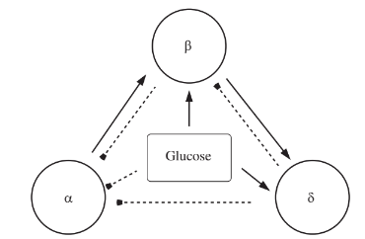
Overview

Slide 5
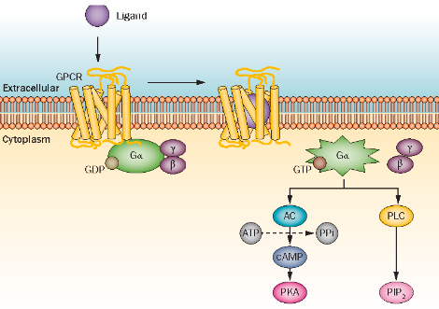
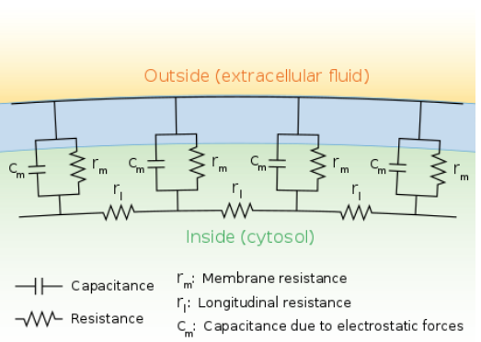
Overview
E + S ↔ ES → P + E
dV/dt = (1/C_{m})(I_{inj}-g_{x}(V_{m}-V_{x})-g_{y}(V_{m}-V_{y})...)

Slide 6
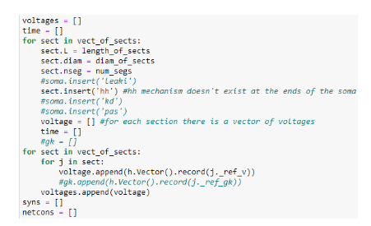
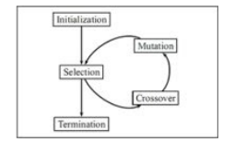
Implementation
Neuron Framework
  Python frontend, C++ backend
  Classes for cells, mechanisms, connections
  Differential equation solver
Previous Models
  Fridlyand, Watts and Sherman
  ChannelPedia
Abstraction/Evolutionary Algorithm
* HPC environment

Slide 7
Abstraction
Input/Output
  Initialization file, serialize output
Parallel processing
  Work around slurm: persistent storage and sandboxing
Modeling islets
  Cells → Space → Model
  Model: initialize, run, score
Extraneous
  Loss function, probabilities, helper functions

Slide 8
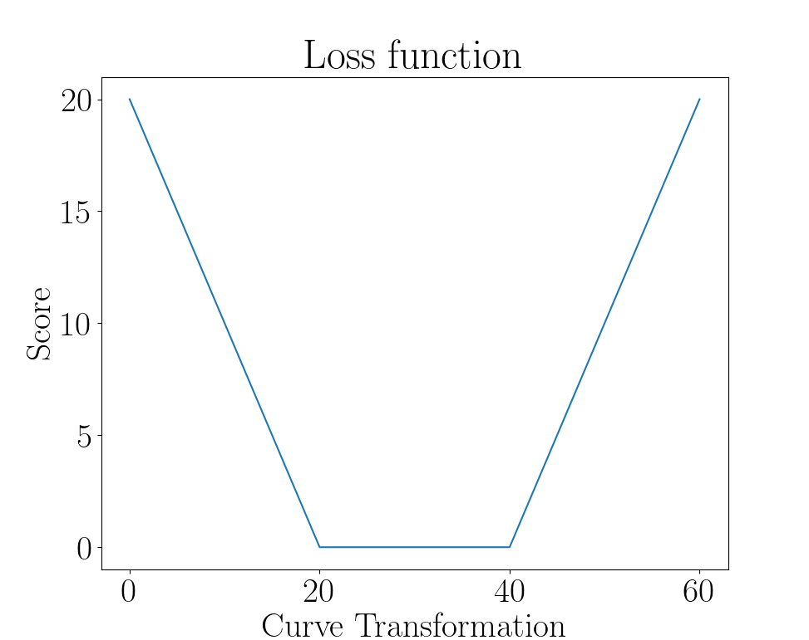
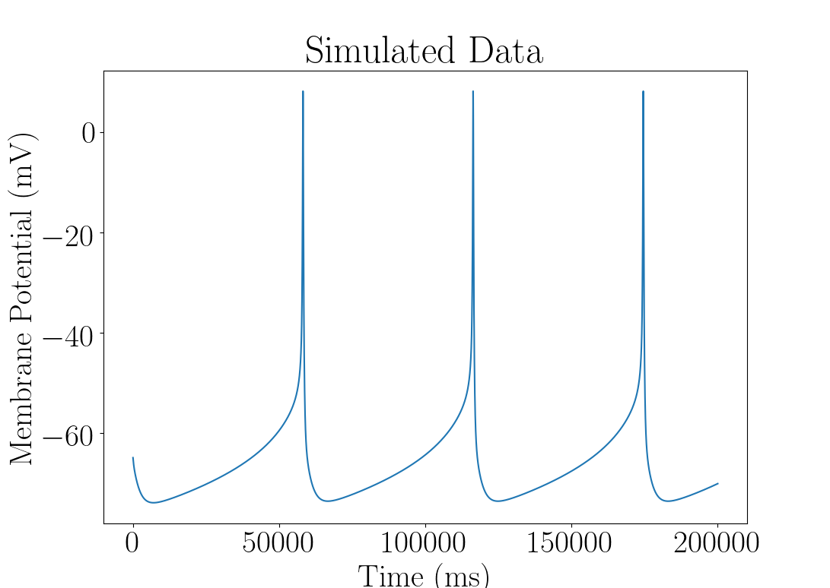
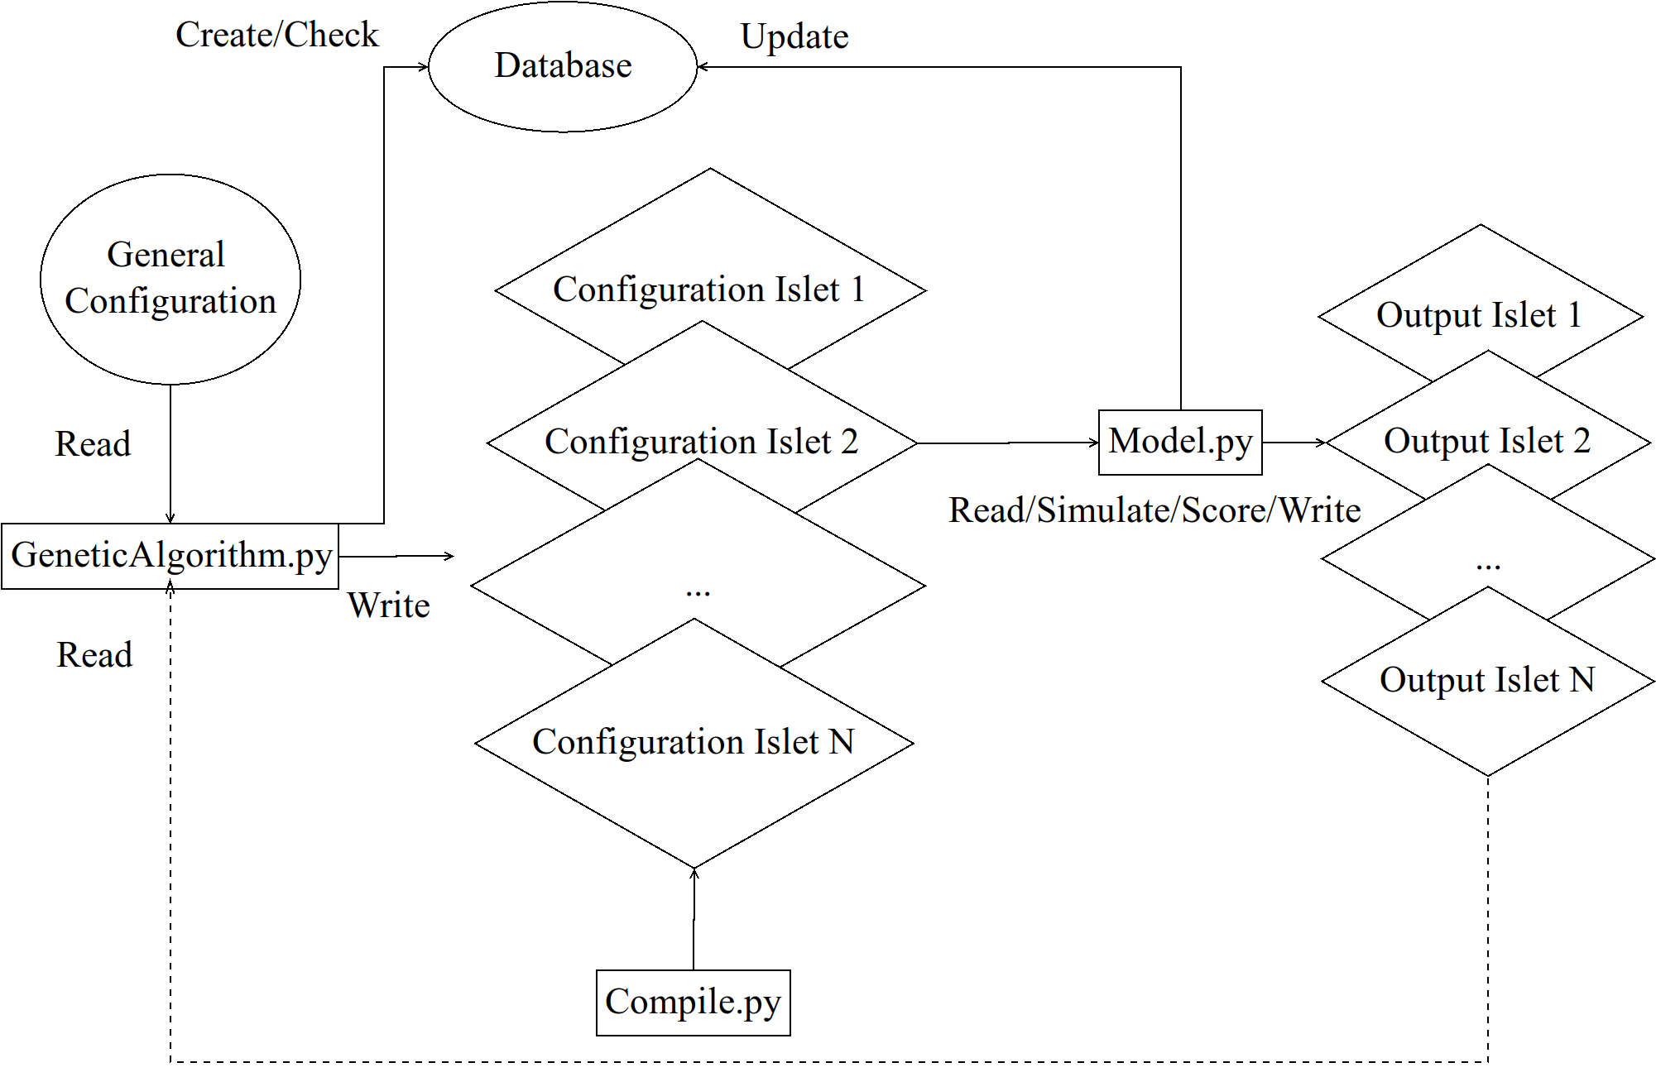
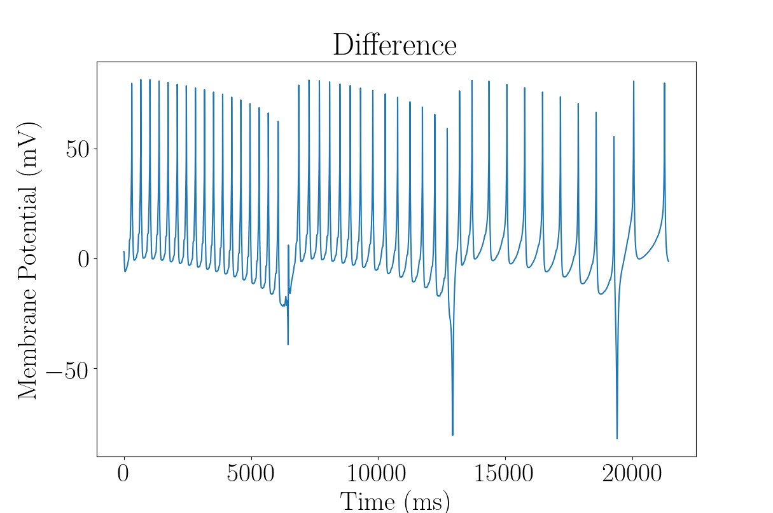
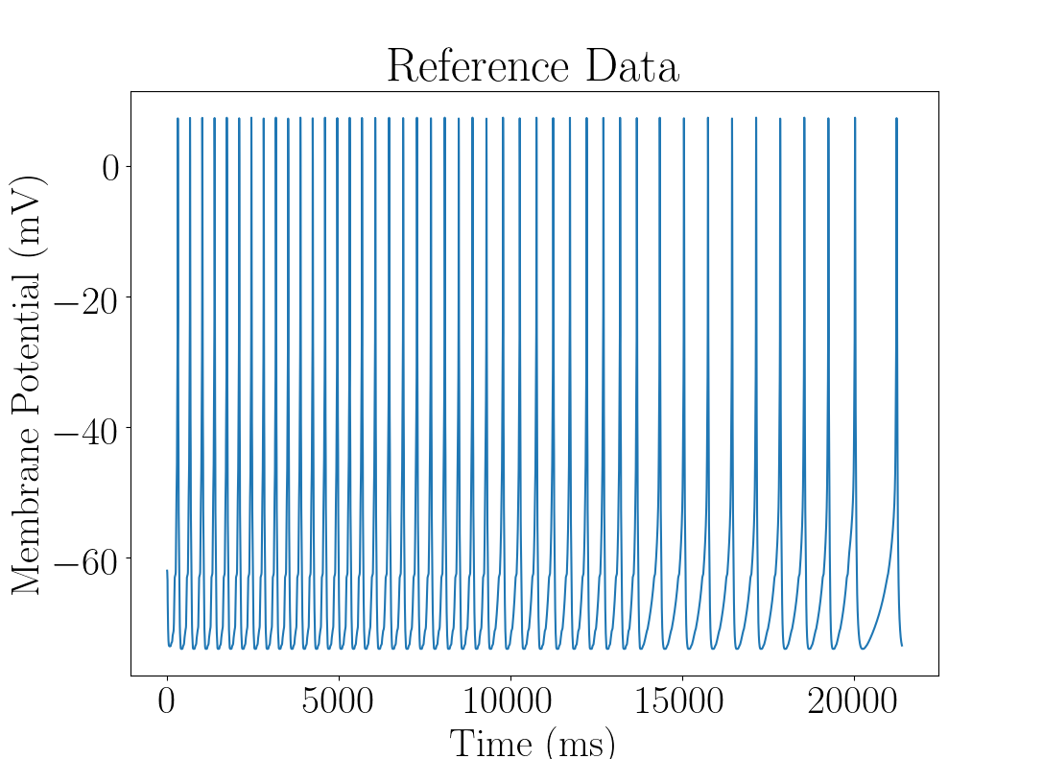
Evolutionary Algorithm
Create generation, dispatch models, score, breed, mutate

Slide 9
Honorable Mentions
Single-compartment cable model
Adjacency matrix vs reaction diffusion
Translation between frameworks
Signal processing
Tendency to overcomplicate

Slide 10
Questions
Greatest challenges
Most prideful about
Current weaknesses
Future strengths

