Slide 1

C H A P T E R 5
BJT Small-signal operation
and models
Microelectronic Circuits, Sixth Edition
Sedra/Smith
Copyright © 2010 by Oxford University Press, Inc.

Slide 2
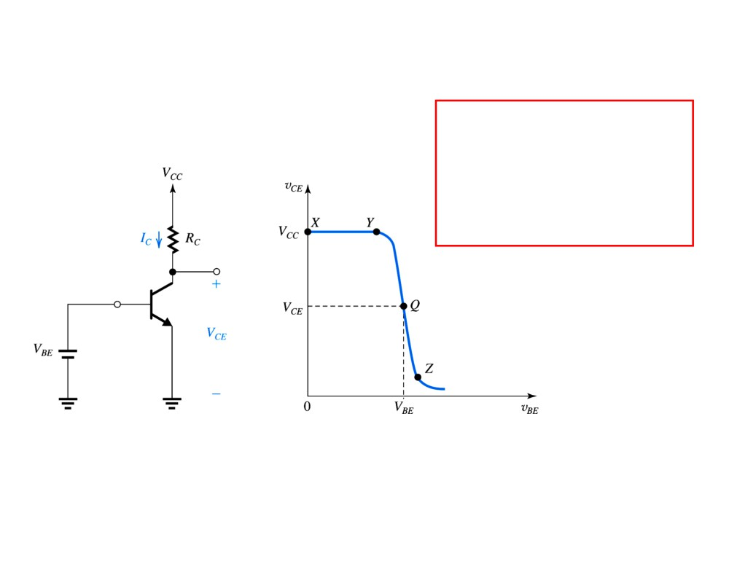
Biasing the BJT to Obtain Linear Operation
V
=V −
R
I
vBE /VT
e
CE
CC
C
S
V
I
=
I
BE /V
e
T
C
S
v
(t) =V +v (t)
BE
BE
be
Figure 6.32 Biasing the BJT amplifier at a point Q
located on the active-mode segment of the VTC.
Microelectronic Circuits, Sixth Edition Sedra/Smith
Copyright © 2010 by Oxford University Press, Inc.

Slide 3
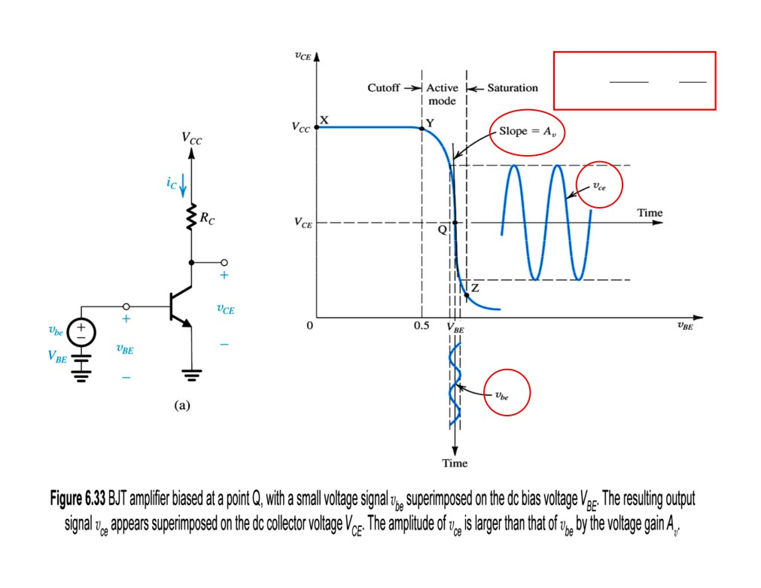
A =−
ICRC
=−
VRC
V
V
T
T

Slide 4
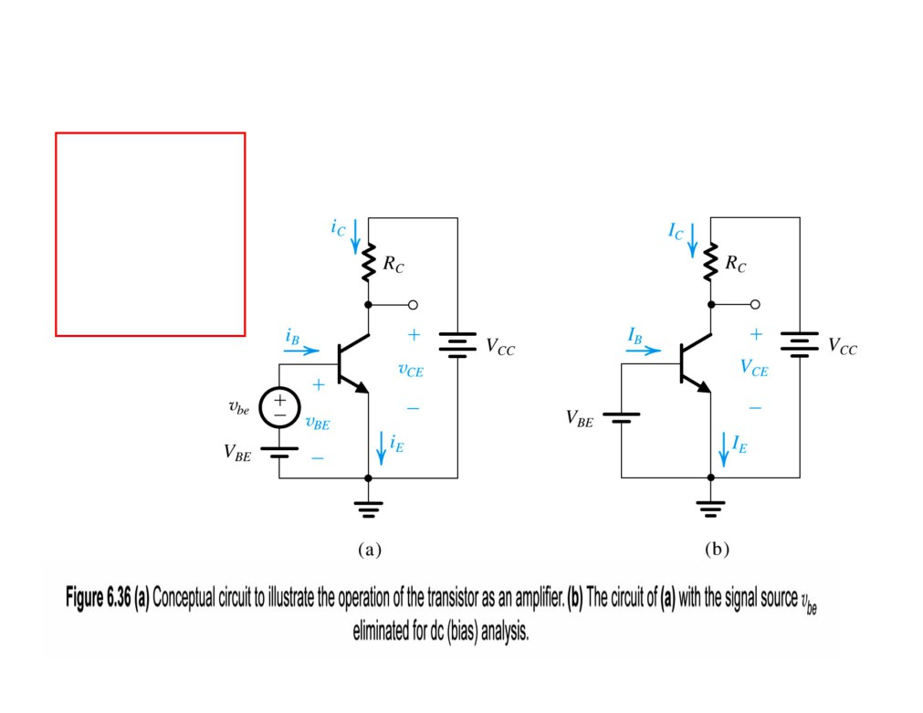
Small-signal operation and models
VC should be greater than (VB - 0.4) by an amount that allows for a reasonable signal swing at the collector.
I
=I
VBE VT/
C
S
e
I
E = I
/α
C
I
=
I
/ β
B
C
V
=V
−
I
R
CE
CC
C
C
M

Slide 5
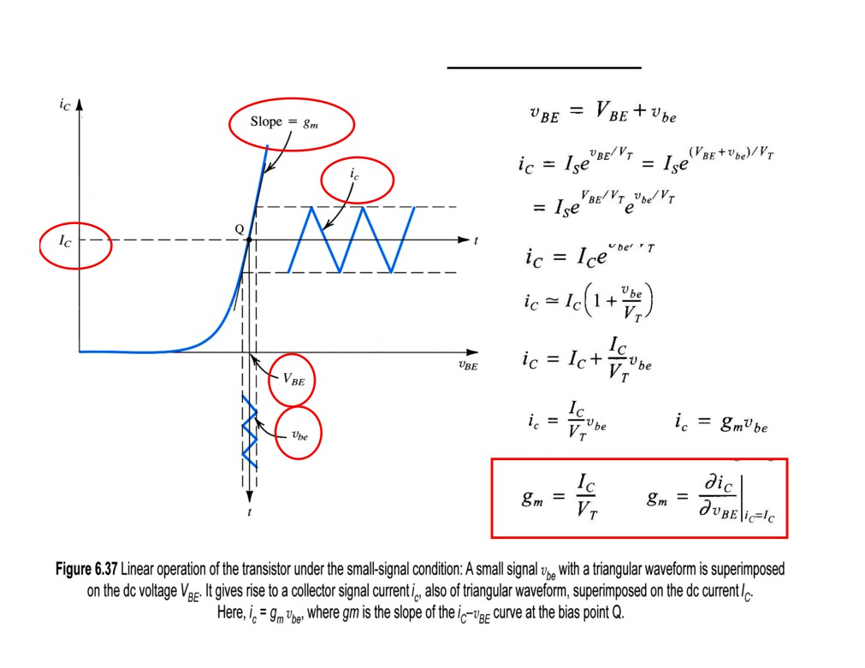
The Collector Current and the Transconductance

Slide 6
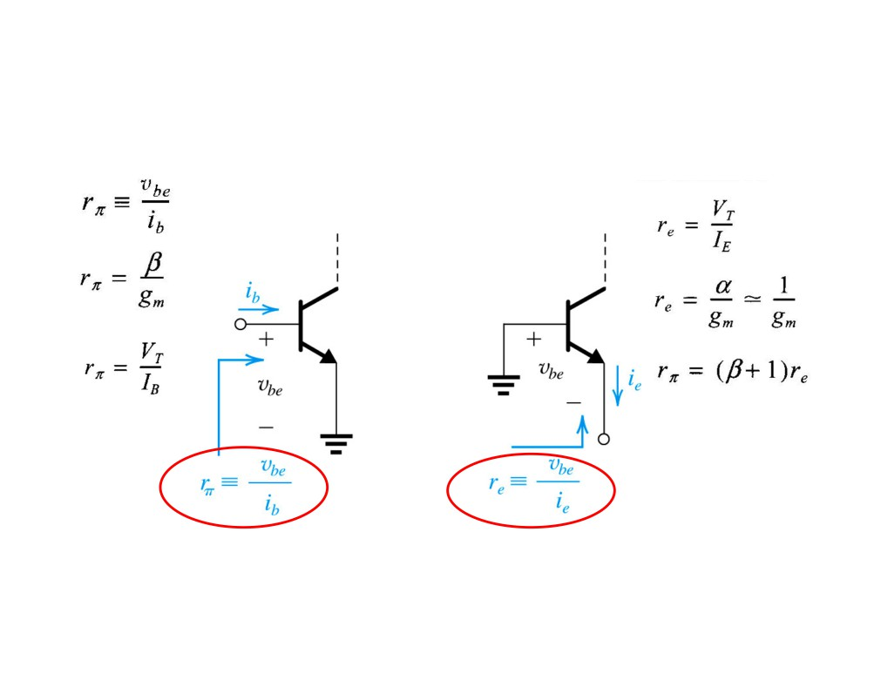
The Base current and the Input Resistance at
The Emitter current and the Input
the base
Resistance at the Emitter
Figure 6.38 Illustrating the definition of rπ and re.
Microelectronic Circuits, Sixth Edition
Sedra/Smith
Copyright © 2010 by Oxford University Press, Inc.

Slide 7
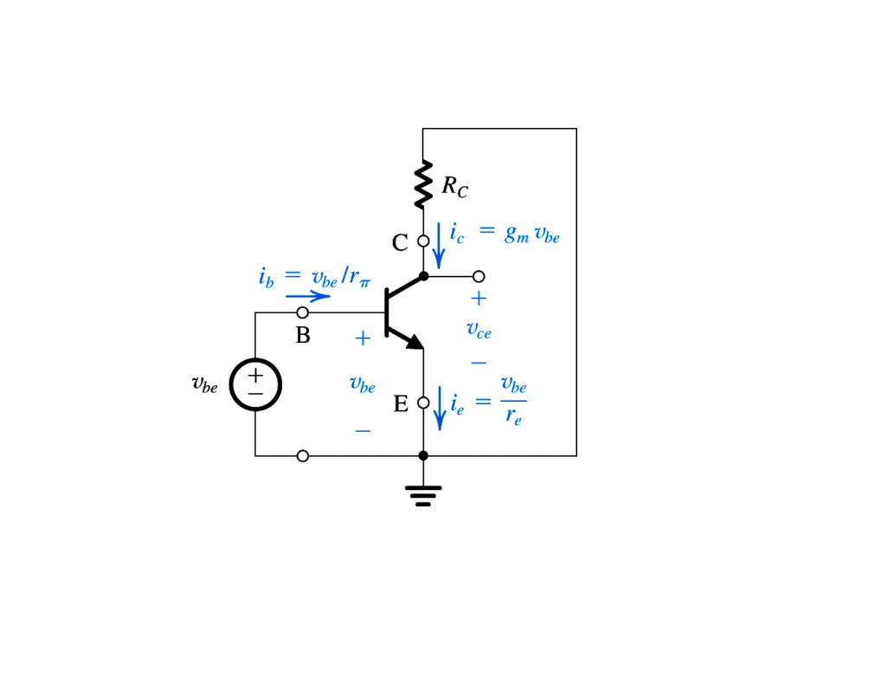
Separating the Signal and the DC Quantities
Figure 6.39 The amplifier circuit of Fig. 6.36(a) with the dc sources (VBE and VCC) eliminated (short-circuited). Thus only the signal components are present. Note that this is a representation of the
signal operation of the BJT and not an actual amplifier circuit.

Slide 8
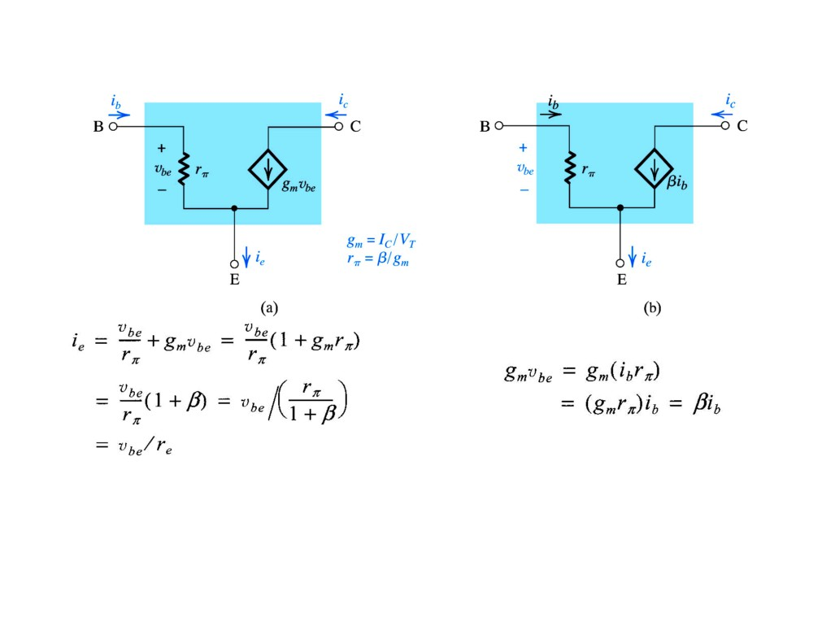
The Hybrid-π Model (npn and pnp)
Figure 6.40 Two slightly different versions of the hybrid-π model for the small- signal operation of the BJT. The equivalent circuit in
(a) represents the BJT as a voltage-controlled current source (a
transconductance amplifier), and that in (b) represents the BJT as a current- controlled current source (a current amplifier).

Slide 9
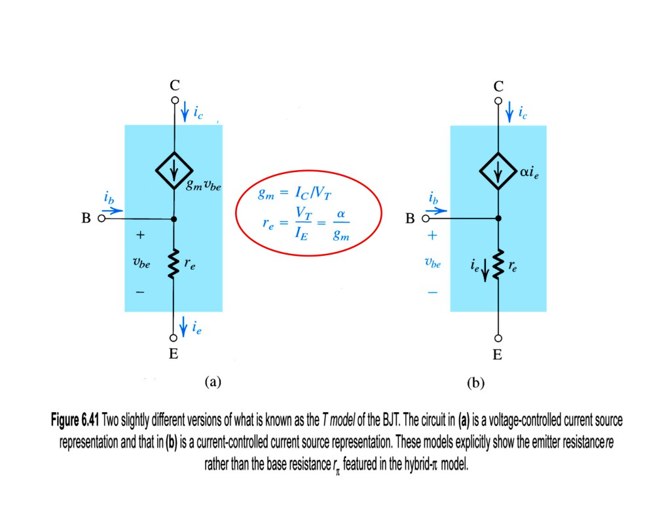
The T Model (npn and pnp)
M

Slide 10
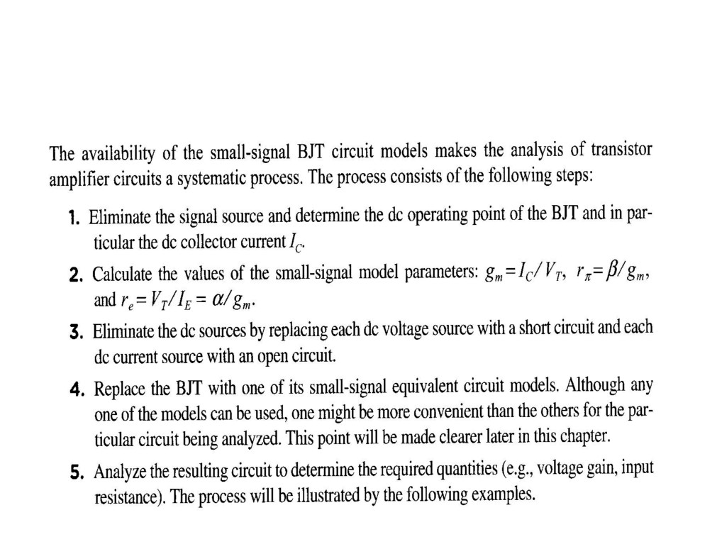
Application of the Small-Signal Equivalent Circuits
M

Slide 11
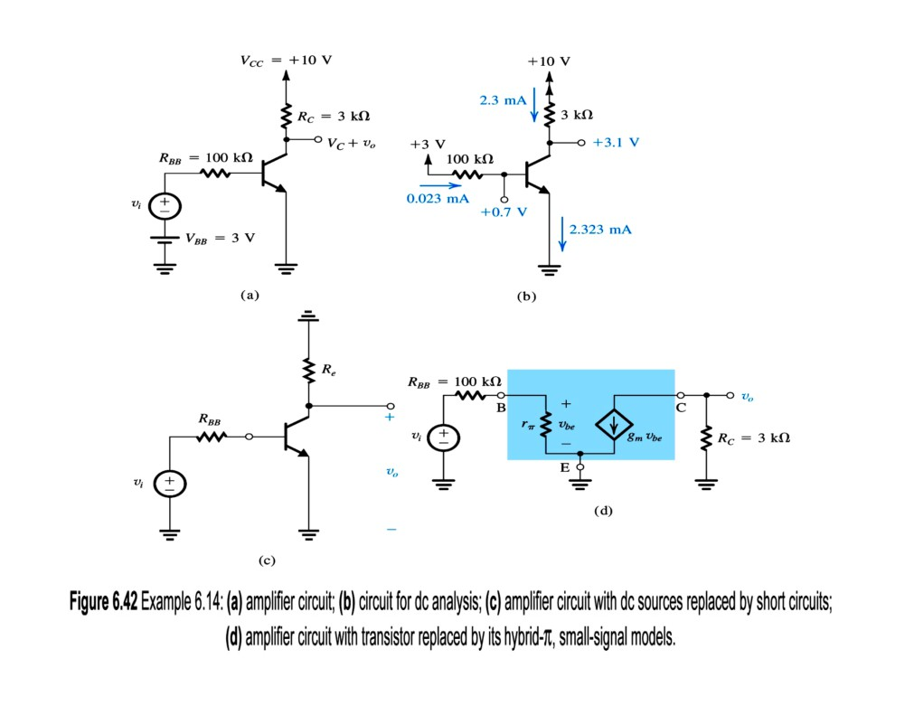
M

Slide 12
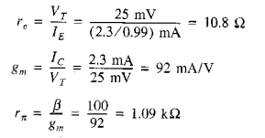

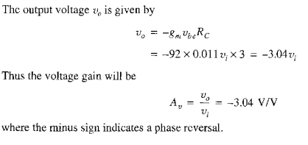

Slide 13
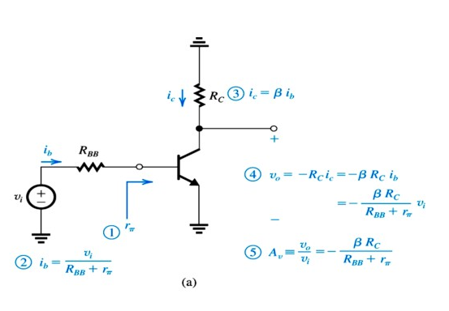
Performing signal analysis directly on the circuit diagram with the BJT small-signal model implicitly employed:
Microelectronic Circuits, Sixth Edition

Slide 14
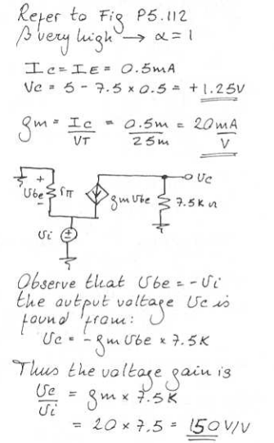
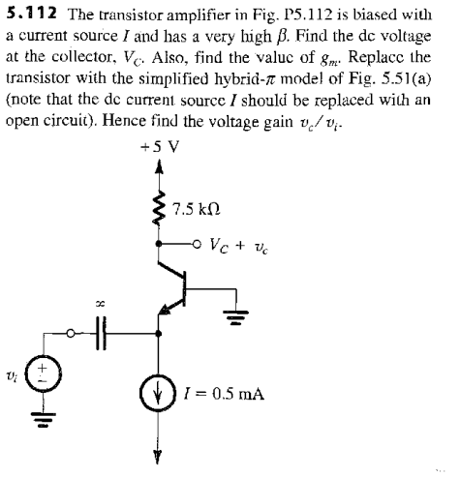

Slide 15
