Slide 1
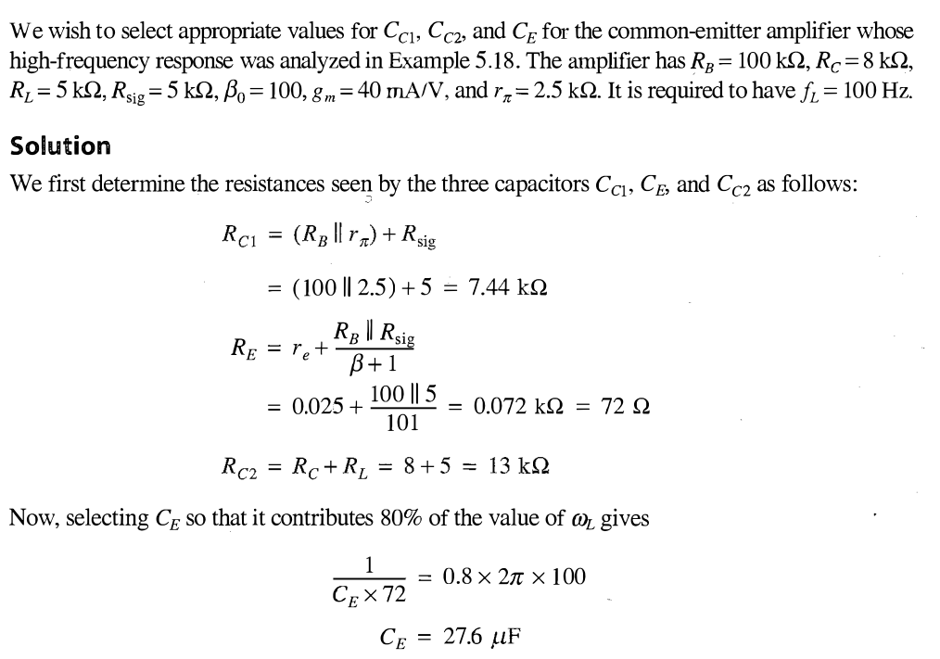
Example 5.19

Slide 2
