Slide 1
Module 2
Memory and Electronics Eco-system
Where is India?

Slide 2
Top players in the memory market
Micron (Hybrid Memory cube to be used in Intel Xeon Phi many core procesor)
Samsung
SanDisk
S k Hynix
Toshiba
Intel

Slide 3
Price performance comparison (approximate)
Type of Memory | Access time | Price per GB in INR
SRAM | 0.5 to 2.5ns | 500
DRAM | 50 to 70ns | 125
Flash | 70 to 150ns | 30
HD | 5ms | 5
SSD, USB stick, SD cards are all examples of NAND flash based
devices.
why their performance level should differ?

Slide 4
RAM vs Flash memory
Flash memory was invented by Dr. Fujio Masuoka from Toshiba (both NAND and NOR)
It is a non volatile memory
NAND flash much more compact and cheaper than NOR but does not allow random access
All flash memory have limited number of read and write
SRAM much faster and much more expensive than flash memory
SRAM vs DRAM…

Slide 5
 | LPDDR1 | LPDDR2 | LPDDR3 | LPDDR3E | LPDDR4 | LPDDR4E
Internal access rate | 200 MHz | 200 MHz | 200 MHz | 266⅔ MHz | 200 MHz | 266⅔ MHz
Prefetch size | 2n | 4n | 8n |  | 16n
Clock frequency | 200 MHz | 400 MHz | 800 MHz | 1066⅔ MHz | 1600 MHz | 2133⅓ MHz
Data transfer rate | 400 MT/s | 800 MT/s | 1600 MT/s | 2133⅓ MT/s | 3200 MT/s | 4266⅔ MT/s
Supply voltage(s) | 1.8 V | 1.2 V, 1.8 V | 1.2 V, 1.8 V |  | 1.1 V, 1.8 V
Command/Address bus | 19 bits, SDR | 10 bits, DDR | 10 bits, DDR |  | 6 bits, SDR

Slide 6
More about NOR vs NAND flash
NOR flash: bit cell like a NOR gate
Random read/write access
Used for instruction memory in embedded systems
NAND flash: bit cell like a NAND gate
Denser (bits/area) –
block-at-a-time access –
Cheaper per GB – Used for USB keys, media storage, …
Flash bits wears out after 1000’s of accesses – Not suitable for direct RAM or disk replacement – Wear leveling: remap data to less used blocks

Slide 7
Industry facts
Joint Electron Device Engineering Council (JEDEC)
Trade association of electronics manufacturers which decides on standards
LPDDR1,2,3,4…
eMMC (embedded MultiMediaCard): Cheap, bootable flash device used in low cost portable devices. It can host OS
Performance wise SRAM > DRAM > SSD > eMMC > USB flash/SD card

Slide 8
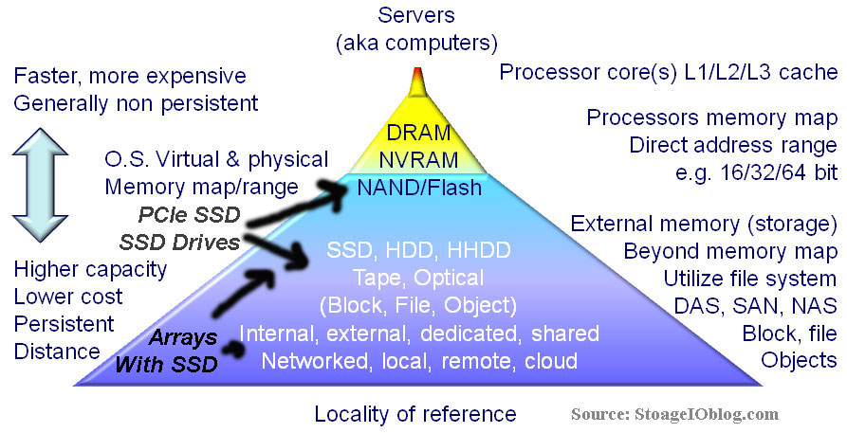

Slide 9
Global Value Chain
Part | company | Country of Incorporation
Application Processor | Apple A10 APL1011 SoC | US
RAM | SK Hynix 2GB DDR3 | Korea
Modem | Qualcomm LTE Modem | US
 | Skyworks 77802-23 Low Band LTE PAD | US
 | Avago A8020 High Band PAD | Singapore
 | Avago A8010 Ultra High Band PA + FBARs | Singapore
 | SkyWorks 77803-20 Mid Band LTE PAD | US
sensors | InvenSense MP67B 6-axis Gyroscope and Accelerometer Combo | US
RF Amplifiers | Avago ACPM-8020 Power Amplifier Module Avago ACPM-8010 Power Amplifier Module | Singapore
Power Amplifier | SkyWorks SKY77356-8 Power Amplifier Module | US
Antenna | RF Micro Devices RF5159 Antenna Switch Module | US

Slide 10
Continued…
Ultra small, tri axial low – g sensor | Bosch Sensortec BMA280 | Germany
Flash memory | SanDisk SDMFLBCB2 128 Gb (16 GB) NAND Flash | US
Wi-Fi module | Murata 339S0228 Wi-Fi Module | Japan
Touch screen IC | Broadcom BCM5976 Touchscreen Controller | US
Motion Coprocessor | NXP LPC18B1UK ARM Cortex-M3 Microcontroller (also known as the M8 motion coprocessor) | Netherlands
NFC chip | NXP 65V10 NFC module + Secure Element (likely contains an NXP PN544 NFC controller inside) | Netherlands
Audio Codec | Cirrus Logic 338S1201 Audio Codec | US
Touch sensor | Texas Instruments 343S0694 Touch Transmitter | US

Slide 11
Comparison of Consumer market
# | 2009 |  |  | 2020 |  |  | 2030
1 | USA | 4377 | 21% | China | 4468 | 13% | India | 12777 | 23%
2 | Japan | 1800 | 8% | US | 4270 | 12% | China | 9985 | 18%
3 | Germany | 1219 | 6% | India | 3733 | 11% | US | 3969 | 7%
4 | France | 927 | 4% | Japan | 2203 | 6% | Indonesia | 2474 | 4%
5 | UK | 889 | 4% | Germany | 1361 | 4% | Japan | 2286 | 4%
6 | Russia | 870 | 4% | Russia | 1189 | 3% | Russia | 1448 | 3%
7 | China | 859 | 4% | France | 1077 | 3% | Germany | 1335 | 2%
8 | Italy | 740 | 3% | Indonesia | 1020 | 3% | Mexico | 1239 | 2%
9 | Mexico | 715 | 3% | Mexico | 992 | 3% | Brazil | 1225 | 2%
10 | Brazil | 623 | 3% | UK | 976 | 3% | France | 1119 | 2%
Source: Homi Kharas, Brookings Institution. June 20, 2011

Slide 12
Manufacturing trouble
India |  | China
% share of GDP due to manufacturing | 15 – 17% | % share of GDP due to manufacturing | 32 -34%
% Share in Global manufacturing | 1.3 – 1.8% | % Share in Global manufacturing | 13.7%

Slide 13
A nation of consumers
Item | Import bill in US$ in 2012 | Import bill as % of total
Total Import Bill | 490 B | 100
Petroleum | 168.4 B | 34.4
Gold | 53.9 B | 11
Electronic goods | 31 B | 6.3
Machinery | 26.95 B | 5.5
Pearls, precious/semi stones | 22 B | 4.4
Source: Exim bank report, 2012 (from DGCSI, MOCI)

