Slide 1
Computer Architecture Part 1 The Concepts Module 5 - 15
Notes:
v10: 28/04/03, Chris Shore
slide 4: added China to text (already on graphic). Updated employee count and geographical distribution.
slide 19: added V6
slides 32: Imported from RV Overview to replace original ADS slide.
slide 33: New general debug architecture diagram
slide 34: new product montage (crib in notes)
slide 35: New question about embedded trace.
v09: 19/11/02, Chris Shore
slides 6-8: New slides showing IP deployment (imported from 926 core module)
v08: 08/02, Rob Levy
- Style update, black & white view amended
v07: 12/01, CJS
Main changes:
- ARM Development Boards slide removed (now in Debug Solutions module)
- Register set slides re-ordered so that the animated graphic comes first
- slide 12: Q bit in v5TEJ as well as v5TE
- slide 14: CPSR changes rephrased slightly
- slide 16: reference to v5T removed.
- slide 27: EASY/Micropack replaced with ADK/ACT
- slide 30: Trace slide updated

Slide 2
Computing Environment
Instruction Set Architecture
Computer Architecture
Implementation
Loop Transformation &
Procedure inlining
Compiler Techniques
Register Allocation
Local and Global Optimization &
Pipeline Scheduling
Operating system
&
Software Techniques

Slide 3
The basics…
Non-pipelined processor.
Assume that each operation
takes 75ns
Pipelined processor with 5 stages
Assume each stage takes 17ns.
Processor B
F
F
D
E
M
W
Processor A
1st Output 75ns
2nd Output 150ns
3rd Output 225ns
… … ….
1st Output 85ns
2nd Output 102ns
3rd Output 119ns
Proc A Speed = 13.33MHz
Proc. B Speed = 58.82MHz
Pipe-lining is a good idea as long as we manage to keep it filled…

Slide 4
Outline
Issues in Pipelining (understanding the rules of the game!)
Data Dependency / Hazard
Structural Dependency / Hazard
Control Dependency / Hazard
ILP, LLP
Branch Prediction and Speculation
Complex pipelining
Superscalar or VLIW?
In order and out of order (issue, execution and retirement)

Slide 5
Single issue pipeline architecture
Instruction
Fetch
Shift + ALU
Memory
Access
Reg
Write
Reg
Decode
Reg
Read
FETCH
DECODE
EXECUTE
MEMORY
WRITE
In such single issue pipeline, the upper limit of performance is 1 clock cycle per instruction (CPI)
Many road blocks in achieving the CPI = 1
Data Flow related issues
Limitation of resources
Branches

Slide 6
Data Dependencies…
Dependences are the property of a program (Data flow)
Date Dependence conveys
Order in which results must be calculated
Potential for a hazard, but actual hazard and length of any stall is a property of the pipeline
I: ADD R1,R2,R3
J: SUB R4,R1,R3
Upper bound on exploitable instruction level parallelism
Dependencies that flow through memory locations are difficult to detect eg [R1, #32] and [R4, #8] might be pointing to the same memory location

Slide 7
Data Hazard
RAW Hazard (Read after Write) – Due to Data Dependency
Instruction J tries to read operand before Instr. I writes it I: ADD R1,R2,R3
J: SUB R4,R1,R3
Caused by a “Dependence” (in compiler nomenclature).
Time (clock cycles)
I: add r1,r2,r3
Ifetch
Reg
DMem
Reg
Value of R1 generated
ALU
Value of R1 needed
J: sub r4,r1,r3
Ifetch
Reg
ALU
DMem
Reg

Slide 8
Solutions
Wait till the Value of R1
Becomes available
Ifetch
Reg
ALU
DMem
Reg
Bubble
Bubble
Ifetch
Reg
ALU
DMem
Reg
Ifetch
Reg
ALU
DMem
Reg
Do Data Forwarding
Ifetch
Reg
ALU
DMem
Reg

Slide 9
Data forwarding can not solve all the problems (Load interlock)
Solution: Wait and your problems will go away!
Time (clock cycles)
LDR R1, [R2]
Ifetch
Reg
ALU
DMem
Reg
SUB R4,R1,R6
Ifetch
Reg
ALU
DMem
Reg
LDR R1, [R2]
Ifetch
Reg
DMem
Reg
ALU
SUB R4,R1,R6
Bubble
Ifetch
Reg
ALU
DMem
Reg

Slide 10
Data Hazard (continued)
WAR Hazard (Write after Read) – Due to Anti-dependence
Instr I writes operand before Instr J reads it
No problem of WAR hazard in simple “in-line” pipelining
Will cause a problem in multiple issue, out of order execution
I: SUB R4,R1,R3
J: add R1,R2,R3

Slide 11
WAW hazard (Write after Write) – Due to Output dependence
Instr J writes operand before Instr I writes it
No possibility of WAW hazard in simple “in-line” pipelining
Will become an issue when out of order execution is allowed
I: SUB R1,R4,R3
J: ADD R1,R2,R3

Slide 12
Name Dependence
Two instructions use the same name but no flow of information
Not a true data dependence, but is a problem when reordering instructions
Antidependence: instruction j writes a register or memory location that instruction i reads
Initial ordering (i before j) must be preserved
Output dependence: instruction i and instruction j write the same register or memory location
Ordering must be preserved
To resolve, use register renaming technique

Slide 13
Structural hazard
Hardware can not support the given combination of instructions. If there is just one memory system for instruction and data then structural hazard may occur.
For complex pipeline with split execution unit (many functional units) structural hazard may occur.
Solution? Wait….

Slide 14
Control Hazard
Ordering of an instruction i with respect to a branch instruction
Instruction control dependent on a branch cannot be moved before the branch so that its execution is no longer controlled by the branch
An instruction not control dependent on a branch cannot be moved after the branch so that its execution is controlled by the branch
If some how we can predict the behavior of branch or even better - eliminate them, then code execution would be very fast.

Slide 15
Final word on dependences
Preserving Control dependence is a simple and effective way of maintaining program correctness
However, Control dependence is not a fundamental performance limit
Control dependence can be violated if;
Exception behavior &
Data Flow
are maintained
Preserving the Exception behavior means that any change in the order of the instruction execution should not change how exception are raised in the program

Slide 16
So what happens to the pipeline CPI?
Pipeline CPI = Ideal CPI + structural stalls + RAW stalls +
WAR stalls + WAW stalls + Control stalls
What can we do about these stall penalties?

Slide 17
Overview of Techniques used for reducing stalls
Technique | Target
ISA based techniques | Control hazard stalls
Forwarding and Bypassing | Potential data hazard stalls
Delayed Branches | Control hazard stalls
Dynamic Scheduling | Data hazard stalls from true dependence
Dynamic Scheduling with renaming | Data hazard stalls & name dependencies stalls
Dynamic Branch Prediction | Control hazard stalls
Multiple Instruction per cycle | Ideal CPI
Speculation | Data hazard and Control hazard stalls
Loop Unrolling | Control hazard stalls
Compiler dependence analysis | Ideal CPI, Data hazard stalls
Software pipelining, trace scheduling | Ideal CPI, Data hazard stalls

Slide 18
ISA based solution…
A cleaver solution has been created to address some of the control stalls
In ARM instruction set, almost every instruction may be conditionally executed.
There are 16 possible condition starting from “Always” to “Never” (which is not used. Code reserved for future expansion).
(conventional way) (ARM way)
CMP R3,#0 CMP R3,#0
BEQ SKIP ADDNE R0,R1,R2 ADD R0,R1,R2
Skip
The conventional way could waste up to three cycles!

Slide 19
Another example…
Take a look at following C
code
int gcd (int i, int j)
{
while (i != 0)
{
if (i > j)
i -= j;
else
j -= i;
}
return i;
}
Equivalent ARM assembly language code would be
Loop CMP Ri, 0 ; set condition
; “NE” if (i != 0)
; “GT” if (i > j)
; “LT” if (i < j)
SUBGT Ri, Ri, Rj ; if GT, i = i – j
SUBLT Ri, Rj, Ri ; if LT, j = j – i
BNE Loop
This code avoids branches around “then” and “else” clause.

Slide 20
Branch Prediction
If branches can be predicted (Taken or Not-Taken) with high percentage, then we can reduce stalls by fetching the “target instruction” earlier
When is information about branches gathered/applied?
– When the program is compiled (“compile-time” or Static)
– As the program is being executed (“dynamic”)
– When a “training run” of the program is executed
(“profile-based”) … compile – profile - compile
Prediction is a gamble!
Performance gain = ƒ(accuracy, cost of misprediction)

Slide 21
Static Branch Prediction Techniques
Static Branch prediction.
Simple to implement. Not much hardware required.
Can be used as a fall through mechanism.
Predict always not taken
Predict always taken
Backward branch predict taken, forward
branch predict not taken.

Slide 22
Dynamic Branch Prediction
Dynamic Branch Prediction Scheme.
Learning based on the past behavior.
Temporal correlation
The way a branch resolves may be a good predictor of the way it will resolve at the next execution
Spatial correlation
Several branches may resolve in a highly correlated manner (a preferred path of execution)

Slide 23
Dynamic Branch Prediction Schemes
1-bit Branch-Prediction Buffer
2-bit Branch-Prediction Buffer
Correlating Branch Prediction Buffer
Tournament Branch Predictor
Branch Target Buffer
Integrated Instruction Fetch Units
Return Address Predictors

Slide 24
Dynamic Branch Prediction (Contd.)
Take advantage of the knowledge of temporal correlation.
Use Branch prediction buffer
Example; Consider 1 bit prediction buffer; 0 = branch not taken and 1 = branch taken
Suppose we have to take this loop 100 times, how will one bit branch prediction scheme perform?
loop | CMP | Ri, 0 | ; Set Condition ; “NE” if (i != 0) ; “GT” if (i > j) ; “LT” if (i < j)
 | SUBGT | Ri, Ri, Rj | ; if GT, i = i - j
 | SUBLT | Ri, Rj, Ri | ; if LT, j = j – i
 | BNE | loop

Slide 25
One Bit Branch Prediction Counter
Branch History Table (BHT): Lower bits of PC address index table of 1-bit values
Says whether or not branch taken last time ( T-Taken, NT Not taken )
No full address check (saves HW, but may be wrong)
In a given single loop, One bit branch prediction counter will provide two wrong predictions;
First time through the loop, when it predicts exit instead of looping
Last time through the loop, when it predicts looping instead of exit
How about using a two bit counter?

Slide 26
Dynamic Branch Prediction (2 bit counter)
Can we better the performance ?
Use two bit branch prediction buffer… i.e. change prediction only when the prediction is wrong twice.
T
NT
Predict Taken
11
10
Predict Taken
T
T
NT
NT
Predict Not
Taken
01
00
Predict Not
Taken
T
NT

Slide 27

Can we do better with n-bit counter?
n-bit predictor:
counter can hold values between 0 and
predict taken when value is greater than or equal to half of maximum value:
The counter is incremented on each taken branch
and decremented on each not taken branch
Not much benefit over 2 bit counter…

Slide 28
Dynamic Branch Prediction (Contd.)
How about Spatial correlation?
Consider following example…
If first condition fails, second condition also fails
Global History Buffer (GHB), records the direction of the last N branches executed by the processor
if (x[i] < 7) then
y += 1;
if (x[i] < 5) then
c -= 4;

Slide 29
Correlating Branch predictor
Hypothesis: Previous 2-bit predictor schemes use only the recent behavior of a single branch to predict the future behavior of that branch
But branches are correlated; that is, behavior of recently-executed branches affects prediction of current branch
if (aa == 2)
aa = 0; #Branch 1
if (bb == 2)
bb = 0; #Branch 2
if (aa! = bb) { #Branch 3
Clearly branch #3 depends on outcome of #1 and #2
Prediction must be a function of own branch as well as recent outcomes of other branches

Slide 30
Correlating Branch predictor (cont.)
Idea: record m most recently executed branches as taken or not taken, and use that pattern to select the proper n-bit branch history table
In general, (m,n) predictor means record last m branches to select between 2^{m} history tables, each with n-bit counters
Thus, old 2-bit BHT is a (0,2) predictor
Global Branch History: m-bit shift register keeping T/NT status of last m branches
Each entry in table has m n-bit predictors

Slide 31
Correlating Branches
Branch address(low-order bits)
4 bits
2-bits per branch predictor
(2,2) predictor
Behavior of recent branches(global branch history) is used to select between four predictions of next branch, updating just that prediction
Prediction
NN
NT
TN
TT
N
T
SHIFT
2-bit global branch history

Slide 32
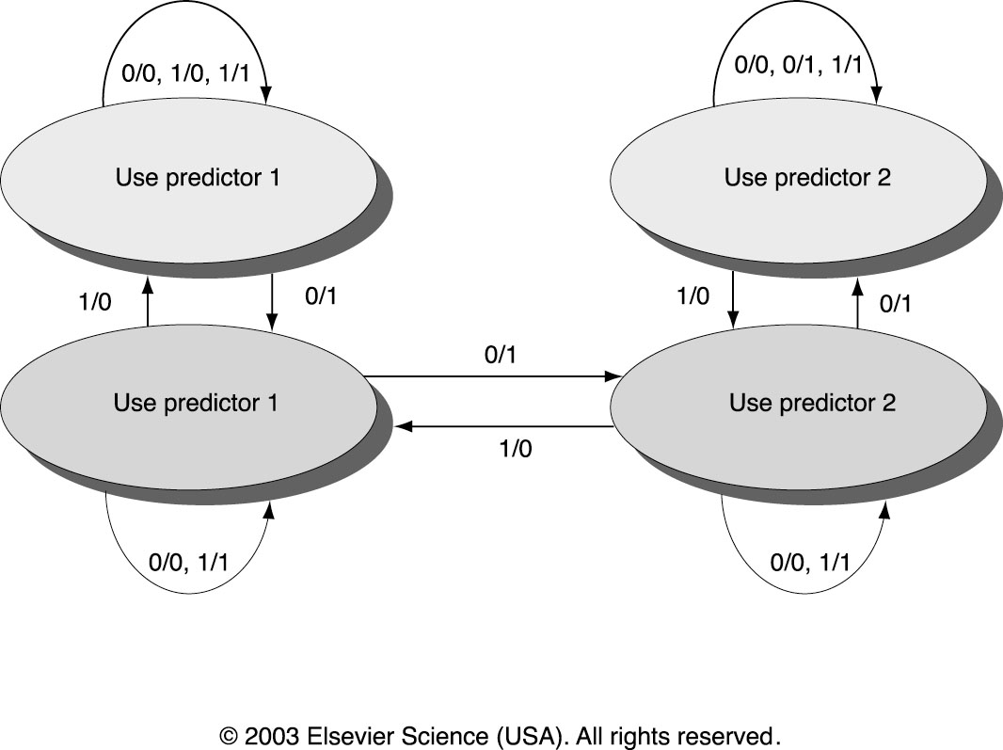
Tournament Predictors
Tournament Predictors are the most popular form of Multilevel branch predictors
Use 2-bit saturating counter per branch to choose between two different predictors
Use choice predictor to choose between global and local predictors
n/m means:
n = left predictor value
m = right predictor value
0: Incorrect
1: Correct
Notes:
gdhgfdgf

Slide 33
Branch Target Predictions
We have been looking at the ways to predict direction of branches (Taken/Not-Taken)
It would be beneficial if we could predict the branch address (target address) and fetch it ASAP
– Branch Target Buffer (BTB)
• Branch target buffer (BTB) stores address of the last target location to avoid recomputing
Useful for conditional/unconditional branches
– Return Address Stack (RAS)
• Useful for procedure returns

Slide 34
Branch Target Buffer
Global history buffer Only predicts branch direction. Therefore, cannot redirect fetch stream until after branch target is determined. This is no good.
Use Branch Target Buffer along with GHB.
BTB stores PCs the same way as caches
The PC of a branch is sent to the BTB
When a match is found the corresponding Predicted PC is returned
If the branch was predicted taken, instruction fetch continues at the returned predicted PC
Zero cycle unconditional branch and some times zero cycle conditional branch (Branch folding)

Slide 35
BTB flow chart
Send PC to memory and branch-target buffer
IF
Entry found in branch-target buffer?
No
Yes
Is instruction a taken branch?
Send out predicted PC
No
Yes
ID
Taken
Branch?
No
Yes
Normal instruction execution
Enter branch instruction address and next PC into branch-target buffer
Mispredicted branch, kill fetched instruction; restart fetch at other target; delete entry from target buffer
Branch correctly predicted; continue execution with no stalls
EX

Slide 36
BTB with GHB
Branch PC
Predicted PC
PC of instruction
FETCH
=?
Extra
prediction state
bits
Yes: instruction is branch and use predicted PC as next PC
No: branch not
predicted, proceed normally
(Next PC = PC+4)

Slide 37
Price to pay for Misprediction
In a simple “in order” architecture, kill all instructions behind the mispredicted branch.
Fetch from the new PC value.
How about interrupts?

Slide 38
Return Address Predictors
Procedure returns account for ~85% of indirect jumps (jumps whose address varies at run time). It will then return to many different locations—BTB may not predict accurately,
Therefore, small buffer of Return Addresses=cache of the most recent return addresses
• Like a hardware stack, LIFO
– At Procedure Call => Push Return address onto stack
– Procedure Return => Prediction off of top of stack, Pop it
• RAS tends to work quite well since call depths are typically not large

