Slide 1
Depth-First Search
A
B
D
E
C
Depth-First Search
Notes:
Depth-First Search

Slide 2
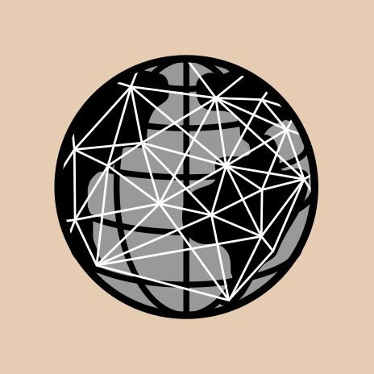
Outline and Reading
Definitions
  Subgraph
  Connectivity
  Spanning trees and forests
Depth-first search
  Algorithm
  Example
  Properties
  Analysis
Applications of DFS
  Path finding
  Cycle finding
Depth-First Search

Slide 3
Subgraphs
A subgraph S of a graph G is a graph such that
  The vertices of S are a subset of the vertices of G
  The edges of S are a subset of the edges of G
A spanning subgraph of G is a subgraph that contains all the vertices of G
Subgraph
Spanning subgraph
Depth-First Search

Slide 4
Connectivity
A graph is connected if there is a path between every pair of vertices
A connected component of a graph G is a maximal connected subgraph of G
Connected graph
Non connected graph with two connected components
Depth-First Search

Slide 5
Trees and Forests
A (free) tree is an undirected graph T such that
  T is connected
  T has no cycles
  This definition of tree is different from the one of a rooted tree
A forest is an undirected graph without cycles
The connected components of a forest are trees
Tree
Forest
Depth-First Search

Slide 6
Spanning Trees and Forests
A spanning tree of a connected graph is a spanning subgraph that is a tree
A spanning tree is not unique unless the graph is a tree
Spanning trees have applications to the design of communication networks
A spanning forest of a graph is a spanning subgraph that is a forest
Graph
Spanning tree
Depth-First Search

Slide 7
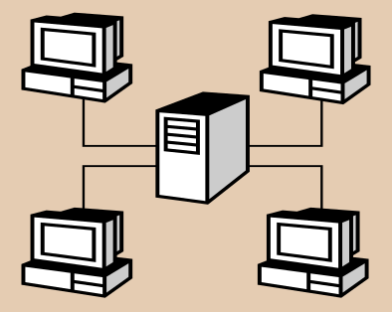
Depth-First Search
Depth-first search (DFS) is a general technique for traversing a graph
A DFS traversal of a graph G
  Visits all the vertices and edges of G
  Determines whether G is connected
  Computes the connected components of G
  Computes a spanning forest of G
DFS on a graph with n vertices and m edges takes O(n + m ) time
DFS can be further extended to solve other graph problems
  Find and report a path between two given vertices
  Find a cycle in the graph
Depth-first search is to graphs what Euler tour is to binary trees
Depth-First Search

Slide 8
DFS Algorithm
The algorithm uses a mechanism for setting and getting “labels” of vertices and edges
Algorithm DFS(G, v)
Input graph G and a start vertex v of G
Output labeling of the edges of G
in the connected component of v
as discovery edges and back edges
setLabel(v, VISITED)
  for all e ∈ G.incidentEdges(v)
  if getLabel(e) = UNEXPLORED
  w ← G.opposite(v,e)
  if getLabel(w) = UNEXPLORED
  setLabel(e, DISCOVERY)
  DFS(G, w)
  else
  setLabel(e, BACK)
Algorithm DFS(G)
Input graph G
Output labeling of the edges of G
as discovery edges and
back edges
  for all u ∈ G.vertices()
  setLabel(u, UNEXPLORED)
  for all e ∈ G.edges()
  setLabel(e, UNEXPLORED)
  for all v ∈ G.vertices()
  if getLabel(v) = UNEXPLORED
  DFS(G, v)
Depth-First Search

Slide 9
Example
A
unexplored vertex
A
A
visited vertex
B
D
E
unexplored edge
discovery edge
C
back edge
A
A
B
D
E
B
D
E
C
C
Depth-First Search

Slide 10
Example (cont.)
A
A
B
D
E
B
D
E
C
C
A
A
B
D
E
B
D
E
C
C
Depth-First Search

Slide 11

DFS and Maze Traversal
The DFS algorithm is similar to a classic strategy for exploring a maze
  We mark each intersection, corner and dead end (vertex) visited
  We mark each corridor (edge ) traversed
  We keep track of the path back to the entrance (start vertex) by means of a rope (recursion stack)
Depth-First Search

Slide 12
Properties of DFS
Property 1
DFS(G, v) visits all the vertices and edges in the connected component of v
Property 2
The discovery edges labeled by DFS(G, v) form a spanning tree of the connected component of v
A
B
D
E
C
Depth-First Search

Slide 13
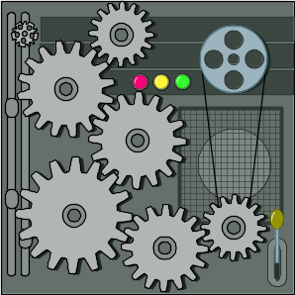
Analysis of DFS
Setting/getting a vertex/edge label takes O(1) time
Each vertex is labeled twice
  once as UNEXPLORED
  once as VISITED
Each edge is labeled twice
  once as UNEXPLORED
  once as DISCOVERY or BACK
Method incidentEdges is called once for each vertex
DFS runs in O(n + m) time provided the graph is represented by the adjacency list structure
  Recall that Σ_{v} deg(v) = 2m
Depth-First Search

Slide 14
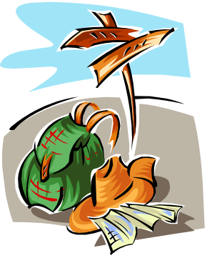
Path Finding
We can specialize the DFS algorithm to find a path between two given vertices u and z using the template method pattern
We call DFS(G, u) with u as the start vertex
We use a stack S to keep track of the path between the start vertex and the current vertex
As soon as destination vertex z is encountered, we return the path as the contents of the stack
Algorithm pathDFS(G, v, z)
setLabel(v, VISITED)
S.push(v)
  if v = z
  return S.elements()
  for all e ∈ G.incidentEdges(v)
  if getLabel(e) = UNEXPLORED
  w ← opposite(v, e)
  if getLabel(w) = UNEXPLORED
  setLabel(e, DISCOVERY)
  S.push(e)
  pathDFS(G, w, z)
  S.pop() { e gets popped }
  else
  setLabel(e, BACK)
  S.pop() { v gets popped }
Depth-First Search

Slide 15

Cycle Finding
We can specialize the DFS algorithm to find a simple cycle using the template method pattern
We use a stack S to keep track of the path between the start vertex and the current vertex
As soon as a back edge (v, w) is encountered, we return the cycle as the portion of the stack from the top to vertex w
Algorithm cycleDFS(G, v, z)
setLabel(v, VISITED)
S.push(v)
  for all e ∈ G.incidentEdges(v)
  if getLabel(e) = UNEXPLORED
  w ← opposite(v,e)
  S.push(e)
  if getLabel(w) = UNEXPLORED
  setLabel(e, DISCOVERY)
  pathDFS(G, w, z)
  S.pop()
  else
  C ← new empty stack
  repeat
  o ← S.pop()
  C.push(o)
  until o = w
  return C.elements()
  S.pop()
Depth-First Search

