Slide 1
Maximum Bipartite Matching

Slide 2
Bipartite Matching

Slide 3
Matching
Matching
Free Vertex

Slide 4
Maximum Matching: matching with the largest number of edges

Slide 5
Note that maximum matching is not unique.

Slide 6
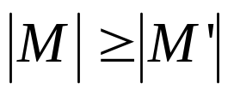
Maximum bipartite matching:
Bipartite graph: a graph (V, E), where V=L∪R, L∩R=empty, and for every (u, v)∈E, u ∈L and v ∈R.
Given an undirected graph G=(V,E), a matching is a subset of edges M⊆E such that for all vertices v∈V,at most one edge of M is incident on v.We say that a vertex v ∈V is matched by matching M if some edge in M is incident on v;otherwise, v is unmatched. A maximum matching is a matching of maximum cardinality,that is, a matching M such that for any matching M’, we have .

Slide 7
L
R
L
R
(a)
(b)
A bipartite graph G=(V,E) with vertex partition V=L∪R.(a)A matching with cardinality 2.(b) A maximum matching with cardinality 3.

Slide 8
Finding a maximum bipartite matching:
We define the corresponding flow network G’=(V’,E’) for the bipartite graph G as follows. Let the source s and sink t be new vertices not in V, and let V’=V∪{s,t}.If the vertex partition of G is V=L ∪R, the directed edges of G’ are given by E’={(s,u):u∈L} ∪{(u,v):u ∈L,v ∈R,and (u,v) ∈E} ∪{(v,t):v ∈R}.Finally, we assign unit capacity to each edge in E’.
We will show that a matching in G corresponds directly to a flow in G’s corresponding flow network G’. We say that a flow f on a flow network G=(V,E) is integer-valued if f(u,v) is an integer for all (u,v) ∈V*V.

Slide 9
s
t
L
R
L
R
(a)
(b)
(a)The bipartite graph G=(V,E) with vertex partition V=L∪R. A
maximum matching is shown by shaded edges.(b) The corresponding
flow network.Each edge has unit capacity.Shaded edges have
a flow of 1,and all other edges carry no flow.

Slide 10
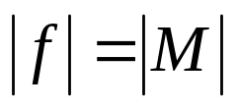
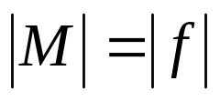
Continue:
Lemma .
Let G=(V,E) be a bipartite graph with vertex partition V=L∪R,and let G’=(V’,E’) be its corresponding flow network.If M is a matching in G, then there is an integer-valued flow f in G’ with value .Conversely, if f is an integer-valued flow in G’,then there is a matching M in G with cardinality .
Reason: The edges incident to s and t ensures this.
  Each node in the first column has in-degree 1
  Each node in the second column has out-degree 1.
  So each node in the bipartite graph can be involved once in the flow.

