Slide 1
CT-111 (ICT)
Yash Vasavada
Winter 2018
DA-IICT
Lecture 8
Power, Energy and SNR
29th January 2018

Slide 2

Instantaneous Power
Voltage $v\left(t\right),$ current $i(t)$ and resistance $R$ are related by Ohm’s Law: $R=v(t)/i(t)$
When the load is resistive, the power is given as p$\left(t\right)=v\left(t\right)i\left(t\right)=\frac{v^{2}\left(t\right)}{R}=i^{2}\left(t\right)R$

Slide 3


Average Power
Recall time averaging:
$$\left\langle w(t)\right\rangle =\lim_{T→∞}{\frac{1}{T}\int_{−T/2}^{T/2}{w\left(t\right)dt}}$$
If the waveform $w(t)$ is periodic with a period of $T_{0}$ seconds:
$$\left\langle w(t)\right\rangle =\frac{1}{T_{0}}\int_{−T_{0}/2}^{T_{0}/2}{w\left(t\right)dt}$$
RMS value of $v(t)$ is
$$V_{RMS}=\sqrt{\left\langle v^{2}(t) \right\rangle }$$
What is the RMS value of $v\left(t\right)=A\cos\left(2πf_{c}t+θ\right)?$
What is the RMS value if $v(t)$ is a rectangular periodic waveform?
When the load is resistive, the average power is given as
$$P=\frac{V_{RMS}^{2}}{R}=I_{RMS}^{2}R$$

Slide 4




Amplitude, Power, and Energy
Instantaneous power $P$ in Watts is proportional to Amplitude $A$ squared
Energy $E$ in Joules is power $P$ Watts integrated over time $T$
For the following waveform, energy per symbol: $E_{S}∝A^{2}T_{S}=P×T_{S}=P/R_{S}$
Here, $T_{S}$ is the symbol duration in seconds and $R_{S}$ is the symbol rate in symbols/sec
Amplitude
A Binary Symbol Stream
$$A$$
Time
$$−A$$
Symbol Duration $T_{S}$

Slide 5
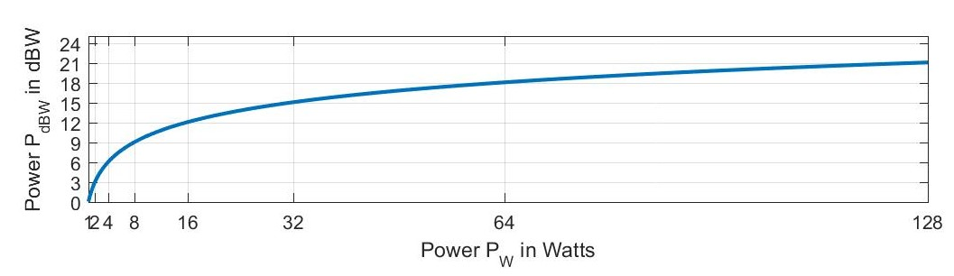

Power in Watts and dBW
The unit of power is Watt.
Power is typically represented in logarithmic decibel unit. Convention: $P_{dBW}=10×\log_{10}{P_{W}}$ in dBW.
Decibel unit converts an exponential growth into a linear growth
For each doubling of (or halving of) power $P_{W}$, the power $P_{dBW}$ increases (or reduces) by 3 dB

Slide 6

Logarithmic versus Linear Units
Substantial amount of increase in Watts translates to only a small increase in dBW
Power in dBW of 30 dBW or 40 dBW is a lot of power in Watts (1000 W or 10000 Watts)
Multiplication of power numbers in Watts is same as addition in dBW
Division is same as subtraction
Ratio of power $P_{W}^{1}/P_{W}^{2}$ in Watts has no unit; likewise difference of $P_{dBW}^{1}−P_{dBW}^{2}$ is in dB and not in dBW
For each 10 times increase/decrease of $P_{W}$, power $P_{dBW}$ increases/decreases by 10 dB

Slide 7
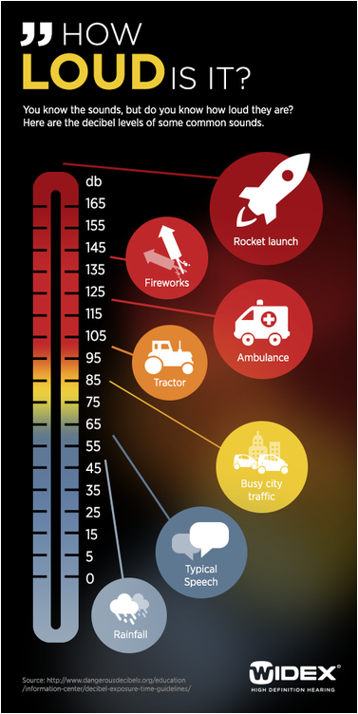
Decibels on Internet
Power of Ten Video (1977): https://www.youtube.com/watch?v=0fKBhvDjuy0
A useful site: http://www.animations.physics.unsw.edu.au/jw/dB.htm

Slide 8

Logarithmic versus Linear Units
Amplifier gain $G$ is often specified as a power ratio in dB
$$G_{dB}=10×\log_{10}{\frac{P_{Out}}{P_{In}}}=10×\log_{10}{\frac{V_{Out}^{2}}{V_{In}^{2}}}=20×\log_{10}{\frac{V_{Out}^{}}{V_{In}^{}}}$$
Therefore,
$P_{Out}=P_{in}×{10}^{0.1G_{dB}}$, and $V_{Out}=V_{in}×{10}^{0.05G_{dB}}$
Power in dBm is $P_{dBm}=10×\log_{10}{P_{mW}}$, where $P_{mW}={10}^{3}P_{W}$ is power in milliwatts
$P_{dBm}=30+P_{dBW}$

Slide 9

Decibel Units
If two signals are added, their powers in Watts add:
If the two signals have nearly equal powers, the power of the summed signal increases by 3 dB
If one signal has half the power (or one-tenth the power) compared to the stronger signal, the summed signal power is about 1.8 dB higher (or 0.3 dB higher) than the strong signal power
If a signal goes through multiple chains of amplification, the individual gains multiply, and therefore, their values in dB get added
Spreading loss: the area of the spherical surface at a distance of $d$ is proportional to $d^{2}$
Accordingly, the power loss at $d=1 m$, $100$ m, $1$ km, $10$ km, $100$ km, $1000$ km and $10000$ km is best expressed in dB units

Slide 10

Decibel Units
For converting the power $P$ in Watts (linear scale) into decibel (logarithmic scale) requires $10×\log_{10}{P}$
For converting the voltages into decibel requires 20 times log 10
Power in Watts (linear scale) converted into decibel (logarithmic scale) makes it dBW
Power in milliWatts converted into decibel scale makes it dBm
Difference of two powers in dBm or dBW has a unit of dB

Slide 11
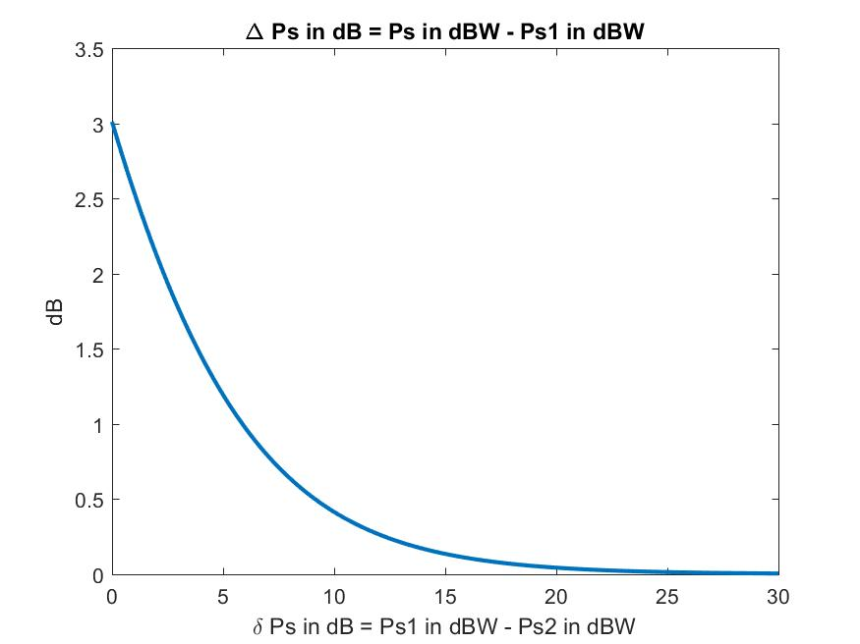

Decibel Units
When signals add (i.e., their voltages add), the summed signal power is the sum of individual signal powers:
$P_{S} = P_{s_{1}} + P_{s_{2}}$ in Watts
Let $P_{s_{1}}> {P_{s}}_{2}$

Slide 12




Amplitude, Power and Energy: Time versus Frequency Domain Views
A rough analogy and a conceptual (mathematically inexact) visualization of the dual relationship between the power and energy in time-frequency domains
Thus, two ways of measuring the quality or fidelity of the received signal compared to the noise
Ratio of power levels of signal and noise (level ratio in time domain, area ratio in frequency domain)
Ratio of energy levels of signal and noise (level ratio in frequency domain, area ratio in time domain)
Power Spectral Density
Time Domain
Frequency Domain
Area: $P×T_{S}=P/R_{S}$ equals the energy $E$ over time period $T_{S}$
Area: $E×R_{S}=E/T_{S}$ equals the power $P$ over bandwidth $R_{S}$
Span $T_{S}=1/R_{S}$
Span $R_{S}=1/T_{S}$

Slide 13
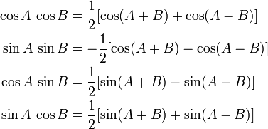

Linear versus Nonlinear Amplification and Mixing
Linear Amplification: $v_{out}=A×v_{in}$
Nonlinear Amplification: $v_{out}=A×v_{in}+B×v_{in}^{2}+C×v_{in}^{3}+…$
If $v_{in}$ is comprised of a single frequency:
Linear amplification: output is the same frequency with a voltage gain of $A$
Nonlinear amplification:
output has that frequency with a voltage gain of A
First Harmonic with a voltage gain of $B$
Second Harmonic with a voltage gain of $C$, etc.
If $v_{in}$ is comprised of two frequencies:
Linear amplification: output is the same frequency with a voltage gain of $A$
Nonlinear amplification:
output has that frequency with a voltage gain of A
First Harmonic of both the frequencies with a voltage gain of $B$
Second Harmonic of both the frequencies with a voltage gain of $C$, etc.
Inter-Modulation Distortion (IMD): frequencies at $mf_{1}±nf_{2}$ (where integers $m,n≥1$)

Slide 14
Block Diagram of a Digital Communication System
Transmitted power is determined by the HPA used
Attained bandwidth is determined by the design of modem
Allotted bandwidth is determined by the spectrum granted by the regulatory bodies (e.g., FCC, ITU)
Electro-magnetic Signal
Data rate is as required by the user (e.g., a video download/upload will have a much greater data rate requirement compared to transfer of emails)

