Slide 1

CT -111 END SEM PROJECT
Assigned By:
Prof Yash Vasavada
GROUP 15

Slide 2
InDex
Why Encoding?
Product Code.
Generating of H matrix.
Encoding.
Decoding (Same logic for both product code and LDPC).
Viterbi
Encoding.
Decoding.

Slide 3
Why Encoding is necessary?
When there is no noise there does not occur any problem.
For example:-

Slide 4
But such a situation is not possible in real life. Noise always gets added into the signal causing error in the original codeword sent . For example:- Here, due to noise, the signal gets converted into another valid code word. As result the information gets wrongly transmitted.

Slide 5
The encoded signal gets transmitted but how will one get back the original codeword to be sent.
That’s where decoding algorithms will play their role!!!!
Many different decoding algorithms are present. For example LDPC decoding, product code decoding, Viterbi decoding algorithm.
LDPC:- low density parity check algorithm

Slide 6
Product code
What is product code?
Generation of H matrix.
Encoding.
Decoding.

Slide 7
What is Product code?
Product code is a coding technique in which K bits (K is a perfect square) is converted to square(sqrt(K)+1) bits.
Some examples of product code are (9,4), (16,9), (25,16).
Here K bit string is selected from the coming sequence and it is encoded in.
N = (sqrt(K) + 1)²
Where N is length of code word.
K is number of information bits.
N-K number of redundant bits.

Slide 8
What is H matrix?
H matrix is a parity check matrix.
Basically H matrix is matrix of dimension (N-K) x N.
Both encoder and decoder will have same H matrix in order to do unique encoding and decoding.

Slide 9
Generation of H Matrix
Here our data bits and parity check bits are arranged as follows.
Here let us understand how to make H matrix for (4,9) code.
Here C1, C2, C3,C4 are our information bit.
And P1, P2, P3, P4, P5 are our check bits.
S1, S2, S3, S4, S5 are check nodes.
C1 | C2 | P1
C3 | C4 | P2
P3 | P4 | P5
S1
S2
S3
S4
S5
C1
C2
P1
C3
C4
P2
P3
P4
P5

Slide 10
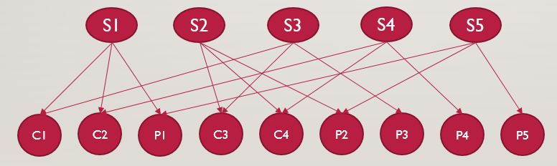
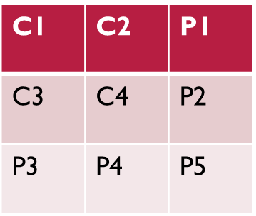
Now the help of this two diagram we can construct the H matrix.
So the H matrix for is.
Here we place ‘1’ at the place where syndrome is connected and ‘0’ at other places.
H=
1 | 1 | 1 | 0 | 0 | 0 | 0 | 0 | 0
0 | 0 | 0 | 1 | 1 | 1 | 0 | 0 | 0
1 | 0 | 0 | 1 | 0 | 0 | 1 | 0 | 0
0 | 1 | 0 | 0 | 1 | 0 | 0 | 1 | 0
0 | 0 | 1 | 0 | 0 | 1 | 0 | 0 | 1

Slide 11
Similarly H matrix for (16,9) is as follow:
H=
1 | 1 | 1 | 1 | 0 | 0 | 0 | 0 | 0 | 0 | 0 | 0 | 0 | 0 | 0 | 0
0 | 0 | 0 | 0 | 1 | 1 | 1 | 1 | 0 | 0 | 0 | 0 | 0 | 0 | 0 | 0
0 | 0 | 0 | 0 | 0 | 0 | 0 | 0 | 1 | 1 | 1 | 1 | 0 | 0 | 0 | 0
1 | 0 | 0 | 0 | 1 | 0 | 0 | 0 | 1 | 0 | 0 | 0 | 1 | 0 | 0 | 0
0 | 1 | 0 | 0 | 0 | 1 | 0 | 0 | 0 | 1 | 0 | 0 | 0 | 1 | 0 | 0
0 | 0 | 1 | 0 | 0 | 0 | 1 | 0 | 0 | 0 | 1 | 0 | 0 | 0 | 1 | 0
0 | 0 | 0 | 1 | 0 | 0 | 0 | 1 | 0 | 0 | 0 | 1 | 0 | 0 | 0 | 1

Slide 12
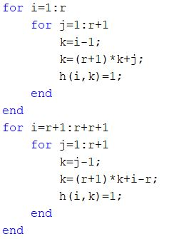
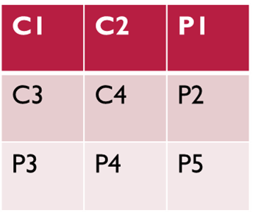
So the code for this is
Here r is the sqrt(K).
Here in first for loop the row are being checked by the syndrome.
And in next for loop the columns are checked by syndrome.
So at that location where syndrome are connected we put 1.
And at other places we put 0 where syndrome are not connected.
This is how H matrix is made.

Slide 13
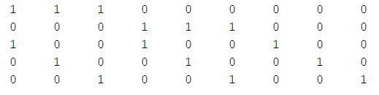
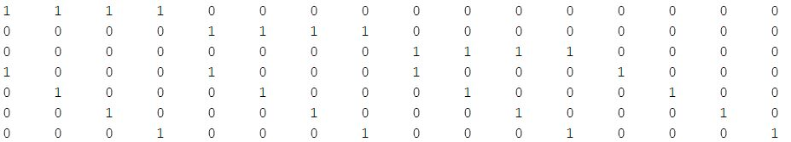
Simulation
Here we are making H matrix.
First for (9,4) value for r=2.
Second (16,9) value for r=3.
This is the code
H for(9,4)
H for(16,9)

Slide 14

Encoding
Here Encoding takes K bits and convert those K bits into N bits.
N = (sqrt(K) + 1)²
Where N is length of code word.
K is number of information bits.
N-K number of redundant bits.
Here example of (9,4) product code is shown.
C1 | C2
C3 | C4

Slide 15
How it is done
Here we encode 4 bit into 9 bits.
Here to get P1, P2, P3, P4, P5 we use following scheme.
P1 = (C1+C2) mod 2.
P2 = (C3+C4) mod 2.
P3 = (C1+C3) mod 2.
P4 = (C2+C4) mod 2.
P5 = (P1+P2) mod 2.
Now we write this 3x3 matrix in straight line.
And now we write this code as C1 C2 P1 C3 C4 P2 P3 P4 P5.

Slide 16
Now for (16,9) hamming code.
P1 = (C1+C2+C3) mod 2.
P2 = (C4+C5+C6) mod 2.
P3 = (C7+C8+C9) mod 2.
P4 = (C1+C4+C7) mod 2.
P5 = (C2+C5+C8) mod 2.
P6 = (C3+C6+C9) mod 2.
P7 = (P1+P2+P3) mod 2.
Now we write this 4x4 matrix in straight line.
And now we write this code as C1 C2 C3 P1 C4 C5 C6 P2 C7 C8 C9 P3 P4 P5 P6 P7.
C1 | C2 | C3 | P1
C4 | C5 | C6 | P2
C7 | C8 | C9 | P3
P4 | P5 | P6 | P7

Slide 17
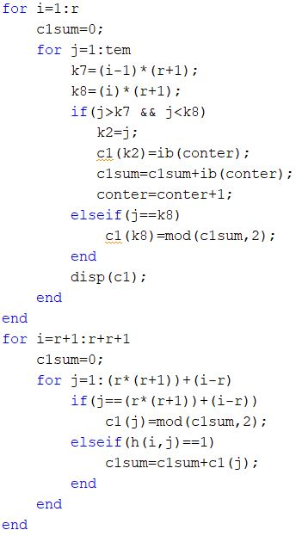
NOW THE CODE FOR THIS IS
Here in this code we enter ib which is the array of information bits.
ib can be visualised as C1,C2,C3,C4 (for (9,4)).
In first loop.
Now we select first r=sqrt(k) bits from ib and put it as the O/P as it is.
Than we add a parity bit corresponding to it the next bit.
This we do it for r times. (eg select C3 C4 and then add P2, similarly P1, P3etc.)
In next loop.
We select r bits from ib in a way that we select such that we select a bit then leave next r-1 bit and select next and than do its mod 2 sum and add parity at last.
Hence by this way we add total of r+1 parity bits. (Think of adding P3,P4,P5)
Hence it is encoded as C1C2P1C3C4P2P3P4P5 (eg for (9,4)).

Slide 18
Simulation
Now we stimulate for (9,4) with ib=[1,0,1,1].
So it is encoded as.
Now we stimulate for (16,9) with ib=[1,0,1,1,1,0,1,0,0].
So it is encoded as.

Slide 19
Decoding for product code and LDPC code
Here we passed the received string into the decoder.
Here it will use the H matrix which we generated for product code and for LDPC codes we use H matrix provided by the user.
Now it will compare the received code with each row H matrix.
Now if the there is one error than it will correct using the syndrome and if more than one error is occurred then it will keep it for next iteration.
Here it is done as: that all variable nodes send information to the check node and accordingly check node returns corrected value to variable node which is in error it is valid for only 1 error connected attached to that check node else it will solve it in next iteration if possible.
Here we are talking about BEC(Binary Erase channel).

Slide 20
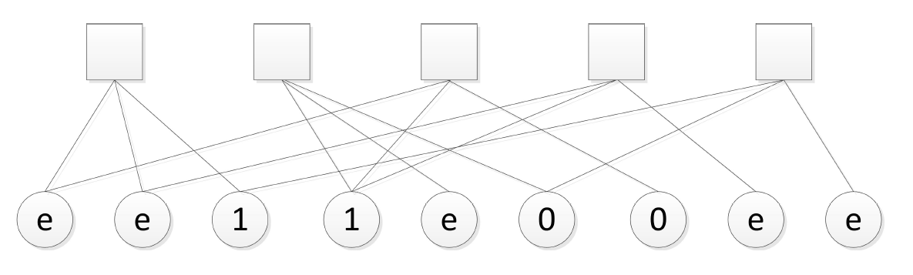
Correcting the Errors : Theoretically
Here, we can see that there are errors represented by ‘e’.

Slide 21
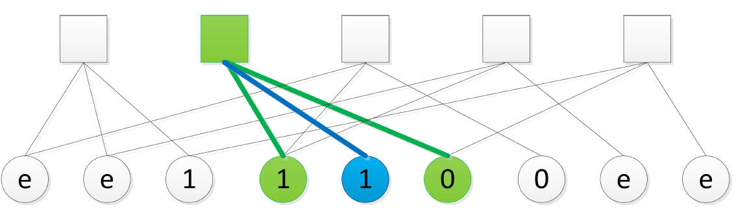
Correcting the Errors : Theoretically

Slide 22
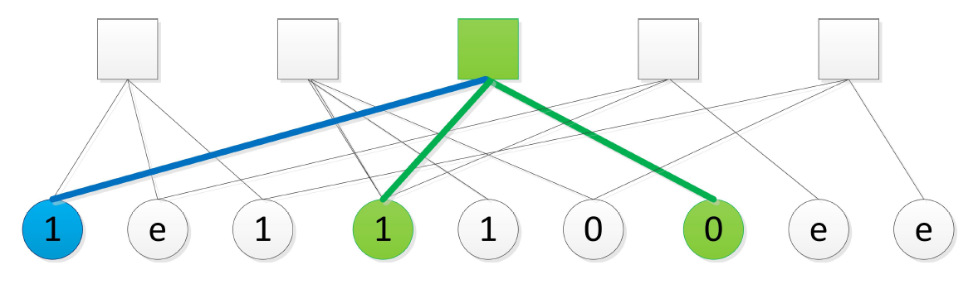
Correcting the Errors : Theoretically

Slide 23
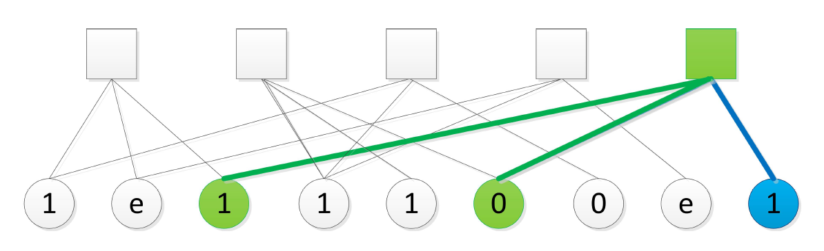
Correcting the Errors : Theoretically

Slide 24
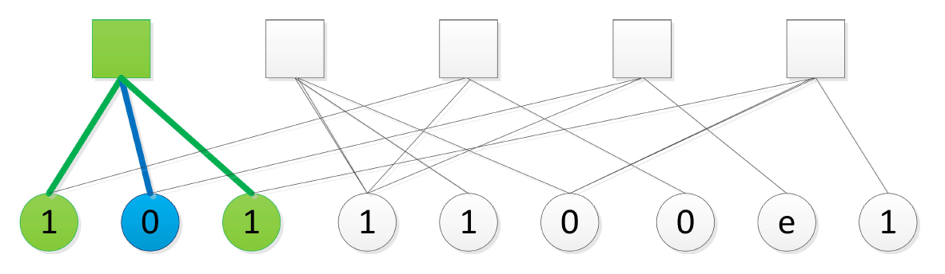
Correcting the Errors : Theoretically

Slide 25
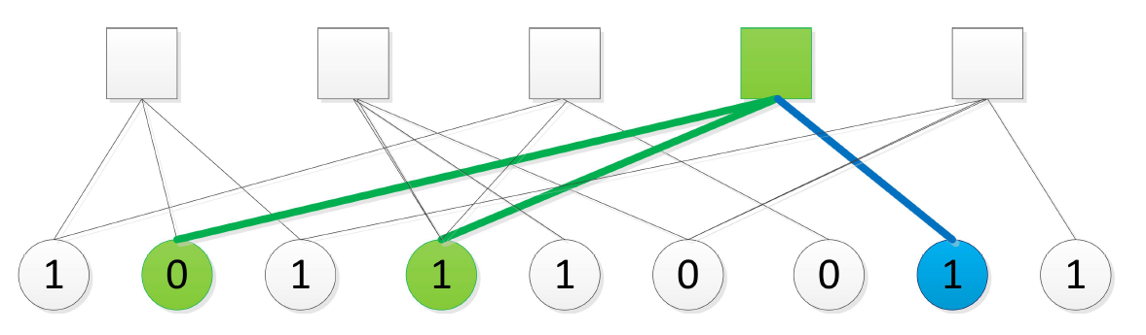
Correcting the Errors : Theoretically

Slide 26
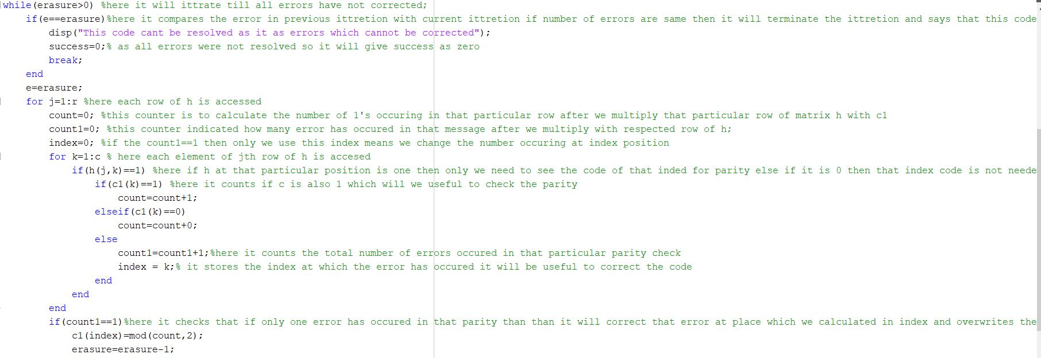
Now the code is

Slide 27
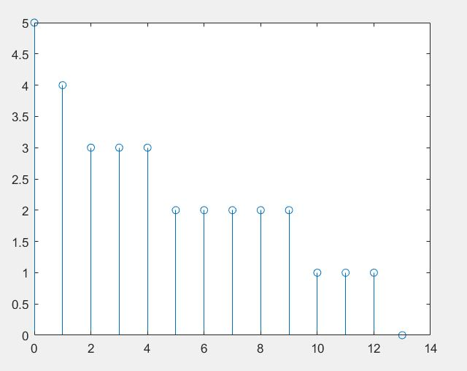
Simulation
Now we take an example of a (9,16) code ib=[1 0 1 1 1 0 1 0 0] .
So it will be encoded as 1 0 1 0 1 1 0 0 1 0 0 1 1 1 1 1.
Now we introduce error and send decoder 1 0 4 0 1 1 7 0 1 6 3 1 1 1 6 1.
Now it decode it properly and at each iteration number is shown in graph. Here 1 iteration means checking with 1 row of H matrix. The graph is as.

Slide 28
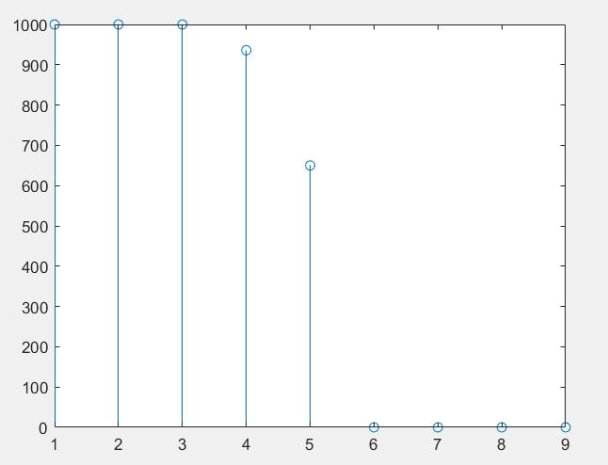
Now we plot Monte-Carlo for this for different number of errors. Here it is for (9,4) code and now it introduces 1,2,3,4,5,6,7,8,9 errors in it and performs 1000 experiments of 1 type and the graph of its correct-ability vs number of errors is plotted here.
Here x axis shows number of errors and axis shows how much it corrected out of 100 experiments.

Slide 29
Viterbi
Encoder
Decoder

Slide 30
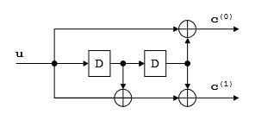
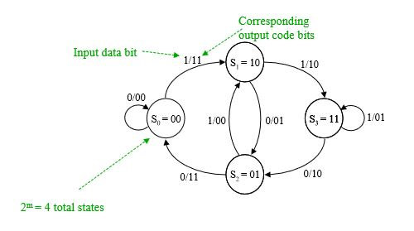
Encoder
Viterbi is a convolutional code.
It uses memory units.
One such encoded is shown.
Its FSM is as shown.

Slide 31
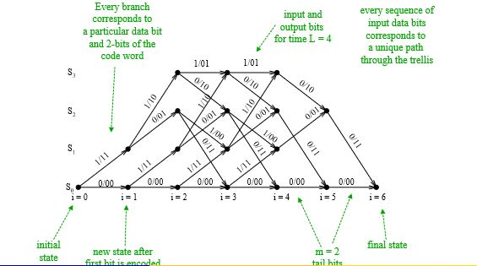
This is represented by trails.
Its outcome is shown by trails.

Slide 32
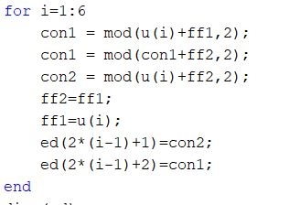
Now code for its encoding is
Here ff1 and ff2 are memory units.
U is message string we want to encode.
Its length here is 4.
We add 2 zero bits in its end to ensure memory bits become 0 after encoding.
And ed will be encoded string.

Slide 33
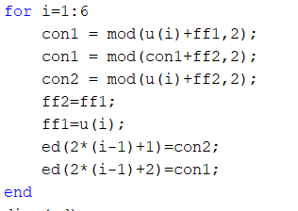
Simulation
Here we encode u=[ 1 1 0 1]
So we will encode u=[1 1 0 1 0 0 ] as we add 2 zero bits at end to make memory bits zero.
So it is encoded as.

Slide 34
Decoding
Now in decoding scheme we will use dynamic approach to decode it.
Here we will find a path from where by minimum number of distance from received signal we can reach from starting of trails to end.
For this also we will need trails as an help to decode it.

Slide 35
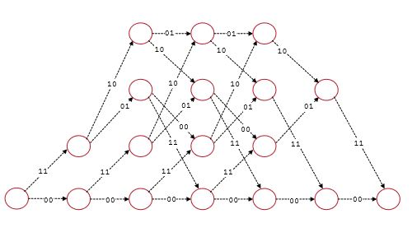
Trails whose help we seek

Slide 36
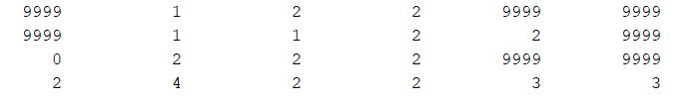
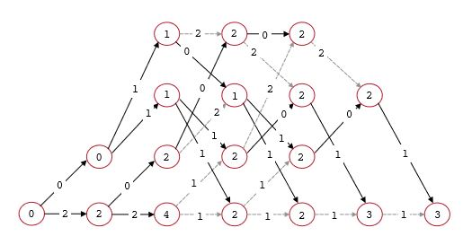


code for decoding
It uses a dynamic approach which is similar as how we solve in pen paper base.
The trellis and matrix for error code is shown.
The other matrix stores index of node before it from which it has emerged so using this 2 information using back tracking we get the path we want to go ad so we obtain original path and using it we decode and get the original transmitted signal.
The total distance storing matrix
Index of previous node from where current node is visited
The path obtained

Slide 37
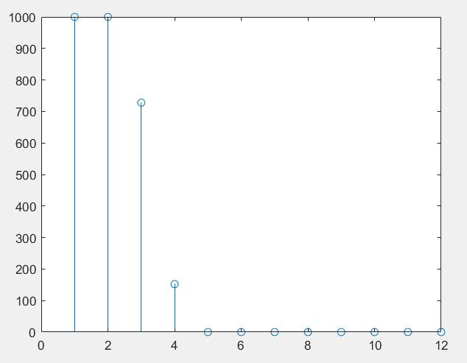
Here this the Monte-Carlo for different number of errors vs how many corrected for 1000 experiments.
X axis show number of errors and y axis shows number of times error corrected out of 1000 experiments.

Slide 38
Thank You

