Slide 1
Engineered Materials
(SC221)

Slide 2
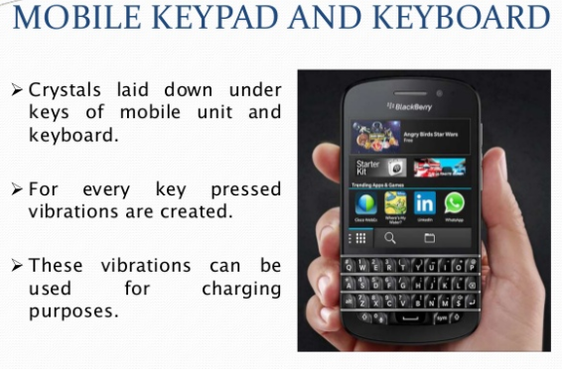
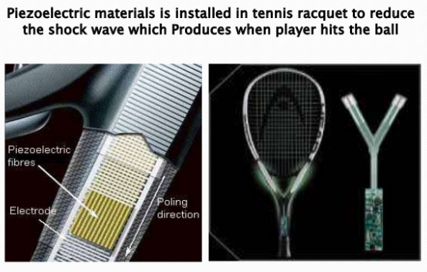
Notes:
Potential applications that can enhance daily life energy consumption by a little, and can improve user experience for many products.

Slide 3
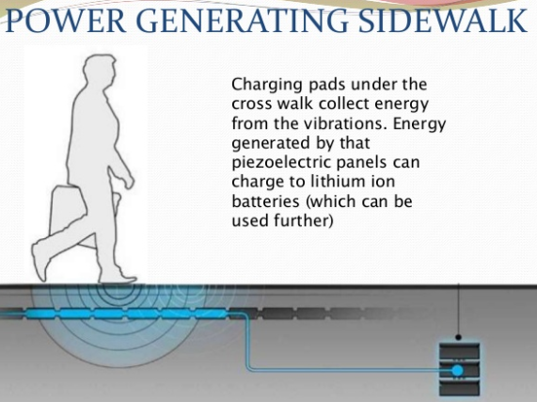
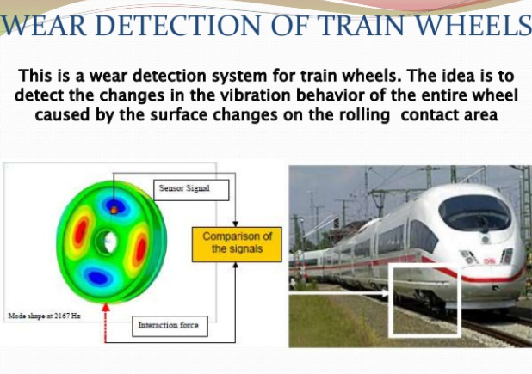
Notes:
Scalable projects where implementing piezoelectric materials seems the right choice.

Slide 4
Hunt for alternative/renewable sources of energy
Piezoelectric materials are very unusual materials with specific properties of being able to convert mechanical energy into electrical energy and vice versa.
These may also be used as energy harvesters and are used where batteries are unavailable or are not feasible option.
Inventors: Pierre Curie and Jacques Curie, 1880
Gabriel Lippmann, 1981

Slide 5
Piezoelectric phenomenon is a complex one and covers concepts of:
electronics as well as most of the areas of classical physics such as:
mechanics,
elasticity and strength of materials,
thermodynamics,
acoustics,
wave’s propagation,
optics,
electrostatics,
circuit theory,
crystallography etc.

Slide 6
Most common Piezoelectric material is Quartz (SiO₂).
Some other popular materials are:
Berlinite (AlPO₄)
Gallium Orthophosphate (GaPO₄)
Tourmaline (mainly boron silicate compounded with Al, Fe, Mg, Mn etc.)
Barium Titanate (BaTiO₃)
Lead Zirconate Titanate (PZT)
Zinc Oxide (ZnO)

Slide 7
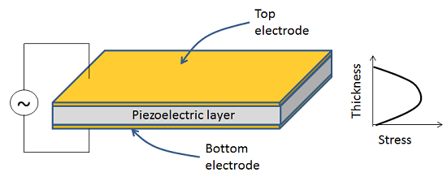
Objective is to extract maximum amount of electrical energy from applied mechanical energy, hence it has to be connected with an LCR circuit (without battery).
Can somebody tell why capacitor is required in this resonant circuit?
Else our job is done by connecting an LR circuit, too.

Slide 8
Piezoelectricity is the electric charge that accumulates in certain solid materials (such as crystals, certain ceramics, and biological matter such as bone, DNA and various proteins) in response to applied mechanical stress.
For example, lead zirconate titanate (PZT) crystals will generate measurable piezoelectricity when their static structure is deformed by about 0.1% of the original dimension. Conversely, those same crystals will change about 0.1% of their static dimension when an external electric field is applied to the material. The inverse piezoelectric effect is used in the production of ultrasonic sound waves.

Slide 9
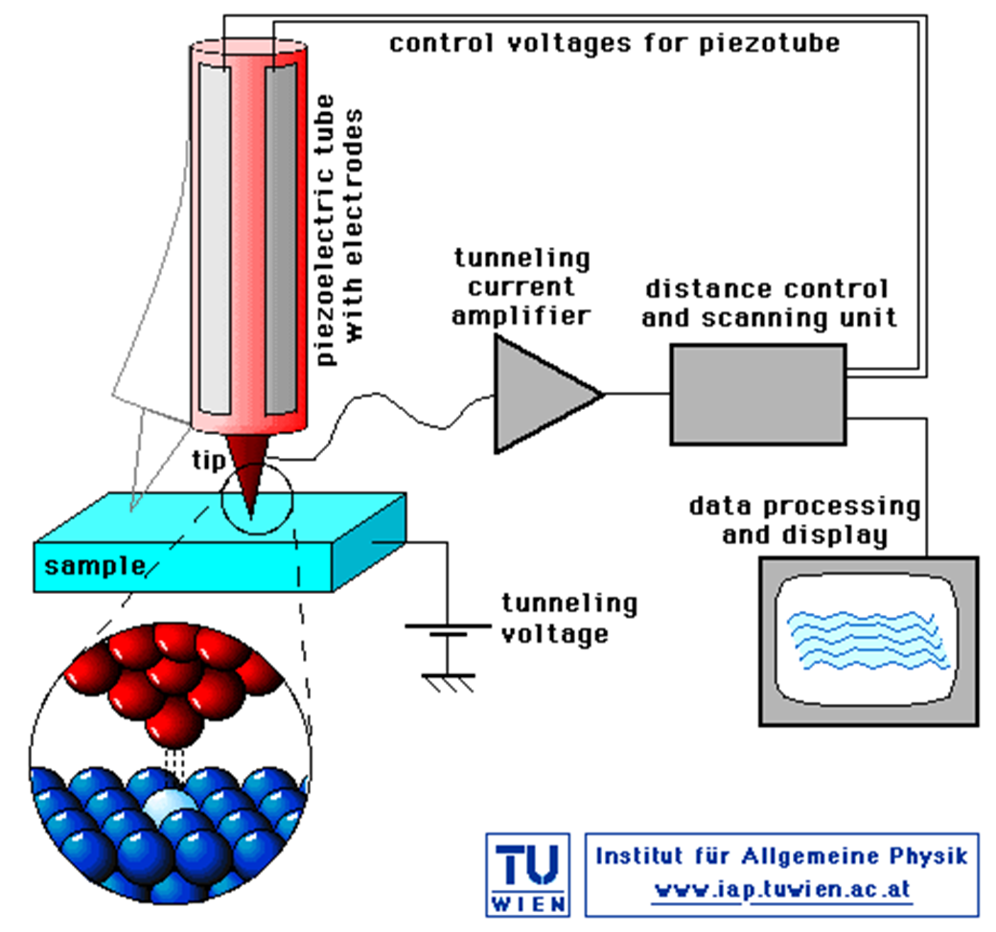
Explain the case of STM – how piezoelectric material helps achieve the precision in deflection of the armature.

Slide 10
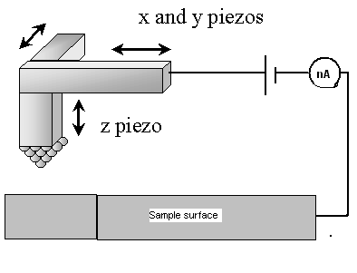
It is possible to accurately control the relative positions of tip and surface by using sensitive piezoelectric positioning device.

Slide 11
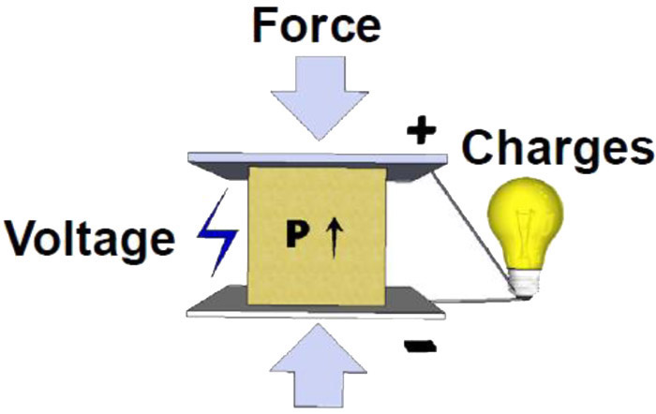
Can somebody tell how piezoelectric material is useful in quartz watches?

Slide 12
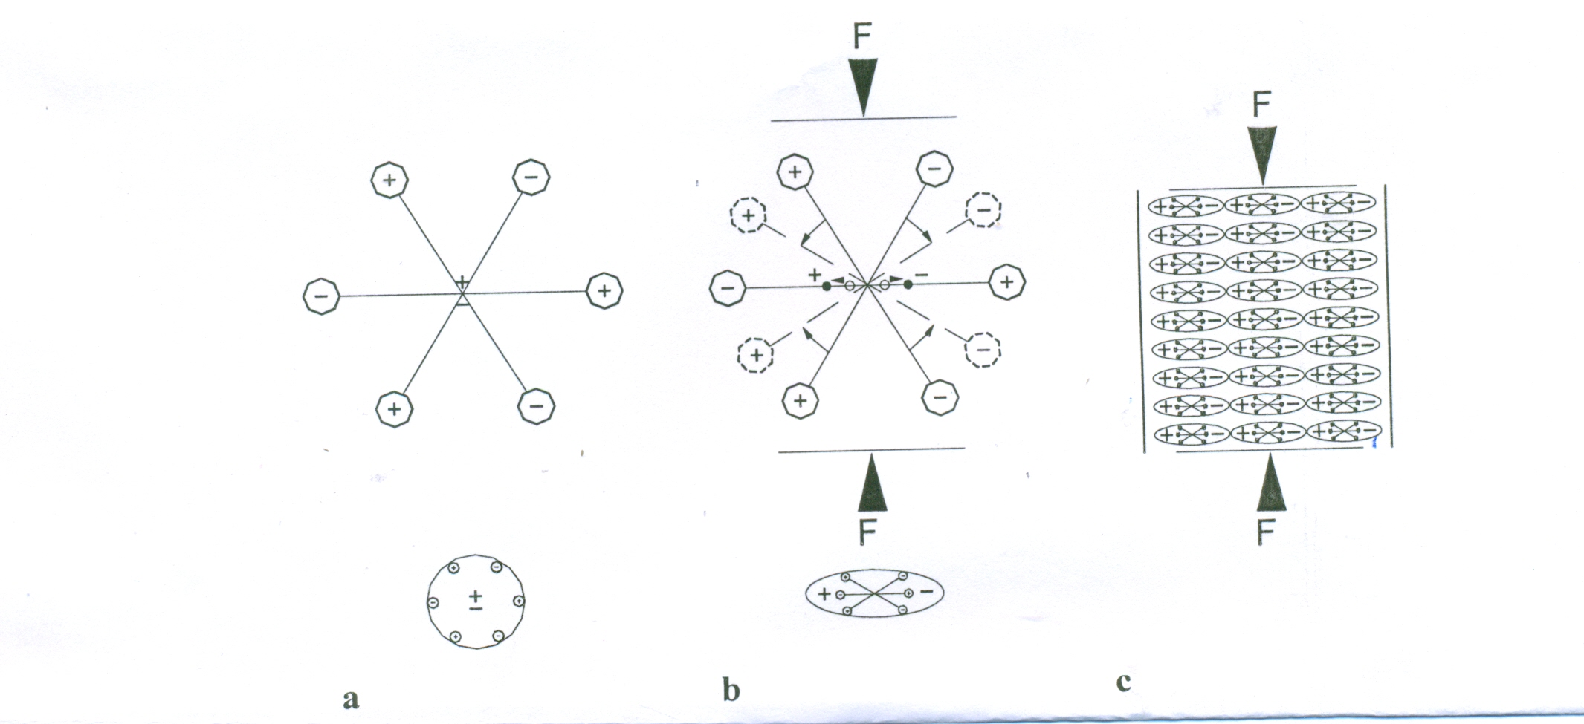
Let’s discuss this situation.

Slide 13
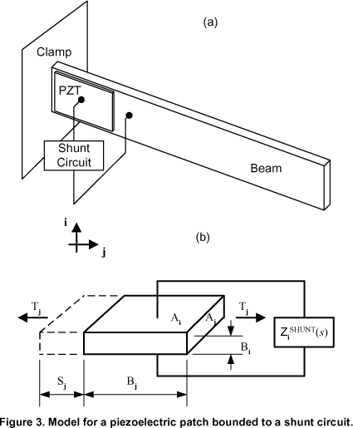
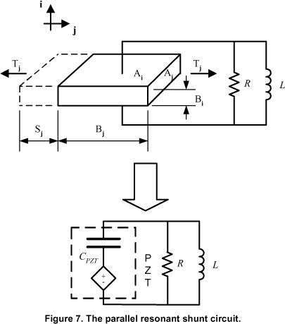
Capacitor is required in this resonant circuit only if we require to charge an energy source. It is like charging a battery for future use.
Schematic of a more practical
application.
Ignore the geometry of the figure
shown here.

Slide 14
A piezoelectric material develops an electrical field under strain. Also, it experiences strain under external electrical field.
Both properties can be harnessed appropriately when designing a sensor and/or transducer from a piezoelectric material.
These reactions can be in either direction (parallel or perpendicular).
Let’s first understand their crystal structure.

Slide 15
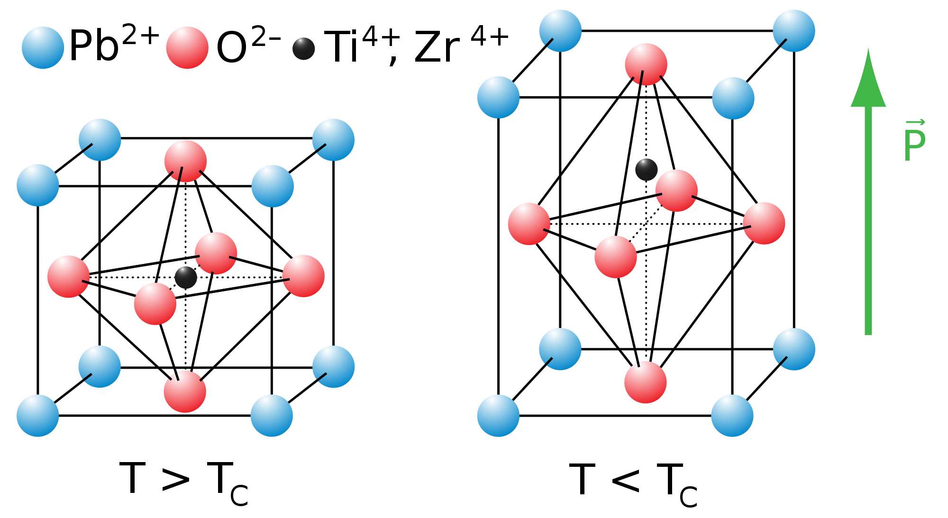
In a piezoelectric material molecules are oriented in such a way that it exhibits a local charge separation.
Hence a dipole moment is manifested.

