Slide 1

CT-iii End-Semester Project
Group 5 Assigned by: Prof. Yash Vasavada

Slide 2
Group Members:
ID | Name
201801046 | Ravi Patel
201801047 | Bhagyesh Ganatra
201801048 | Ayush Krishan Mohan
201801049 | Darsh Badodariya
201801050 | Anirudh Iyengar
201801051 | Preet Amin
201801052 | Hitesh Goyal
201801053 | Vatsal Agrawal
201801054 | Tejaswa Alia
201801055 | Rahul Khatri
201801056 | Dhruvil Bhatt

Slide 3
Honour Code
We declare that -
The work that we are presenting is our own work.
We have not copied the work (the code, the results, etc.) that someone else has done.
Concepts, understanding and insights we will be describing are our own.
We make this pledge truthfully. We know that violation of this solemn pledge can carry grave consequences.
Signed by: All the members of the project group.

Slide 4
Overview
Problem Statement
Introduction to LDPC coding technique
Introduction to Product Codes
Encoding techniques:
Generator Matrix and its use
Algorithm for creating Generator Matrix
Channels
Decoding Techniques
Parity Check Matrix
Tanner Graphs
Graphs and Inferences

Slide 5
Problem statement
During transmission of signal through channel , there is a high probability of error due to noise which changes the original transmitted message and thus wrong message is received by the receiver.
To minimize this error, various channel encoding techniques are used.
In this project , our main focus is on 2 such techniques i.e. Product Code and LDPC Code(how do they work , how to implement them and their efficiency)

Slide 6
Why use Product Code / LDPC CODES ?
The most basic method of solving this error issue is by using Single Parity Check(SPC) code.
By using the SPC method we are able to solve simple and short messages but this is not the case in the communication needs of this time where the messages are long and complex, which results in higher probability of error.
Thus here LDPC codes help us in this regard and helps to solve this problem by correcting the error or loss of message bits.

Slide 7
What are LDPC codes?
A low density parity check(LDPC) code is a error decoding code.
Each Regular LDPC code is characterised by wr, wc and n. wr denotes the number of 1’s in each row (as it is regular) and wc denotes the number of 1’s in each column (as it is regular).
It is represented using a bipartite graph called tanner graphs. These codes are specified by the linear block codes like parity check codes, H matrix and the generator matrix G.
This H matrix contains mostly 0’s and a few number of 1’s in it.
Each LDPC code has a parity bit mapping, also known as the Tanner Graph (which is explained later in detail).

Slide 8
Where LDPC codes are used?
The Low-Density-Parity-Check(LDPC) codes have gain much attention during the past few decades. It is because of the following advantages or the importance of this code.
It will be used in upcoming 5G technologies of communication system.
LDPC codes are increasingly used in some of the applications where reliable and highly efficient information transfer over bandwidth - constraint in the presence of corrupting noise is required.
The key feature of these LDPC codes are the linear decoding capacity. Because of the iterative decoding of the LDPC codes, it has lower time complexity as compared to other linear codes which have higher time complexity.

Slide 9
What are product codes and why they are important?
Product code is the encoded code represented by the matrix of k information bits out of n total message bits.
Single parity check codes have no error correction capability. However error correction can be achieved by combining two single parity check codes in the form of rectangular array.
Product code presented the first such method through which error free coding can be done with a non-zero code rate. By using simple constituent codes, this idea represents a very good technique to handle long and powerful codes.

Slide 10
Channel Encoding
Channel
DECODING
Encoding

Slide 11
PRODUCT CODE
Its codeword, have K number of message bits, N number of total encoded bits, and (N-K) number of parity bits.
Cases we deal with have the relation, N = (sqrt(K)+1)*(sqrt(K)+1).
The Product Code Matrix has the dimensions of ((sqrt(K)+1), (sqrt(K)+1)).
The value of each parity bit is obtained by computing the XOR of numbers in corresponding rows or columns.
EX: (9,4) Product Code: Here, K=4 and hence using the relation of K and N,
N=9. Thus, for the product code encoding, we generate a 3x3 matrix, which
contains all the encoded bits.

Slide 12
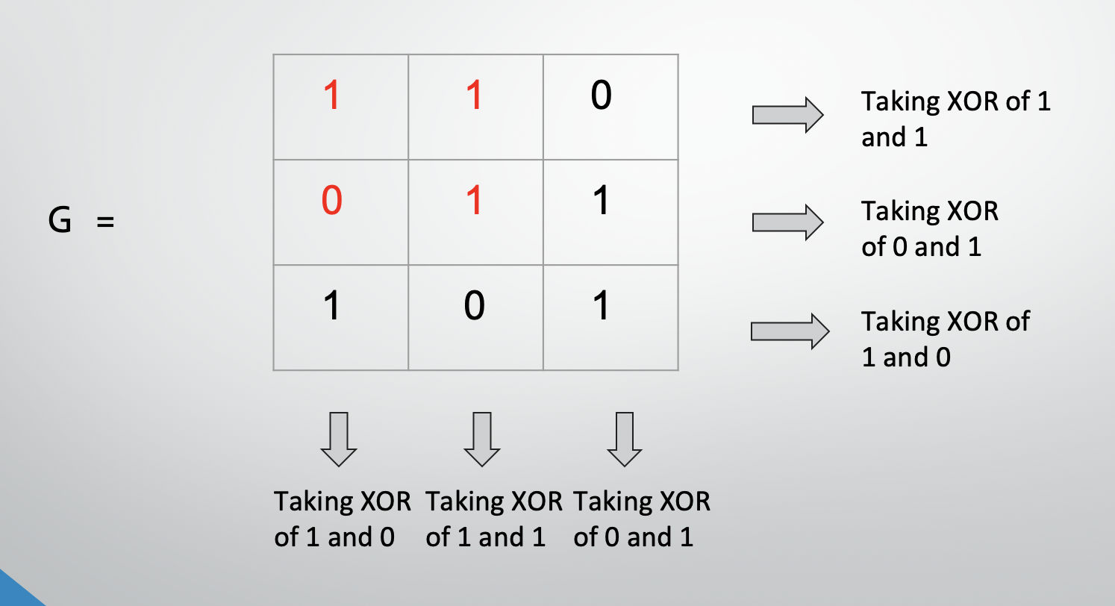
Encoded matrix(Product Code)
It is denoted by “C” and has the dimensions (N,1).
Each element of this column-matrix represents an encoded bit (parity bits are also present along with message bits).
Ex: (9,4) Product Code, where Message Signal = 1 1 0 1.

Slide 13
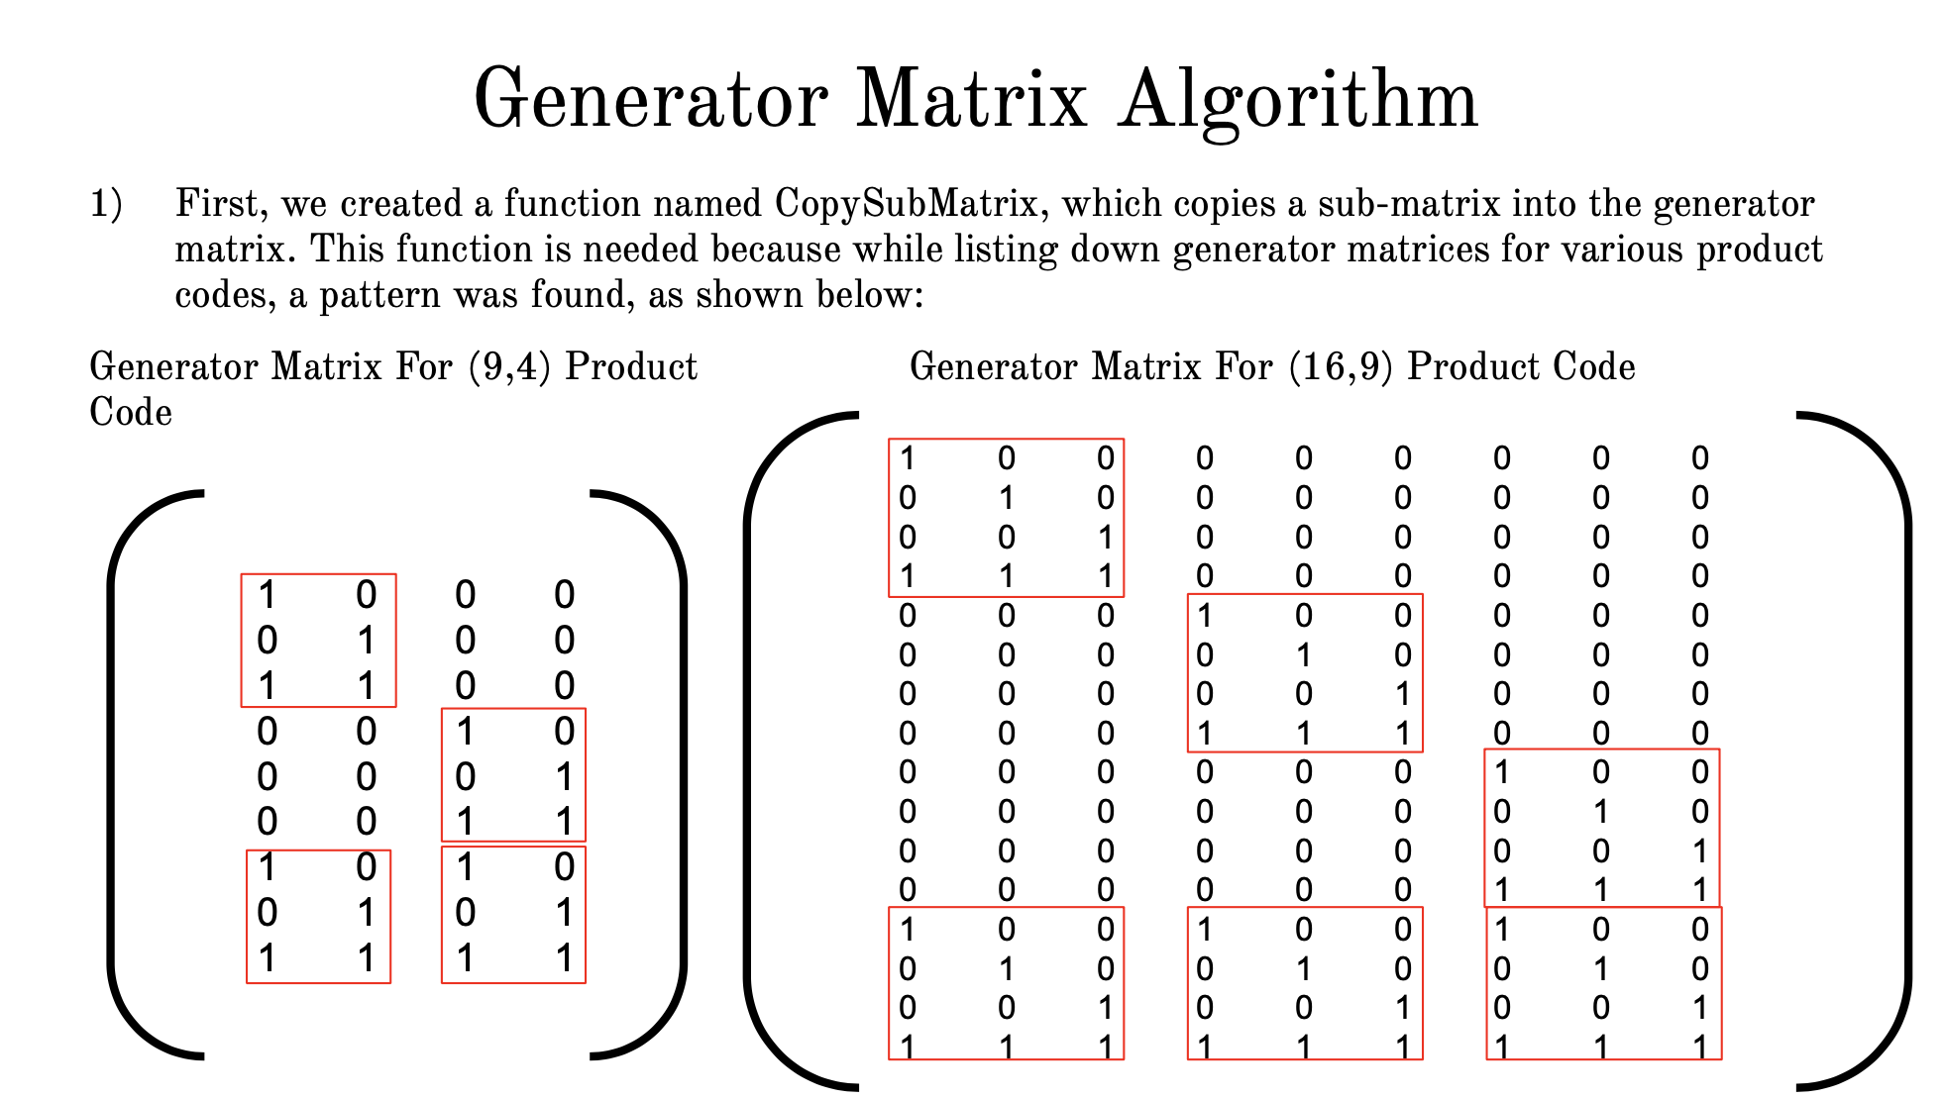

Slide 14
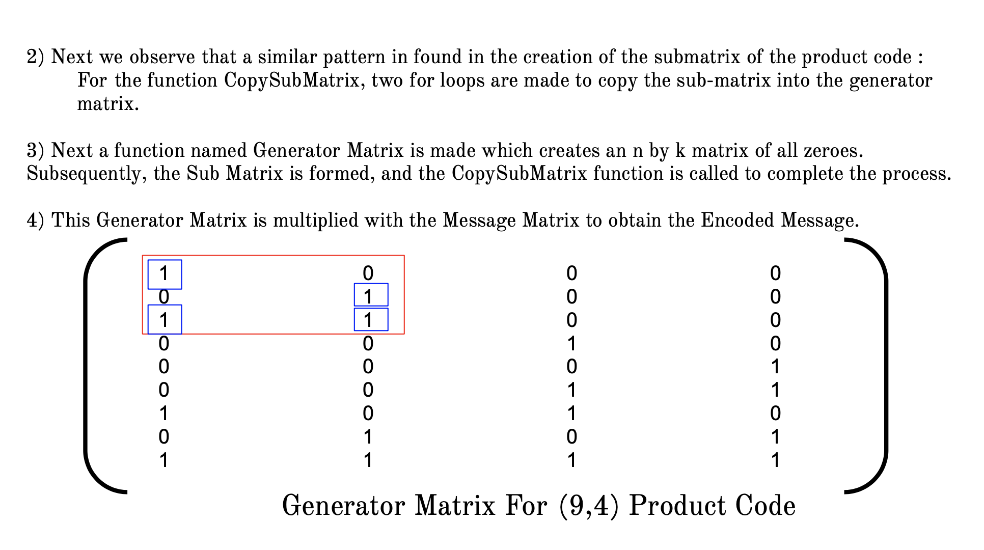

Slide 15
Channel Encoding
Channel
DECODING
Encoding

Slide 16
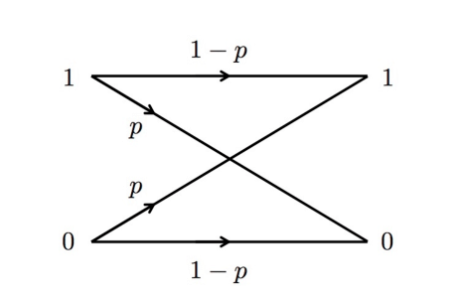
Binary Symmetric Channel (BSC)
Binary Symmetric Channel (BSC) is one of the common channels that is used for the transmission of the encoded bits.
In this channel the bits gets flipped during transmission.
A binary symmetric channel with cross-over probability p :

Slide 17
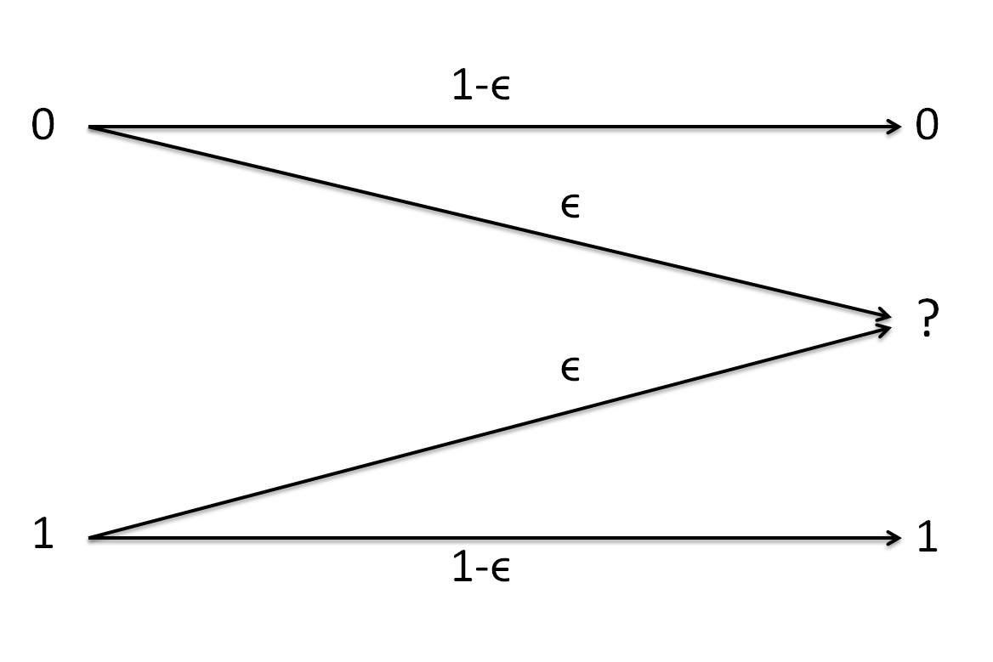
Binary Erasure Channel (BEC)
Binary Erasure Channel (BEC) is again one of the common channels that is used for the transmission of the encoded bits.
In this channel the bits gets erased during transmission.

Slide 18
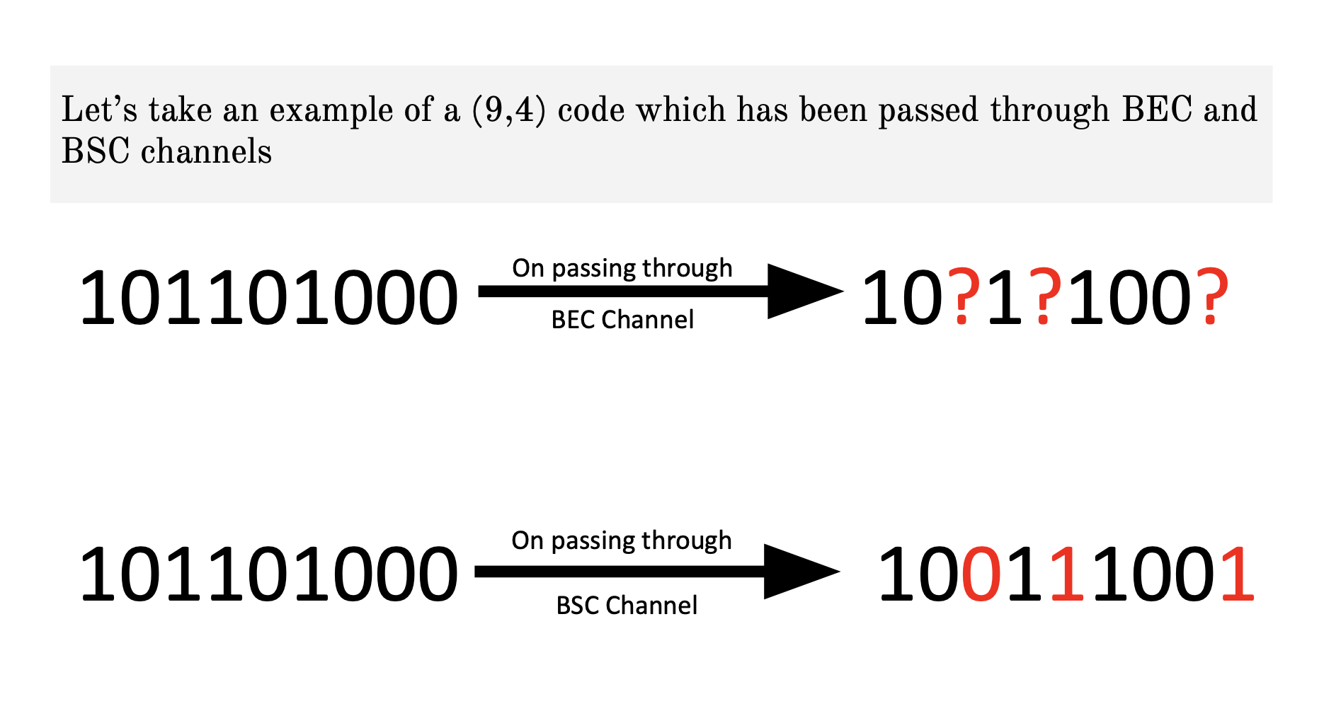

Slide 19
Channel Encoding
Channel
DECODING
Encoding

Slide 20
Parity Check Matrix
The solution developed is based on Parity Check Matrix, H which is based on the encoding scheme. Product Code of (n,k) dimensions has has H matrix of (n-k)*k order.
Similarly Low-Density-Parity-Check Matrix(LDPC)is higher order parity check matrix and as the name suggests has low density of 1’s in its matrix. It is unique for a particular value of N and K.
The value of H.G turns out to be zero matrix, irrespective of whether noise is added to the channel or not!

Slide 21
Parity Check Matrix For Product Code
ALGORITHM:
For first sqrt(k)-1 rows we put ‘1’ at columns from j=offset to offset+sqrt(k) where offset is initially ‘0’ and is incremented by sqrt(n)+1 at the end of each iteration.
For next sqrt(k)-1 rows we put ‘1’ at columns from i-sqrt(n) to n where i starts from sqrt(k) to 2*sqrt(k)-1 and incremented by 1 at each iteration and columns are incremented by sqrt(n).
For the last remaining (n-k-1)th row we put ‘1’ at columns ‘i*sqrt(n) + sqrt(k)’ and ‘sqrt(n)*sqrt(k) + i’ where i starts from ‘0’ and ends at sqrt(n).
At last we return our parity check matrix.

Slide 22
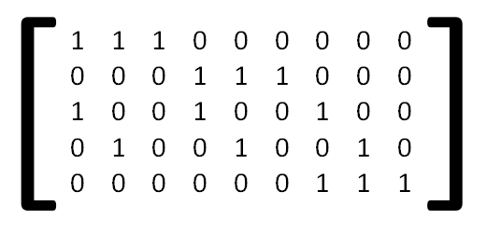
Here is an example of H matrix of a (9,4) Product Code. The dimensions are 5x4.

Slide 23
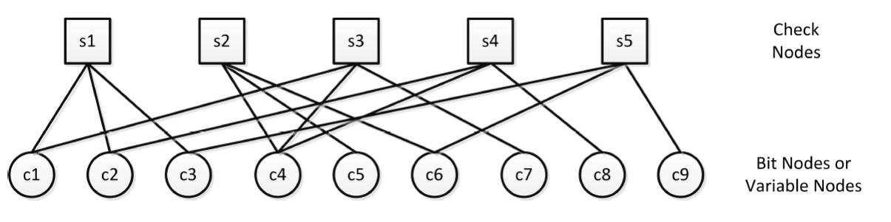
Tanner graph
Tanner introduced an effective representation of the parity-check matrix, which we now know as Tanner Graph.
Tanner graph consists of two sets of nodes, the variable nodes and check nodes.

Slide 24
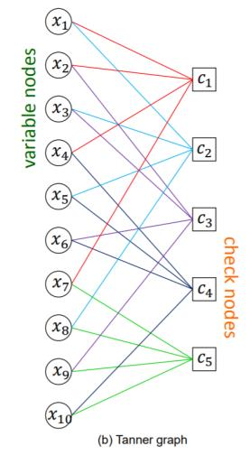
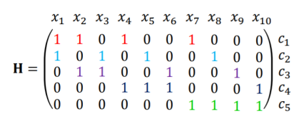
Here is an example H matrix and its Tanner Graph respectively :

Slide 25
Decoding using Tanner graph
Each of the variable node stores the value of EX-OR of the variable nodes connected to the check node except the selected the variable node itself.
This operation happens multiple times for each check node and thus the variable nodes store multiple suggested bits.
If the majority of the suggested bits are 1 then the variable nodes sets it value to 1, and if the majority of the suggested bits are 0 then to 0. If none of them is two is true then it retains its original value.
This would iterate until we find all the check nodes to be zero and hence decoding is successful. If we do not get all the check nodes to be zero, we stop iteration after n loops (we have taken n=50).

Slide 26
Operation on nodes:
Variable node operation:
V_{n}={ 0 If Ci has more zeros
1 If Ci has more ones
Vn Otherwise, }
where n=1, 2, … N for all variable nodes,
i=1,2, … for all check nodes
Check node operation:
C_{k}=V₁⊕V₂⊕…..⊕V_{l} ∀l≠k
where l and k are check nodes,
k=1,2… for all check nodes

Slide 27
Let’s take an example of a code which has been passed through BEC channel:
101101000
On passing through
BEC Channel
10?1?100?
We see here the three bits erased by the noise added due to BEC channel,
S1
S2
S3
S4
S5
1
0
?
1
?
1
0
0
?

Slide 28
When the S1 check-node checks if the EX-OR of all variable nodes connected to it.....
S1
S2
S3
S4
S5
1
0
?
1
?
1
0
0
?

Slide 29
When the S1 check-node checks if the EX-OR of all variable nodes connected to it.....
1 ⊕ 0 ⊕ ? = 0
S1
S2
S3
S4
S5
1
0
?
1
?
1
0
0
?

Slide 30
Similarly this iteration follows for other check nodes as well.
S1
S2
S3
S4
S5
1
0
1
1
?
1
0
0
?

Slide 31
Similarly for S2 check-node
1 ⊕ ? ⊕ 1 = 0
S1
S2
S3
S4
S5
1
0
1
1
?
1
0
0
?

Slide 32
S1
S2
S3
S4
S5
1
0
1
1
0
1
0
0
?

Slide 33
S3 check-node does not need to be checked
S1
S2
S3
S4
S5
1
0
1
1
0
1
0
0
?

Slide 34
S4 check-node does not need to be checked
S1
S2
S3
S4
S5
1
0
1
1
0
1
0
0
?

Slide 35
Similarly for S5 check-node
1 ⊕ 1 ⊕ ? = 0
S1
S2
S3
S4
S5
1
0
1
1
0
1
0
0
?

Slide 36
S1
S2
S3
S4
S5
1
0
1
1
0
1
0
0
?

Slide 37
S1
S2
S3
S4
S5
1
0
1
1
0
1
0
0
0
Thus finally the iteration ends and we decode the erased bits. Thus decoding is complete.

Slide 38
GRAPHS
Fund Category
Performance of BEC DECODER
Performance of BSC DECODER
Fund Category
RANDOMNESS OF RANDOM FUNCTION
LDPC

Slide 39
THEORETICAL ANALYSIS OF BEC (9,4) PRODUCT-CODE DECODING
NO. OF BITS IN ERROR | PROBABILITY OF NOT ABLE TO DECODE THE RECEIVED MESSAGE
<=3 | 0
4 | 9*(P^4).(1-P)^5
5 | 45*(P^5).(1-P)^4
6 | 84*(P^6).(1-P)^3
7 | 36*(P^7).(1-P)^2
8 | 9*(P^8).(1-P)^1
9 | 1*(P^9)

Slide 40
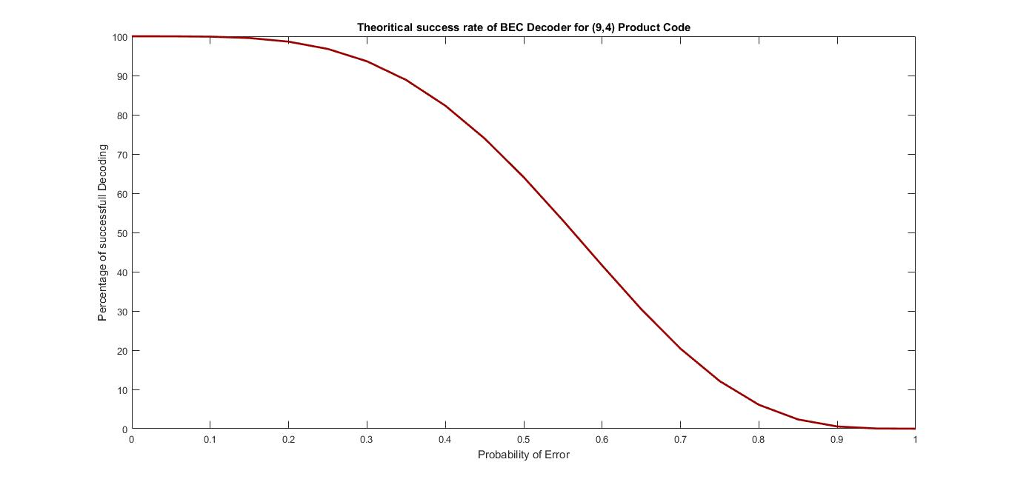

Slide 41
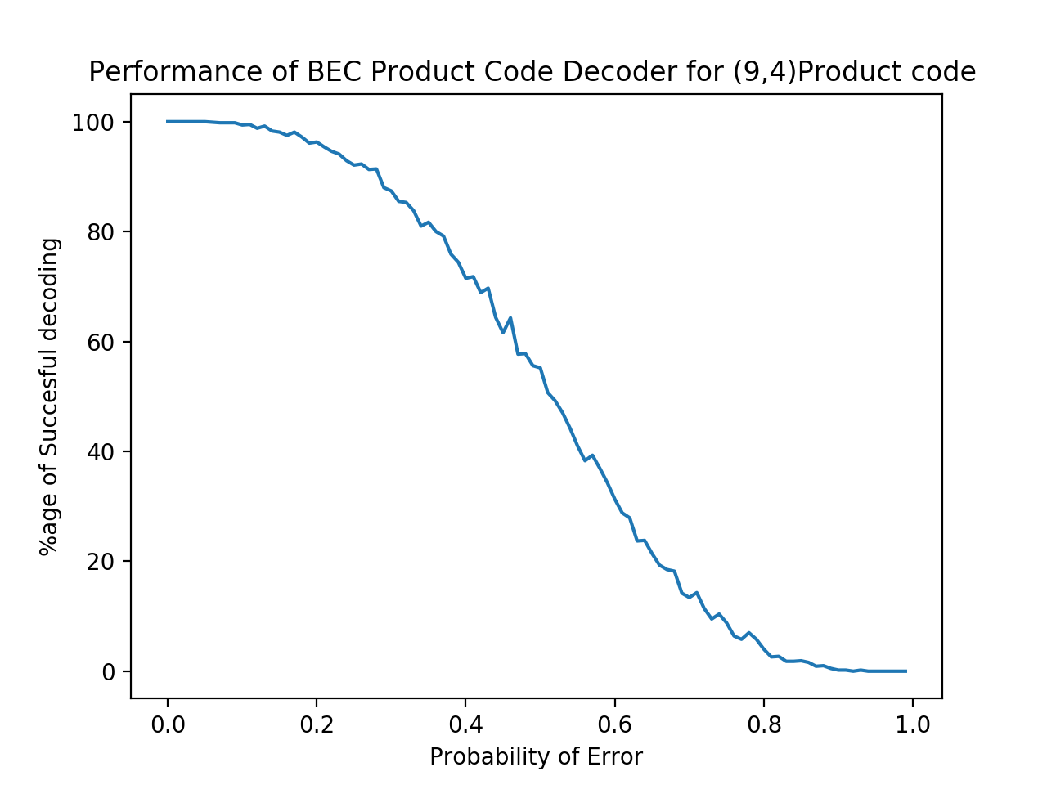
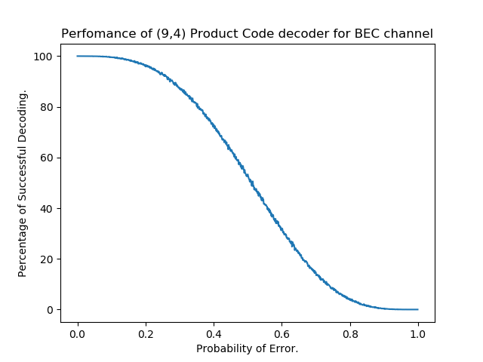
BEC
For 100X100 iteration (probabilities from 0-1 with gap of 0.01 and for each probability 100 iterations.)
For 1000X10000 iteration (probabilities from 0-1 with gap of 0.001 and for each probability 10000 iterations.)

Slide 42
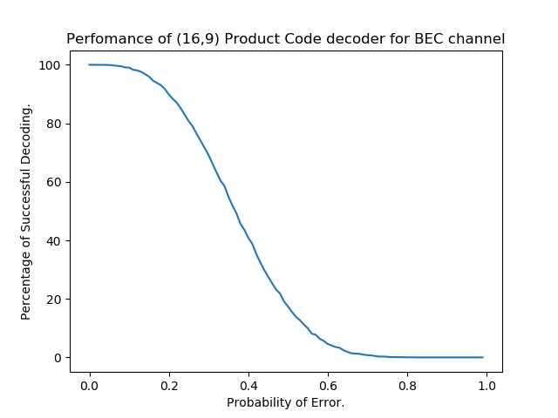
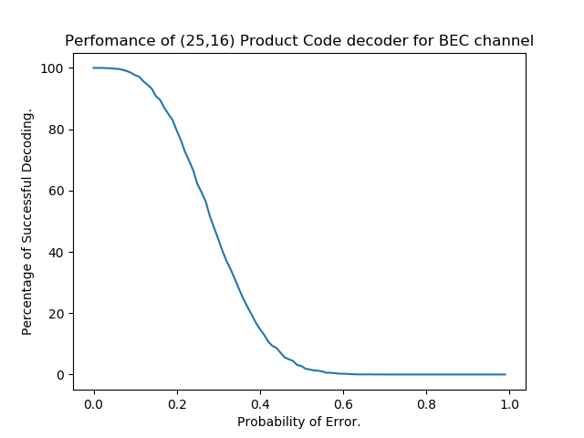
For 100x1000 iteration (probabilities from 0-1 with gap of .01 and for each probability 1000 iterations.)
For 100x1000 iteration (probabilities from 0-1 with gap of .01 and for each probability 1000 iterations.)

Slide 43
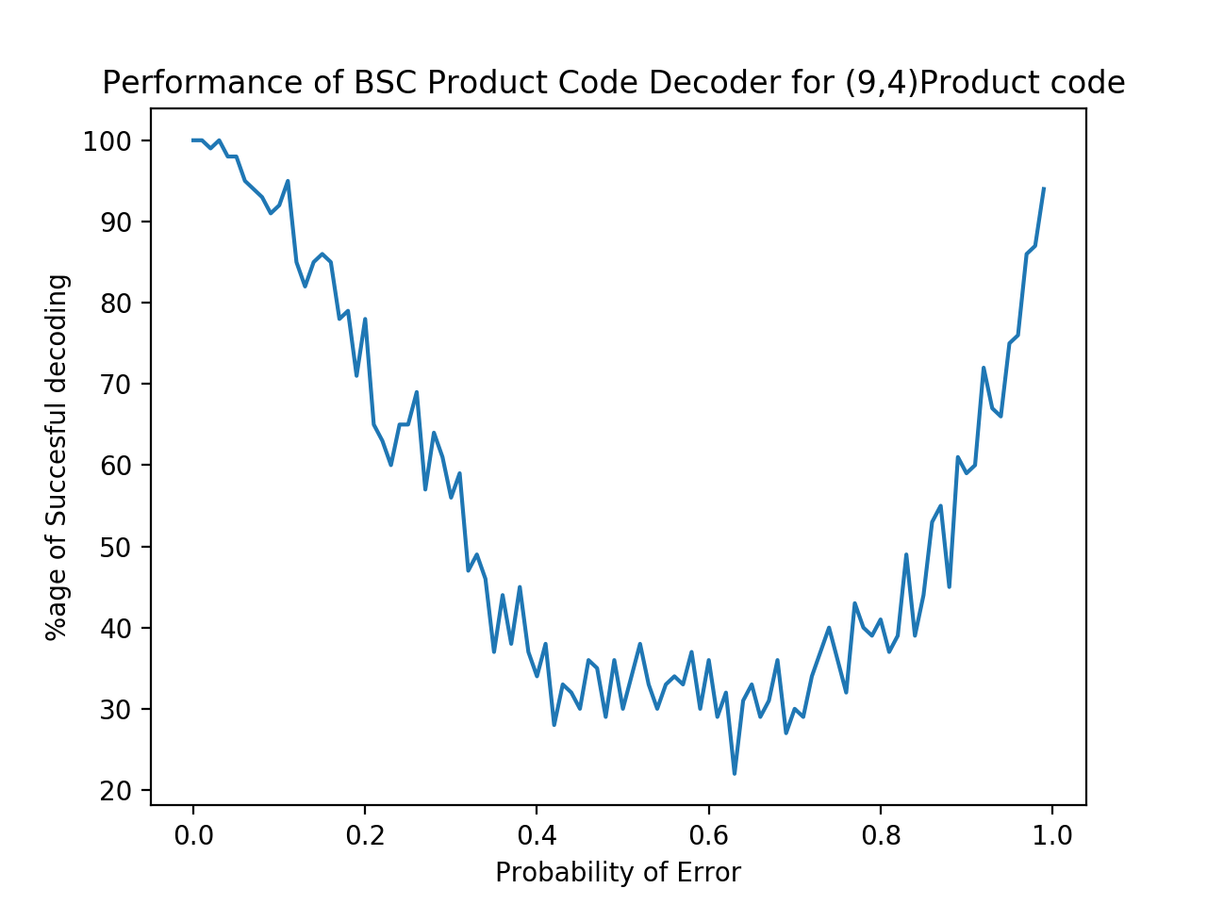
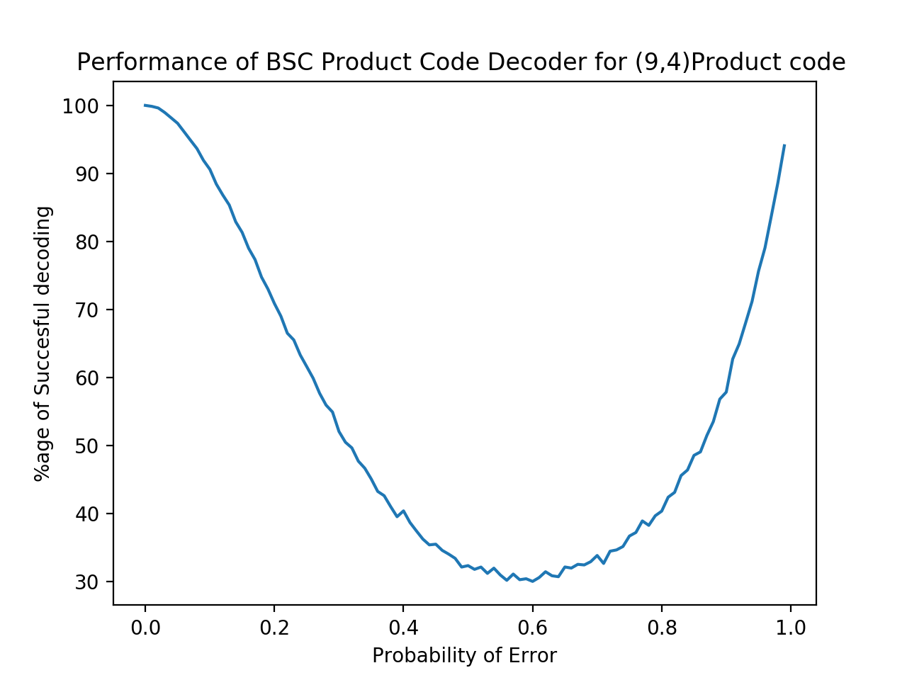
BSC
For 100X100 iteration (probabilities from 0-1 with gap of 0.01 and for each probability 100 iterations.)
For 1000X10000 iteration (probabilities from 0-1 with gap of 0.001 and for each probability 10000 iterations.)

Slide 44
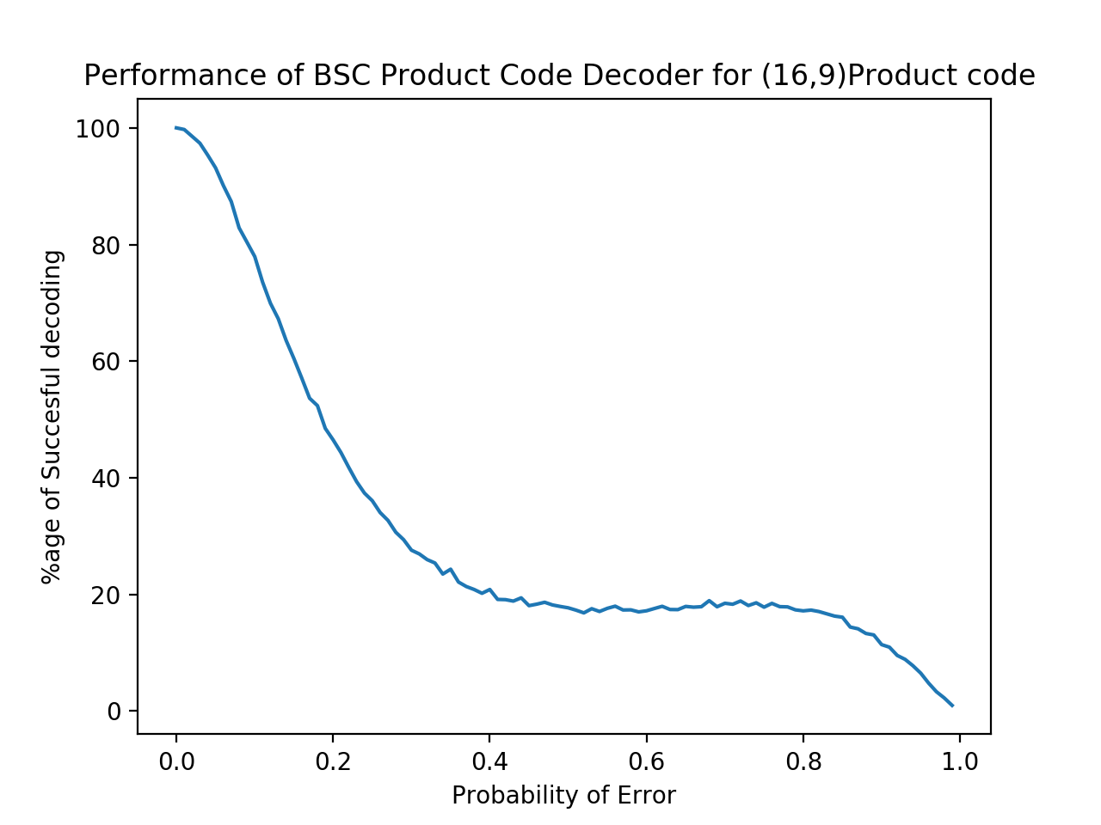
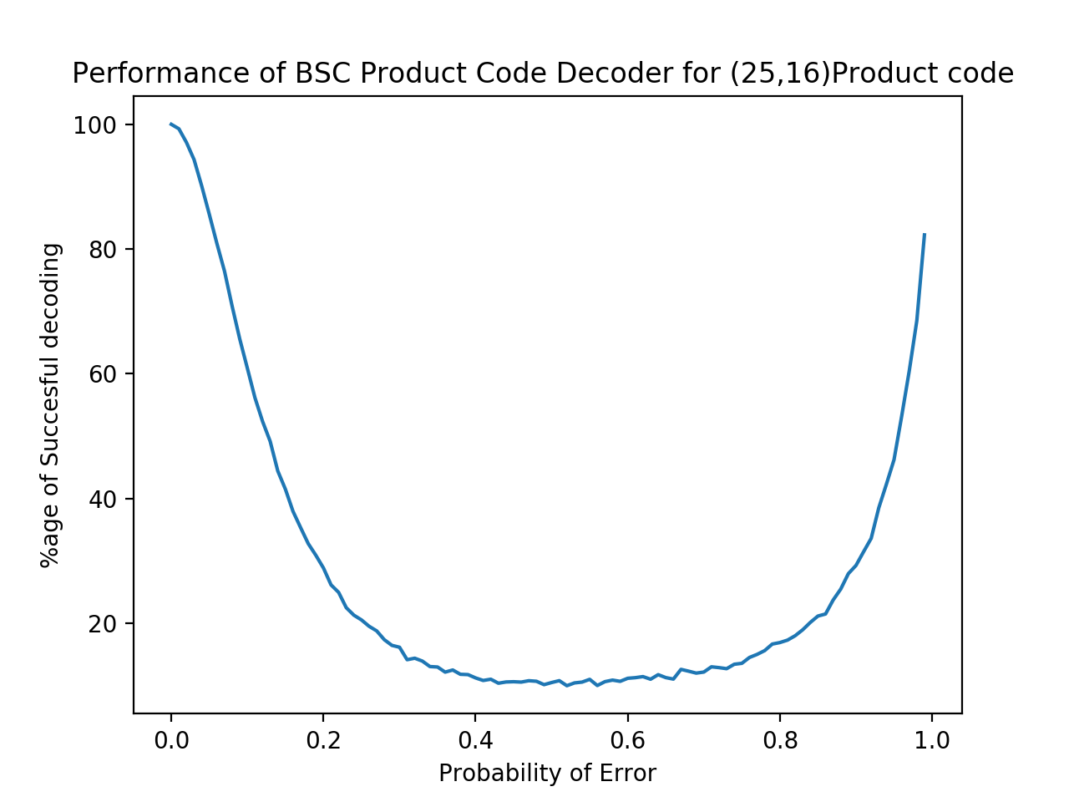
For 100x1000 iteration (probabilities from 0-1 with gap of .01 and for each probability 1000 iterations.)
For 100x1000 iteration (probabilities from 0-1 with gap of .01 and for each probability 1000 iterations.)

Slide 45
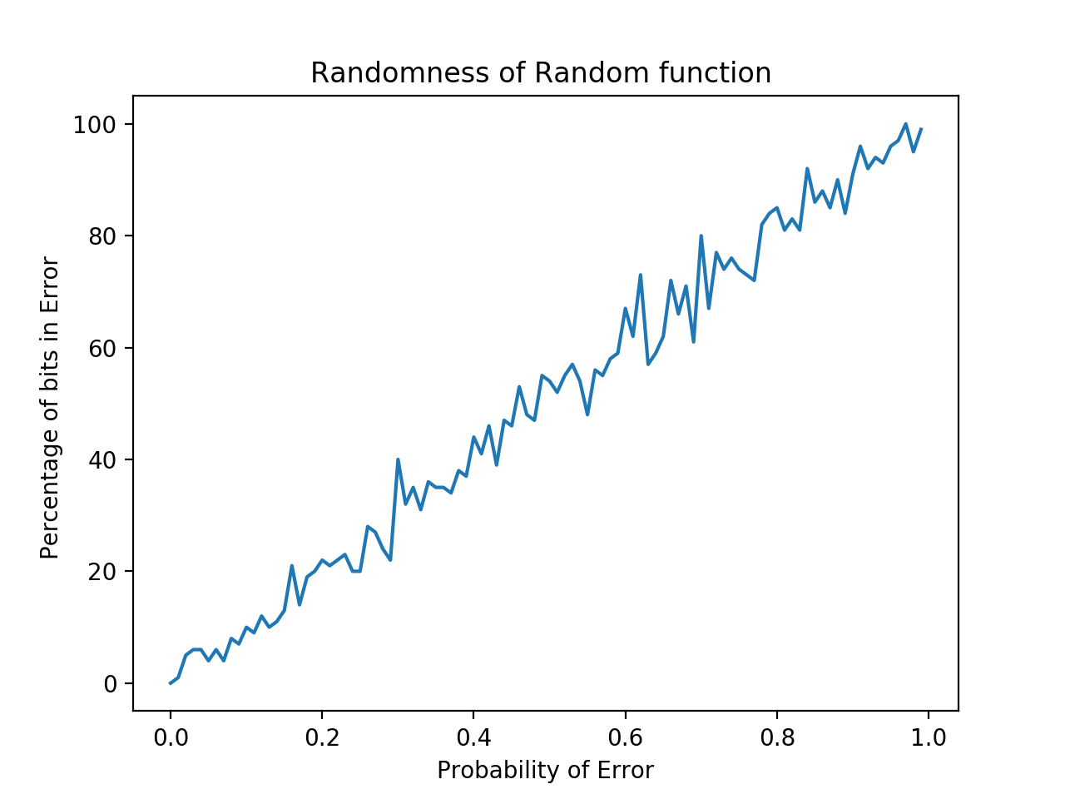
CHECKING RANDOM FUNCTION

Slide 46
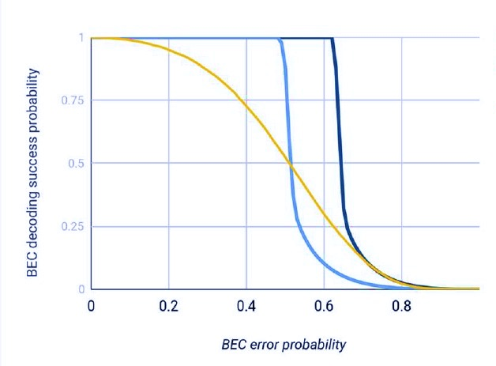
LDPC
H (3792X5056)
H (3000X5000)
H (9X12)

Slide 47
Challenges faced by us
Most of our prior knowledge was based on C++ and Matlab but for this very project we learned basic Python and its libraries like “numpy”, “scipy” and “matplotlib”.
Initially, we made our program in C++ , we switched to Python after finding that plotting graphs and file handling was very difficult in C++.
Also, initially, the time complexity was O(n3). So, we optimised it and brought the time complexity to O(n2) by increasing Space complexity.

Slide 48
What we learnt from this project?
We learnt about LDPC codes, Product codes and Tanner graphs.
We learnt working on python.
We learnt to collaborate and coordinate with the group members and also got the exposureof the ideas of the other people.

Slide 49

Thank You

