Slide 1
TWO-PORT NETWORKS

Slide 2
TWO-PORT NETWORK- Definition
A port : an access to a network and consists of two terminals
One-port network
I
+
V
−
Linear
network
I
- One pair of terminal
- Current entering the port = current leaving the port

Slide 3
TWO-PORT NETWORK- Definition
Two-port network
I₁
I₂
+
V₁
−
Linear
network
+
V₂
−
Input port
Output port
I₁
I₂
- Two pairs of terminal : two-port
- Current entering a port = current leaving a port
- V₁,V₂, I₁ and I₂ are related using two-port network parameters
- we will study on four sets of these parameters
Impedance parameters
Admittance parameters
Hybrid parameters
Transmission parameters

Slide 4
TWO-PORT NETWORK
Why ?
- Typically found in communications, control systems, electronics
- used in modeling, designing and analysis
- Know how to model two-port network will help in the analysis of larger network
- two-port network treated as ‘black box’

Slide 5


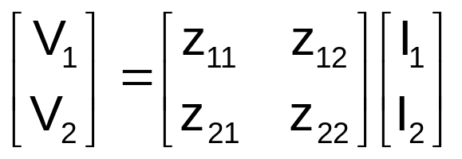
TWO-PORT NETWORK
Impedance parameters (z parameters)
Parameters can be determined by calculations or measurement

Slide 6
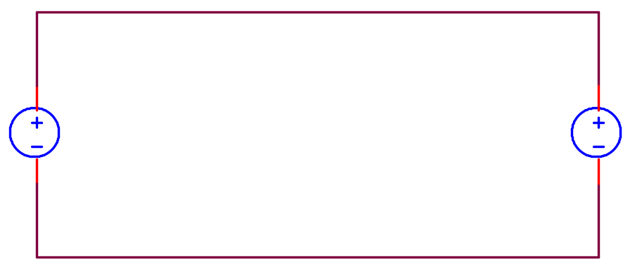
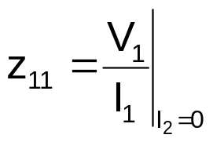

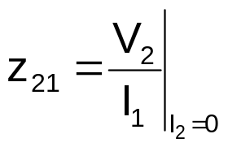

TWO-PORT NETWORK
Impedance parameters (z parameters)
z₁₁ and z₂₁
Output port : open
I₂ = 0
I₁
I₂
Input port : Apply voltage source
+
V₂
−
V₁

Slide 7
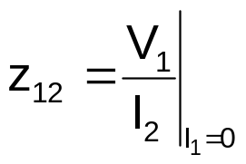

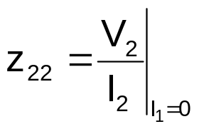

TWO-PORT NETWORK
Impedance parameters (z parameters)
z₁₂ and z₂₂
Input port : opened
I₁ = 0
I₁=0
I₂
Output port : Apply voltage source
+
V₁
−
V₁
V₂

Slide 8


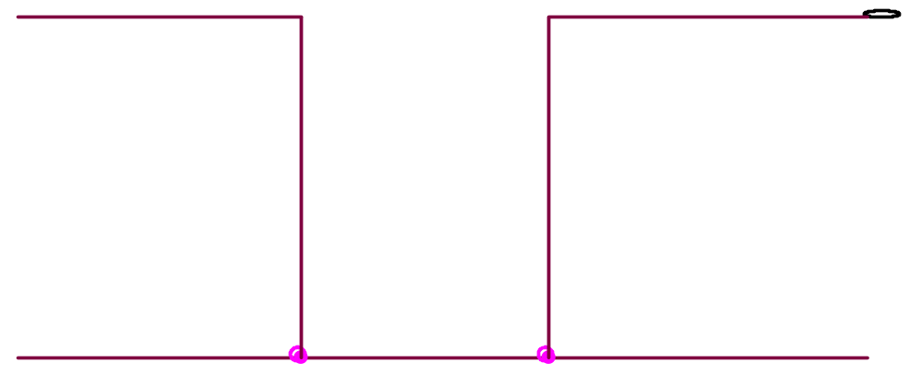


TWO-PORT NETWORK
Impedance parameters (z parameters)
Equivalent circuit based on these equations:
I₁
I₂
+
V₁
−
+
V₂
−
+
−
+
−

Slide 9
TWO-PORT NETWORK
Impedance parameters (z parameters)
ammeter
Linear network with NO dependent sources:
RECIPROCAL
Voltage source and ideal ammeter connected to the ports are interchangeable
I
I
V
Reciprocal
network
A
Reciprocal
network
A
V

Slide 10

TWO-PORT NETWORK
Impedance parameters (z parameters)
Linear network with NO dependent sources:
RECIPROCAL
Voltage source and ideal ammeter connected to the ports are interchangeable
z₁₂ = z₂₁
Can be replaced with T-equivalent circuit:
Z₁₁-z₁₂
Z₂₂-z₁₂
+
V₁
−
+
V₂
−
Z₁₂

Slide 11
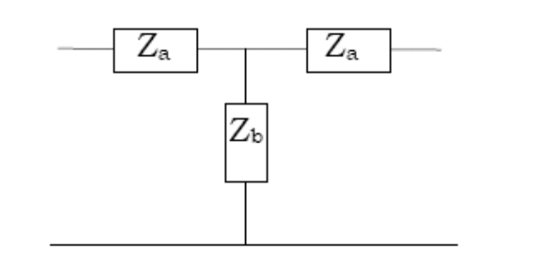
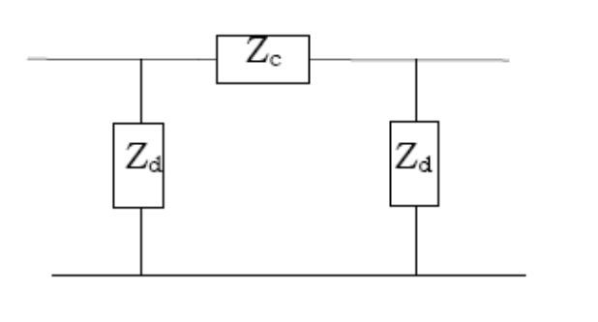
TWO-PORT NETWORK
Impedance parameters (z parameters)
Linear network with NO dependent sources:
RECIPROCAL
Network with mirror-like symmetry: SYMMETRICAL
z₁₁ = z₂₂

Slide 12
TWO-PORT NETWORK
Impedance parameters (z parameters)
Linear network with NO dependent sources:
RECIPROCAL
Network with mirror-like symmetry: SYMMETRICAL
If the two-port network is reciprocal and symmetrical, only 2 parameters need to be determined

Slide 13


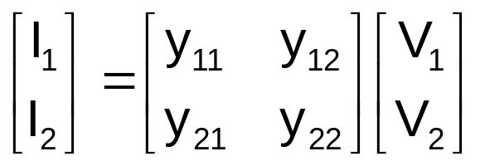
TWO-PORT NETWORK
Admittance parameters (y parameters)
Parameters can be determined by calculations or measurement

Slide 14
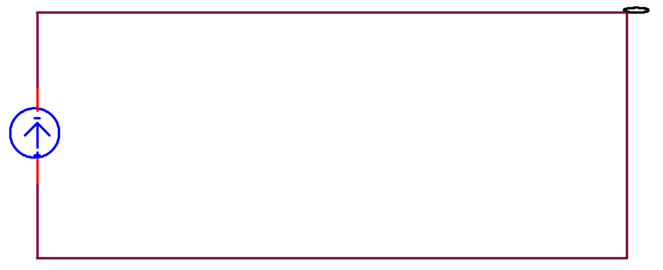
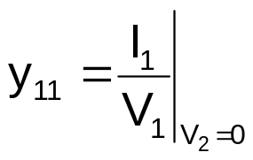

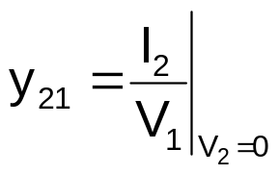

TWO-PORT NETWORK
Admittance parameters (y parameters)
y₁₁ and y₂₁
Output port : shorted
V₂ = 0
I₁
I₂
Input port : Apply current source
+
V₁
−
+
V₂ = 0
−

Slide 15
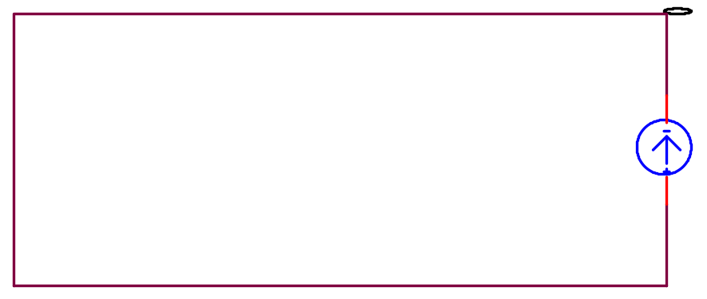


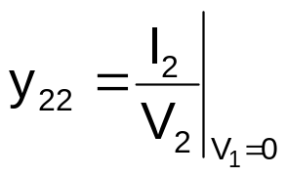

TWO-PORT NETWORK
Admittance parameters (y parameters)
y₁₂ and y₂₂
Input port : shorted
V₁ = 0
I₁
I₂
Output port : Apply current source
+
V₁=0
−
+
V₂
−

Slide 16
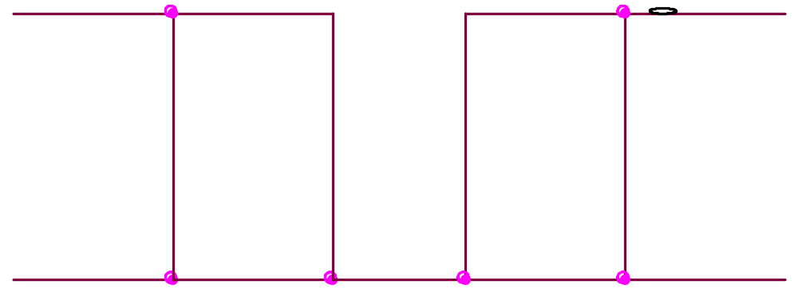




TWO-PORT NETWORK
Admittance parameters (y parameters)
Equivalent circuit based on these equations:
I₁
I₂
+
V₁
−
+
V₂
−

Slide 17
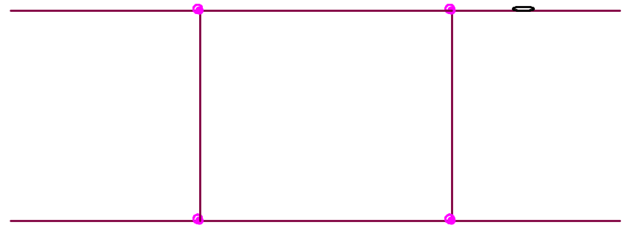
TWO-PORT NETWORK
Admittance parameters (y parameters)
Linear network with NO dependent sources:
RECIPROCAL
Current source and ideal voltmeter connected to the ports are interchangeable
y₁₂ = y₂₁
Can be replaced with π-equivalent circuit:
-y₁₂
+
V₁
−
+
V₂
−
y₁₁+ y₁₂
y₂₂+ y₁₂

Slide 18
TWO-PORT NETWORK
Admittance parameters (y parameters)
Network with mirror-like symmetry: SYMMETRICAL :
y₁₁ = y₂₂

Slide 19


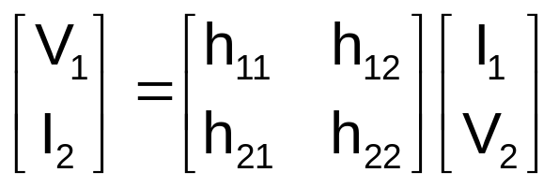
TWO-PORT NETWORK
Hybrid parameters (h parameters)
Some two port network cannot be expressed in terms z or y parameters but can be expressed in terms of h parameters
Parameters can be determined by calculations or measurement

Slide 20
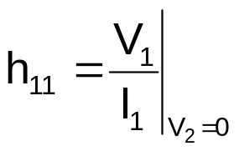

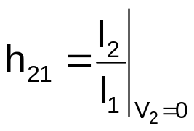

TWO-PORT NETWORK
Hybrid parameters (h parameters)
h₁₁ and h₂₁
Output port : shorted
V₂ = 0
I₁
I₂
Input port : Apply current source
+
V₁
−
+
V₂ = 0
−
(Ω)

Slide 21
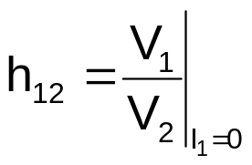



TWO-PORT NETWORK
Hybrid parameters (h parameters)
h₁₂ and h₂₂
Input port : opened
I₁ = 0
I₁=0
I₂
Output port : Apply voltage source
+
V₁
−
V₂
(S)

Slide 22
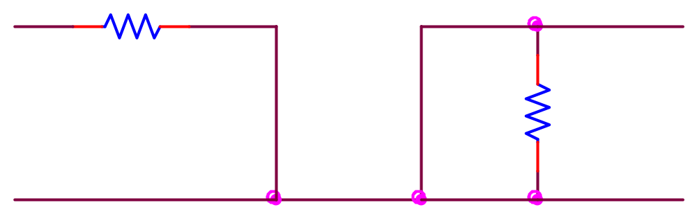
TWO-PORT NETWORK
Hybrid parameters (h parameters)
Equivalent circuit based on these equations:
I₁
h₁₁
I₂
+
V₁
−
+
V₂
−
+
−
h₁₂V₂
h₂₁I₁
1 / h₂₂

Slide 23
TWO-PORT NETWORK
Hybrid parameters (h parameters)
Linear network with NO dependent sources:
RECIPROCAL
Current source and ideal voltmeter connected to the ports are interchangeable
h₁₂ = -h₂₁

Slide 24
TWO-PORT NETWORK
Hybrid parameters (h parameters)
Network with mirror-like symmetry: SYMMETRICAL :
h₁₁h₂₂ – h₁₂h₂₁ = 1

Slide 25


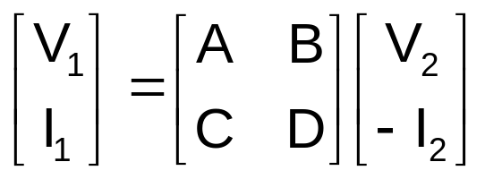
TWO-PORT NETWORK
Transmission parameters (t parameters)
Used to express the sending end voltage an current in terms of receiving end voltage and current
I₁
-I₂
+
V₁
−
Linear
network
+
V₂
−
sending end
receiving end
I₁
I₂

Slide 26
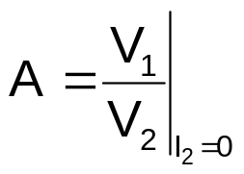
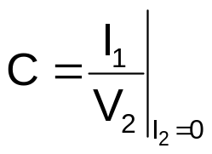


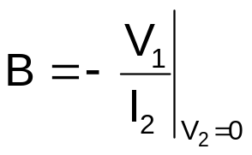
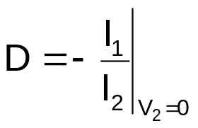


TWO-PORT NETWORK
Transmission parameters (h parameters)
Output port : opened
I₂ = 0
Output port : shorted
V₂ = 0
For RECIPROCAL network, AD – BC = 1
For SYMMETRICAL network, A = D

Slide 27
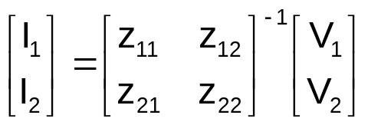

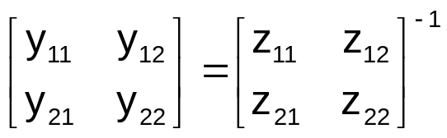
TWO-PORT NETWORK
Relationships between parameters
If a two-port network can be presented by different set of parameters, then there exists relationships between parameters.
e.g. relationships between z and y parameters:
We know that
Therefore

Slide 28
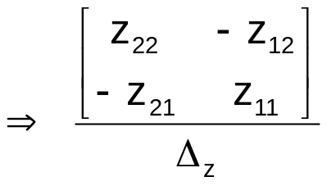

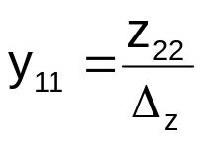
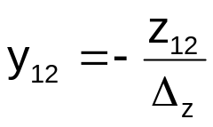
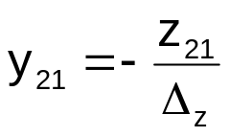
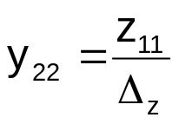
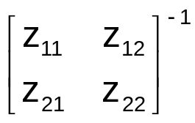
TWO-PORT NETWORK
Relationships between parameters
where
Therefore,
The conversion formulae can be obtained from the conversion table
e.g. on page 869 of Alexander/Sadiku

Slide 29
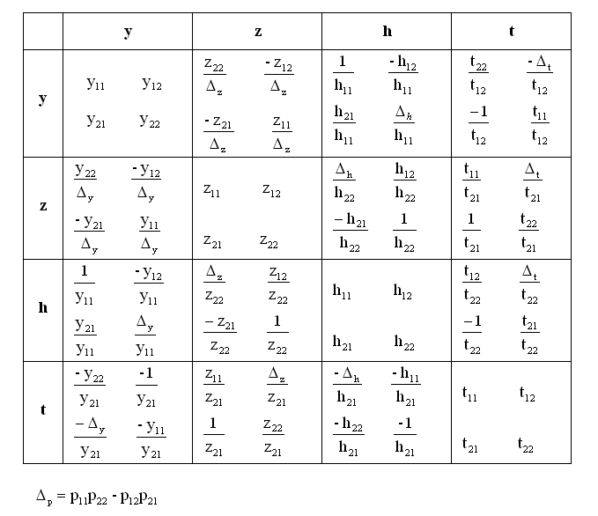
TWO-PORT NETWORK
Relationships between parameters

Slide 30
TWO-PORT NETWORK
Interconnection of networks
Complex large network can be modeled with interconnected two-port networks
Simplify the analysis /synthesis
Simplify the design
Parameters of interconnected two-port networks can be obtained easily: depending on the type of parameters and type of connections:
Series: z parameters
Parallel: y parameters
Cascade: transmission parameters

Slide 31
TWO-PORT NETWORK
Interconnection of networks
Series: z parameters
I_{1a}
I_{2a}
+
V_{1a}
−
+
V_{2a}
−
+
V₁
−
z_{a}
+
V₂
−
I₁
I₂
+
V₁
−
+
V₂
−
z
I_{1b}
I_{2b}
+
V_{1b}
−
+
V_{2b}
−
z_{b}
[z] = [z_{a}] + [z_{b}]

Slide 32
TWO-PORT NETWORK
Interconnection of networks
Parallel: y parameters
I_{1a}
I_{2a}
+
V_{1a}
−
+
V_{2a}
−
y_{a}
I₁
I₂
I₁
I₂
+
V₁
−
+
V₂
−
+
V₁
−
+
V₂
−
y
I_{1b}
I_{2b}
+
V_{1b}
−
+
V_{2b}
−
y_{b}
[y] = [y_{a}] + [y_{b}]

Slide 33
TWO-PORT NETWORK
Interconnection of networks
Cascade: t parameters
I₁
I_{1a}
-I_{2a}
I_{1b}
-I_{2b}
-I₂
+
V₁
−
+
V_{1a}
−
+
V_{2a}
−
+
V_{1b}
−
+
V_{2b}
−
+
V₂
−
t_{a}
t_{b}
I₁
-I₂
+
V₁
−
+
V₂
−
t
[t] = [t_{a}][t_{b}]

