Slide 1
Probability theory

Slide 2
Sample Space: It is the set of all possible outcomes of an experiment. It is denoted by S
Examples:
Flipping a coin, S = {T, H}
Rolling a dice, S = {1,2,..,6}

Slide 3
Probability Space (PS)
PS = (S, Pr), where :
S is the sample space
Pr is a function from 2^{S} to [0, 1]

Slide 4
Event: Each subset of S is called an event. It is denoted by A.
Example: Rolling a dice, S= {1,2, …,6}
Odd number appears, A={1,3,5}

Slide 5
Axioms of a PS = (S, Pr)
Pr(Φ)= 0
Pr(S)=1
0<= Pr(A) <= 1, where A ⊆ S
If A, B ⊆ S and A Π B = Φ, then
Pr(A U B)= Pr(A) + Pr(B)

Slide 6
Independence
Two events A and B are independent if
Pr(A Π B)= Pr(A). Pr(B)

Slide 7
Conditional Probability
The probability that A happens, given that B has already happened is denoted by Pr(A|B).
Pr(A|B) = Pr(A Π B)/ Pr(B)

Slide 8
Random Variable X
It is a function X that maps each element of S to a real number
X: S → R
Indicator Random Variable:
X: S → {0, 1}

Slide 9
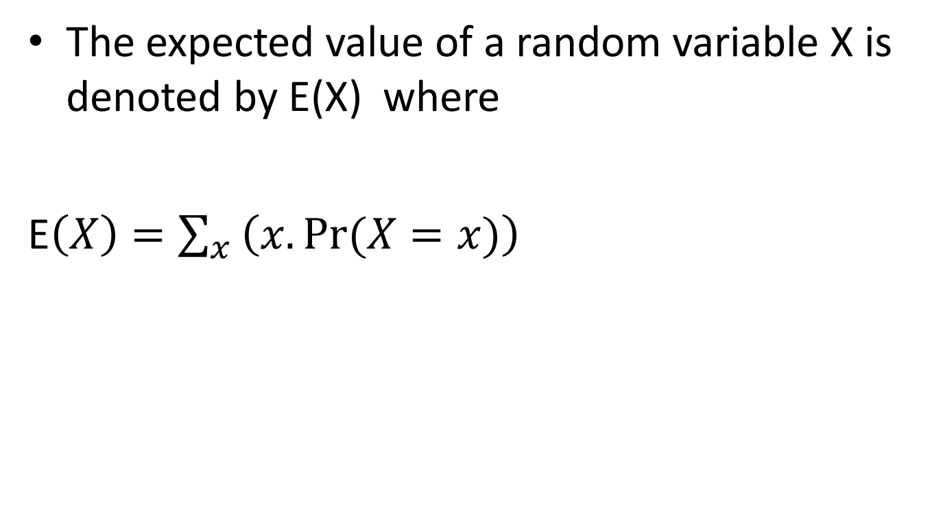
Expected value
The expected value of a random variable X is denoted by E(X) where
E$\left(X\right)=\sum_{x}{\left(x.Pr⁡(X=x)\right)}$

Slide 10
Example
Let X be a random variable that assigns the outcomes of the roll of two fair dice the sum of the number on the two dices. What is the expected value of X.
E(X)= ?

Slide 11
Example
Let X be a random variable that assigns the outcomes of the roll of two fair dice the sum of the number on the two dices. What is the expected value of X.
E(X)= 7

Slide 12
Linearity of Expectation
Let X and Y be two random variables
E(X + Y)= E(X) + E(Y)
E(c.X)= c.E(X) where c is a real number.

Slide 13
Example
What is the expected number of times a person must toss a coin to get a head.

Slide 14
Example
What is the expected number of times a person must toss a coin to get a head.
Answer is 2

