Slide 1




Slide 2

Approach
Two aspects:
  Physical collision experiment with eraser boxes
    provides real world data to corroborate simulation
  Interactive computer simulation
    Simulates collisions with a variety of shapes

Slide 3
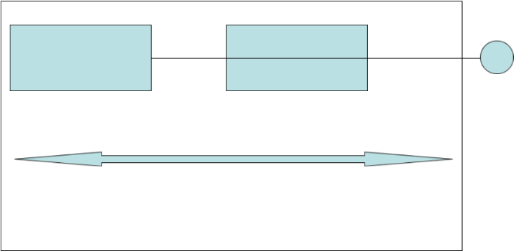
Experiment Setup
Eraser box
22.5 grams
Eraser box
22.5 grams
weight
1.85 meters
table

Slide 4
Experimental Variables
Independent:
  Initial distance and orientations
Dependent:
  Angles of objects
  Location of objects
Controlled:
  Force applied to object
  Friction of table.

Slide 5
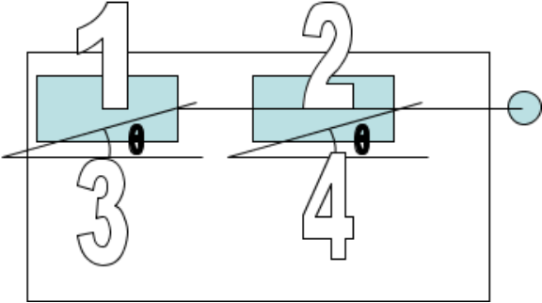
Measurements
  Distance of first box
  Distance of second box
  Angle of first box
  Angle of second box

Slide 6
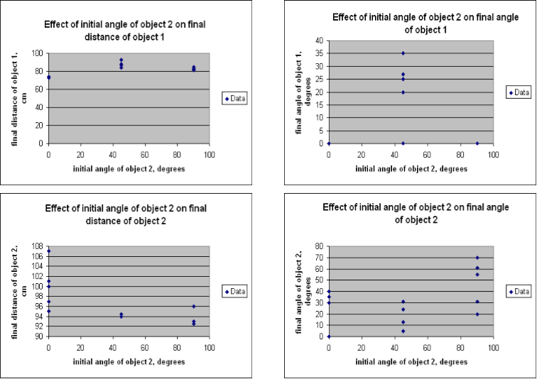
Data

Slide 7
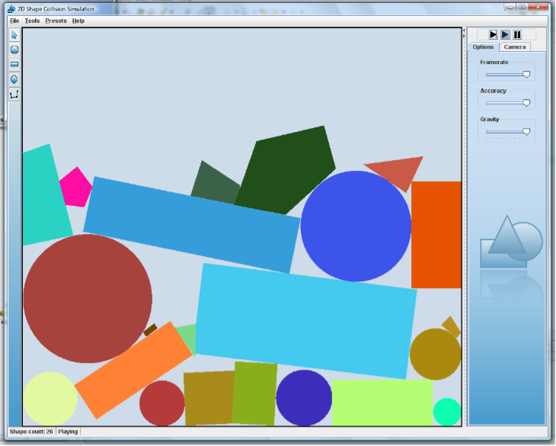
Simulation

Slide 8
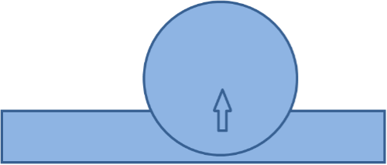
Engine
  Contained in one package (separate from the GUI)
  Contains circles and polygons
  Each shape has a position, velocity, angular velocity, mass, and moment of inertia
    Moment of inertia : measure of how difficult an object is to turn.

Slide 9
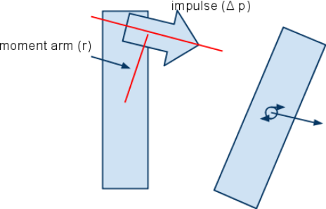
Impulses
  Impulse : a force applied instantaneously, measured in kg m/s
  Can change a shape’s linear and/or angular velocity.
  Rotation depends on moment arm (r).
  Δv = Δp/m, Δω = rΔp/I (I = moment of inertia)

Slide 10
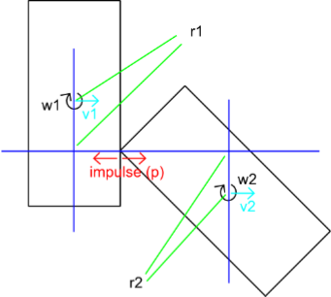
Collisions
  Impulses push the objects apart
  Elastic collisions preserve kinetic energy
  Ek = ½mv2+ ½ Iω2
  Both angular and linear velocity changes
  p = 2(v1 – v2 + w1r1 – w2r2)
  (1/m1 + 1/m2 + r1 2 /I1 + r2 2 /I2)

Slide 11
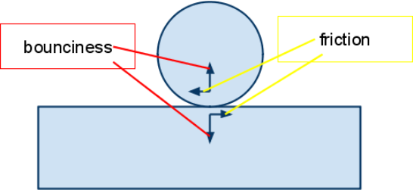
More on Collisions
  Objects have friction and bounciness
  p = 2(v1 – v2 + w1r1 – w2r2)
  (1/m1 + 1/m2 + r1 2 /I1 + r2 2 /I2)
  This formula is only for elastic collisions
  For inelastic collisions, the 2 is replaced by 1 + b1b2 (the bounciness factors, 0≤b≤1)
  Friction: μ = f1f2 (the friction factors, 0≤f≤1)
  Friction impulse = μ * p (normal impulse)

Slide 12
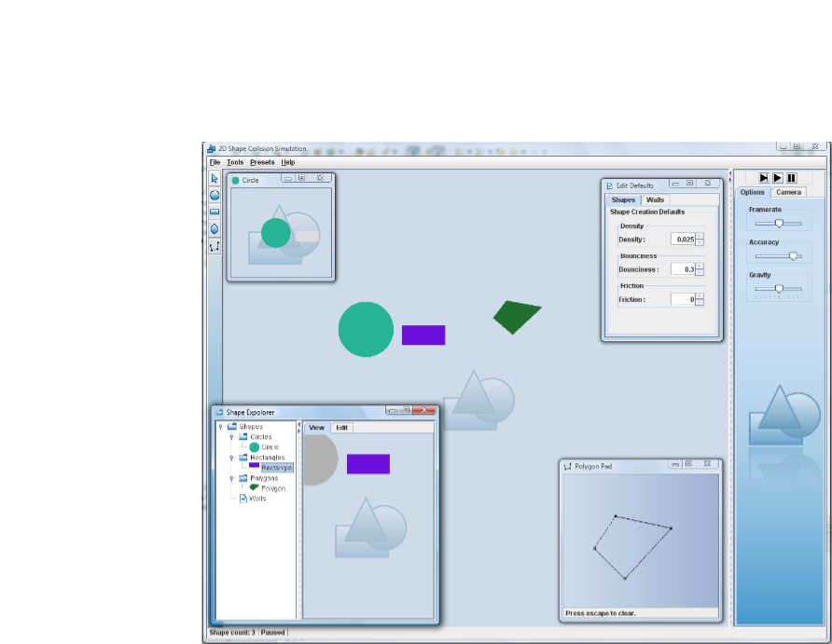
GUI

Slide 13
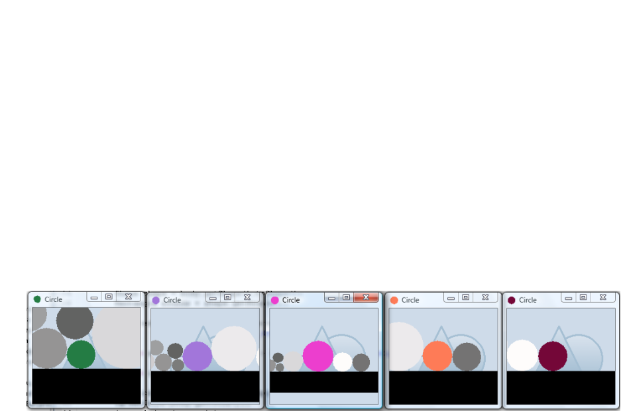
Structure
  Modular and extendable
  Model / view separation
    GUI in different package from model
    Model: the actual shapes and math
    GUI: the user interface, uses the model

Slide 14
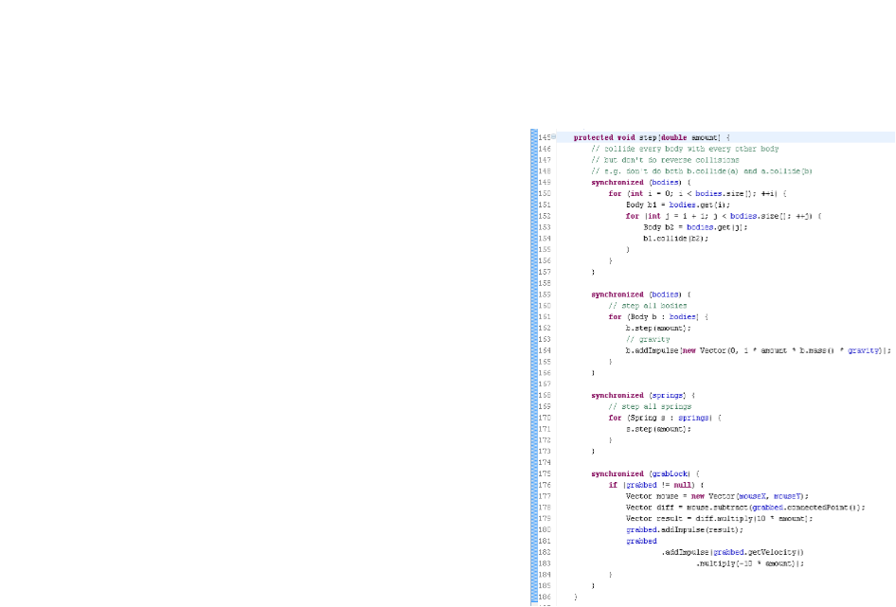
Synchronization
  Concurrency
    Animation always requires multiple threads
  Manual synchronization
    The two main lists needed to be synchronized manually

Slide 15
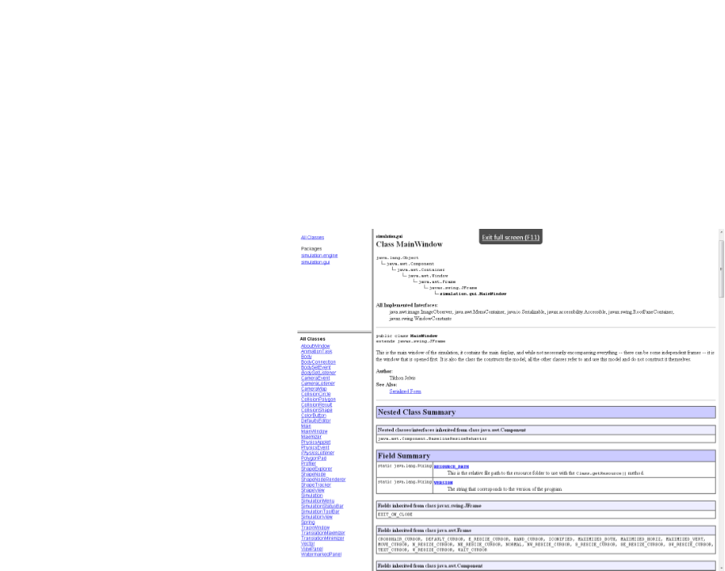
Documentation
  Javadocs (auto-generated html-based documentation for Java)
  Could help other people working on similar projects

