Slide 1
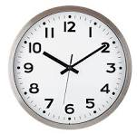
CLOCK APP
FOR PC

Slide 2
start
Import module
Define function
Create
GUI
Initial update and main loop
stop

Slide 3
GROUP MEMEBERS
MERCY GAMBO---BHU/23/04/05/0100
AYENI OLUWAFUNMILAYO PEACE---BHU/23/04/05/0110
MATOLUWA KENNEDY------BHU/23/04/09/0039
OLA OLUWADAMILARE JOSEPH-----BHU/23/04/05/0070
OKAFOR MICHEAL KAMBILI------BHU/23/04/09/0035
YUSUF GWEIMEN ABBA-----BHU/23/04/09/0031

Slide 4
WHAT IS A CLOCK
A clock is a device that keeps time, displaying hours, minutes, and often seconds.

Slide 5
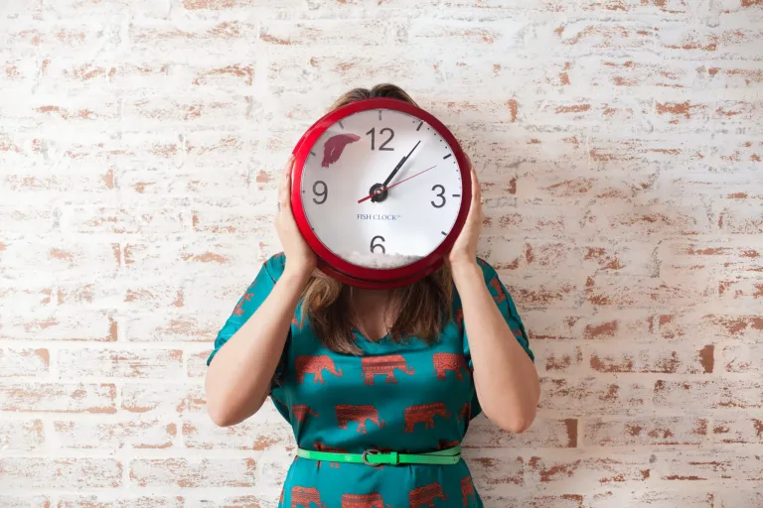
how is clock important to everyday life

Slide 6
It helps us to be on time for our lectures
time helps us make a good habit of structuring and organizing our daily activities

Slide 7
HOW WE CREATED THE CLOCK
To create a simple clock app in Python, we used the time and tkinter libraries.

Slide 8

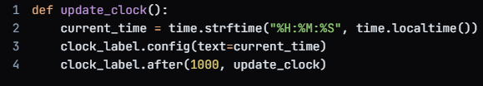
1. we imported the required libraries
2. We created a function to update the clock

Slide 9


3.We created the main window and a label for the clock
4.We named the “update clock” function initially to start the clock

Slide 10

5. Start the main event loop:

Slide 11
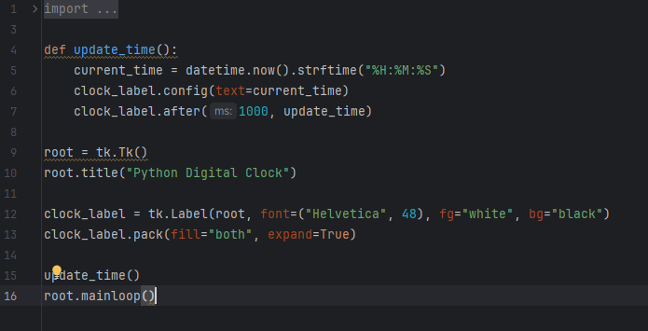
Here is the complete code

Slide 12
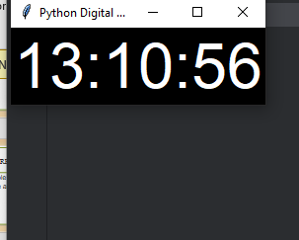
END RESULT

