Slide 1
Predicting Song Popularity
Can audio features tell us if a song will be popular?
ITAI 1371 | Final Project Pitch Day
Trilok
Houston Community College | May 5, 2026

Slide 2
Why I picked this
I listen to a lot of music. Wanted to know if a song’s audio actually predicts how popular it gets, or if popularity is mostly about everything except the sound.
Spotify, Apple Music, and TikTok all use audio-feature models for recommendations. So this is a real industry question, not just an academic one.
Practical angle: a label deciding whether to push a release, or an artist trying to figure out if a track has commercial potential.
Personally curious about where ML works on cultural data and where it hits a ceiling. Music seemed like a clean test case.
114K
songs analyzed
across 113 genres
public Kaggle dataset
from Spotify Web API

Slide 3
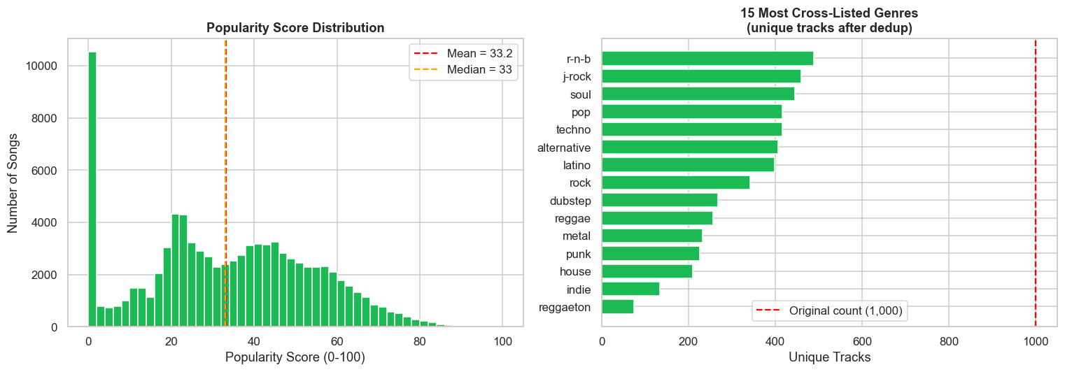
What I’m trying to figure out
The core task: predict a Spotify track’s popularity score (0-100) using only its audio features (danceability, energy, loudness, valence, etc.).
Regression predict the exact 0-100 score. Hard but more useful.
Classification sort songs into Low / Medium / High tiers. Easier, more practical.
Popularity is right-skewed.
11% of tracks have score = 0.
Side questions:
How much does adding genre help on top of audio?
Do songs naturally cluster by sound alone?
Is the model fair across genres?

Slide 4
What’s already out there
Spotify itself
Uses ML extensively for Discover Weekly, Daily Mixes, and Radio. Combines audio features with collaborative filtering, playlist co-occurrence, and listening behavior.
2023 academic study
Sulistyaningsih et al. studied the Indonesian Spotify market. Found Extra Trees and Random Forest explain a meaningful fraction of popularity from audio features, but cultural context matters significantly.
Industry consensus
Audio features alone are necessary but not sufficient. Best results come from hybrid models combining audio with user-side signals like playlist placement and listening history.
My question: how far can audio features alone get you, and how much does just adding genre help?

Slide 5
What I built
DATA
FEATURES
MODELS
EVAL
Started with 114K rows from Kaggle
Same song appears under multiple genres, so I deduplicated on track_id
Ended up with 89,740 unique tracks across 113 genres
Dropped 1 row missing artist and title info
Built two feature sets to test how much genre adds
Set A: Audio only (14 features) - danceability, energy, loudness, tempo, etc.
Set B: Audio + Genre (127 features) - Set A plus one-hot encoded genre
StandardScaler for linear models, raw values for tree models
Regression: Linear, Ridge, Random Forest, HistGradient Boosting
Classification: Logistic, Decision Tree, Random Forest, HistGradient Boosting
Unsupervised: K-Means with elbow + silhouette
Tuning: GridSearchCV on best regressor
80/20 train-test split with fixed random seed
Regression: RMSE, MAE, R² on test set
Classification: Accuracy, weighted F1
Per-genre prediction error for fairness check
Two regression experiments (Audio Only vs Audio + Genre) isolate exactly how much signal genre adds.

Slide 6
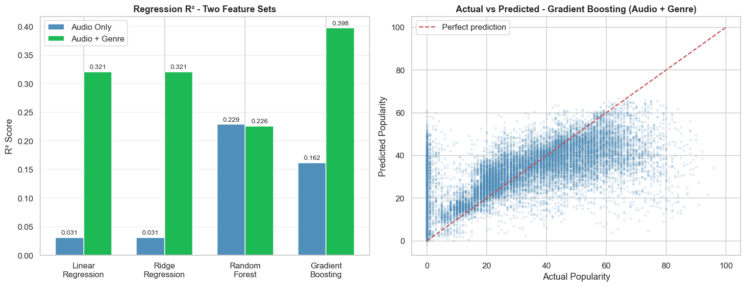
What I found
R² = 0.42
70%
0.03 → 0.42
best regression
(tuned HGB)
classification accuracy
(F1 = 0.70)
Linear-audio baseline
to best ensemble
The story
Linear with audio alone: R² = 0.03. Basically useless. The relationship is too non-linear.
Random Forest with audio alone: R² = 0.23. Same data, but it finds non-linear patterns linear methods can’t.
Adding genre is the biggest single boost. Linear jumps from 0.03 to 0.32 because genre carries the per-genre baseline.
Tuned HGB: R² = 0.42, RMSE = 15.6. Final winner.
Audio alone barely moves linear models. Tree-based ensembles find non-linear signal in the audio. But adding genre is the single biggest boost in this whole project.

Slide 7
Challenges I ran into
1
First dataset was synthetic
2
Tree models were slow
My first download looked legit but every model was predicting 50 for every song. I checked the data: every audio feature had identical mean and std, all correlations were 0.00. Real Spotify data has energy and loudness correlated at +0.76. Mine was fake. Switched to the real Kaggle file and started over.
Standard GradientBoosting took forever on 89K rows by 130 features. Switched to histogram-based gradient boosting (HGB), which uses binning under the hood. About 10x faster, slightly more accurate too. Same idea, much better implementation.
3
Data leakage risk
4
Heavily skewed target
Same song appears under multiple genres in the raw data, so the same track could end up in both train and test splits. That would inflate my metrics without me realizing it. Had to deduplicate on track_id before the train-test split.
14% of tracks have popularity = 0 (catalog tracks nobody streams). Considered dropping them but decided to keep them since they’re real data. RMSE takes a hit but the model is honest about what it can actually do on the real catalog.

Slide 8
What I’d add next
Artist features
Probably the single biggest gain. An artist’s mean popularity and total track count both proxy for their existing fan base. Right now my model has no idea Drake songs do better than mine before either is even released. That’s a huge missing signal.
Temporal features
Days since release, weekday vs weekend release, holiday windows. Older songs naturally lose popularity over time and the model is currently completely blind to that.
Lyrics-based NLP
Sentiment, themes, language, repetition. Audio captures sound but not what the song is actually about. Two songs with identical audio profiles can have totally different lyrical content.
Better evaluation
Temporal holdout: train on pre-2023 songs, test on 2024 songs. The random split I used probably overstates how well the model generalizes to genuinely new releases.
What I learned
Audio features have a real ceiling on this problem.
The next big jump comes from non-audio features: who is releasing the song, when they release it, and what their fan base looks like.

Slide 9
What this comes down to
23%
42%
70%
of variance from
audio features alone
with audio + genre
(tuned HGB, R² = 0.42)
classification accuracy
Low / Medium / High
Audio features matter, but they’re not the whole story.
About 58% of popularity variance comes from things outside this dataset: marketing, virality, artist reputation, playlist placement, cultural moments. The real win wasn’t the R² number - it was learning where ML hits its limits on creative and cultural data.
Thanks. Happy to take questions.

Slide 10
References
[1] maharshipandya. (2022). Spotify Tracks Dataset. Kaggle.
kaggle.com/datasets/maharshipandya/-spotify-tracks-dataset
[2] Sulistyaningsih, A., Hardiyanto, S., & Pratama, A. (2023). Predicting song popularity based on Spotify’s audio features: insights from the Indonesian streaming users.
Journal of Management Analytics.
[3] Pedregosa, F. et al. (2011). Scikit-learn: Machine Learning in Python.
Journal of Machine Learning Research, 12, 2825-2830.
[4] Spotify Engineering blog. How Spotify Uses ML to Power Discover Weekly.
engineering.atspotify.com
All plots generated by my own code in the project notebook.

