Slide 1

Custom Chatbots with LLMs
Pink Pink
Yan Pan (z5484351)
Keyin Lin (z5440167)
Sifang Gao (z5471175)
Yiqing Yu (z5453538)
Jinyuan Fan (z5461665)

Slide 2
Motivation
Advancing Reliability in Multimodal AI
Improving Visual to Textual Knowledge Transfer
Enhanced Question Understanding
Broad array of applications:
Education: students with visual impairments
Scientific research: complex images
Robotics: interpret and interact with their surroundings accurately
Presenter: Sifang Gao (z5471175)

Slide 3
Problem Statement
The goal of this project is to evaluate the effectiveness of multimodal AI by transforming visual content into text-based descriptions and assessing the model's understanding in question-answering contexts.
Using different image processing models, we generate textual descriptions for image-based questions and combine these descriptions with the questions and answer options as input for LLMs.
This work contributes to advancing the alignment of visual and linguistic processing within AI, supporting its application in areas where precise interpretation of visual information is crucial.
Presenter: Sifang Gao (z5471175)

Slide 4
Dataset
ScienceQA is collected from elementary and high school science curricula, and contains 21,208 multimodal multiple-choice science questions.it has rich domain diversity from three subjects: natural science, language science, and social science.
Questions in each subject are categorised first by the topic (Biology, Physics, Chemistry), then by the category (Plants, Cells, Animals, etc.), and finally by the skill.
Presenter: Yan Pan (z5484351)

Slide 5
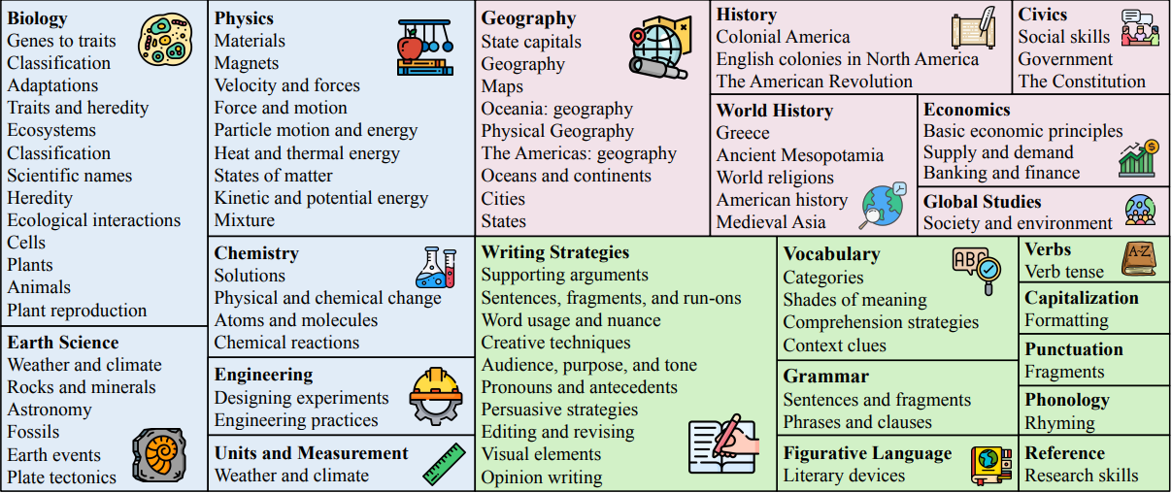
Dataset
ScienceQA features 26 topics, 127 categories, and 379 skills that cover a wide range of domains.
Social
Natural
Language
Presenter: Yan Pan (z5484351)

Slide 6
Dataset
Easy Q
(Grade 1-6)
3,800
(17.39%)
Image
3,688
(17.39%)
Text
6,532
(30.8%)
7,188
(33.89%) No context
Difficult Q
(Grade 7- 12)
Image and text!
Presenter: Yan Pan (z5484351)

Slide 7
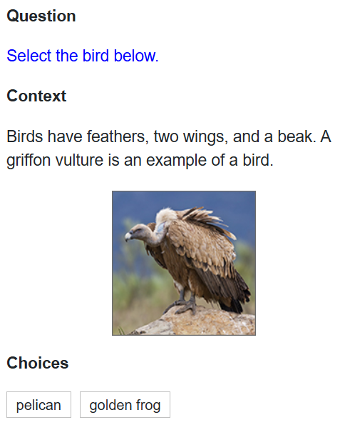
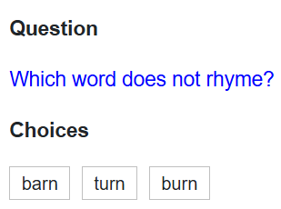
Dataset
Presenter: Yan Pan (z5484351)

Slide 8
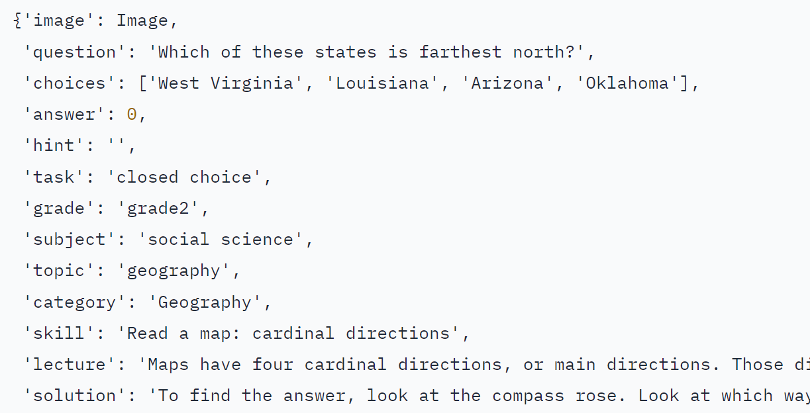
Data Analysis
image : Contextual image
question : Prompt relating to the lecture
choices : Multiple choice answer with 1 correct to the question
answer : Index of choices corresponding to the correct answer
hint : Hint to help answer the question
task : Task description
grade : Grade level from K-12
subject : High level
topic : natural-sciences, social-science, or language-science
category : A subcategory of topic
skill : A description of the task required
lecture : A relevant lecture that a question is generated from
solution : Instructions on how to solve the question
Presenter: Yan Pan (z5484351)

Slide 9
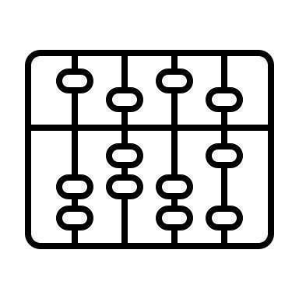
Methods
VLP
Description
LLM
answer
Image
CoT
Prompt
solution
Question
Overall process
Presenter: Jinyuan Fan (z5461665)

Slide 10
Methods
LLM : Large Language Model
VIT: Vision Transformer (original)
GPT-4omini: Multimodal Large Language Model
Blip: Bootstrapping Language-Image Pre-training
Blip+GPT-4omini: Vision-Language Pre-training Models+ LLM
Presenter: Jinyuan Fan (z5461665)

Slide 11
Methods
CoT : chain of thought
Image description
Result
Question
Please respond in the following JSON format exactly without any additional text only one answer
Choices
Output
Hint
Presenter: Jinyuan Fan (z5461665)

Slide 12
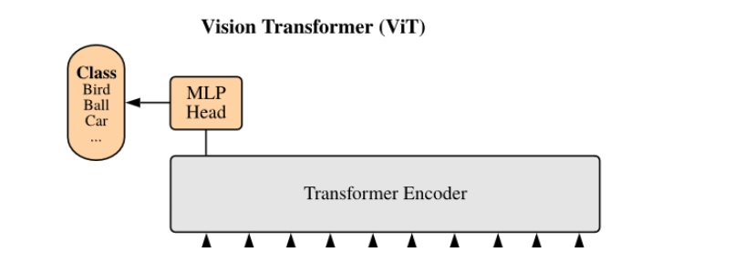
VIT
Presenter: Jinyuan Fan (z5461665)

Slide 13
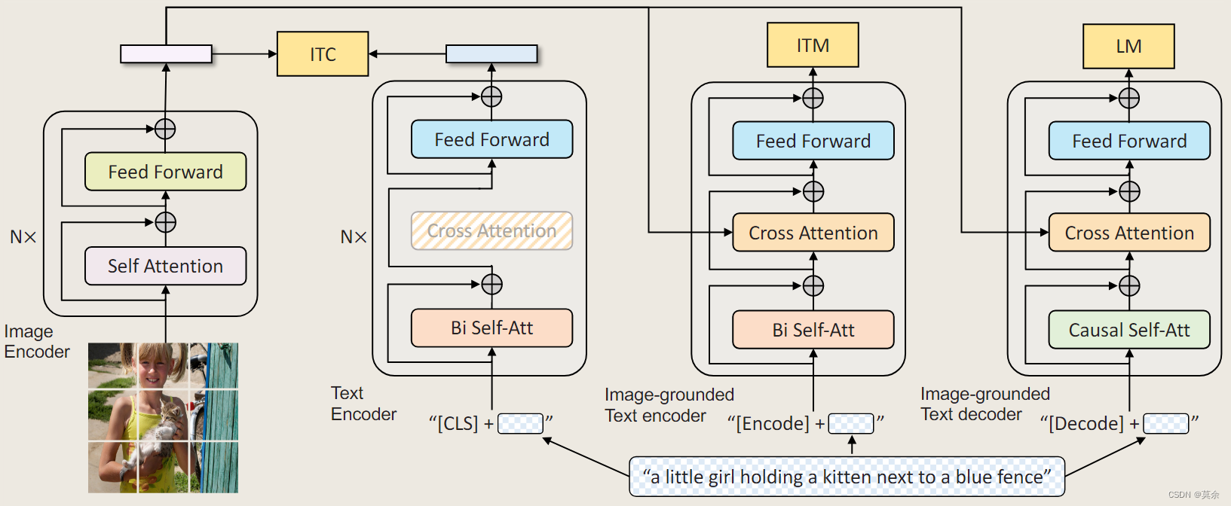
BLIP
Presenter: Jinyuan Fan (z5461665)

Slide 14
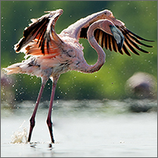
Results
VIT-GPT2: A bird that is flying in the air.
BLIP: A bird with its wings spread.
GPT-4omini: "The image depicts a graceful flamingo in mid-flight, showcasing its vibrant pink plumage. The bird is partially turned, with its long, slender legs elevated above the water's surface, creating a dynamic sense of movement. Its wings are spread wide, displaying a striking gradient of colors that range from soft pink at the base to darker tips. Water droplets are splashing around as the flamingo takes off or lands, adding to the serene yet active atmosphere of the scene. The background features a blurred, natural setting, likely a wetland area, which enhances the focus on the flamingo and emphasizes its elegant posture."
Presenter: Keyin Lin (z5440167)

Slide 15
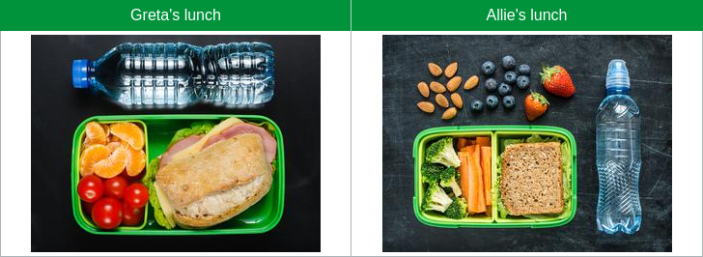
Results
Greta and Allie open their lunch boxes in the school cafeteria. Both of them could be happier with their lunches. Greta wanted broccoli in her lunch and Allie was hoping for tomatoes. Look at the images of their lunches. Then answer the question below.
What can Greta and Allie trade to each get what they want?
"Greta can trade her tomatoes for Allie's sandwich.",
"Allie can trade her broccoli for Greta's oranges.",
"Allie can trade her almonds for Greta's tomatoes.",
"Greta can trade her tomatoes for Allie's broccoli.
response："The answer is D for answer index 3, because Greta wants broccoli which she can get by trading her tomatoes to Allie, who wants tomatoes."
Presenter: Keyin Lin (z5440167)

Slide 16
Results
Accuracy rate: Whether the results are correct or not
NAT = natural science, SOC = social science, LAN = language science,
TXT = text context, IMG = image context, NO = no context,
G1-6 = grades 1-6, G7-12 = grades 7-12
VLP | LLM | NAT | SOC | LAN | TXT | IMG | NO | G1-6 | G7-12 | Avg
VIT-GPT2 | GPT | 79.36 | 73.90 | 85.73 | 76.74 | 70.20 | 88.78 | 82.05 | 75.94 | 79.86
BLIP | GPT | 81.44 | 75.14 | 86.55 | 79.33 | 72.88 | 89.27 | 84.58 | 75.81 | 81.44
GPT | GPT | 82.46 | 79.64 | 86.36 | 78.79 | 76.95 | 88.78 | 86.67 | 76.07 | 82.88
Presenter: Keyin Lin (z5440167)

Slide 17
Results
BLEU-1: single-word
BLEU-4: multi-word combinations
ROUGE-L: the longest common subsequence (LCS)
Similarity: overall similarity(cosine similarity)
VLP | LLM | BLEU-1 | BLEU-4 | ROUGE-L | Similarity
VIT-GPT2 | GPT | 0.062 | 0.026 | 0.233 | 0.485
BLIP | GPT | 0.064 | 0.028 | 0.234 | 0.480
GPT | GPT | 0.066 | 0.026 | 0.232 | 0.479
Presenter: Keyin Lin (z5440167)

Slide 18
Discussion
Advantages: High accuracy, clear answers
Drawbacks: Low similarity, not highly varied
Future Work:
Few-shot learning
Fine-tuning
MLLM (Multimodal Large Language Model)
Few examples
add to
Prompt
Presenter: Yiqing Yu (z5453538)

Slide 19
Conclusion
This project assessed LLM capabilities in handling multimodal tasks by using various VLP models (VIT-GPT2, BLIP, GPT-4o-mini) combined with CoT. We compared similarity scores and accuracy, showing that advanced VLP models combined with precise CoT reasoning lead to more accurate and clear responses in multimodal question-answering tasks.
Presenter: Yiqing Yu (z5453538)

Slide 20

Thanks！

