Slide 1
5G TECHNOLOGY
Submitted by
TILAK RAJ G
SHANJAY M

Slide 2
CONTENT
Introduction
Evolution of 1G to 5G
Comparison of 1G to 5G
Architecture
Application
Advantages
Government’s steps
Challenges
Conclusion

Slide 3
Introduction to 5G
What is 5G?
What does it offer?

Slide 4
What is 5G ?
5G is the latest form of cellular technology, designed to greatly increase the speed and responsiveness of wireless network.
Complete wireless communication with almost no limitation.
Has incredible transmission speed.

Slide 5
What does it offer ?
World wide cellular phones.
Low latency.
Extraordinary data capabilities.
High connectivity.
No network congestion.
Connectivity to a full circle.
Large phone memory, more dialing speed, more clarity in audio and video.

Slide 6
Evolution from 1G to 5G
1G
2G
3G
4G
5G

Slide 7
1G wireless system
Developed in 1980s.
Based on analog system.
Speed up to 2.4kbps.
Supported only voice calls.
Allows users to make voice call in 1 country.

Slide 8
2G wireless system
Launched in 1990s.
Based on digital system.
Speed up to 64kbps.
Services such as digital voice & sms.

Slide 9
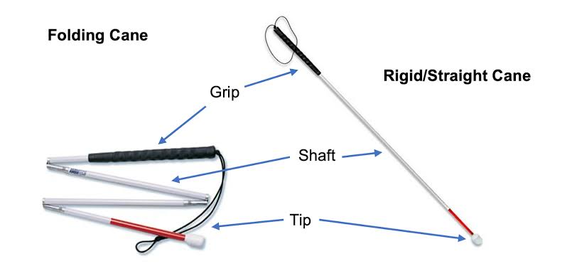
2.5 wireless system
It allows its users to scan their surroundings for obstacles.

Slide 10
Disadvantage
May crack or break easily
The stick may get stuck at the foot path cracks
Difficult to handle at crowded place
High chances for getting missed

Slide 11
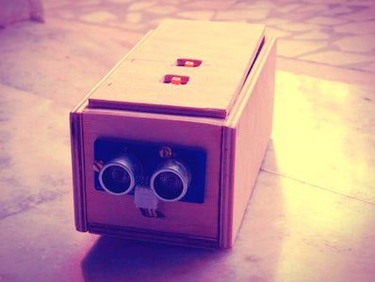
Vision
Vision is a smart device used is used by blind or visually impaired to navigate their path.
This uses ultrasonic waves to detect the obstacles and notify the user using a buzzer .
This idea was inspired from the bats, which use high frequency sound waves to move.

Slide 12
Disadvantage
Difficult to carry
Requires skill to use
High chances of getting dropped
Inconvenient to use

Slide 13
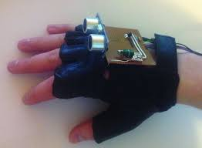
VIBRATION GLOVES
This system consists of a glove with a ultrasonic sensor
and vibration module .
The system this wore in the fist and requires the user
to raise his fist to detect the object
.
The ultrasonic sensor senses the nearby obstacles and
vibration is produced if an obstacle is present

Slide 14
Disadvantage
Difficult to handle
Difficult to perform other works wearing the gloves
May cause strain in the client hand
It can break when collide with other objects.

Slide 15
PROPOSED SYSTEM
In this system we are developing a navigation system for the blind persons.
This is very easy to use and work as a navigator to the blind people to easily navigate.
In this system the ultrasonic sensors will detect the object and gives beep sound and also sends vibration signals.
In the noisy area, the person may unable to hear the beep sound but still can feel the vibration.

Slide 16
The purpose of the project is to develop a product that is useful for blind people and people who often rely on others.
Visually impaired people move around and learn about nearby objects by using the portable armband holder that emits ultrasound, buzz when obstacles are detected.
The aim of the project is therefore to develop a cost-effective and efficient way to navigate more comfortably, faster and safer.

Slide 17
ADVANTAGES
It is portable and Economical
Small and light weight
Easy understandable mechanism.
Blind people navigate without the need of expensive tech or sticks.
It has the feature to detect the distance of objects.
Sending SOS message in case of any emergency.

Slide 18
SYSTEM REQUIREMENTS
HARDWARE REQUIREMENT:
ESP32
Ultrasonic Sensor
Vibration Module
Buzzer
Wires
Eye Glasses
GPS Module
SOFTWARE REQUIREMENT:
Operating System: Windows 10 or above
Platform : Arduino IDE
Programming Language : Embedded C
What’s App
Twilio API

Slide 19
SOFTWARE DESCRIPTION
The Arduino IDE is an open source software, which is used to write and upload code to the Arduino boards.
The IDE application is suitable for different operating systems such as Windows, MacOS, Linux.
It supports the programming languages C and C++.
The program or code written in the Arduino IDE is often called as sketching.
The sketch is saved with the extension “.ino “

Slide 20
OVERALL DIAGRAM

Slide 21
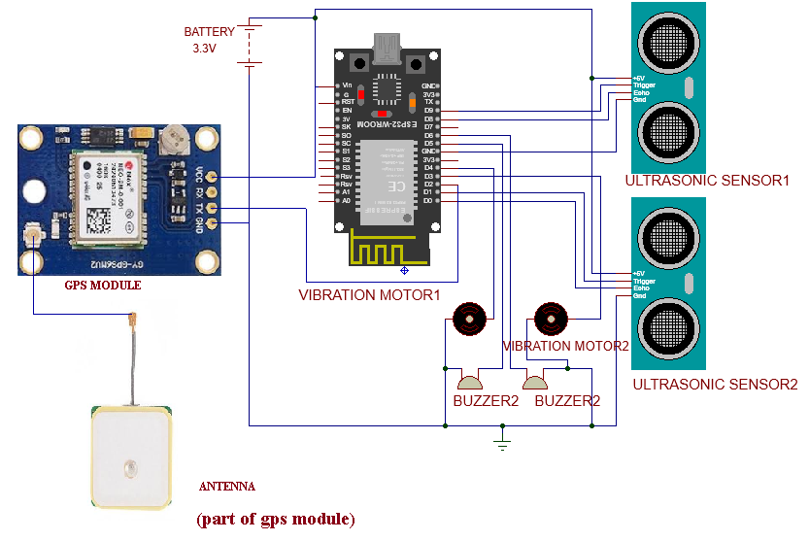

Slide 22
MODULES
There are three modules in our project
Object detection
Buzzer and vibrant notification
Sending SOS message through what’s app (in case of emergency)
MODULE DESCRIPTION :
Object detection:
In this module, the objects in the surrounding are detected by the ultrasonic sensors and those signals are sent to the micro controller.

Slide 23
The ultrasonic sensor consists of two parts
i)Trigger
ii)Echo
Trigger
It transmits ultrasonic waves which reflects back to the sensor on reaching the object.
Echo
It receives the ultrasonic waves deflected from the object reaches the Echo
The distance is calculated by
Distance/2

Slide 24
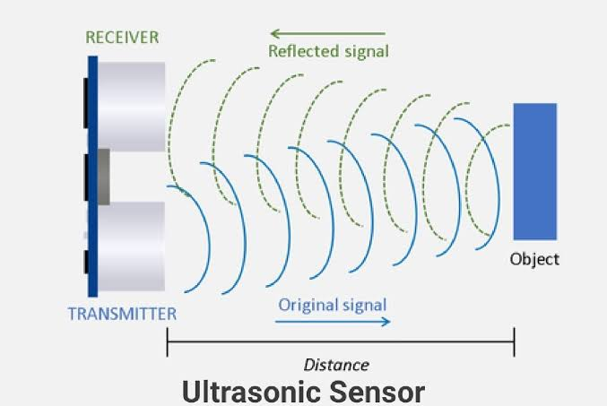
(Trigger)
(Echo)

Slide 25
Buzzer and vibrant notification:
The micro controller after receiving the signals from the sensor, the microcontroller makes the buzzer to buzz and vibration module to produce vibration.
Sending SOS message through what’s app (in case of emergency):
In case of emergency, the blind person clicks a button on the glass which sends a emergency message to the target what’s app through Twilio API.

Slide 26
THANK YOU !!!

