Slide 1
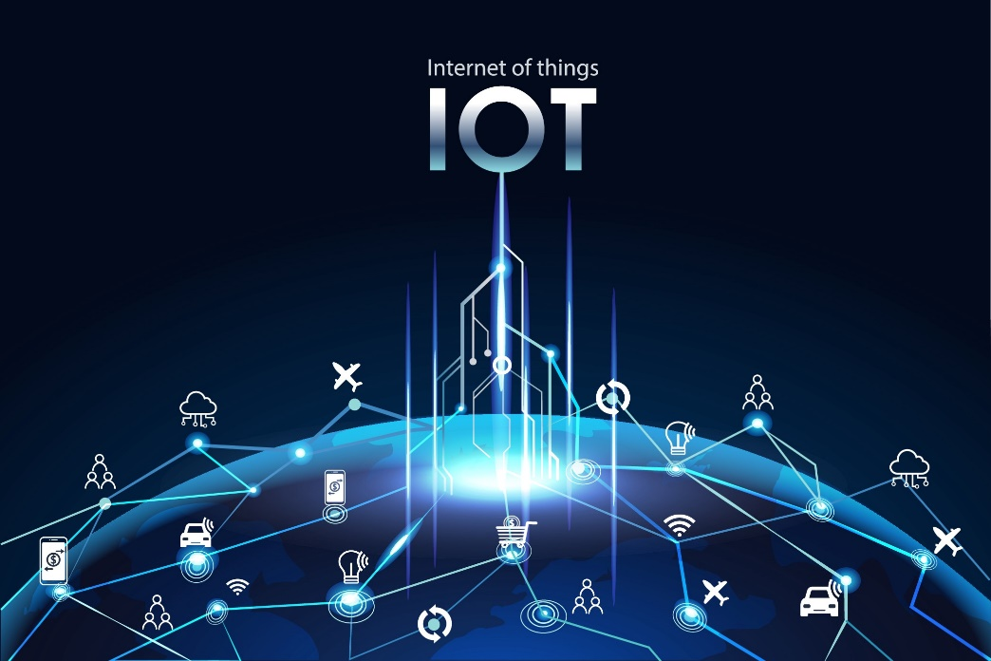
IOT BASED THIRD EYE FOR VISUALLY CHALLENGED PEOPLE

Slide 2
TEAM MEMBERS
MAADHAVAN U (22504167)
AARTHI K (22591780)
ABINAYA A (22591781)
AKASH V (22591784)
BARATH KRISHNAN N (22591785)
TILAK RAJ G (22591809)

Slide 3
AGENDA
Abstract
Introduction
Objective
Existing System
Disadvantages
Proposed System
Advantages
System Requirements
Software Description
Overall diagram
Modules
Project Implementation
Project Testing
Conclusion
Appendix
Snapshots & Screenshots

Slide 4
ABSTRACT
Blind can navigate with speed and confidence.
Object detected using ultrasonic sensor.
Notified using Buzzer and vibration effect.
Required to wear it as one of their accessories.

Slide 5
Buzzer and vibration occurs when object come closer than 1 meter.
Vibration motor is used to notify in noisy place.
Enables blind to navigate object even in traffic place.

Slide 6
INTRODUCTION
Helps the blind people to run their life as usual.
43 million people are blind(surveyed by WHO).
Still using traditional system with many cons.
The proposed system is more efficient way to help visually impaired people navigate with great comfort, speed and confidence

Slide 7
Our project consists of the spectacles which has ultrasonic sensors attached to it.
These ultrasonic sensors detect the nearby objects and alerts the blind person with the buzzer sound and vibrating wave signals.
The vibration helps the blind person to know about the presence of object in the noisy area.
This ensures the security of the blind person.

Slide 8
OBJECTIVE
The objective of project IoT based Third Eye For visually Challenged is
To design portable wearable device.
To help the move around from one place to another with confidence.
To ensure the well being of the person by sending SOS message in case of emergency.

Slide 9
EXISTING SYSTEM
The major exiting systems are
White Cane
Vision (a torch for blinds)
Vibration Gloves

Slide 10
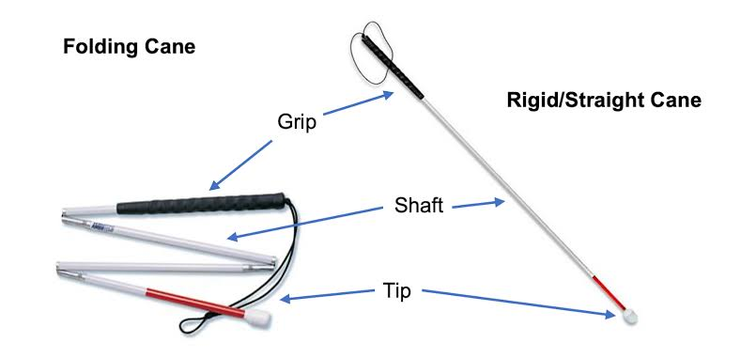
White Cane
Device used by many people who are blind or visually impaired.
It allows its users to scan their surroundings for obstacles.

Slide 11
Disadvantage
May crack or break easily
The stick may get stuck at the foot path cracks
Difficult to handle at crowded place
High chances for getting missed

Slide 12
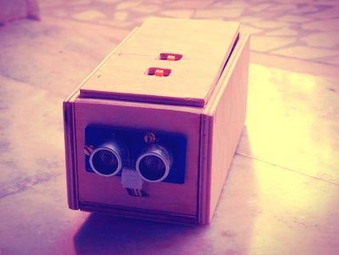
Vision
Smart device used is used by blind or visually impaired to navigate their path.
Ultrasonic sensors are used to detect object.
Buzzer and vibration module is used for notification.

Slide 13
Disadvantage
Difficult to carry
Requires skill to use
High chances of getting dropped
Inconvenient to use

Slide 14
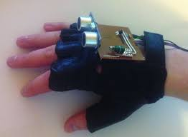
VIBRATION GLOVES
A glove with a ultrasonic sensor and vibration module .
The system this wore in the fist and requires the user to raise his fist to detect the object.
The ultrasonic sensor senses the nearby obstacles and vibration is produced if an obstacle is present.

Slide 15
Disadvantage
Difficult to handle
Difficult to perform other works wearing the gloves
May cause strain in the client hand
It can break when collide with other objects.

Slide 16
PROPOSED SYSTEM
Developing a navigation system for blind.
Ultrasonic sensors will detect the object and produces buzzer sound along with vibration signals.
In the noisy area, the person may unable to hear the beep sound but still can feel the vibration.

Slide 17
Consists of GPS module to fetch the current location.
When push button is pressed, location is sent to the messaging app.
Hence ensuring the safety and security of the blind.

Slide 18
ADVANTAGES
It is portable and Economical
Small and light weight
Easy understandable mechanism.
Blind people navigate without the need of expensive tech or sticks.
It has the feature to detect the distance of objects.
Sending SOS message in case of any emergency.

Slide 19
SYSTEM REQUIREMENTS
HARDWARE REQUIREMENT:
ESP32
Ultrasonic Sensor
Vibration Module
Buzzer
Wires
Eye Glasses
GPS Module
SOFTWARE REQUIREMENT:
Operating System: Windows 10 or above
Platform : Arduino IDE
Programming Language : Embedded C
What’s App
Twilio API

Slide 20
ESP32
Microcontroller(Manages the whole system).
Integrated WiFi and Bluetooth support.
No separate module is needed.
Widely used in wireless communication projects.

Slide 21
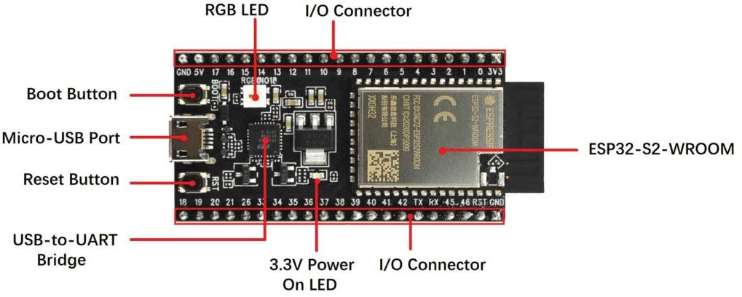

Slide 22
ULTRASONIC SENSOR
Measure distance.
Uses ultrasonic waves.
Maximum range : 4 meters.
Two parts
Trigger (Transmitter).
Echo (Receiver).

Slide 23
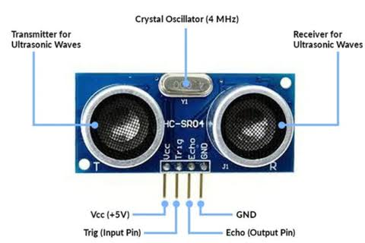

Slide 24
GPS MODULE(NEO6M)
Receiving signals from GPS satellites orbiting the earth.
Antenna is used to receive the signals.
Contains chip that processes satellite signals.
Output produced in the form of latitude and longitude.

Slide 25
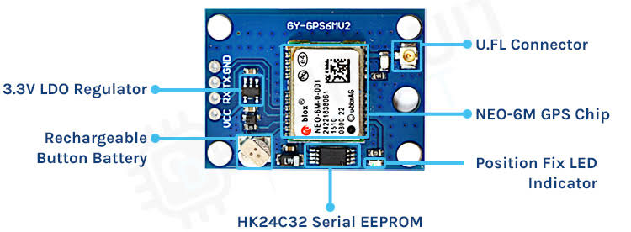
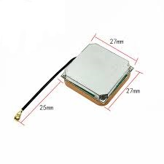

Slide 26
SOFTWARE DESCRIPTION
The Arduino IDE is an open source software, which is used to write and upload code to the Arduino boards.
Cross platform
It supports the programming languages C and C++.
The program written in Arduino is called Sketch.
Extension is “ .ino “ .

Slide 27
OVERALL DIAGRAM

Slide 28
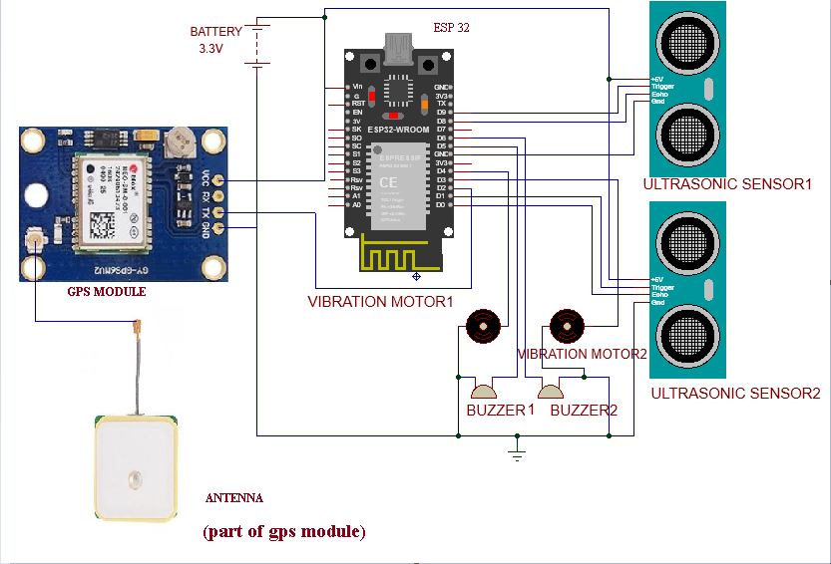

Slide 29
MODULES
There are three modules in our project
Object detection
Buzzer and vibrant notification
Sending SOS message through what’s app (in case of emergency)
MODULE DESCRIPTION :
Object detection:
Objects in the surrounding are detected by the microcontroller and signals are sent to the microcontroller.

Slide 30
The ultrasonic sensor consists of two parts
i)Trigger
ii)Echo
Trigger
It transmits ultrasonic waves which reflects back to the sensor on reaching the object.
Echo
It receives the ultrasonic waves deflected from the object reaches the Echo
The distance is calculated by
Distance/2

Slide 31
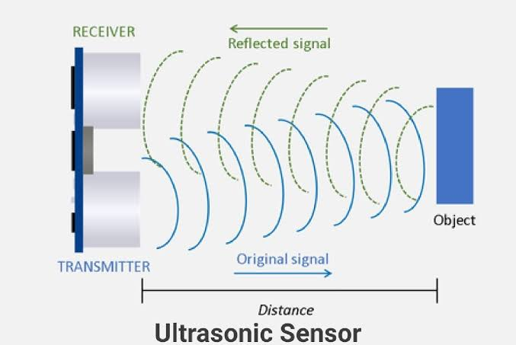
(Echo)
(Trigger)

Slide 32
Buzzer and vibrant notification:
The micro controller after receiving the signals from the sensor, it sends signals to buzzer and vibration module.
The corresponding buzzer and vibration module
produce tone and vibration.

Slide 33
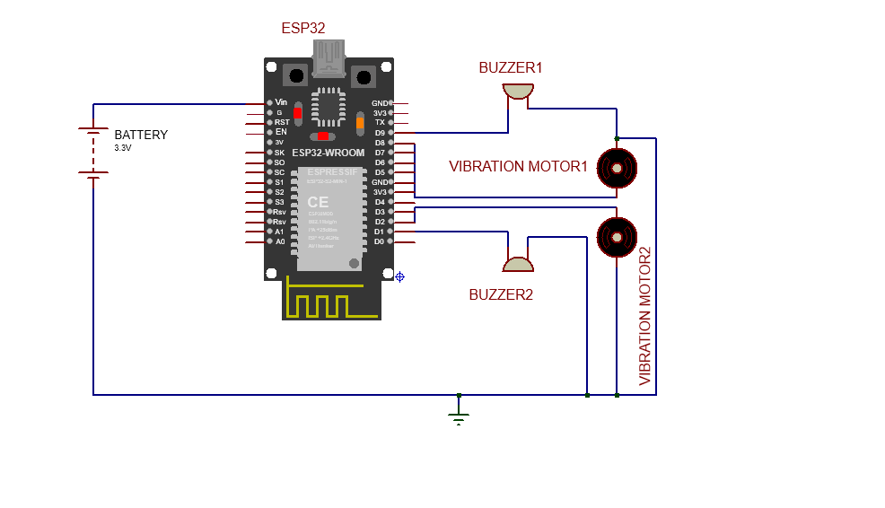


KNOWING THE SYSTEM

Slide 34
The Process
SYSTEM
TONE&BUZZER
USER

Slide 35
Sending SOS message through what’s app (in case of emergency):
In case of emergency, the blind person clicks a push button on the glass which sends a emergency message(along with the message) to the target what’s app through Twilio API.

Slide 36
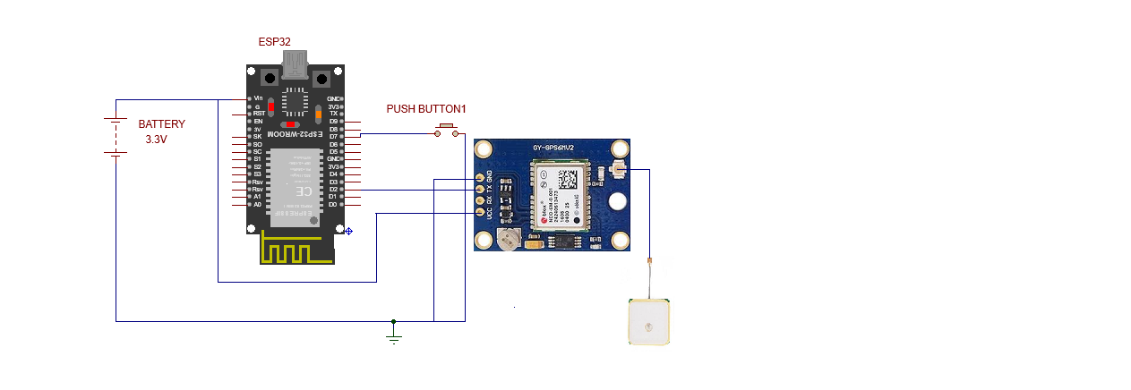

KNOWING THE SYSTEM
GPS MODULE
ANTENNA

Slide 37
The Process
LOCATION
TWILIO
API
WHAT’S APP
SYSTEM

Slide 38

PROJECT IMPLEMENTATION
Logical Designing of the system.
Assembling the hardware.
Programming the microcontroller.
Integration with Twilio API.

Slide 39
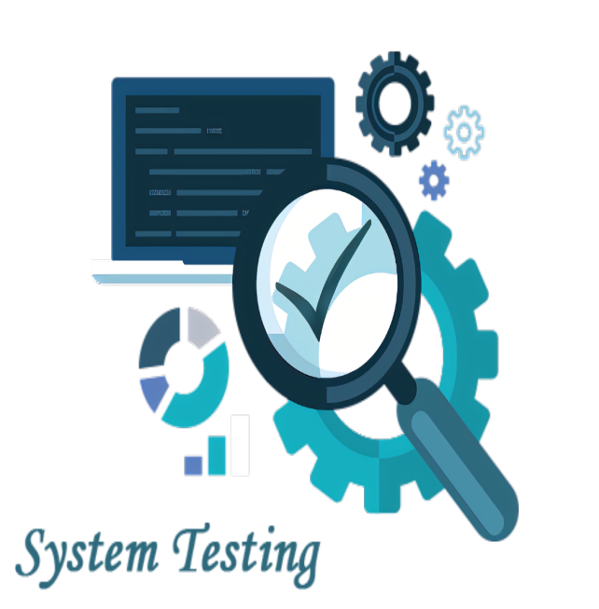
PROJECT TESTING
Sensor Calibration.
Power Consumption.
Wearable comfort.
Functionality Testing(Hardware and Software)

Slide 40
CONCLUSION
Our project is successfully removing the problem of existing navigation techniques like carry stick with us while walking, use of another person while moving one place to another and many more issue was successfully resolved by this project.
This project has the feature to detect the distance of objects that are major issue for blind people after detecting the object distance they also know about the direction where the object was.
It really makes a bigger impact to the society and community.

Slide 41

FUTURE ENHANCEMENT
180 degree area coverage.
Sending sms to the target phone number.
Different tone for buzzer and different vibration intensity for vibration motor.

Slide 42
APPENDIX
PROGRAM
#define trigPin1 5
#define echoPin16
#define motor17
#define buzzer18
#define trigPin2 9
#define echoPin2 10
#define motor2 11
#define buzzer2 12

Slide 43
long duration, distance, UltraSensor1, UltraSensor2;
char data;
String SerialData="";
void setup()
{
Serial.begin (9600);
pinMode(trigPin1, OUTPUT);
pinMode(echoPin1, INPUT);
pinMode(motor1, OUTPUT);

Slide 44
pinMode(buzzer1, OUTPUT);
pinMode(trigPin2, OUTPUT);
pinMode(echoPin2, INPUT);
pinMode(motor2, OUTPUT);
pinMode(buzzer2, OUTPUT);
digitalWrite(motor1,LOW);
digitalWrite(motor2,LOW);
digitalWrite(buzzer1,LOW);
digitalWrite(buzzer2,LOW);
}

Slide 45
void loop()
{
SonarSensor(trigPin1, echoPin1);
UltraSensor1 = distance;
SonarSensor(trigPin2,echoPin2);
UltraSensor2 = distance;
while(Serial.available())
{
delay(10);
data=Serial.read();
SerialData+=data;
}

Slide 46
if(SerialData=="display distance")
{
Serial.print("distance measured by the first sensor: ");
Serial.print(UltraSensor1);
Serial.println(" cm");
Serial.print("distance measured by the second sensor: ");
Serial.print(UltraSensor2);
Serial.println(" cm");

Slide 47
Serial.println("---------------------------------------------------------------------------------------------------------");
}
SerialData="";
if(UltraSensor1 <=70)
{
digitalWrite(buzzer1,HIGH);
digitalWrite(motor1,HIGH);
}
else
{
digitalWrite(buzzer1,LOW);
digitalWrite(motor1,LOW);
}

Slide 48
else
{
digitalWrite(buzzer2,LOW);
digitalWrite(motor2,LOW);
}
}
void SonarSensor(int trigPinSensor,int echoPinSensor)
{
digitalWrite(trigPinSensor, LOW);
delayMicroseconds(2);
digitalWrite(trigPinSensor, HIGH);

Slide 49
delayMicroseconds(10);
digitalWrite(trigPinSensor, LOW);
duration = pulseIn(echoPinSensor, HIGH);
distance= (duration/2) / 29.1;
}

Slide 50
SNAPSHOTS & SCREENSHOTS

Slide 51
THANK YOU !!!

