Slide 1
MLOPS · ASSIGNMENT 01
Heart Disease Risk Prediction
End-to-End MLOps Pipeline
Data → Model → Tracking → CI/CD → Docker → Kubernetes → Monitoring
Bala Gangadhara Tilak
AIMLCZG523 Machine Learning Operations · BITS Pilani
https://github.com/TilakMtech/heart-mlops
Notes:
Introduce the goal: a heart-disease classifier operated like a production model — everything from data download to monitoring is automated and reproducible.

Slide 2
SCOPE
Nine assignment tasks, one reproducible pipeline
1
Data & EDA
2
Features & models
3
Experiment tracking
download script, cleaning, 6 figures
sklearn Pipeline, 4 tuned models
MLflow runs, params, plots, registry
4
Packaging
5
CI/CD & tests
6
Containerisation
model.joblib + meta, pinned deps
GitHub Actions, 37 pytest tests
FastAPI /predict in Docker
7
Deployment
8
Monitoring
9
Documentation
Minikube: Deployment, LB, Ingress, HPA
JSON logs, Prometheus, Grafana
report, README, architecture
Heart Disease Risk · End-to-End MLOps · AIMLCZG523 Assignment 01
2 / 15
Notes:
Map each assignment task to what was built; details follow.

Slide 3
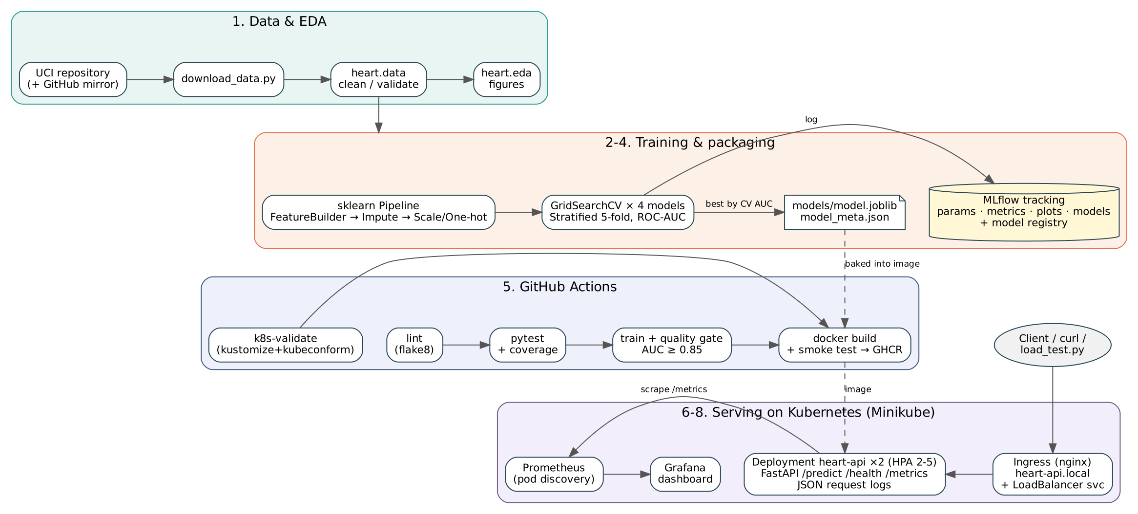
ARCHITECTURE
Architecture: one package used by every stage
Heart Disease Risk · End-to-End MLOps · AIMLCZG523 Assignment 01
3 / 15
Notes:
src/heart is the single implementation of cleaning, features and inference; notebooks, training CLI, tests and the API all import it. CI builds the image that Kubernetes runs; Prometheus scrapes the pods.

Slide 4
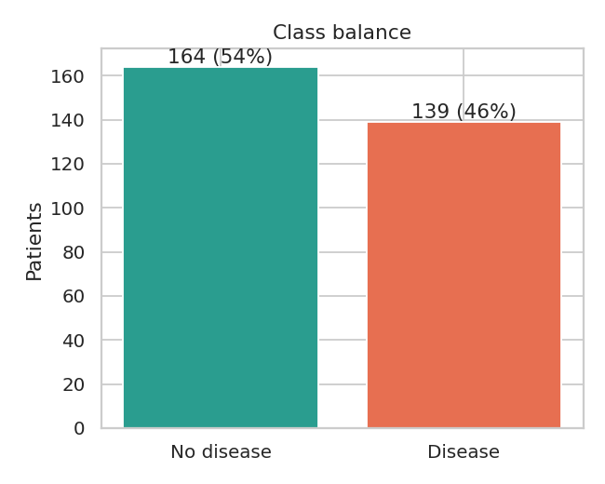
TASK 1 · DATA ACQUISITION
Data: 303 Cleveland patients, nearly balanced
303
46%
patients (UCI Cleveland)
have heart disease
13
6
input features
missing values (ca, thal)
▸ Download script UCI first, GitHub mirror fallback
▸ Stateless cleaning '?' → NaN, target num>0 → 1, range checks
▸ Imputation inside the pipeline no leakage, same at serving
Heart Disease Risk · End-to-End MLOps · AIMLCZG523 Assignment 01
4 / 15
Notes:
Demo: python scripts/download_data.py --force. Explain why imputation is not done in cleaning.

Slide 5
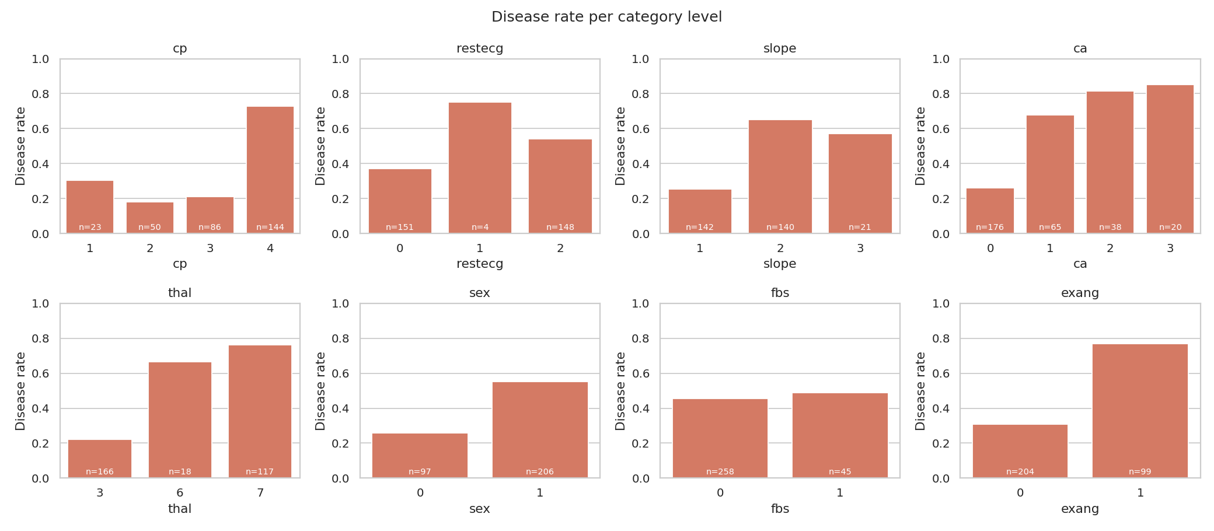
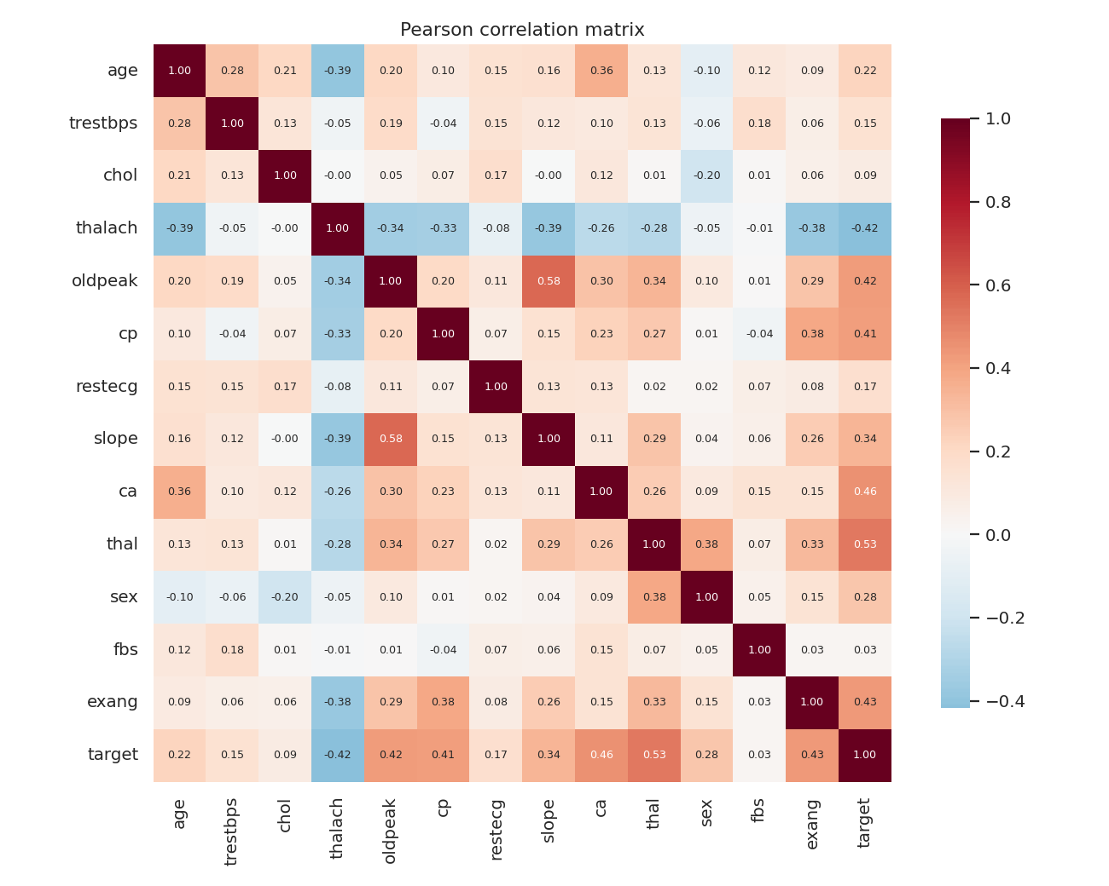
TASK 1 · EDA
EDA: chest pain, thal and vessels carry the signal
▸ Strongest correlations with target: thal 0.53, ca 0.46, exang 0.43, oldpeak 0.42
▸ Asymptomatic chest pain (cp=4) and reversible defect (thal=7) → disease rate above 70 %
▸ chol, trestbps overlap heavily between classes
Heart Disease Risk · End-to-End MLOps · AIMLCZG523 Assignment 01
5 / 15
Notes:
Mention the other figures in reports/figures (histograms, boxplots).

Slide 6
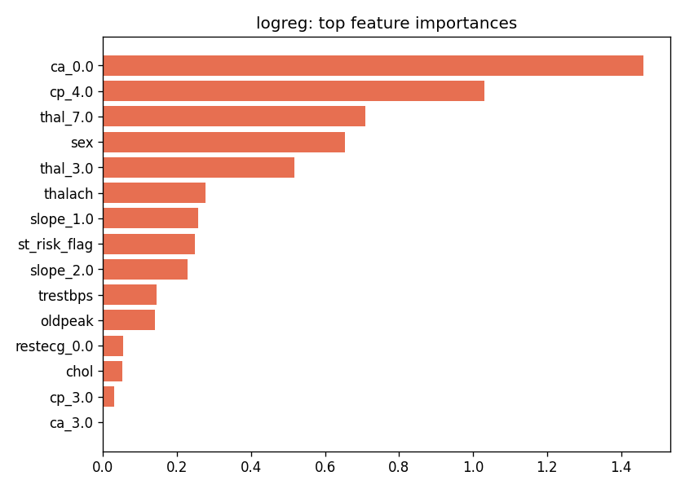
TASK 2 · FEATURES
Feature engineering lives inside the model pipeline
HeartFeatureBuilder
Impute
Scale + One-hot
Classifier
→
→
→
derived features
median / mode
ColumnTransformer
tuned estimator
▸ hr_reserve_pct thalach / (220 − age)
▸ chol_per_age cholesterol load relative to age
▸ st_risk_flag oldpeak ≥ 2 or exercise angina
▸ One object saved training and API apply identical transforms
Heart Disease Risk · End-to-End MLOps · AIMLCZG523 Assignment 01
6 / 15
Notes:
Show src/heart/features.py. Point out the ablation model without engineered features.

Slide 7
TASK 2 · MODEL SELECTION
logreg wins on cross-validated ROC-AUC
SELECTED
logreg
C=0.3, class_weight=balanced, penalty=l1
0.905
CV ROC-AUC (± 0.013)
96%
hold-out recall
Heart Disease Risk · End-to-End MLOps · AIMLCZG523 Assignment 01
7 / 15
Notes:
Rule: highest mean 5-fold CV ROC-AUC on the training split; hold-out used only for reporting. Linear models beat tree ensembles on 303 rows.

Slide 8
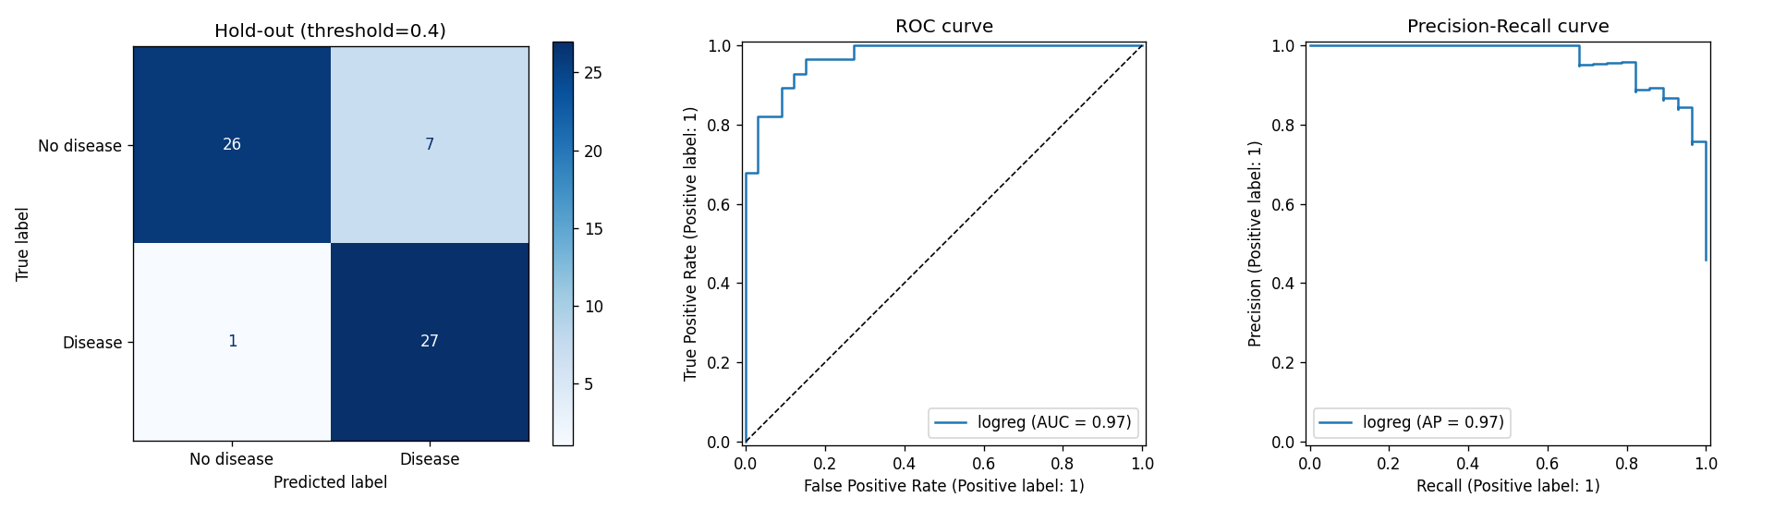
TASK 2 · EVALUATION
Selected model on the hold-out set
86.9%
79.4%
96.4%
0.970
accuracy
precision
recall
ROC-AUC
Heart Disease Risk · End-to-End MLOps · AIMLCZG523 Assignment 01
8 / 15
Notes:
Recall matters most clinically: missing a disease case is costly.

Slide 9
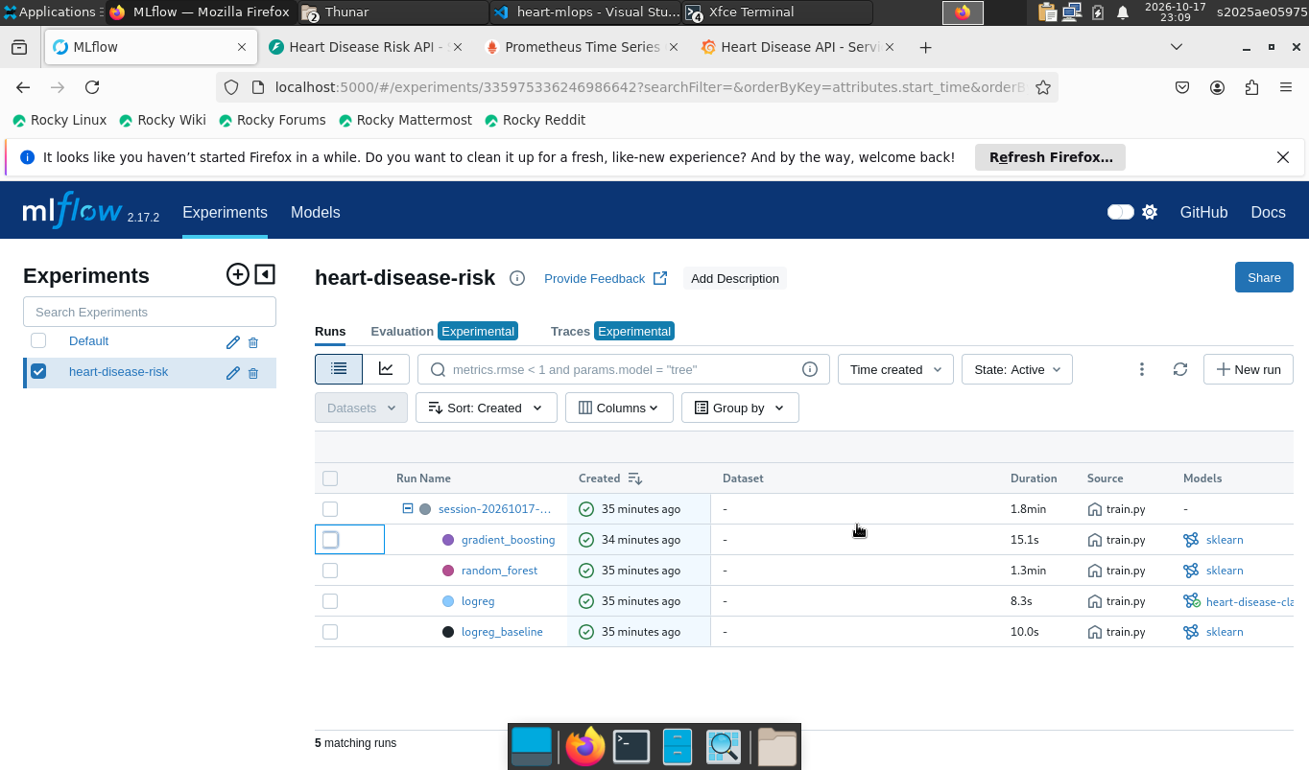
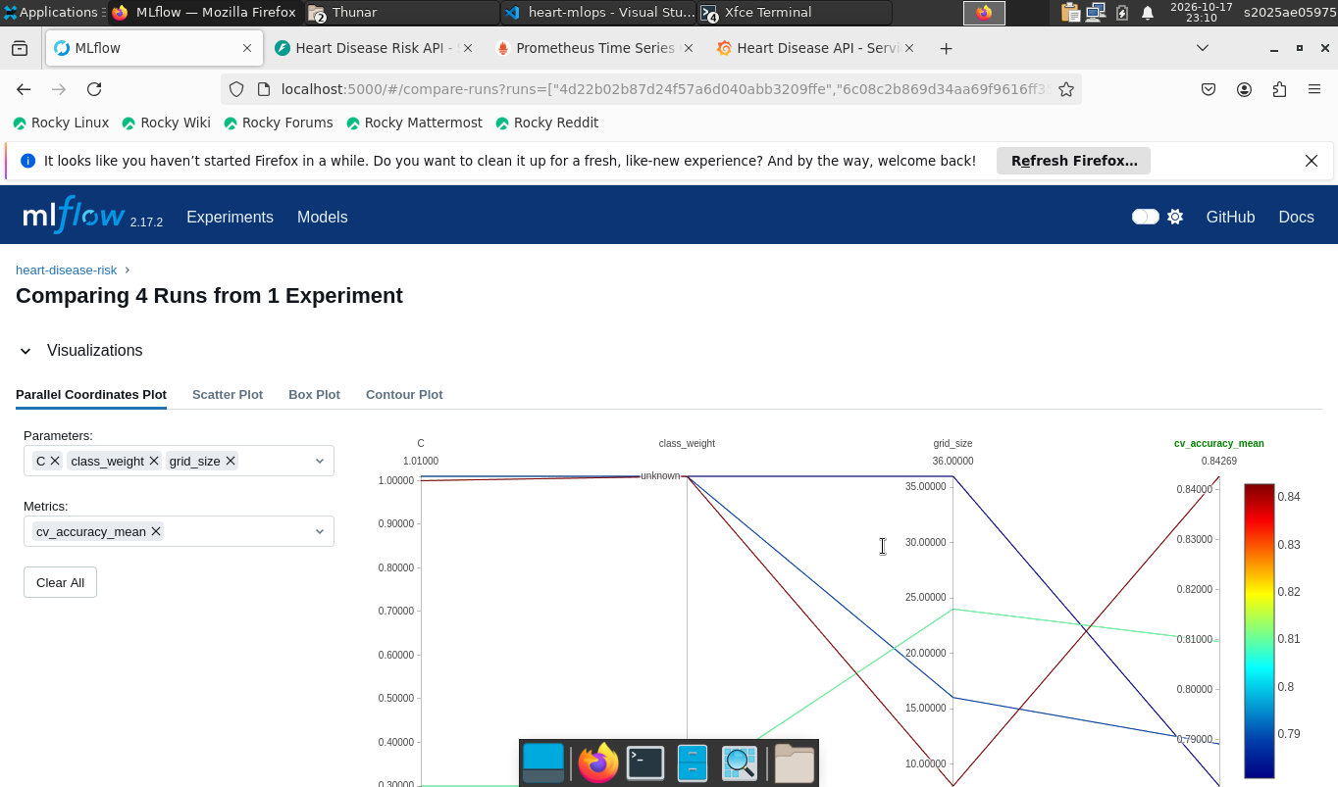
TASK 3 · EXPERIMENT TRACKING
Every run tracked in MLflow
Parent + nested runs
Run comparison
▸ Params best hyper-parameters, grid size, feature set
▸ Metrics CV mean ± std for 5 metrics, hold-out metrics
▸ Artifacts plots, grid results, model with signature, registry entry
Heart Disease Risk · End-to-End MLOps · AIMLCZG523 Assignment 01
9 / 15
Notes:
Demo: make mlflow → http://localhost:5000, open a child run.

Slide 10
TASKS 4–5 · PACKAGING & TESTS
Reproducible packaging and automated tests
▸ models/model.joblib whole pipeline in one object
▸ model_meta.json version, run IDs, params, metrics, feature order
▸ 3-layer requirements serve · train · dev, all pinned
▸ Fixed seeds RANDOM_STATE = 42 everywhere
▸ 48 pytest tests data, features, model, API — no network needed
▸ Make targets make data · train · test · lint · docker-build
$ make lint
python -m flake8
$ make test
48 passed
$ make train
Selected logreg -> models/model.joblib
$ make docker-build docker-run smoke
SMOKE TEST PASSED
$ ./scripts/deploy_minikube.sh
deployment "heart-api" successfully rolled out
Heart Disease Risk · End-to-End MLOps · AIMLCZG523 Assignment 01
10 / 15
Notes:
Demo: run make lint test live in the terminal.

Slide 11
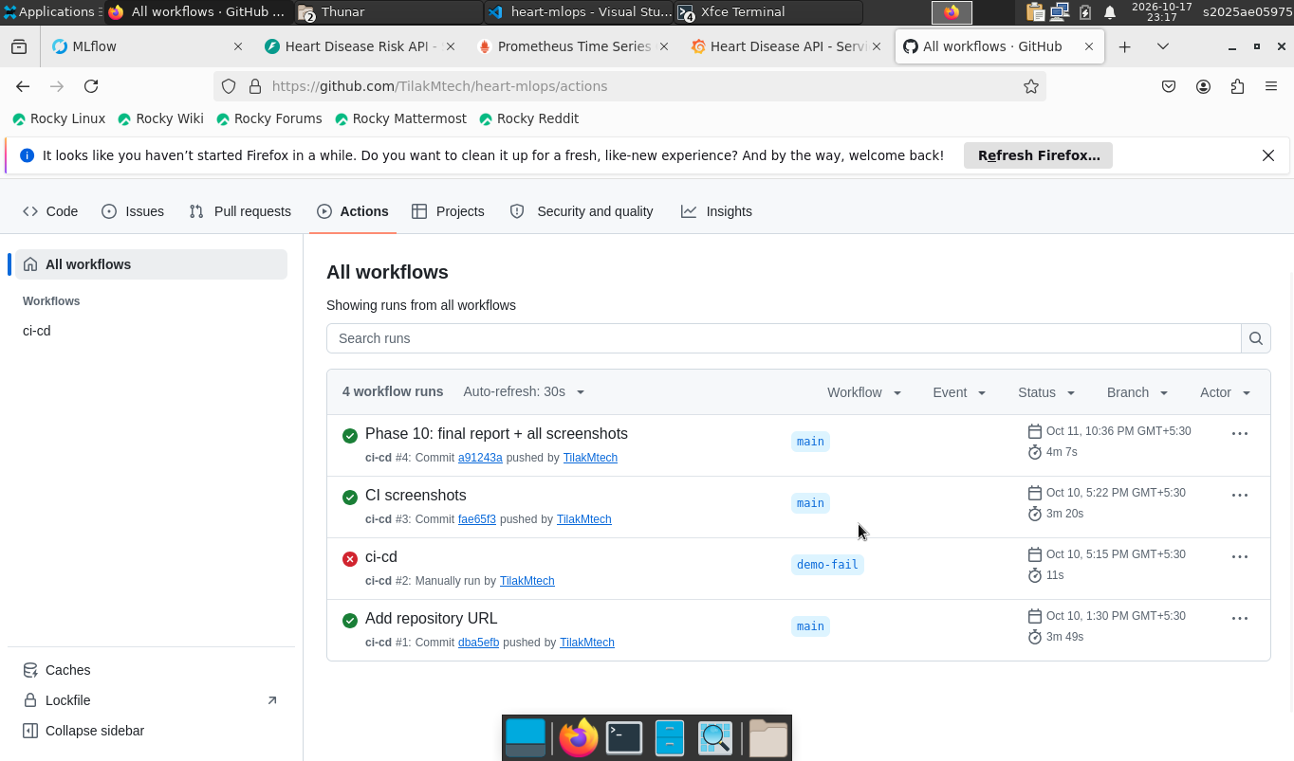
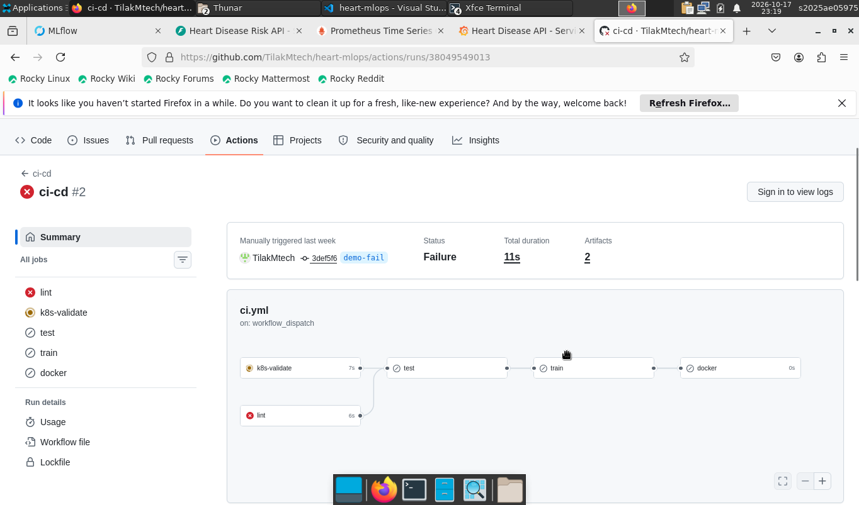
TASK 5 · CI/CD
GitHub Actions gates every change
lint
k8s-validate
test
train + gate
docker
Green run on main
Lint error stops the pipeline
Heart Disease Risk · End-to-End MLOps · AIMLCZG523 Assignment 01
11 / 15
Notes:
Quality gate: CV ROC-AUC ≥ 0.85. Artifacts: lint report, JUnit, coverage, model, MLflow store, container logs. Image pushed to GHCR on main.

Slide 12
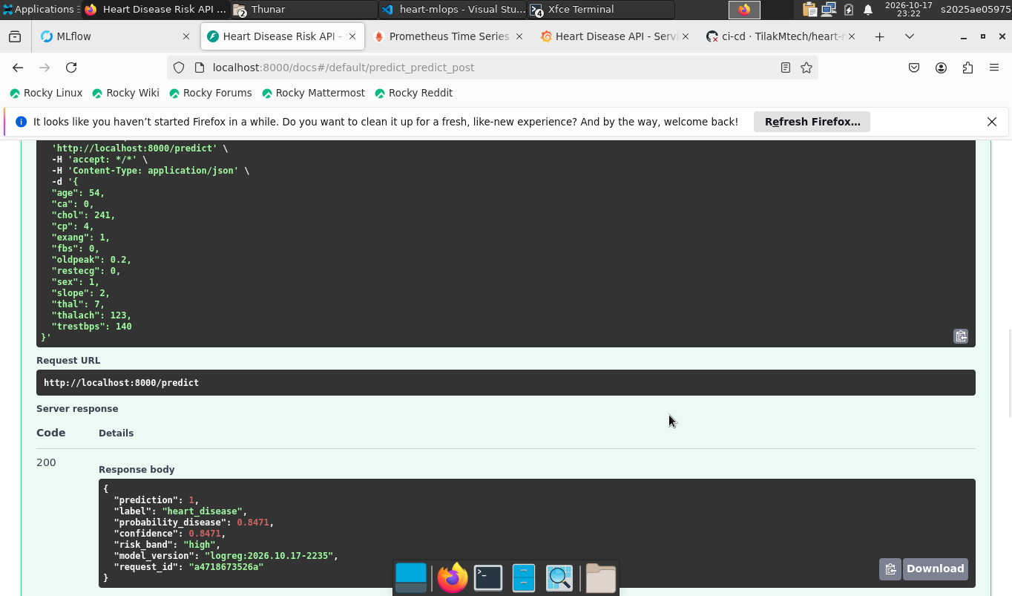
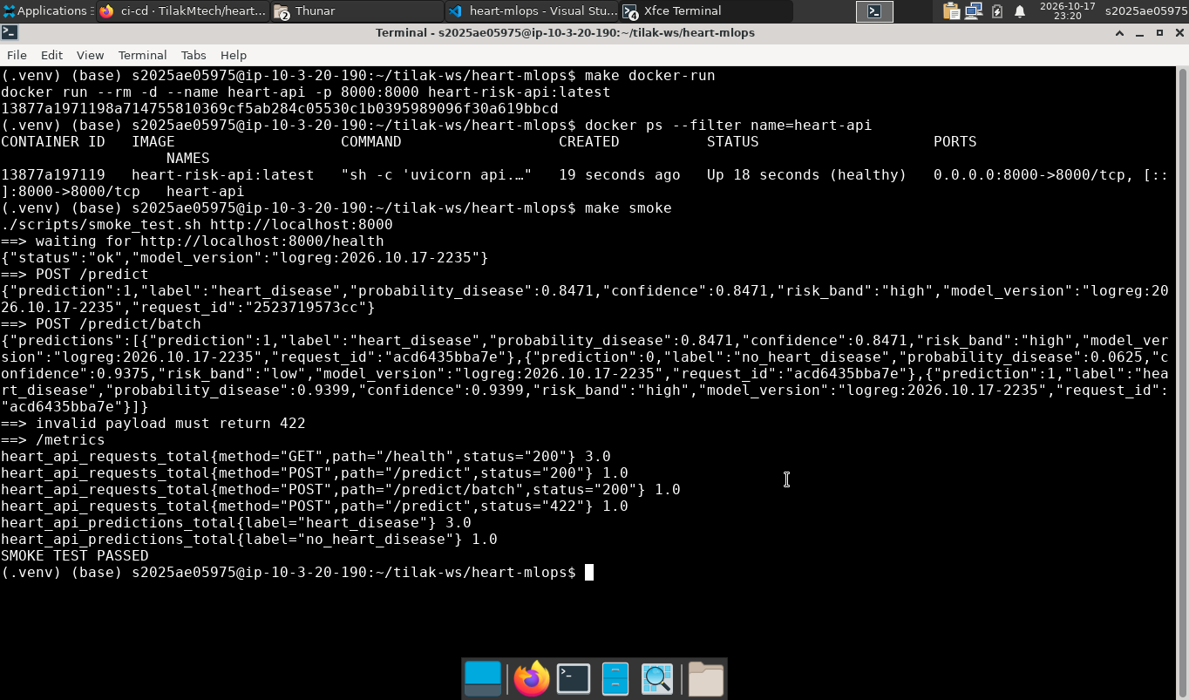
TASK 6 · CONTAINERISATION
FastAPI service in a slim, non-root container
Endpoint | Returns
POST /predict | prediction, confidence, risk band
POST /predict/batch | up to 500 records
GET /health | 200 when model loaded
GET /metrics | Prometheus format
GET /docs | Swagger UI
Swagger /predict
▸ python:3.11-slim serving deps only, UID 1001, HEALTHCHECK
▸ Pydantic validation bad input → 422
Build + smoke test
Heart Disease Risk · End-to-End MLOps · AIMLCZG523 Assignment 01
12 / 15
Notes:
Demo: make docker-build docker-run smoke.

Slide 13
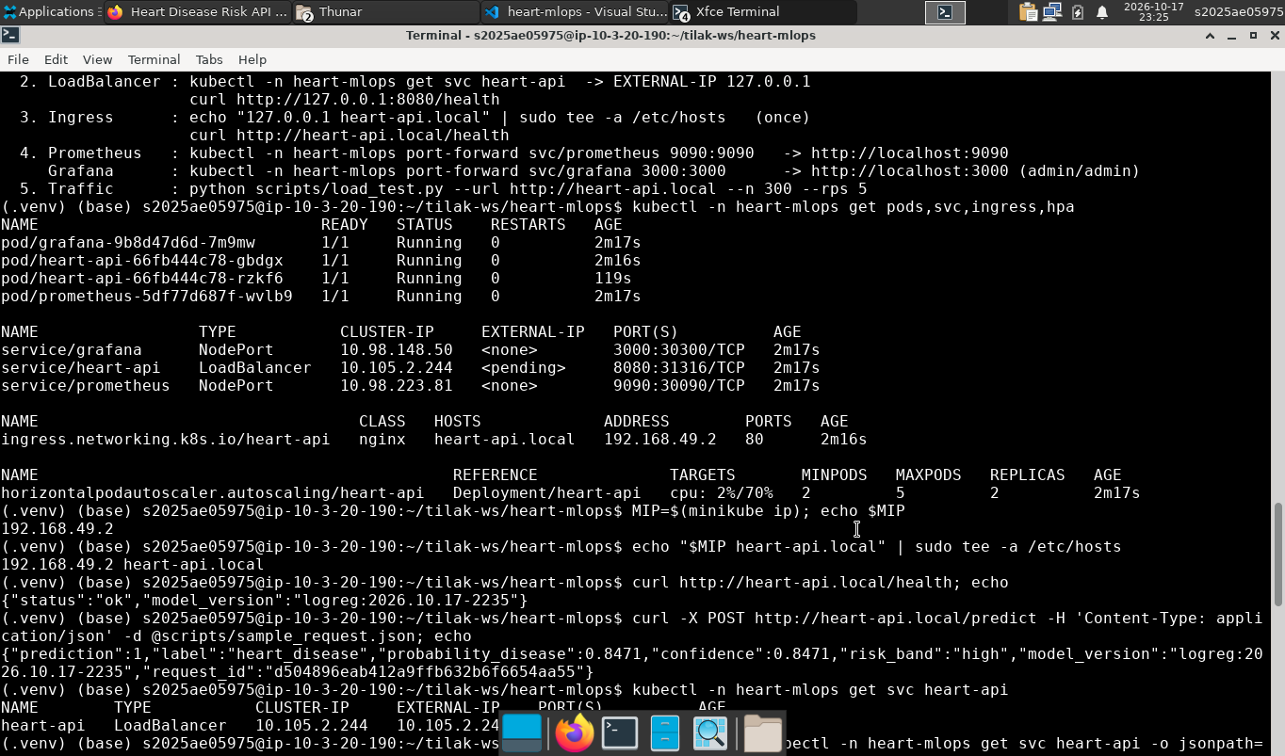
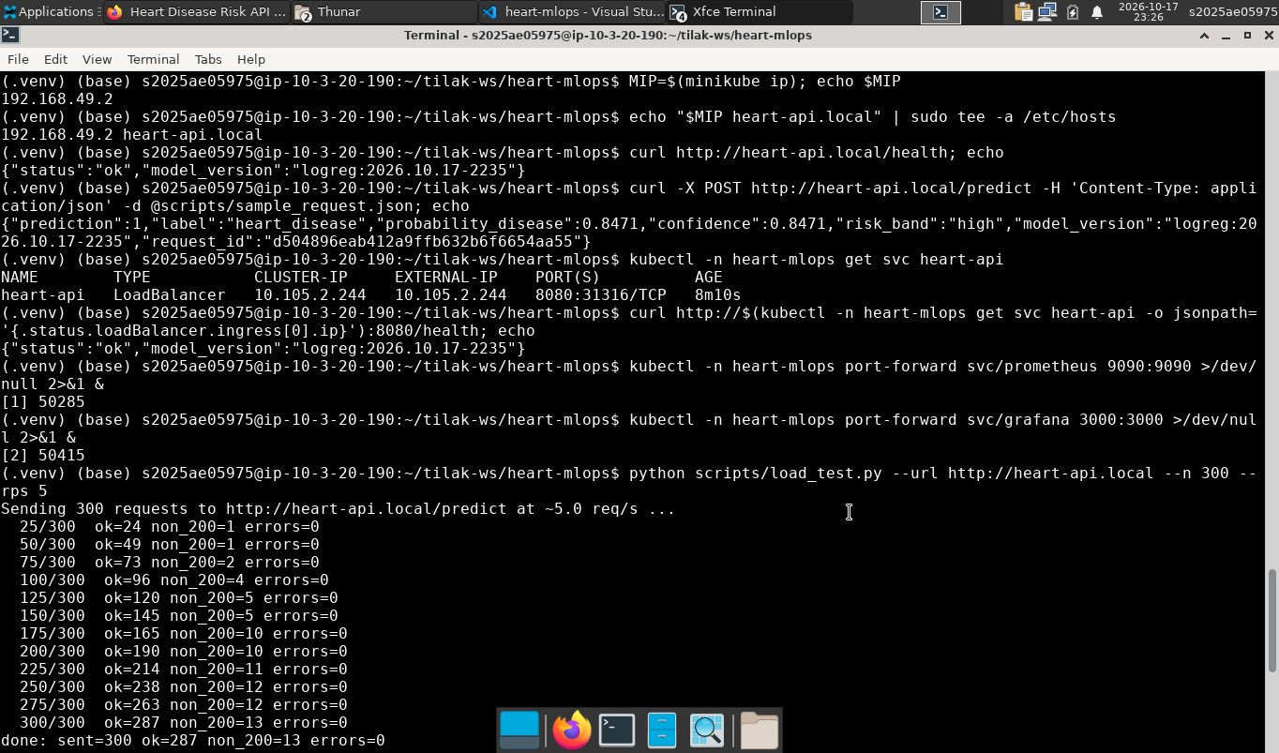
TASK 7 · DEPLOYMENT
Deployed on Kubernetes (Minikube)
▸ Deployment 2 replicas, rolling update, probes, limits
▸ Service LoadBalancer on :8080 (minikube tunnel)
▸ Ingress nginx, host heart-api.local
▸ HPA 2–5 replicas at 70 % CPU
▸ Kustomize kubectl apply -k k8s/
▸ One script ./scripts/deploy_minikube.sh
Cluster resources
Prediction through the Ingress
Heart Disease Risk · End-to-End MLOps · AIMLCZG523 Assignment 01
13 / 15
Notes:
Demo: kubectl -n heart-mlops get pods,svc,ingress,hpa; curl http://heart-api.local/health

Slide 14
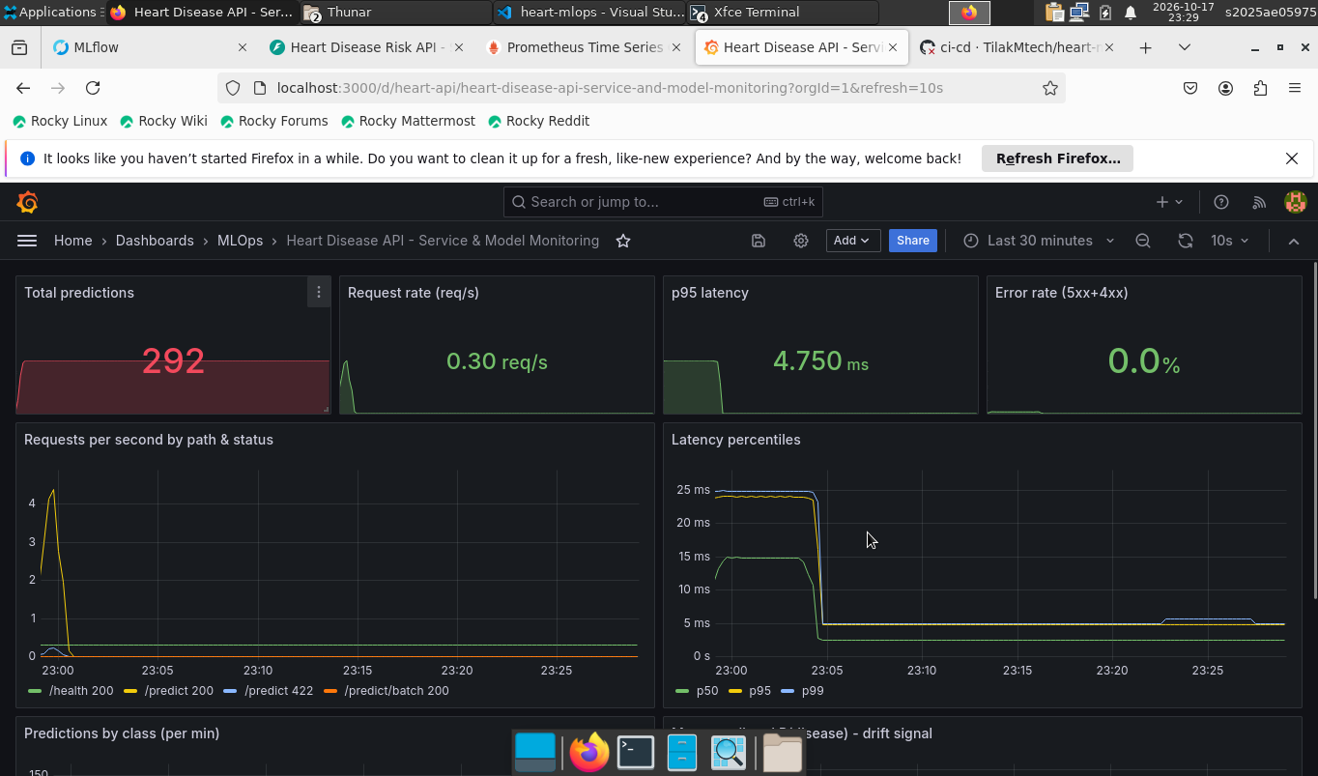
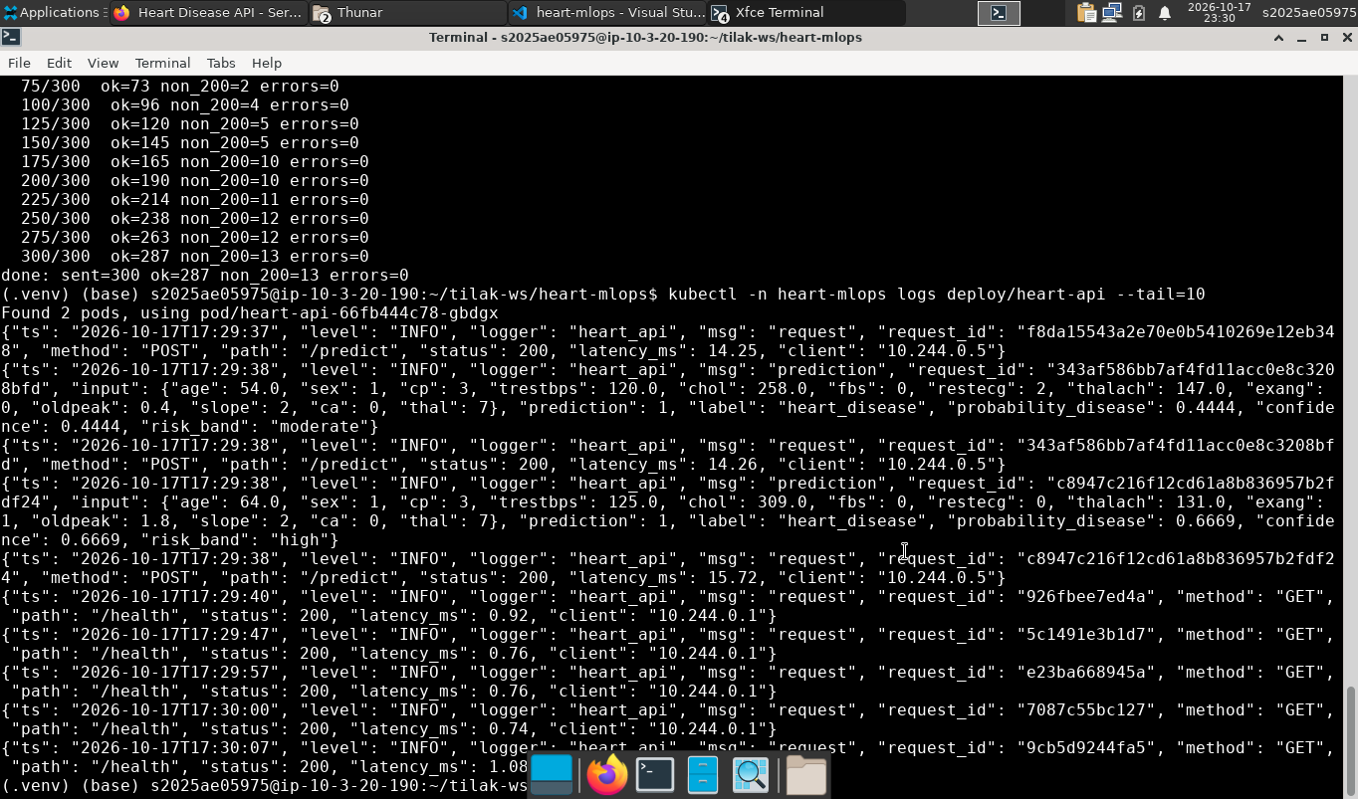
TASK 8 · MONITORING
Monitoring: logs, metrics, dashboard
JSON request logs
▸ Request rate, p95 latency, errors
▸ Predictions per class
▸ Mean P(disease) drift signal
▸ Prometheus pod discovery
Grafana dashboard
Heart Disease Risk · End-to-End MLOps · AIMLCZG523 Assignment 01
14 / 15
Notes:
Demo: python scripts/load_test.py --url http://heart-api.local, then show Grafana panels updating.

Slide 15
SUMMARY
From raw CSV to a monitored API — fully automated
0.905
96%
48
5
CV ROC-AUC
hold-out recall
unit tests
CI jobs
Next steps
Probability calibration and a recall-oriented threshold · per-feature drift tests on logged inputs
Remote MLflow server with model promotion · Helm chart with separate environments
https://github.com/TilakMtech/heart-mlops
Notes:
Thank the audience, share the repo link, take questions.

