Slide 1

Smart Airport Security — AI Face Recognition at the Boarding Gate
Candidate
Supervisor
Dr Mayuranathan M,
Professor,
SIMATS Engineering
Tilak Venkat Sai M 192424415

Slide 2
INTRODUCTION
Smart Airport Security — AI Face Recognition at the Boarding Gate
Modern airports handle millions of passengers each day, and manual identity checks at every touchpoint slow the entire journey.
A startup can deploy an AI face recognition pipeline that verifies a traveller's identity in under a second — from check-in to the boarding gate.
The solution relies on three connected pillars: image processing to clean the captured frame, computer vision levels to interpret it, and camera models to guarantee optical accuracy.
Together they replace slow document inspection with a contactless, secure and scalable screening experience.
< 1 s
Verification time
99%+
Match accuracy
24 / 7
Continuous screening
1 / 5

Slide 3
PROPOSED OBJECTIVES
01 Image Processing
Enhance captured frames with denoising, histogram equalisation and alignment so the recognition engine receives a clean, well-lit face.
02 Vision Levels
Move data through low-level (pixels & edges), mid-level (segmentation & landmarks) and high-level (identity) analysis for reliable interpretation.
03 Camera Models
Use calibrated pinhole and wide-angle IP camera models to correct lens distortion and estimate real-world face geometry.
04 Real-Time Screening
Match a live face against the airline's passenger and watchlist database within one second at the boarding gate.
05 Privacy & Compliance
Process biometric templates on secure edge devices and follow DPDP / GDPR data-retention rules.
06 Scalable Deployment
Design a modular pipeline that runs across check-in kiosks, immigration counters and boarding gates.
2 / 5

Slide 4
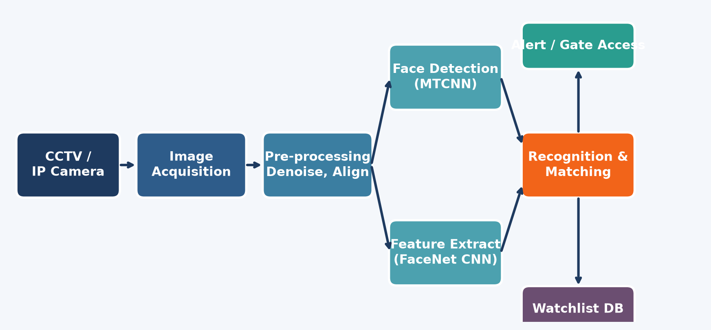
03
SYSTEM ARCHITECTURE DIAGRAM
Pipeline Flow
• Camera captures live video at the gate.
• Frames are pre-processed (denoise, align, normalise).
• MTCNN detects the face region.
• FaceNet extracts a 128-D embedding.
• Embedding matched against watchlist DB.
• Result triggers gate access or alert.
3 / 5

Slide 5
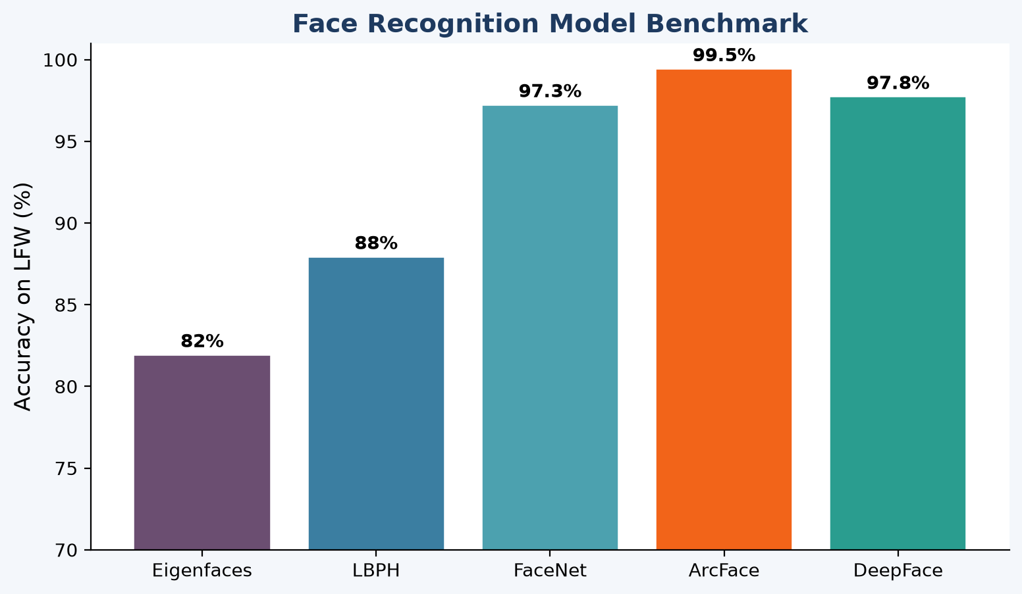
MODELS AND RECOGNITION
Chosen Stack
• Detection – MTCNN handles multi-scale faces even at oblique gate angles.
• Embedding – FaceNet / ArcFace produces a compact 128-D vector per face.
• Matching – Cosine similarity against the encrypted passenger vector store.
• Camera – Pinhole model for kiosks, wide-angle for gate CCTV, calibrated with a chessboard pattern.
• Threshold – 0.68 similarity balances false-accept and false-reject at the gate.
4 / 5

Slide 6
CONCLUSION
Image Processing
Cleans and standardises every captured frame so face features stay sharp under changing airport lighting.
Vision Levels
Low, mid and high-level analysis turn raw pixels into an identity decision the security system can trust.
Camera Models
Calibrated pinhole and wide-angle models remove distortion and give accurate spatial context for each face.
Combined Impact
The startup delivers contactless, sub-second boarding-gate authentication that scales across the entire terminal.
5 / 5

