Slide 1
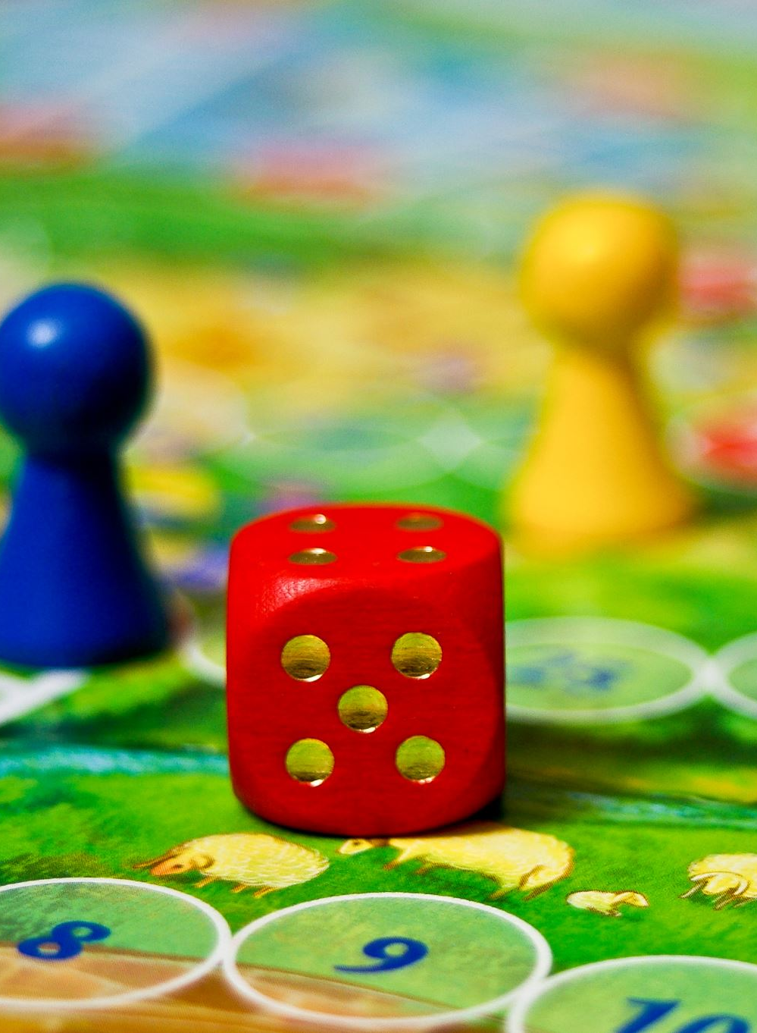
PREDICTIVE ANALYTICS FOR SALES & LOYALTY OPTIMISATION AT TURTLE GAMES
Tilani Wijamunige – Data Analyst
30/09/2024

Slide 2
Purpose of the analysis
Understand
Understand customer behaviors.
Improve
Evaluate models to predict loyalty points and optimize customer engagement.
Improve Loyalty Program and overall sales.
Identify patterns in spending, loyalty, and product preferences by demographics.
Segment customers to inform targeted marketing strategies.

Slide 3
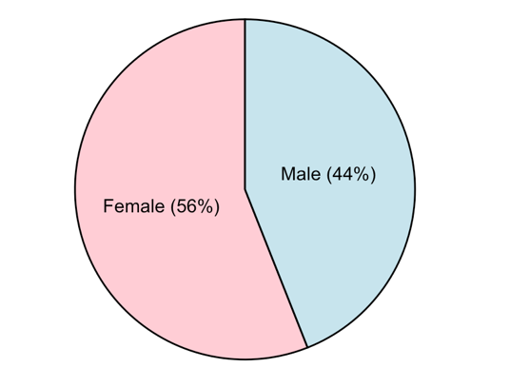
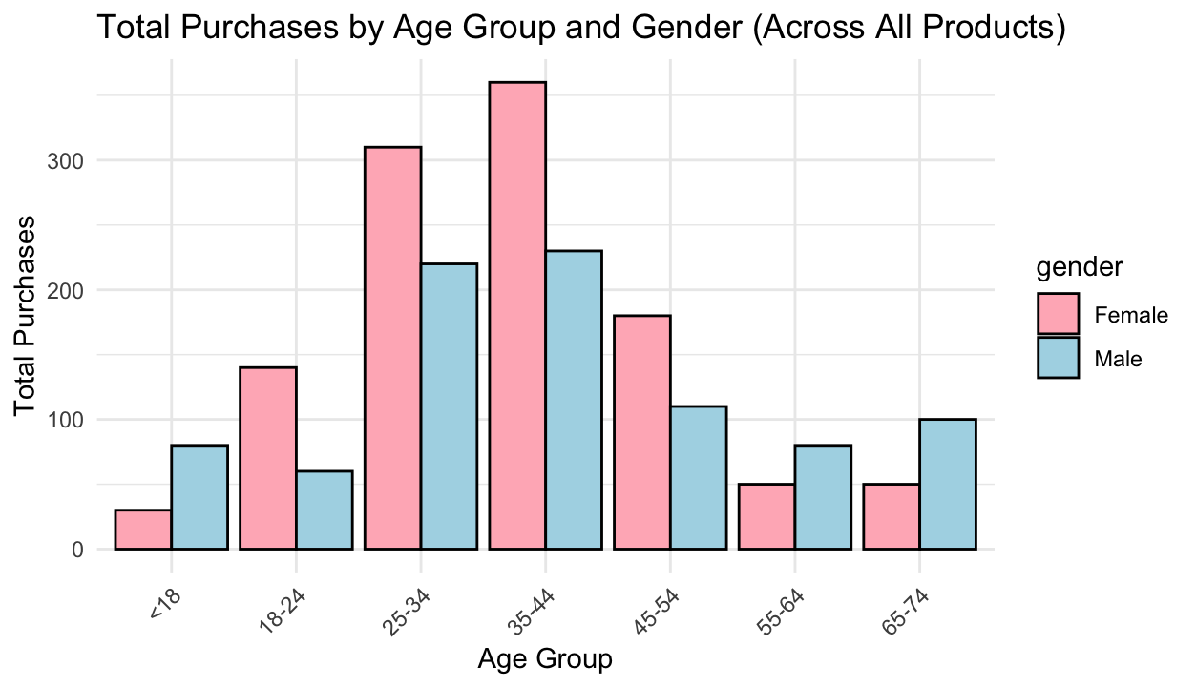
Who are our customers?
Gender and Age Insights
Females represent majority of the customer base
25-44 age group dominates.
Purchases decline significantly after age 50

Slide 4
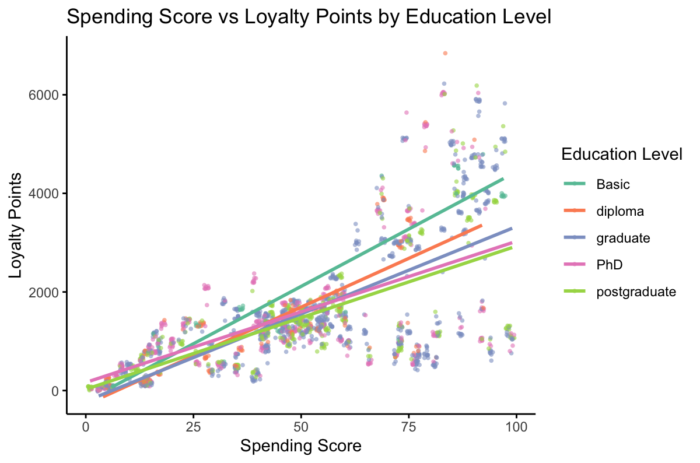
Who are our customers?
Education level, spending and loyalty point
Basic education : highest loyalty points.
Graduate/PhD : consistent spending, lower points.
Opportunity to engage higher-educated customers.

Slide 5
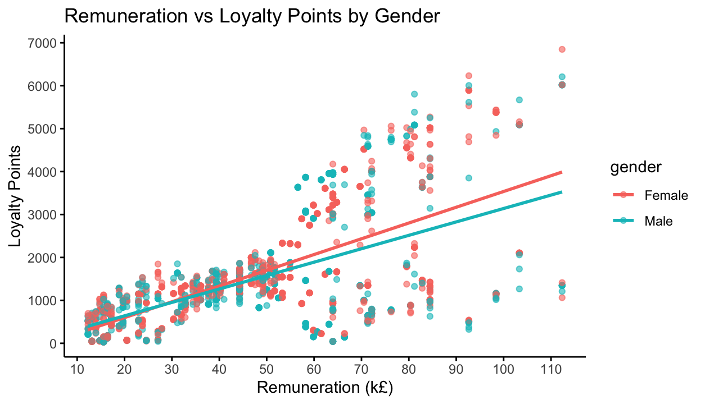
Who are our customers? Gender, Income, Loyalty
Loyalty increases with income for both genders.
Females accumulate more loyalty points than males at similar income levels.
Greater variation in loyalty points among higher-income customers.

Slide 6
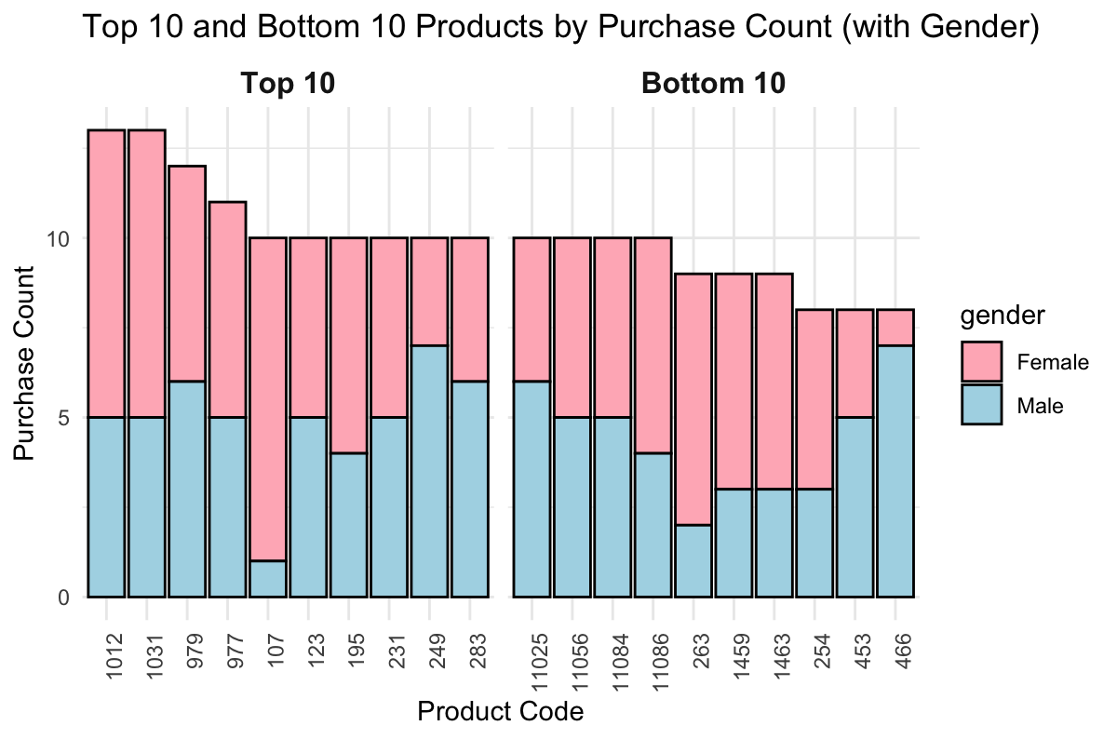
Product Purchase Patterns: Top / Bottom Performers
Females > Males, particularly for PC 1012, 1031, and 979.
PC 107 female favorite.
In the Bottom 10 products, the purchase count is more balanced between males and females.
PC 11056,11084 almost equal engagement from both genders.

Slide 7
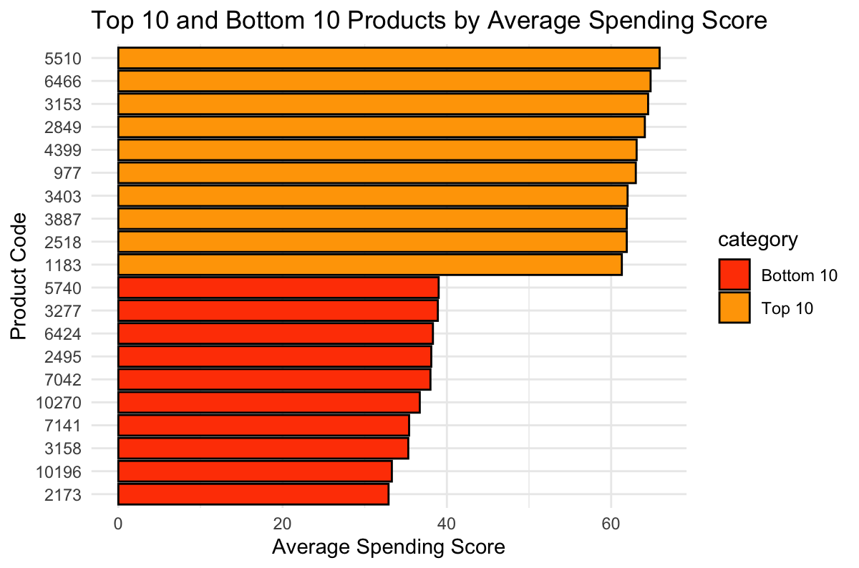
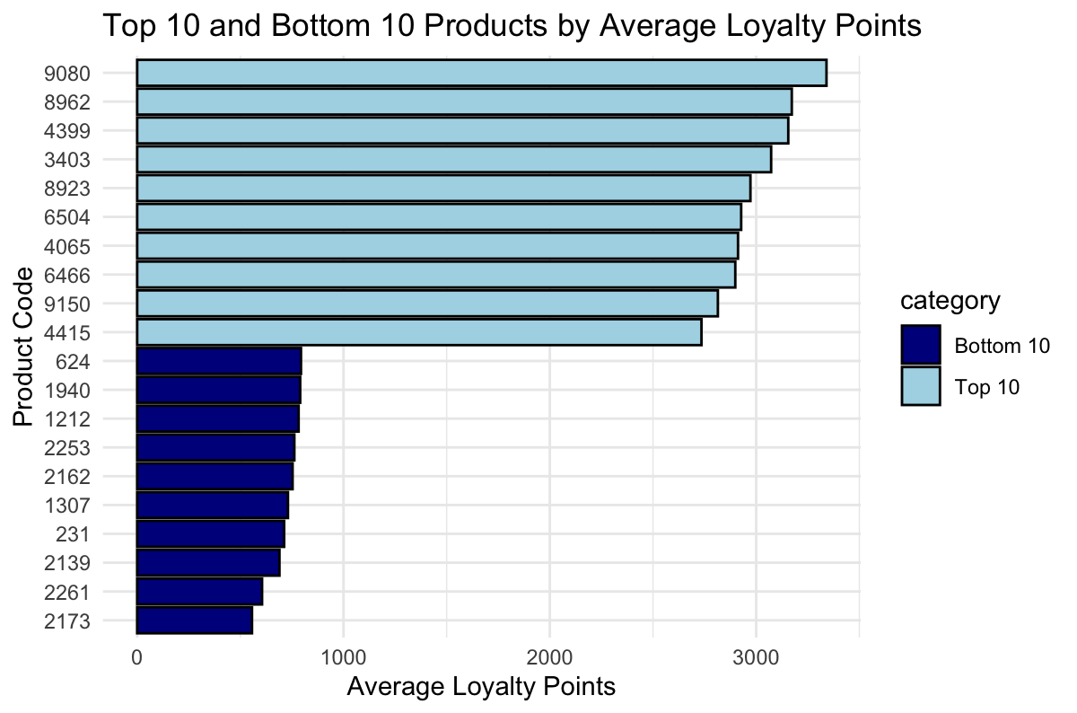
Product Purchase Patterns: Top / Bottom Performers
PC- 4399,3403,6466 Top 10 for both spending score and loyalty points
PC- 2173 consistently ranks in the Bottom 10 for both spending score and loyalty points

Slide 8
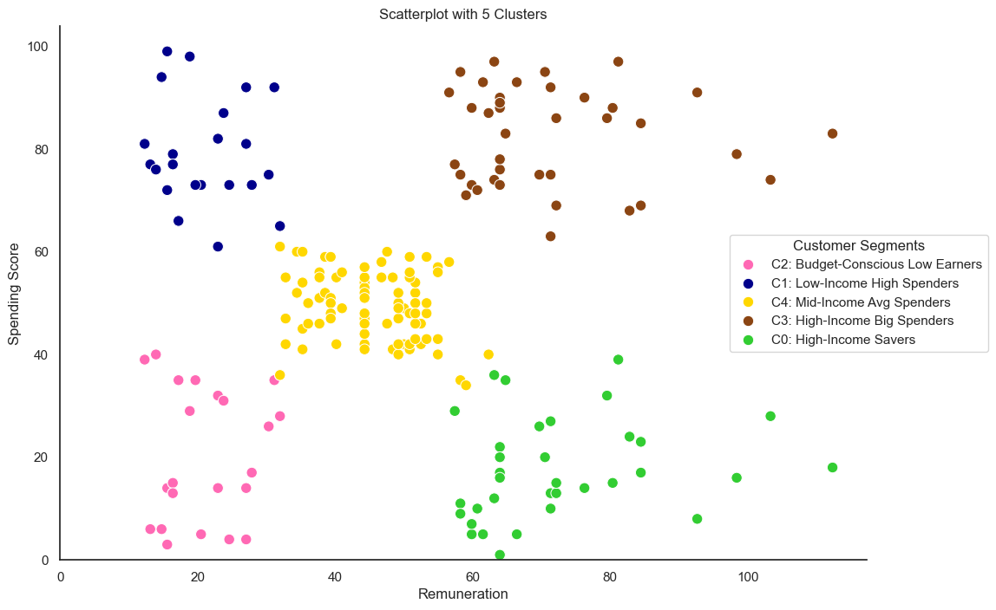
Customer Segmentation
C2 = 14% Budget-Conscious Low Earners
C1 = 14% Low-Income High Spenders
C4 = 39% Middle-Income Average Spenders
C3 = 18%. High-Income Big Spenders
C0 = 17% High-Income Savers

Slide 9
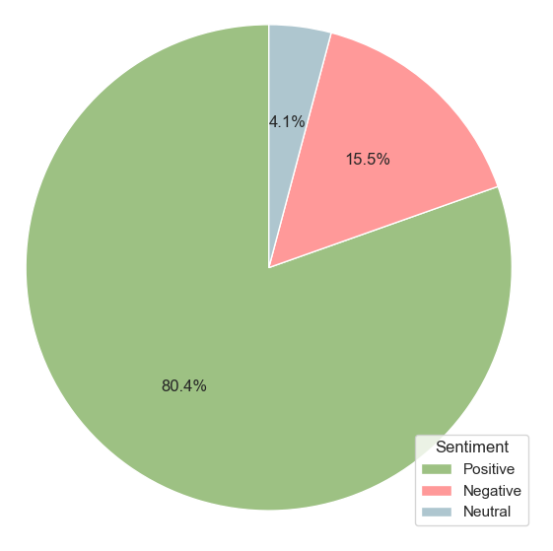
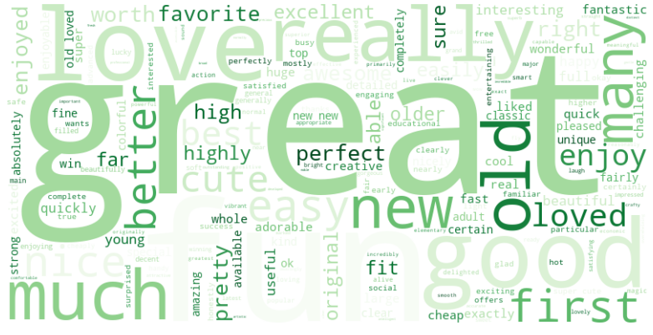
What do customers say?

Slide 10
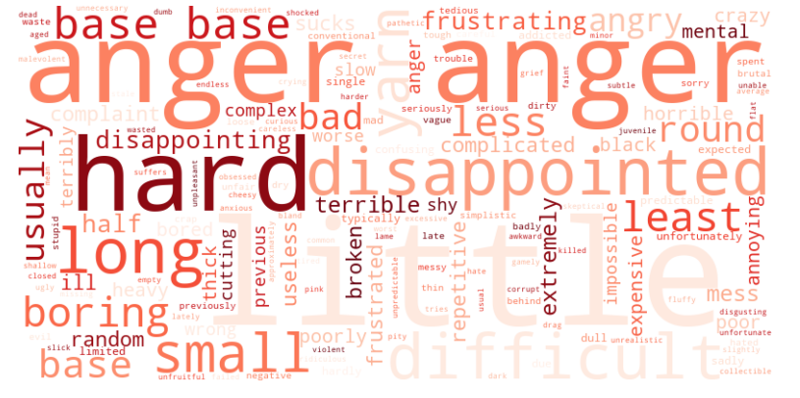
Negative Reviews
Key Sentiments: "Anger," "Hard," "Disappointed.”
Complaints: Difficulty, complexity, small size.
Areas for Improvement:
User experience product frustration

Slide 11
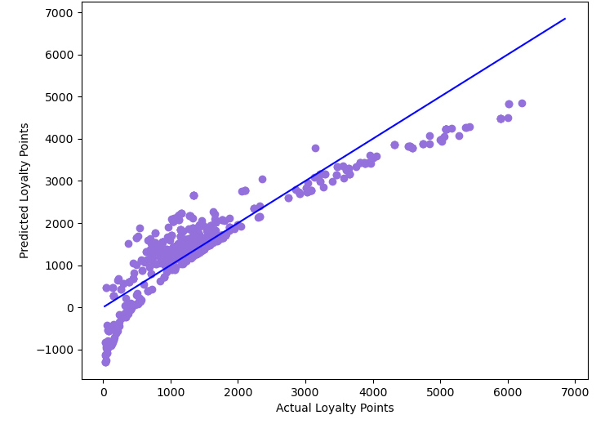
Predictive Model 1 - MLR
Good Fit:
Strong alignment between actual and predicted loyalty points.
Deviations:
Some underprediction at lower loyalty points.
Model Accuracy:
High predictive performance with minor deviations.

Slide 12
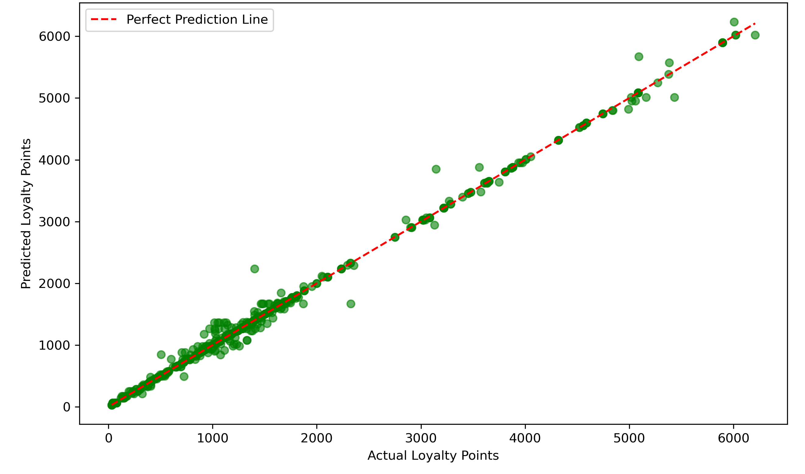
Predictive Model 2- Decision Tree
Excellent Fit: Predicted loyalty points closely match actual values.
High Accuracy:
Points align well with the perfect prediction line.
Minimal Error:
Small deviations, particularly in higher ranges.

Slide 13
Recommendations
1) Use Customer Segmentation & Decision Tree model for Loyalty Predictions
Segment customers by behaviour, apply Decision Tree analysis to each group for accurate loyalty point predictions, and craft personalised marketing campaigns based on these insights.
2) Target 25-44yr Females
Focus marketing on this high-purchase group with loyalty rewards tied to products like 1012 and 1031.
3) Engage Graduate/PhD Customers
Increase participation through premium rewards and exclusive benefits.
4) Promote High-Performer products
Focus on premium products (5510, 6466, 9080) to drive sales.
5) Reassess Low-Performer products
Promote or phase out underperforming products like 10270 and 2173.
6) Optimise Loyalty Program
Tailor rewards based on income, offering value-driven and premium incentives.
7) Enhance Feedback Collection
Introduce structured feedback system for better sentiment analysis.
8) Improve Product Categorisation
Use detailed categories to analyse trends by gender, age, and seasonality.

