Slide 1
Randomized Algorithms
Idea: use some probability in your algorithm
Surprisingly, this can help a lot!
We’ll see examples mostly for NP-complete problems
But also helpful for problems in P

Slide 2

Outline
Stirling’s approximation
Color Coding
${O^{∗}(k}^{k})$ for $k$-path
${O^{∗}(\left(2e\right)}^{k})$ for $k$-path
Schöning’s Algorithm
Feedback Vertex Set

Slide 3
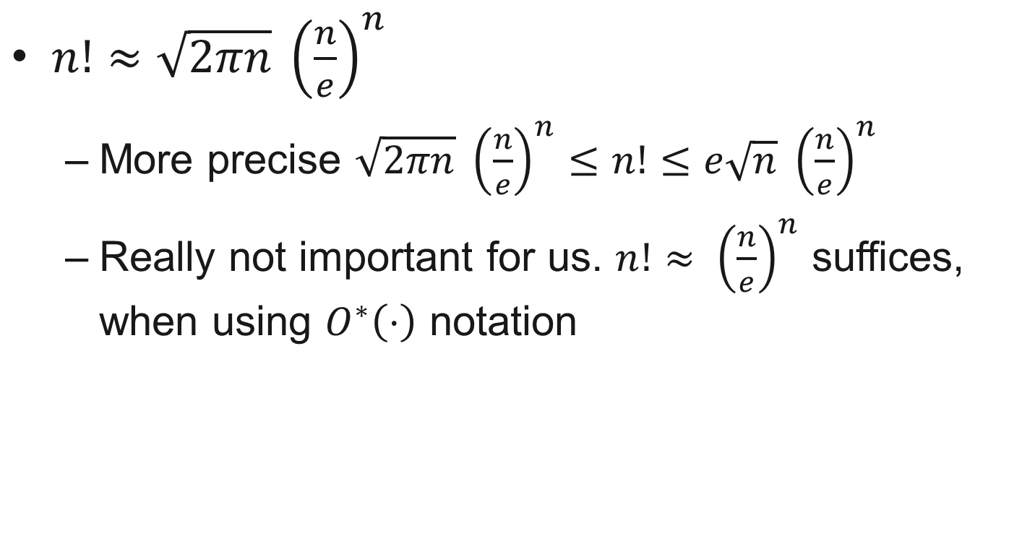
Stirling’s approximation
$n!≈\sqrt{2πn} {\left(\frac{n}{e}\right)}^{n}$
More precise $\sqrt{2πn} {\left(\frac{n}{e}\right)}^{n}≤n!≤e\sqrt{n} {\left(\frac{n}{e}\right)}^{n}$
Really not important for us. $n!≈ {\left(\frac{n}{e}\right)}^{n}$ suffices, when using $O^{∗}\left(⋅\right)$ notation

Slide 4
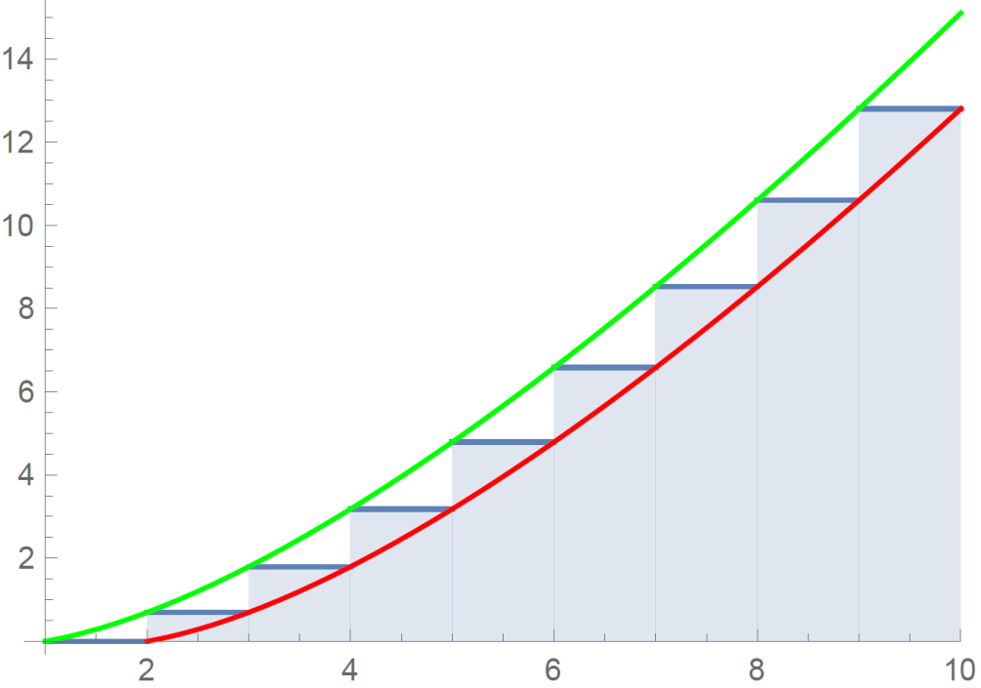
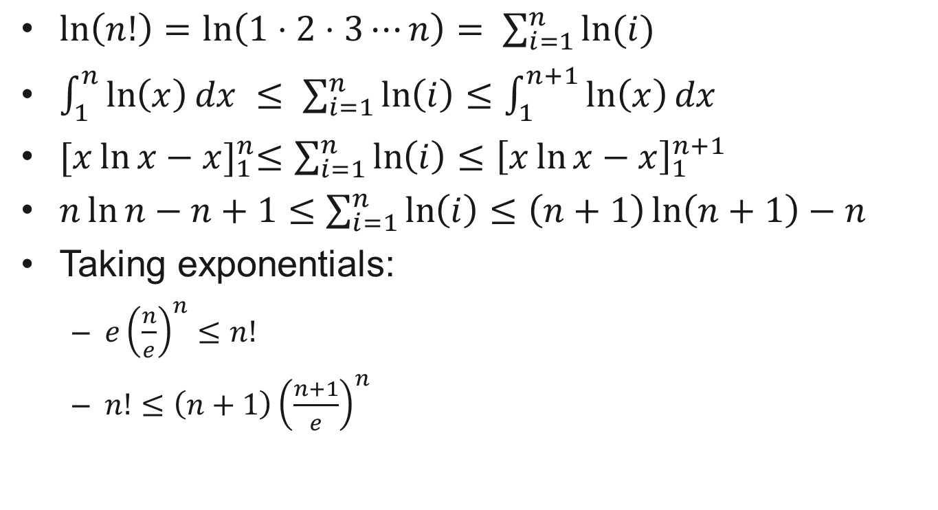
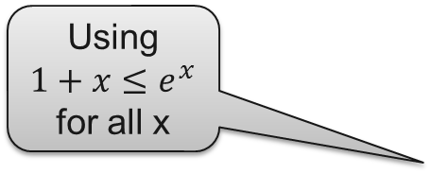

Derivation Stirling’s approximation (not examined)
$\ln\left(n!\right)=\ln\left(1⋅2⋅3⋯n\right)= \sum_{i=1}^{n}{ln⁡(i)}$
$\int_{1}^{n}{\ln\left(x\right)dx }≤ \sum_{i=1}^{n}{\ln\left(i\right)}≤\int_{1}^{n+1}{\ln\left(x\right)dx }$
${[x\ln{x−x}]}_{1}^{n}≤\sum_{i=1}^{n}{\ln\left(i\right)}≤{\left[x\ln{x−x}\right]}_{1}^{n+1}$
$n\ln{n}−n+1≤\sum_{i=1}^{n}{\ln\left(i\right)}≤\left(n+1\right)\ln\left(n+1\right)−n$
Taking exponentials:
${e\left(\frac{n}{e}\right)}^{n}≤n!$
$n!≤{\left(n+1\right)\left(\frac{n+1}{e}\right)}^{n}$
Using $1+x≤e^{x}$
for all x
$$≤\left(n+1\right){\left(1+\frac{1}{n}\right)}^{n}{\left(\frac{n}{e}\right)}^{n}$$
$≤\left(n+1\right)e{\left(\frac{n}{e}\right)}^{n}$

Slide 5
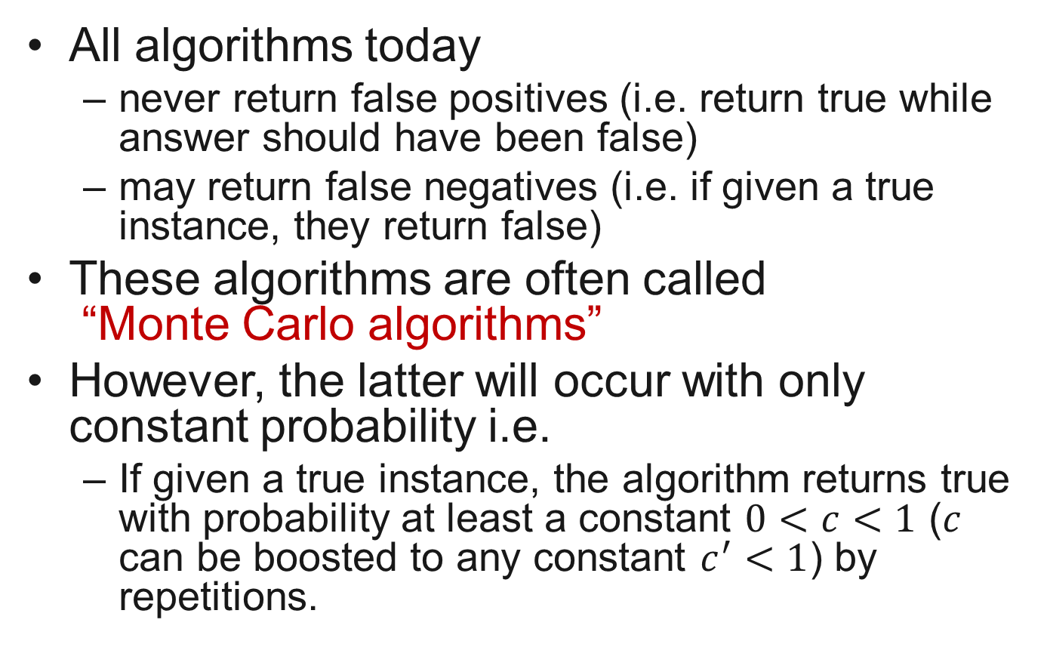
One-sided constant error probability
All algorithms today
never return false positives (i.e. return true while answer should have been false)
may return false negatives (i.e. if given a true instance, they return false)
These algorithms are often called “Monte Carlo algorithms”
However, the latter will occur with only constant probability i.e.
If given a true instance, the algorithm returns true with probability at least a constant $0<c<1$ ($c$ can be boosted to any constant $c^{′}<1$) by repetitions.

Slide 6
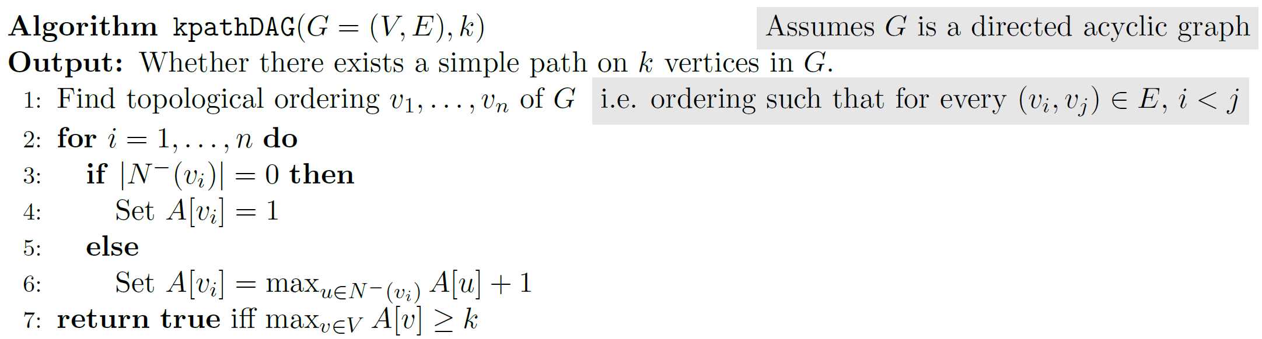






Color Coding 1
Directed $k$-path problem: given directed graph $G$, is there a simple path on at least $k$ vertices.
In polynomial time if $G$ is acyclic:
Crux: cannot collide with previous part of the path
$$v_{1}$$
$$v_{2}$$
$$v_{3}$$
$$v_{i}$$
$$v_{n}$$
1
2
1

Slide 7
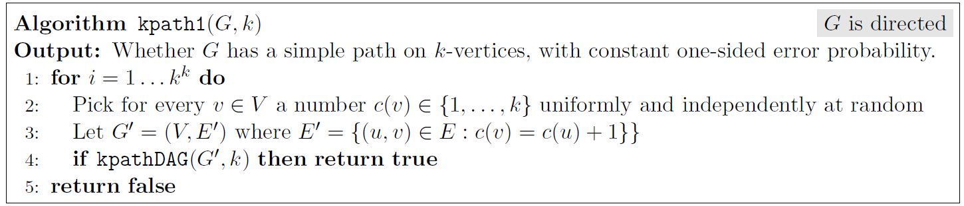


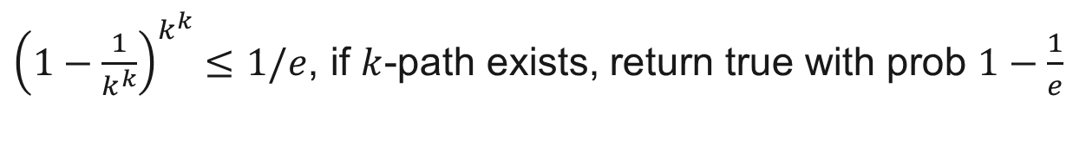
Color Coding 1
Idea: try to reduce the general case to acyclic case.
If true is returned, $G^{′}$ has a $k$-path so $G$ as well
If $G$ has a $k$-path, look at one iteration:
$\underset{c}{Pr}{[G^{′}\text{has} k\text{−}\text{path} p_{1},…,p_{k} ]}≥\underset{c}{Pr}\left[∀i∈\{1,…,k\}:c\left(p_{i}\right)=i\right]={\left(\frac{1}{k}\right)}^{k}$
So prob. we won’t find a path in the whole loop is at most
$$1+x≤e^{x}$$
for $$x=−1/k^{k}$$
${\left(1−\frac{1}{k^{k}}\right)}^{k^{k}}≤1/e$, if $k$-path exists, return true with prob $1−\frac{1}{e}$
$O^{∗}(k^{k})$ time algorithm with constant one-sided err.

Slide 8


Color Coding 2
Let’s try to do faster now, we’ll see $O^{∗}({\left(2e\right)}^{k})$ time.
Requirement vertices consecutively ordered was too strict
Think of the values $c(v)$ as colors

Slide 9
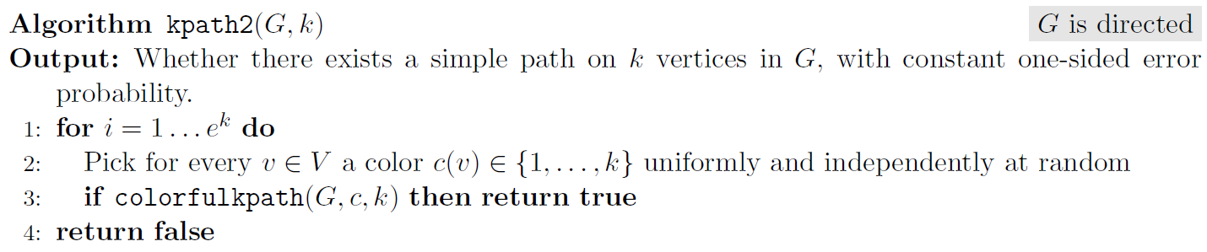
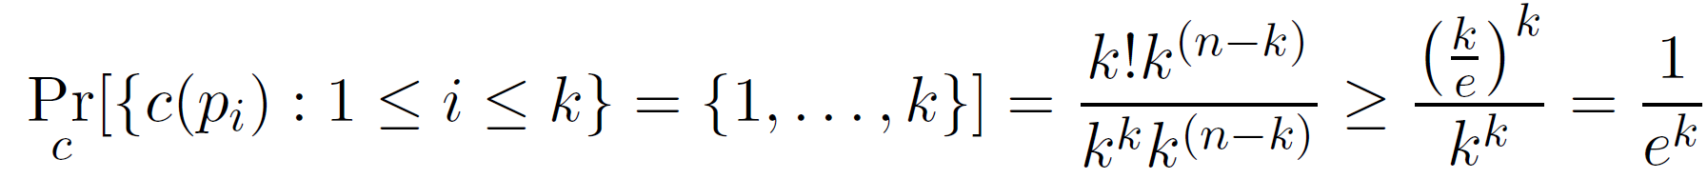

Color Coding 2
Let’s try to do faster now, we’ll see $O^{∗}({\left(2e\right)}^{k})$ time.
Requirement vertices consecutively ordered was too strict
Think of the values $c(v)$ as colors
Call a $k$-path $p_{1},…,p_{k}$ colorful if $c\left(p_{i}\right)≠c(p_{j})$ for $i≠j$
Equivalently, if $c:V→\{1,…,k\}$, $\{c\left(p_{i}\right):i∈\{1,…,k\}\}= \{1,…,k\}$
Algorithm misses $k$-path with prob at most $1/e$.

Slide 10
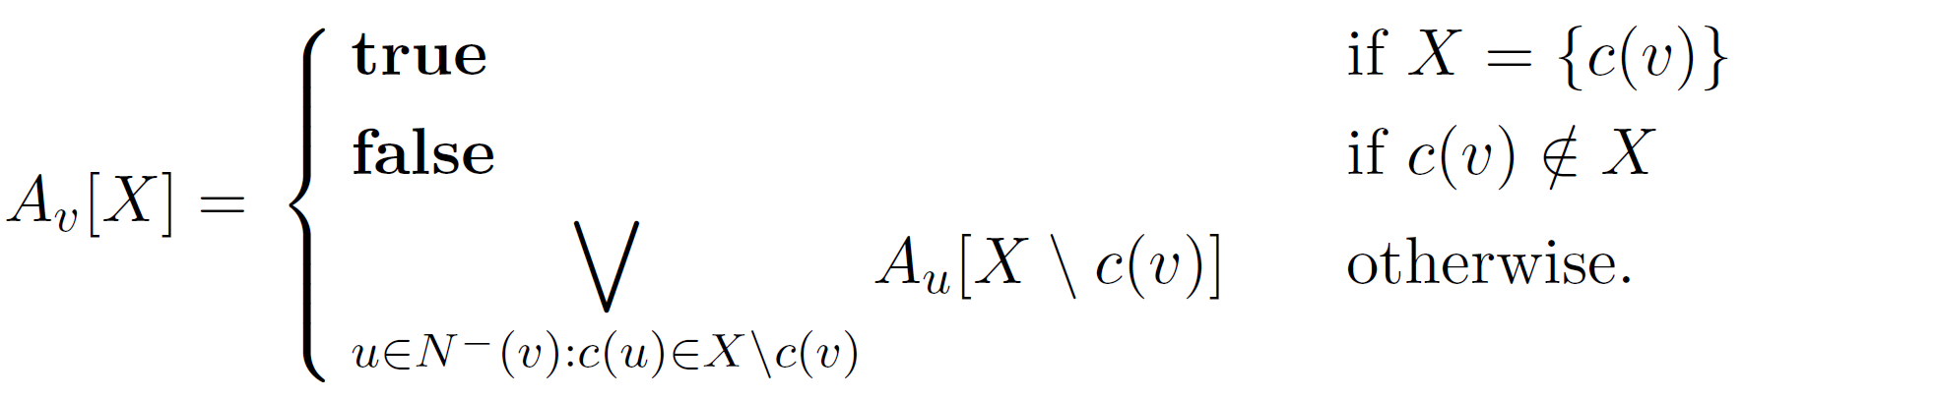
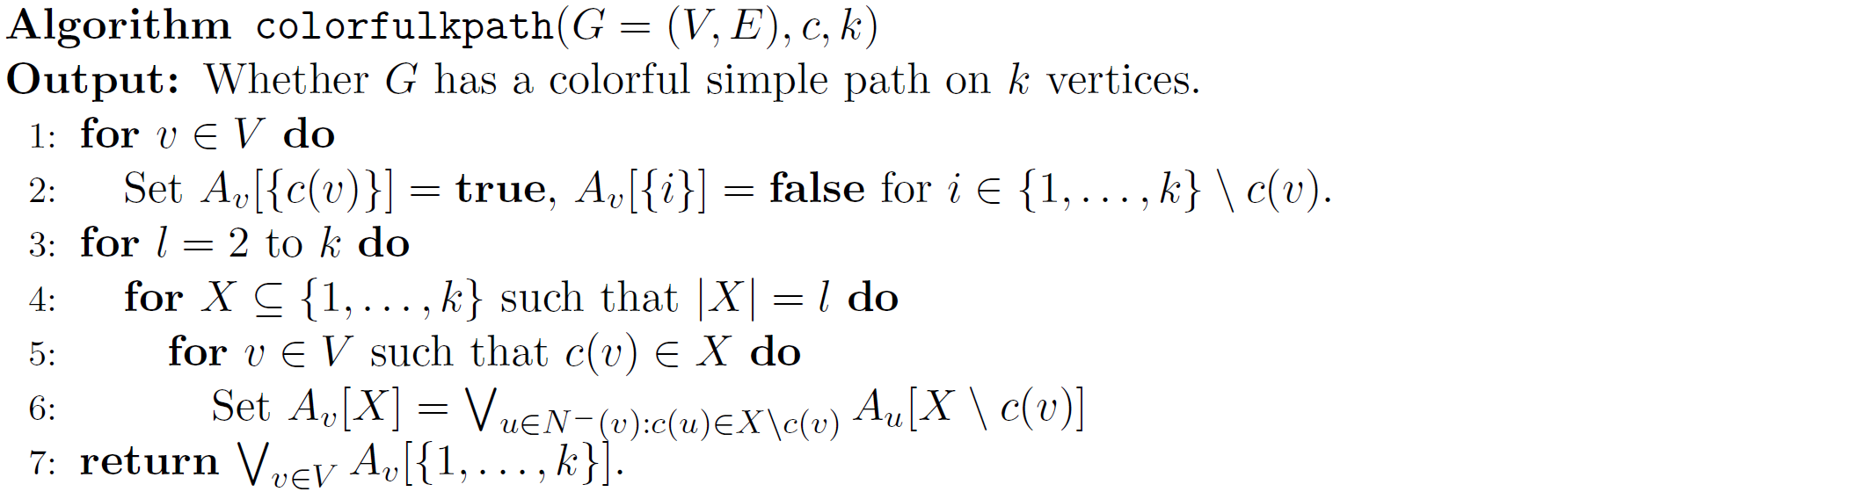

Color Coding 2
Call a $k$-path $p_{1},…,p_{k}$ colorful if $c\left(p_{i}\right)≠c(p_{j})$ for $i≠j$
Equivalently, if $c:V→\{1,…,k\}$, $\{c\left(p_{i}\right):i∈\{1,…,k\}\}= \{1,…,k\}$
X
u
u
v
u

Slide 11
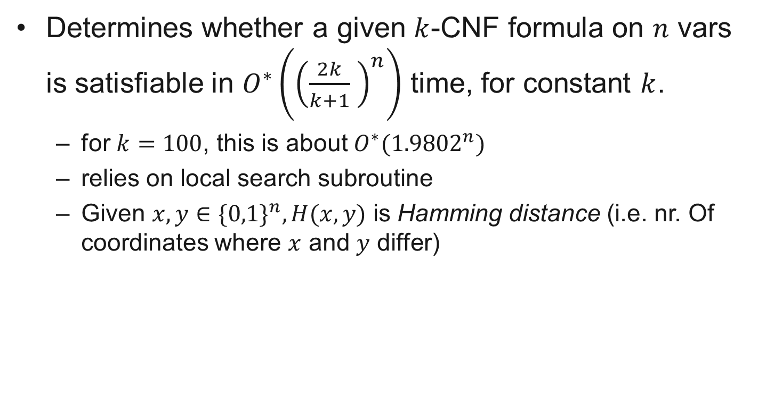
Schöning’s algorithm for k-CNF-SAT
Determines whether a given $k$-CNF formula on $n$ vars is satisfiable in $O^{∗}\left({\left(\frac{2k}{k+1} \right)}^{n}\right)$ time, for constant $k$.
for $k=100$, this is about $O^{∗}({1.9802}^{n})$
relies on local search subroutine
Given $x,y∈\{0,1\}^{n}, H(x,y)$ is Hamming distance (i.e. nr. Of coordinates where $x$ and $y$ differ)

Slide 12
Searching the Hamming-ball
Flashback to Johan’s lecture
Lemma:
Given any truth assignment a and a 3-SAT formula F, we can decide in O*(3^{d}) time whether there is an truth assign-ment that satisfies F at Hamming distance at most d from a
Proof:
If truth assignment a is not a satisfying assignment, then there is a clause C that is not satisfied by a
In any satisfying assignment at least one of the literals in C must be flipped: we generate a subproblem for each literal in C where the value of the corresponding variable is flipped
If there is a satisfying assignment at Hamming distance at most d, then we should find it after branching d times in this way
So, this requires O*(3^{d}) time
For k-SAT this can be done in O*(k^{d}) time

Slide 13
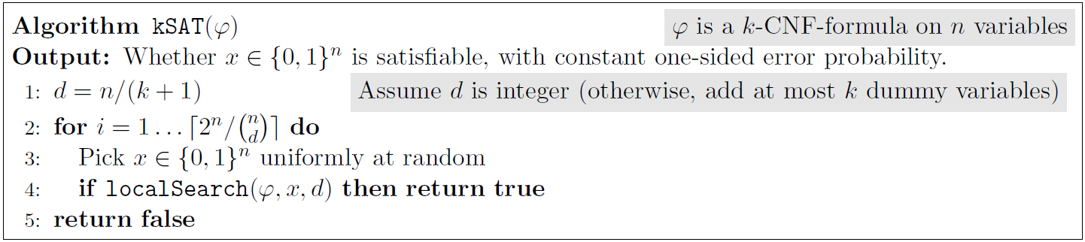
Schöning’s algorithm for k-CNF-SAT
x
x
x
x
x

Slide 14
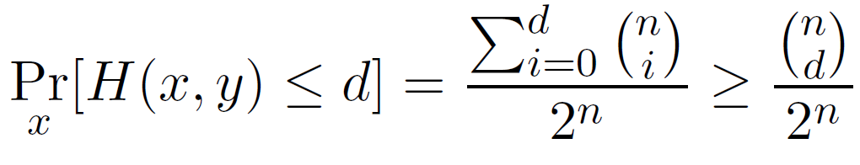
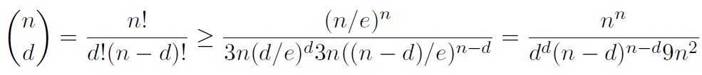
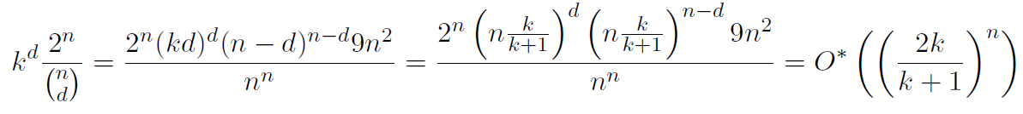

Schöning’s algorithm for k-CNF-SAT
If returns true it is correct since so is localSearch
If sol y exists, prob true is returned in one iteration is
, so in total $≥1−\frac{1}{e}$
And the running time boils down to:

Slide 15
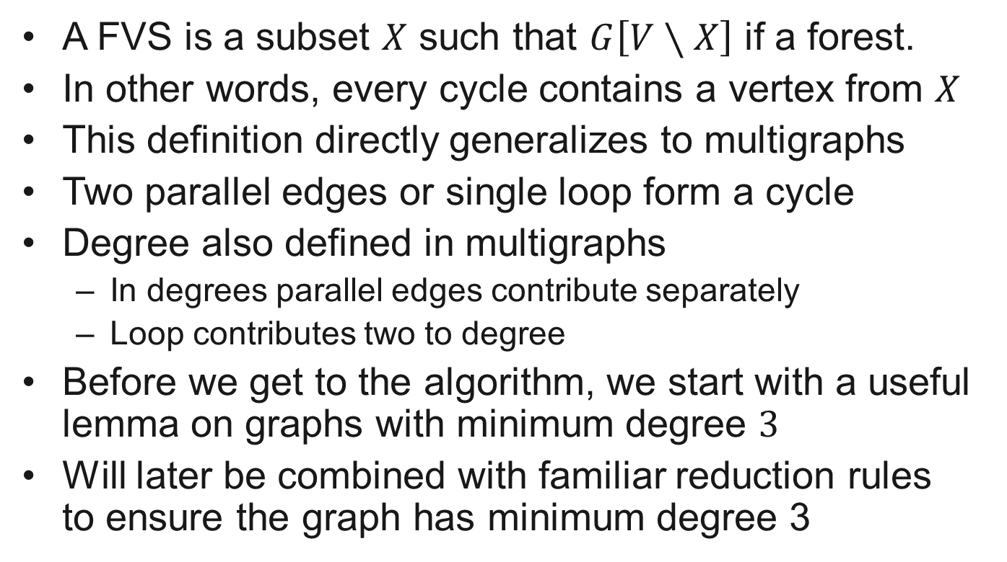
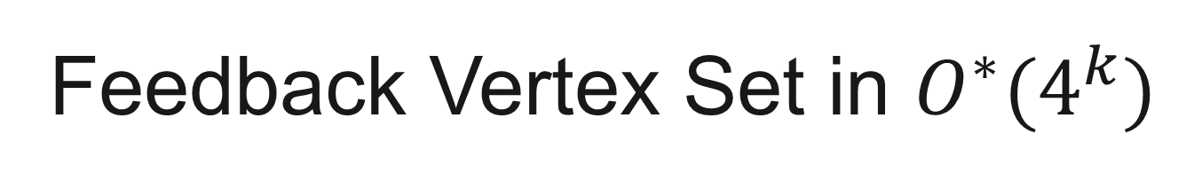
Feedback Vertex Set in $O^{∗}(4^{k})$
A FVS is a subset $X$ such that $G\left[V∖X\right]$ if a forest.
In other words, every cycle contains a vertex from $X$
This definition directly generalizes to multigraphs
Two parallel edges or single loop form a cycle
Degree also defined in multigraphs
In degrees parallel edges contribute separately
Loop contributes two to degree
Before we get to the algorithm, we start with a useful lemma on graphs with minimum degree $3$
Will later be combined with familiar reduction rules to ensure the graph has minimum degree 3

Slide 16

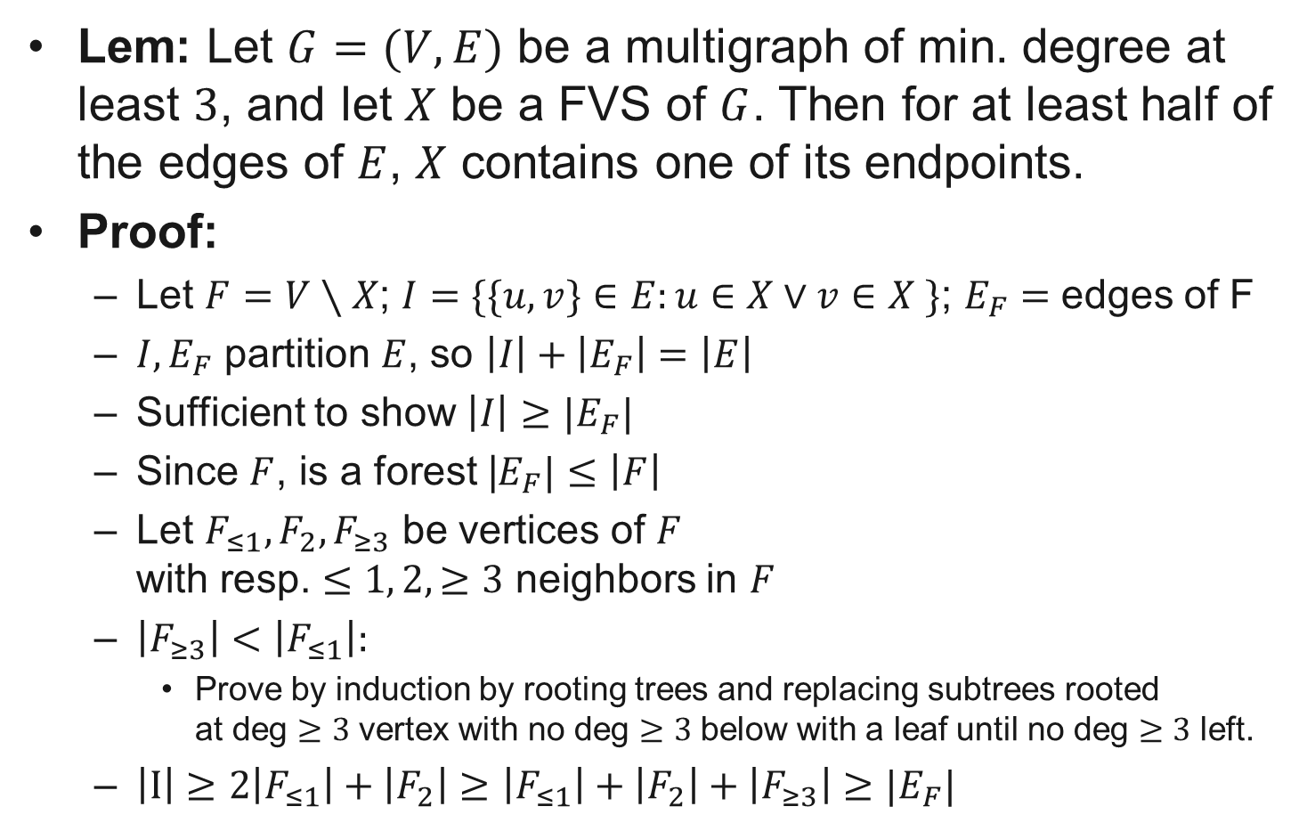
A useful lemma
Lem: Let $G=(V,E)$ be a multigraph of min. degree at least $3$, and let $X$ be a FVS of $G$. Then for at least half of the edges of $E$, $X$ contains one of its endpoints.
Proof:
Let $F=V∖X$; $I=\{\{u,v\}∈E:u∈X∨v∈X \}$; $E_{F}=$ edges of F
$I,E_{F}$ partition $E$, so $\left|I\right|+\left|E_{F}\right|=\left|E\right|$
Sufficient to show $\left|I\right|≥|E_{F}|$
Since $F$, is a forest |$E_{F}|≤\left|F\right|$
Let $F_{≤1},F_{2}, F_{≥3}$ be vertices of $F$ with resp. $≤1, 2,≥3$ neighbors in $F$
$\left|F_{≥3}\right|<\left|F_{≤1}\right|:$
Prove by induction by rooting trees and replacing subtrees rooted at deg $≥3$ vertex with no deg $≥3$ below with a leaf until no deg $≥3$ left.
$\left|I\right|≥2\left|F_{≤1}\right|+\left|F_{2}\right|≥\left|F_{≤1}\right|+\left|F_{2}\right|+\left|F_{≥3}\right|≥|E_{F}|$
forest $F$
X

Slide 17
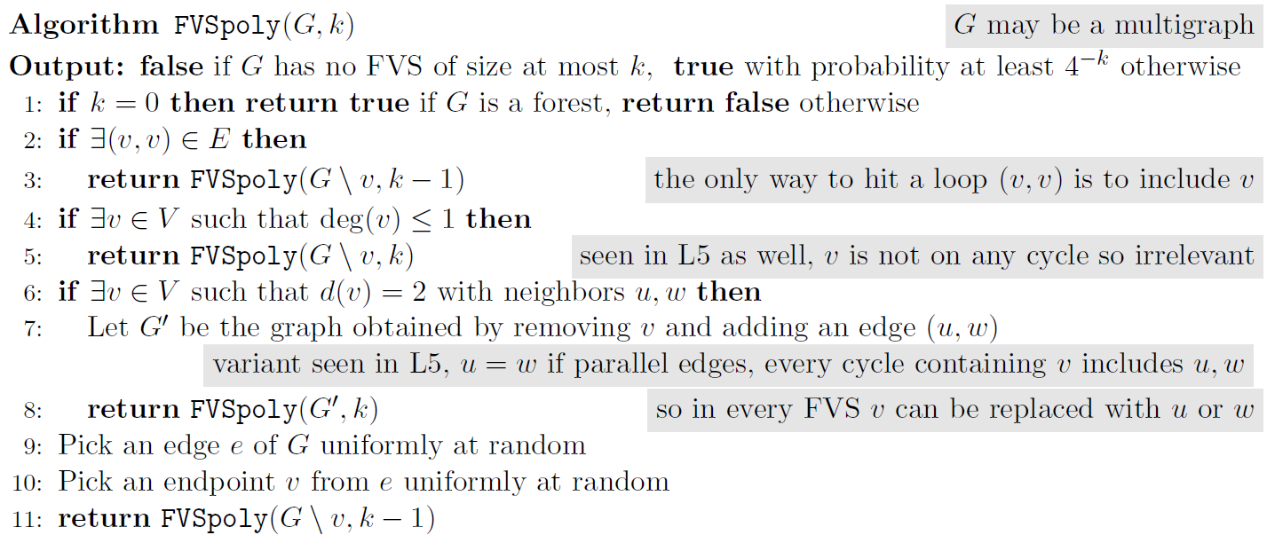
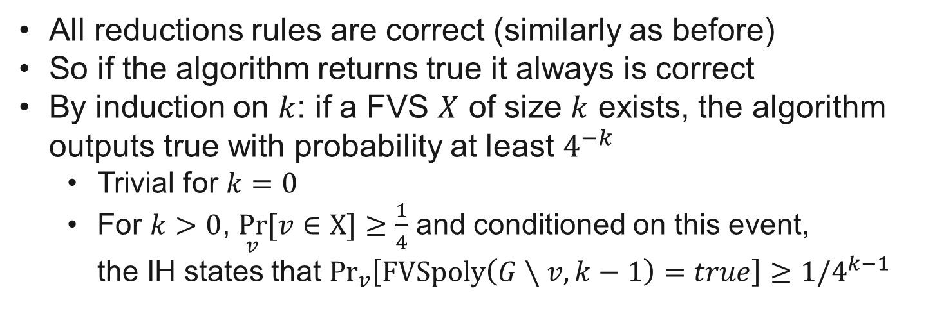
All reductions rules are correct (similarly as before)
So if the algorithm returns true it always is correct
By induction on $k$: if a FVS $X$ of size $k$ exists, the algorithm outputs true with probability at least $4^{−k}$
Trivial for $k=0$
For $k>0$, $\underset{v}{Pr}{[v∈X]}≥\frac{1}{4}$ and conditioned on this event, the IH states that ${Pr}_{v}\left[\text{FVSpoly}\left(G∖v,k−1\right)=true\right]≥{1/4}^{k−1}$

Slide 18
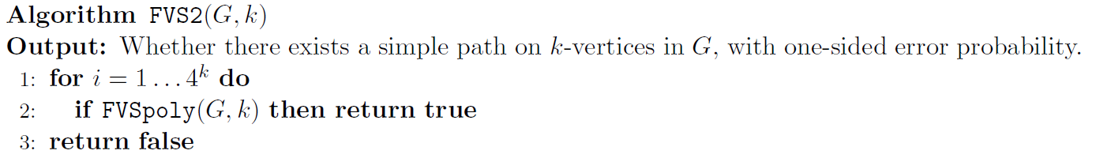

So the algorithm does what it promises and we can simply boost the probability of finding an FVS if it exists:
$$≤1/e$$
If FVS of size $≤k$ exists, $\operatorname{Pr}\left[FVS2\left(G,k\right)=false\right]≤{\left(1−4^{−k}\right)}^{4^{k}}$

