Slide 1
ProbML Tutorial 22.04.25
Leonhard Hennicke, Rainer Schlosser

Slide 2
3 topics
LogSumExp trick
Julia: typed containers and plotting

Slide 3
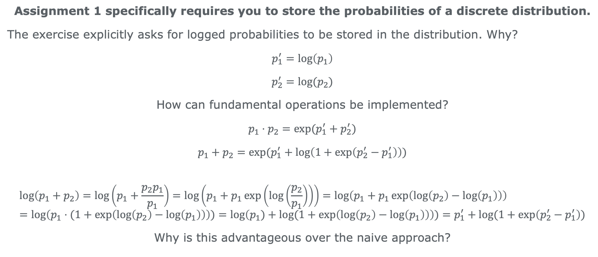
Logged probabilities
Assignment 1 specifically requires you to store the probabilities of a discrete distribution.
The exercise explicitly asks for logged probabilities to be stored in the distribution. Why?
$$p_{1}^{′}=\log\left(p_{1}\right)$$
$$p_{2}^{′}=log⁡(p_{2})$$
How can fundamental operations be implemented?
$$p_{1}⋅p_{2}=\exp{(p_{1}^{′}+p_{2}^{′})}$$
$$p_{1}+p_{2}=exp⁡(p_{1}^{′}+\log\left(1+\exp\left(p_{2}^{′}−p_{1}^{′}\right)\right))$$
$$\log\left(p_{1}+p_{2}\right)=\log\left(p_{1}+\frac{p_{2}p_{1}}{p_{1}}\right)=\log\left(p_{1}+p_{1}\exp\left(\log\left(\frac{p_{2}}{p_{1}}\right)\right)\right)=\log\left(p_{1}+p_{1}\exp\left(\log\left(p_{2}\right)−\log\left(p_{1}\right)\right)\right)=\log\left(p_{1}⋅(1+\exp\left(\log\left(p_{2}\right)−\log\left(p_{1}\right)\right)\right))=\log\left(p_{1})+\log{(1+\exp\left(\log\left(p_{2}\right)−\log\left(p_{1}\right)\right)}\right))=p_{1}^{′}+\log{(1+\exp\left(p_{2}^{′}−p_{1}^{′}\right))}$$
Why is this advantageous over the naive approach?

Slide 4
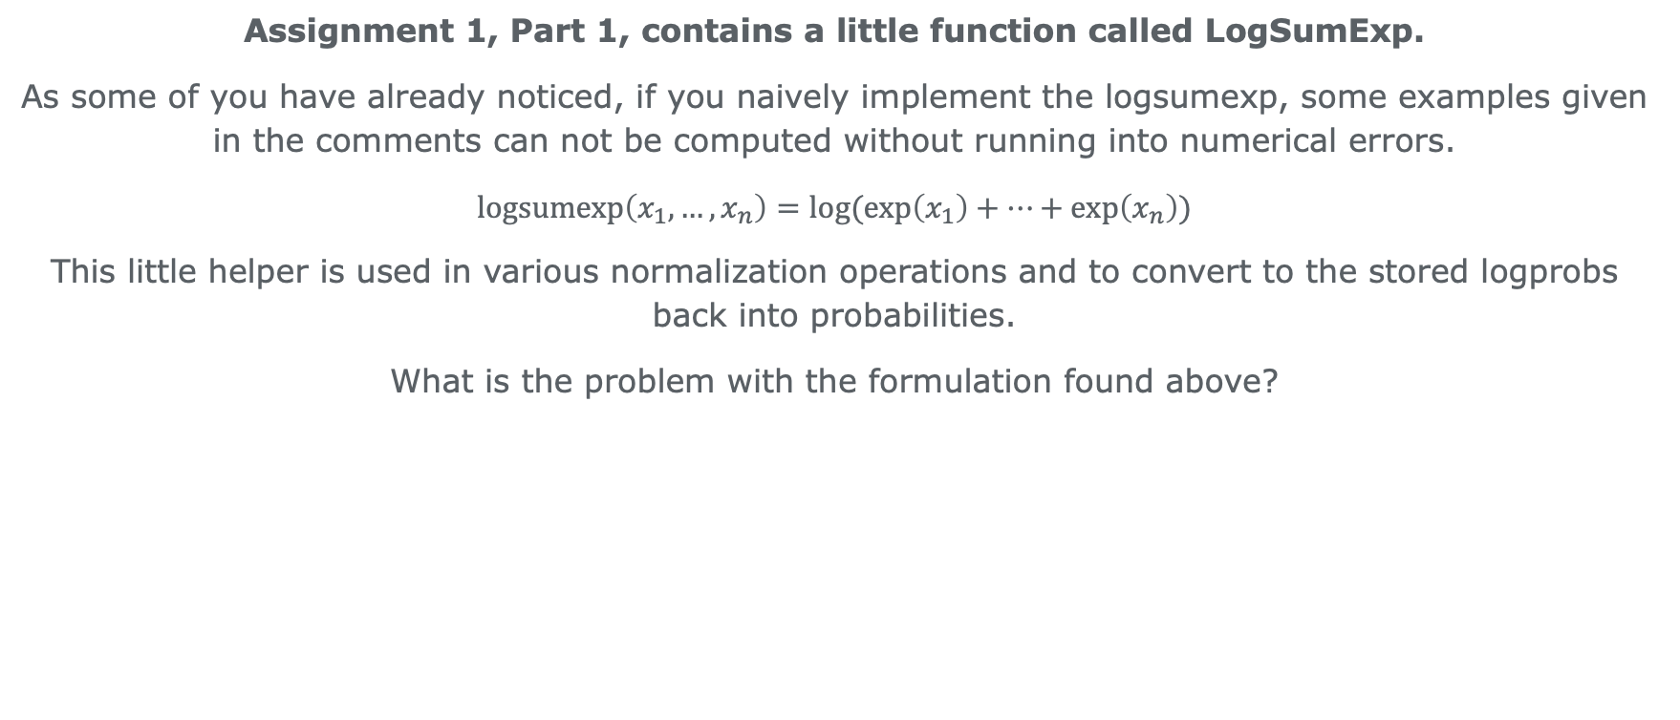
LogSumExpTrick
Assignment 1, Part 1, contains a little function called LogSumExp.
As some of you have already noticed, if you naively implement the logsumexp, some examples given in the comments can not be computed without running into numerical errors.
$$\operatorname{logsumexp}\left(x_{1},…,x_{n}\right)=\log{(\exp\left(x_{1}\right)+…+\exp\left(x_{n}\right))}$$
This little helper is used in various normalization operations and to convert to the stored logprobs back into probabilities.
What is the problem with the formulation found above?

Slide 5
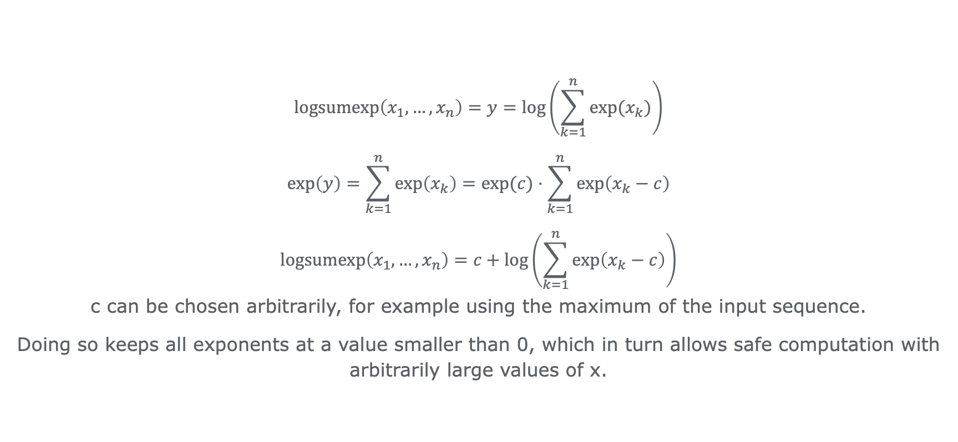
LogSumExpTrick (2)
$$logsumexp\left(x_{1},…,x_{n}\right)=y=\log\left(\sum_{k=1}^{n}{exp⁡(x_{k})}\right)$$
$$\exp\left(y\right)=\sum_{k=1}^{n}{\exp\left(x_{k}\right)}=\exp{(c)}⋅\sum_{k=1}^{n}{\exp\left(x_{k}−c\right)}$$
$$logsumexp\left(x_{1},…,x_{n}\right)=c+\log\left(\sum_{k=1}^{n}{\exp\left(x_{k}−c\right)}\right)$$
c can be chosen arbitrarily, for example using the maximum of the input sequence.
Doing so keeps all exponents at a value smaller than 0, which in turn allows safe computation with arbitrarily large values of x.

Slide 6
Julia typing for containers and plotting
See containers.jl and beta.jl

Slide 7
Thank you ☺

