Slide 1
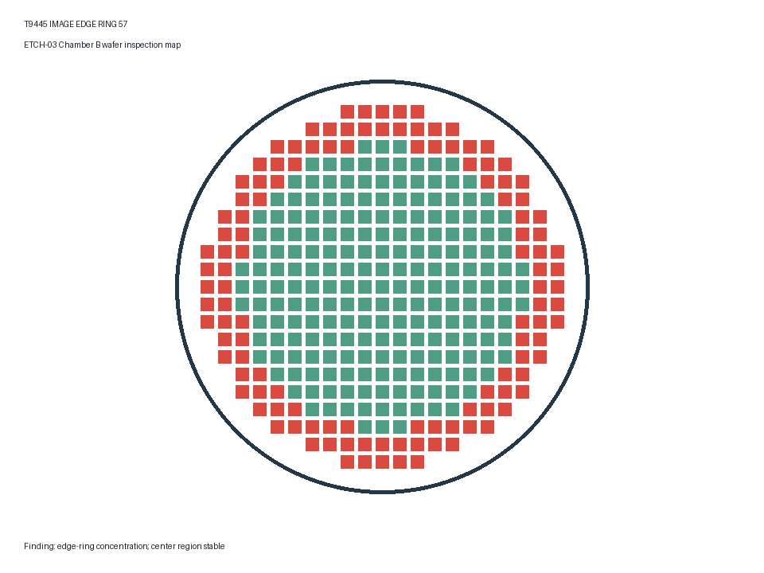
ETCH-03 Edge-Ring Response
Control token T9445-PPTX-EDGE-72. Hold the lot and correlate pressure with RF match.
Check | Expected
Pressure | <= 12 Pa
RF Match | >= 85 %

Slide 2
Release Gate
Release after leak check completion and two stable monitor wafers.

