Slide 1
How do you want the course to go?
Focus on culture?
Focus on process?
Focus on technology?

Slide 2
Supplemental Material
https://github.com/Tim-AEQ/devops

Slide 3
In your table groups, discuss what
DevOps means to you

Slide 4
DevOps is the union of people, process, and products to enable continuous delivery of value to our end users.

Slide 5
Company | Deploy Freq. | Deployment Lead Time | Reliability | Customer Responsiveness
Google | 5500 / day | Minutes | High | High
Netflix | 500/ day | Minutes | High | High
Instagram | 50 / day | Minutes | High | High
Facebook | 1 / day | Hours | High | High
Bing | 20 / wk | Hours | High | High
Twitter | 3/ wk | Hours | High | High
Traditional Enterprises | 1/ 9 months | Months or Quarters | Low/ Med | Low/ Med

Slide 6




DevOps: the three stage conversation
1
People
2
Process
3
Tools
Notes:
People = Culture
Fundamental attributes of successful cultures:
Shared mission and incentives: infrastructure as code, apps as services, DevOps/all as teams
You need to consider your hardware as a commodity, (don't give your servers names) , servers are like farm animals, it is just harder if you let theids name them
Build deep instrumentation into services, push complexity up the stack
Rally around agile, shared metrics, CI, service owners on call, etc.
Changing the culture: any change takes time, changing culture is no exception and you can't do it alone, exploit compelling events to change culture: downtimes, cloud adoption, devops buzz
PROCESS Definition and design, compliance, and continuous improvement
PEOPLE Responsibilities, management, skills development, and discipline
Products Tools and infrastructure

Slide 7
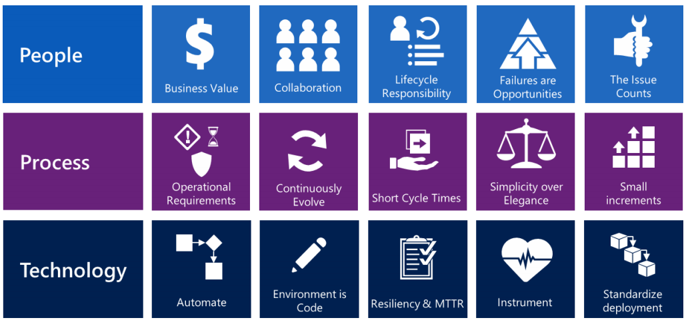
Components for DevOps success

Slide 8
In your table groups, discuss which of the 3 P’s is most problematic, and why?

Slide 9
Culture
Automation
Lean
Metrics
Sharing
“Continuous” CI/CD
Hearts & Minds
Measure everything
Show the improvement
“Infrastructure as Code”
Embrace Change
Open information sharing
Collaboration
Focus on producing value for the end-user
Small batch sizes
Notes:
For your own knowledge/reference, would recommend only presenting reactively if brought up.

Slide 10
Introducing the “Three Ways”
Increasing Maturity in DevOps
Way #1: System Thinking
Focus is on holistic system performance
Minimize/eliminate bugs going “downstream”
Increase flow of work / eliminate bottlenecks
Decreased time to business value
Way #2: Feedback Loops
Get feedback from one workstream to the next quickly
Iterate on feedback and shorten cadence
Share knowledge and centralize it
Way #3: Continuous Learning and Experimentation
Take risks, try new approaches to solve the business pain
Allocate time for introspection (what could have been done better today?)
Celebrate failure as an opportunity to learn

Slide 11
How do you know you’ve mastered the First Way?
You have identified bottlenecks in your process that inhibits work from getting done and have fixed this.
Your product quality is starting to trend upwards
Your teams are starting to collaborate more organically.

Slide 12
How do you know you’ve mastered the Second Way?
You are measuring the time-to-value for feedback implementation and it the cadence is increasing.
Teams work together well. There are no walls, physical or virtual that cause friction between the teams.
Automation is now a key component of the lifecycle.
Unplanned work is minimized.

Slide 13
How do you know you’ve mastered the Third Way?
Team members are demonstrably growing their skill sets.
Team members are not bottlenecks (i.e.: multiple team members have equally skilled capabilities).
Telemetry is used to identify areas of improvement.
Team members proactively experiment with ways to improve time to value.

Slide 14
In your table groups, discuss how your group lives the Three Ways and what it can do to be truer to them?

Slide 15
DevOps Key Attributes and Elements
Attribute | Key Elements
High-trust, high- performance culture IT capabilities = strategic assets, not cost centers Highly automated processes; mature deployment pipeline Continuous delivery of software and IT value Commitment to continuous learning & improvement | Unified mission; aligned incentives across departments and teams; little fear/failure/blame, high quality of work life Projects, features and work flow through fast cycles times, systems are “anti-fragile,” IT processes & capabilities are aligned with overarching organizational needs Technical phases of projects supported by common tools and automation processes, collaboration replaces handoffs, codebase/IT infrastructure is agile and functional by default Features, projects and IT work follow a regular, iterative flow. Cycle time is short, workflow favors small frequent changes Disciplined feedback loops quickly travel back upstream for inclusion. Tools for monitoring, measurement and alerting implemented & effective. Shared knowledge repositories.

Slide 16
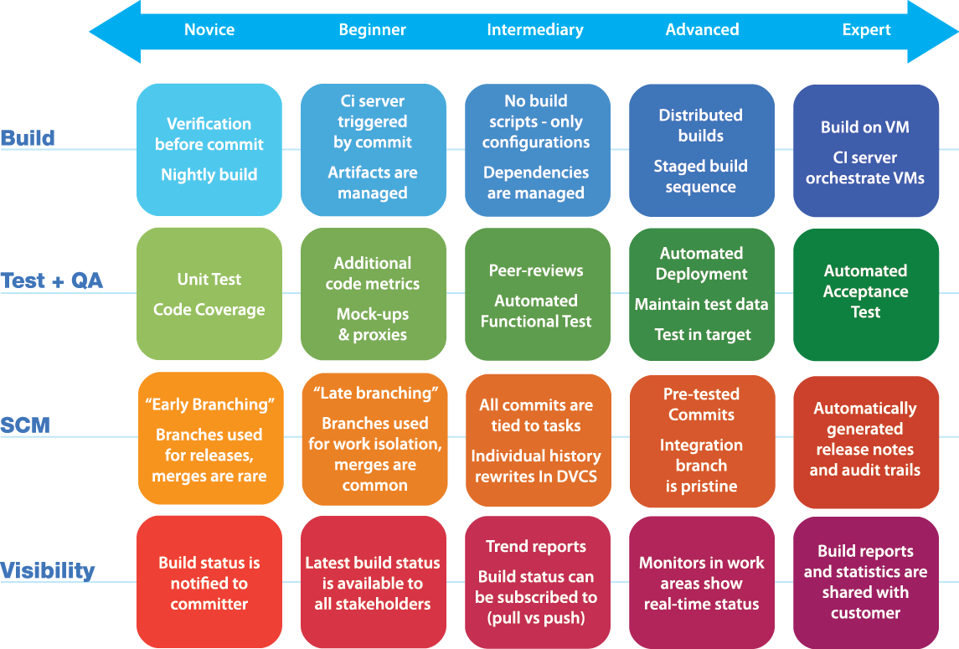
Continuous Delivery Maturity Matrix

