Slide 1
Rockbuster Stealth Analysis
Tim Brandt
8/14/23

Slide 2
Project Overview
Objective: Assist the Rockbuster Stealth Management Board with their 2020 company strategy by providing date-driven answers to the following questions:
What was the average rental duration for all videos?
Which countries are Rockbuster customers based in?
Where are customers with a high lifetime value based?
Which movies contributed the most/lease to revenue?

Slide 3
Film Data Overview

Slide 4
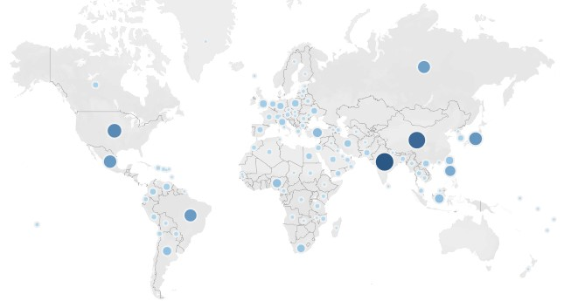


Countries By Total Revenue
Top 10
India
China
United States
Japan
Mexico
Brazil
Russian Federation
Philippines
Turkey
Indonesia

Slide 5
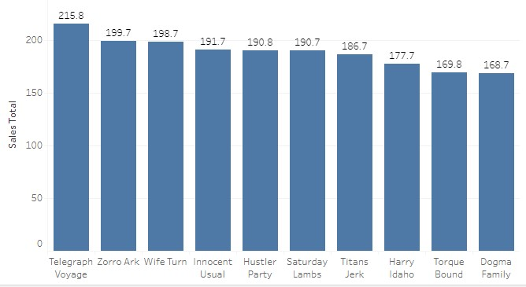
Top 10 Movies By Sales
Telegraph Voyage
Zorro Ark
Wife Turn
Innocent Usual
Hustler Party
Saturday Lambs
Titans Jerk
Harry Idaho
Torque Bound
Dogma Family

Slide 6
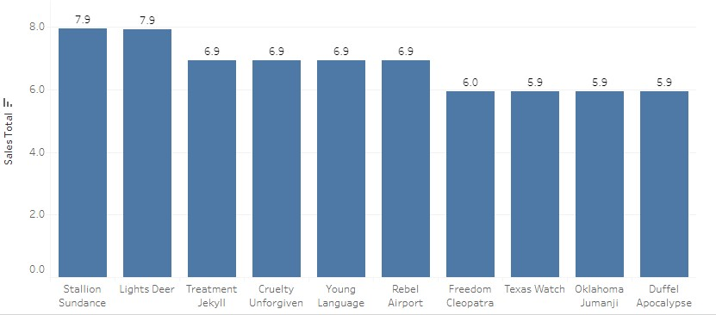
Bottom 10 Movies By Sales
Stallion Sundance
Lights Deer
Cruelty Unforgiven
Treatment Jekyll
Young Language
Rebel Airport
Freedom Cleopatra
Texas Watch
Oklahoma Jumanji
Duffel Apocalypse

Slide 7
Top 5 Customers

Slide 8
Key Takeaways
The top 10 countries account for 53% of all customers
10 out of the 109 countries generate 50% of the revenue
The top 5 customers averaged 40 rentals

Slide 9
Next Steps
Since the data shows a pattern of repeat business, focus marketing efforts on existing customers
Concentrate marketing efforts on the top 10 countries

Slide 10
Tableau Links
Countries by Total Revenue
Top 10 Movies by Sales
Bottom 10 Movies by Sales

