Slide 1
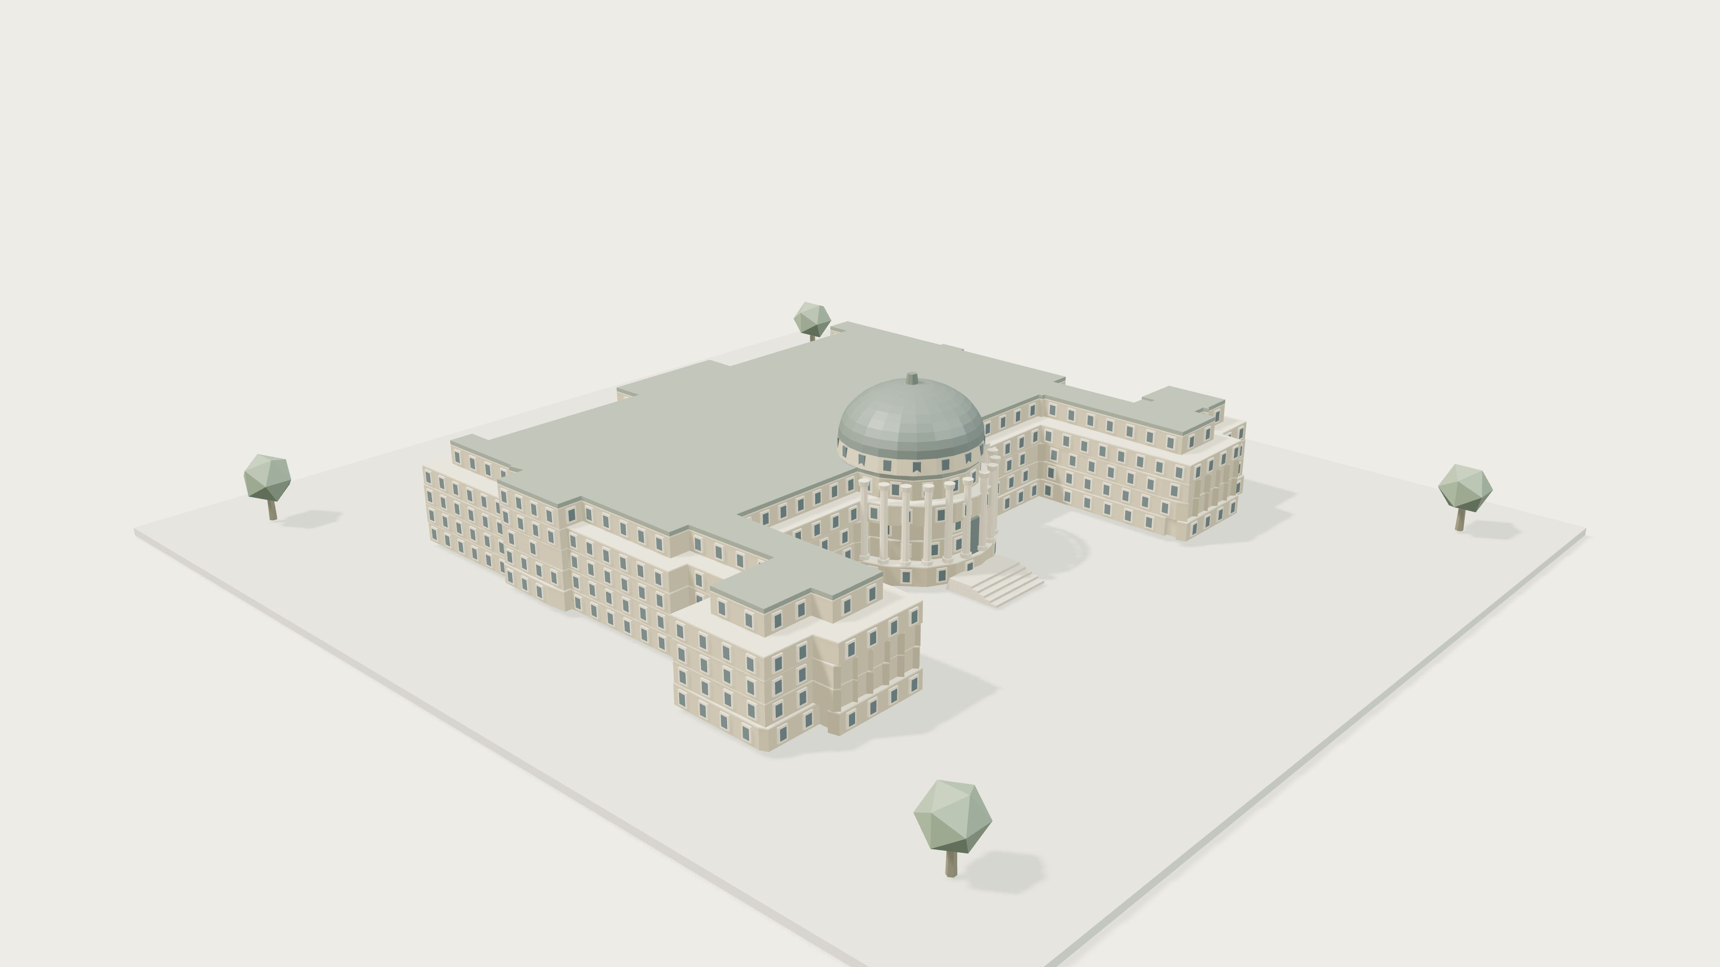
Notes:
Another day at ETH. Lectures are finished. Now you need somewhere to study.

Slide 2
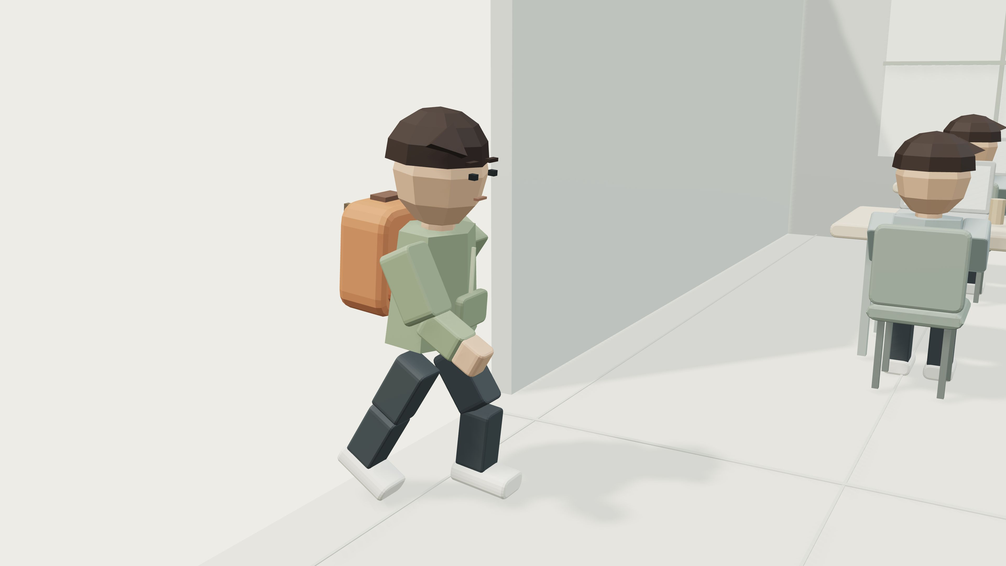
Notes:
You walk through the buildings looking for a free seat.

Slide 3
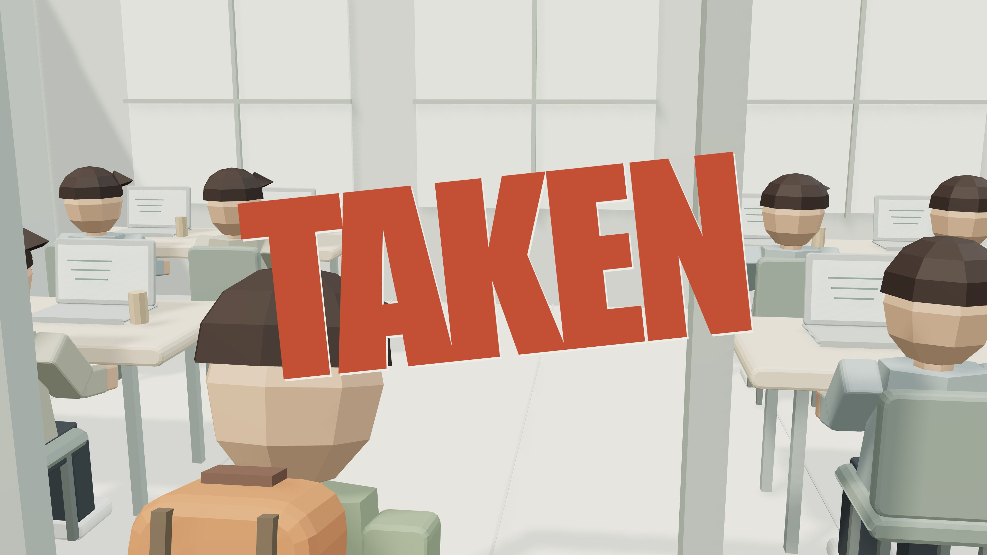
Notes:
The first room is full.

Slide 4
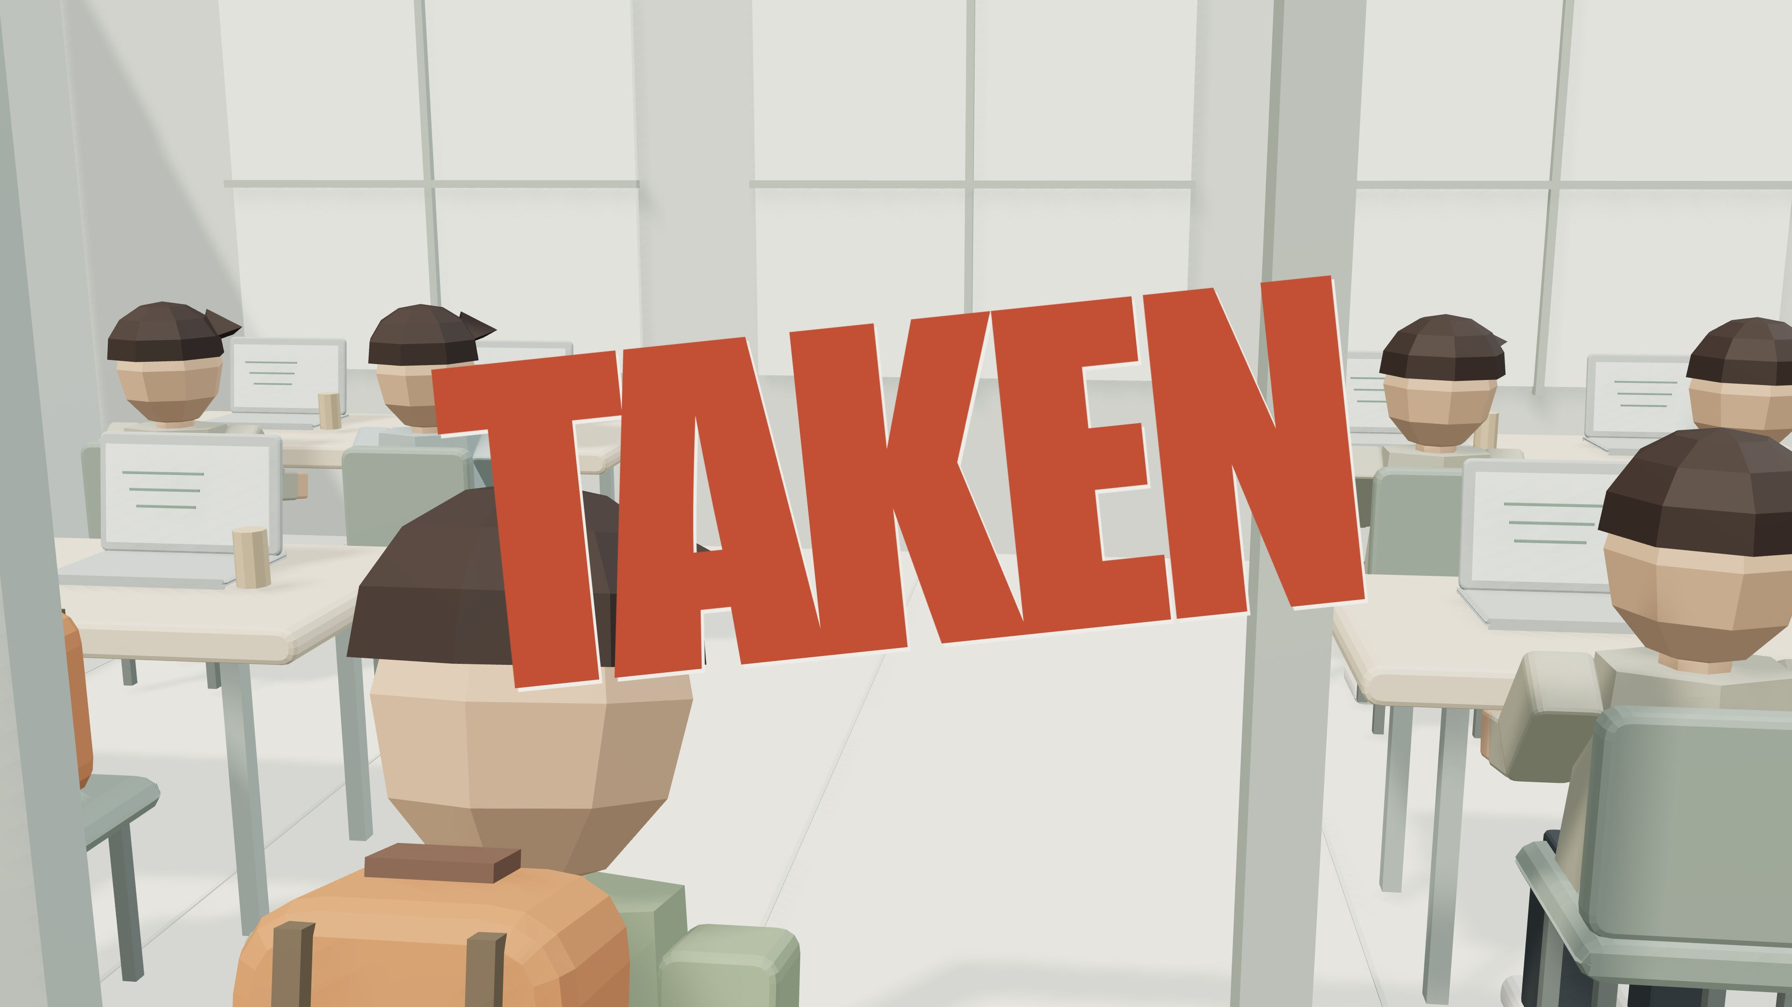
Notes:
So is the next one.

Slide 5
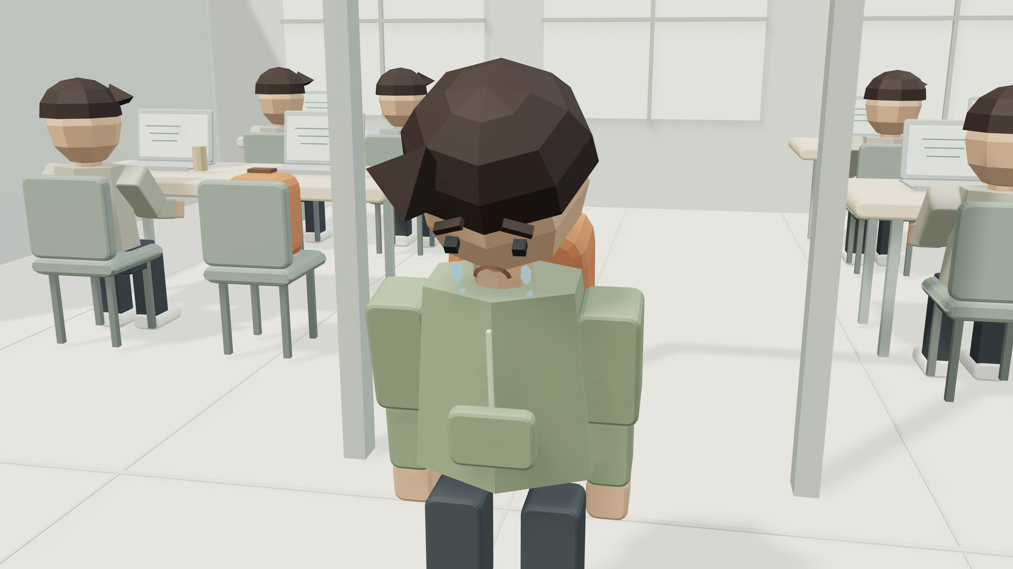
Notes:
You have spent your time finding a seat instead of studying.

Slide 6
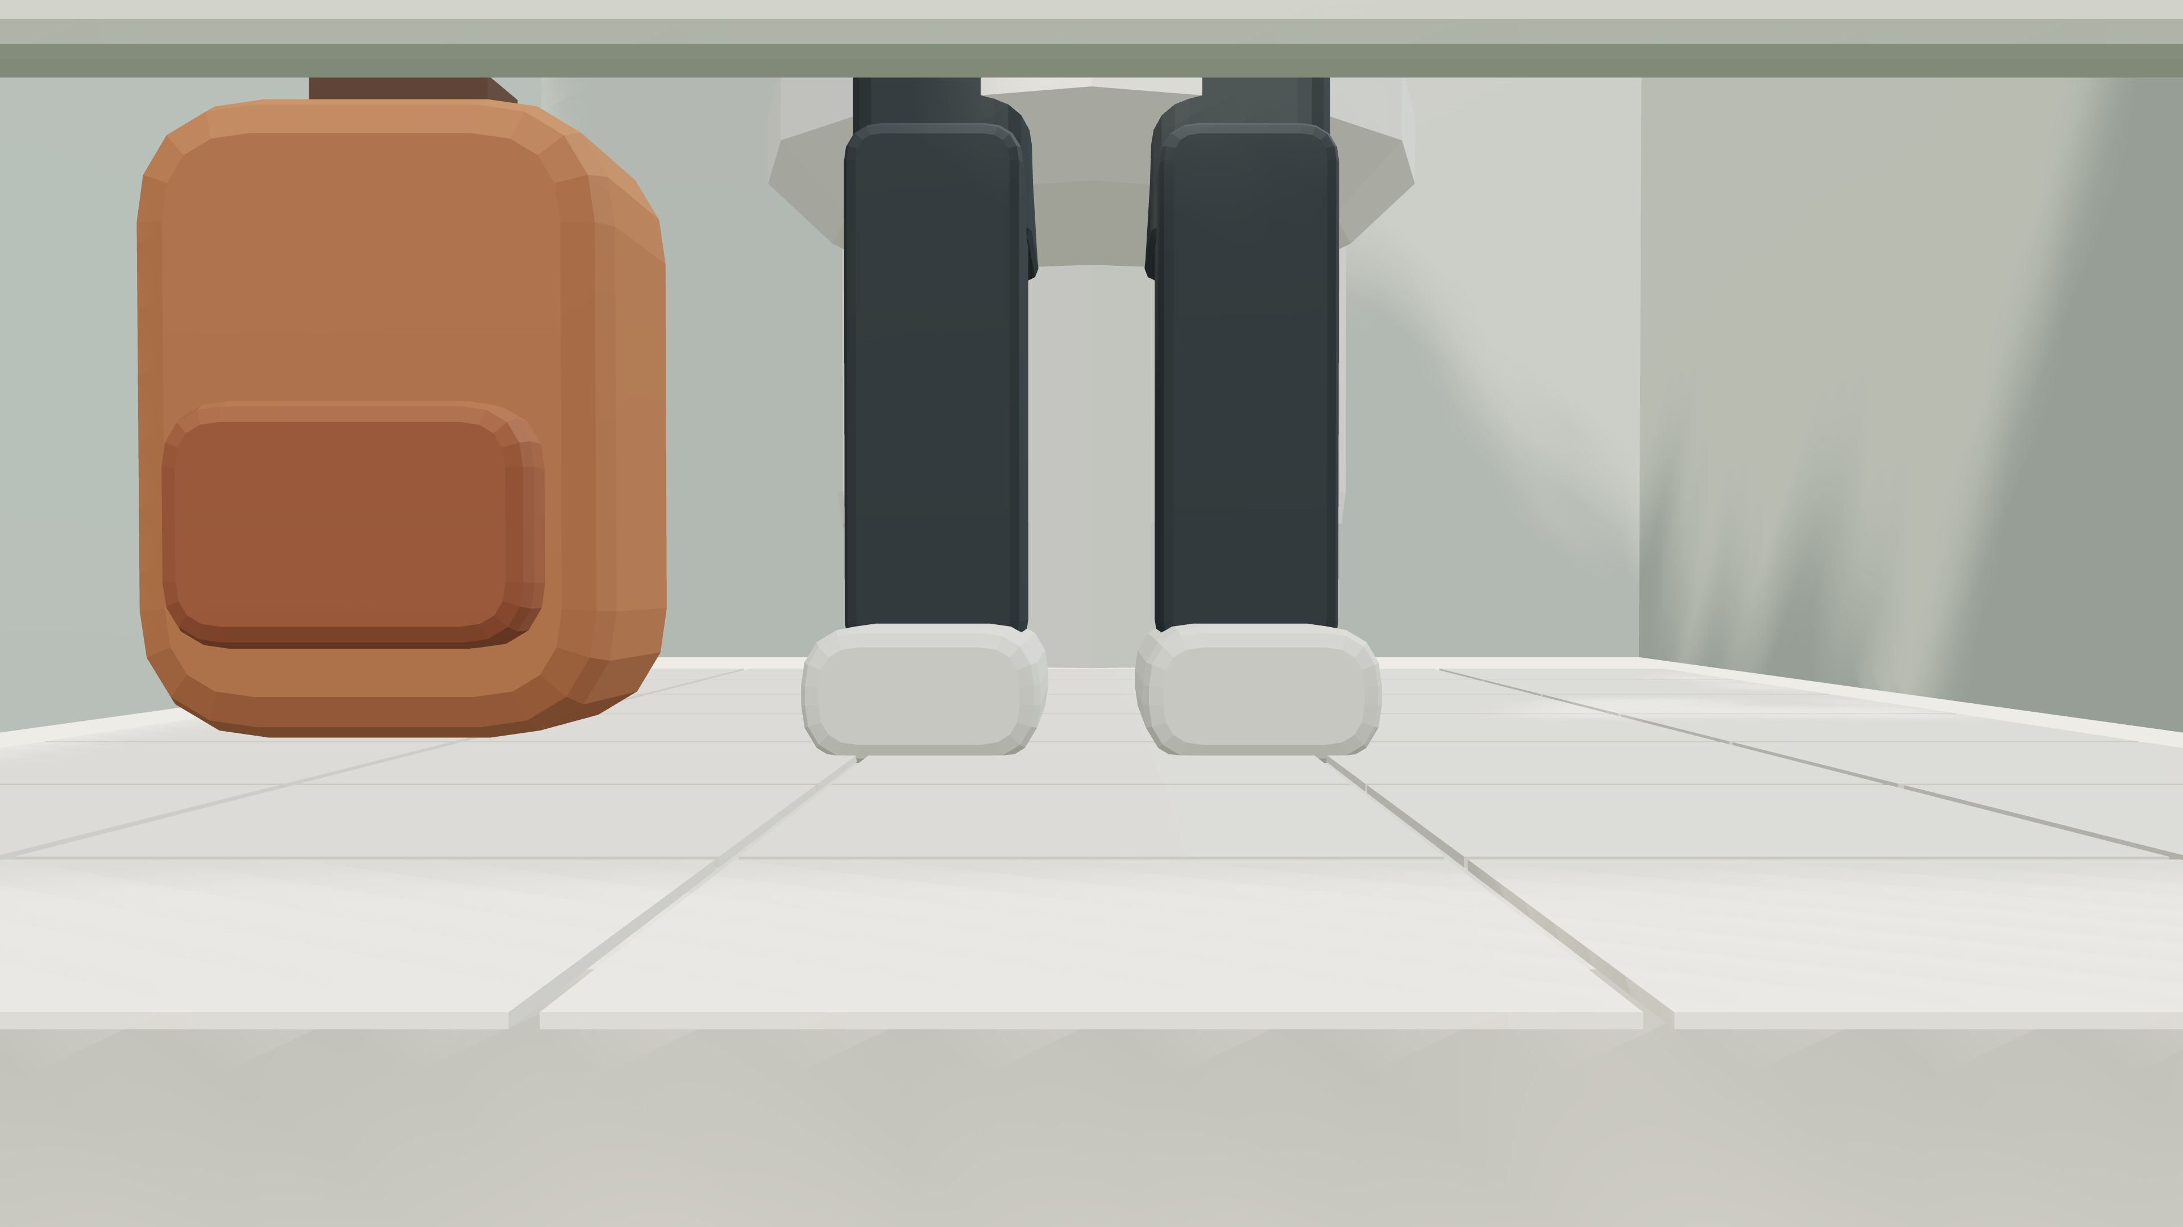
Notes:
There has to be an easier way.

Slide 7
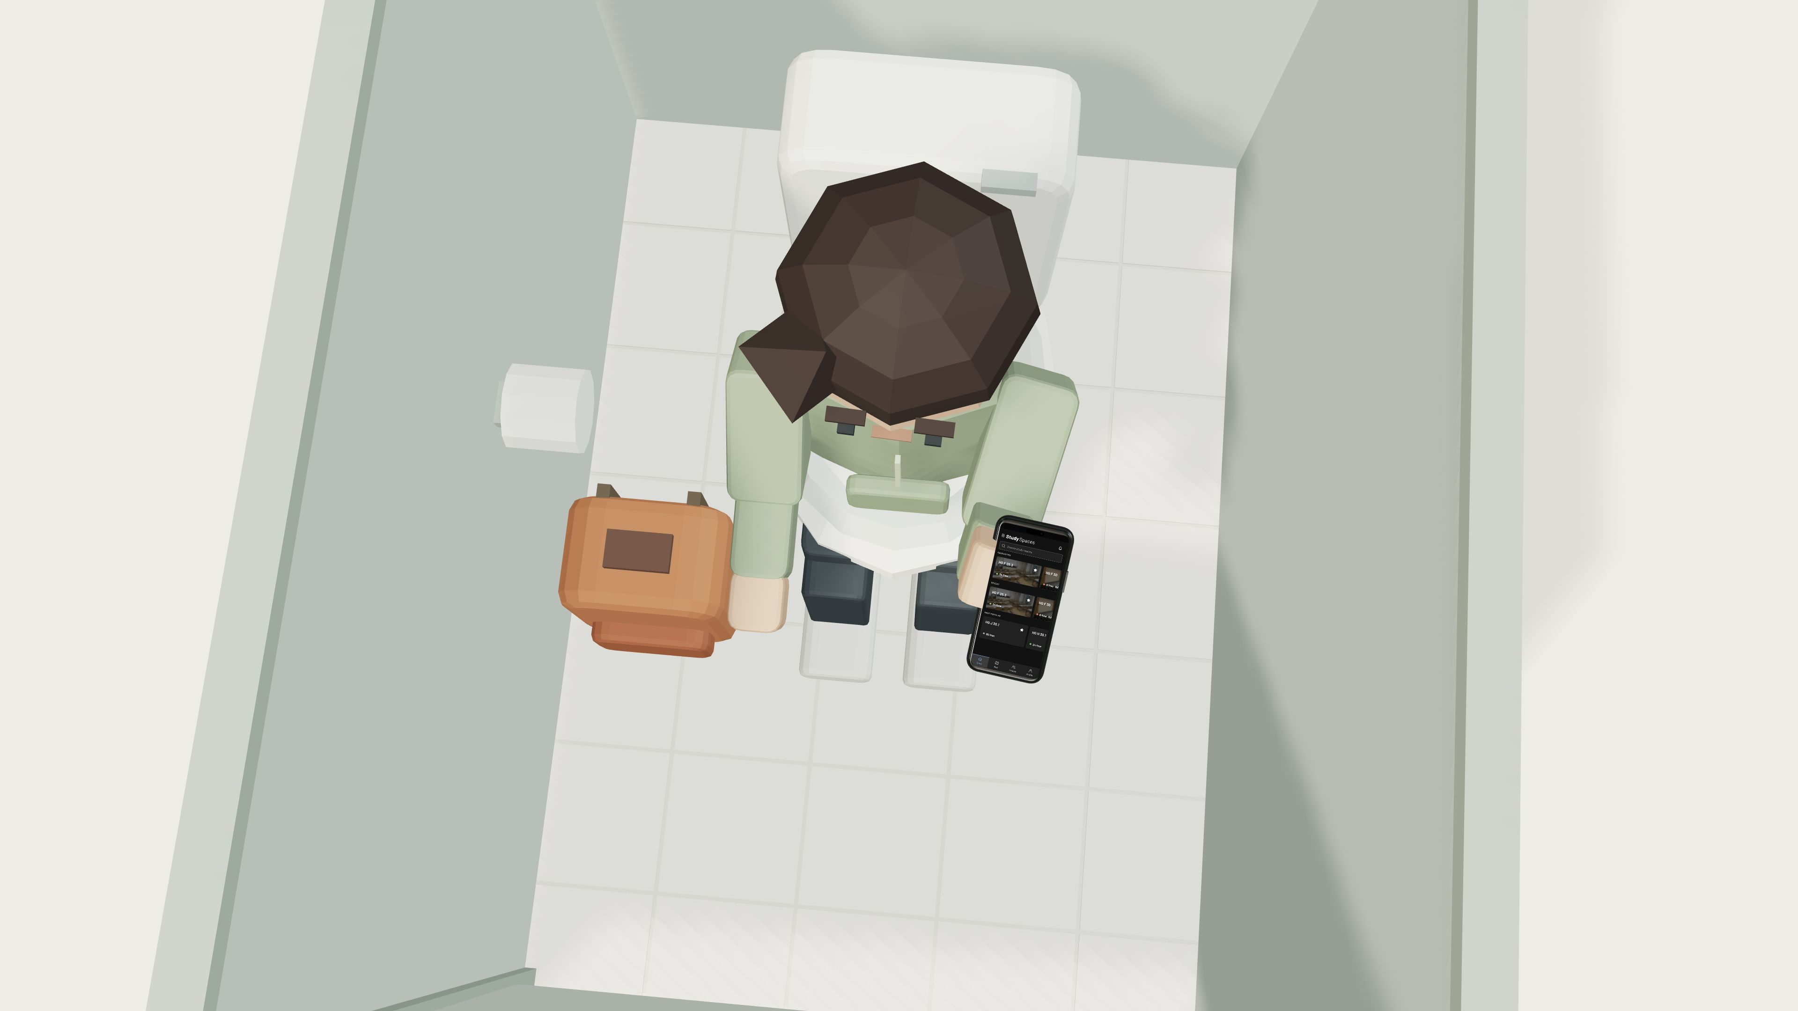
Notes:
Check availability across the whole campus. Book a seat from the toilet.

Slide 8
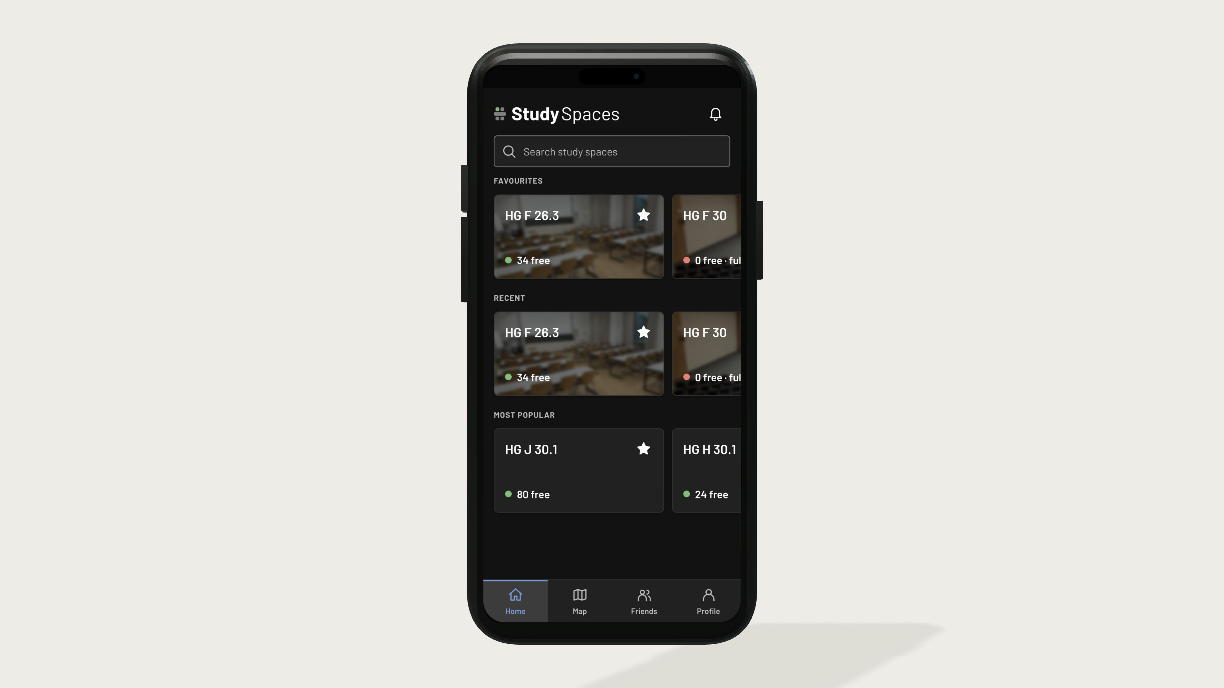
Notes:
Find a study space on Home or explore the campus map.

Slide 9
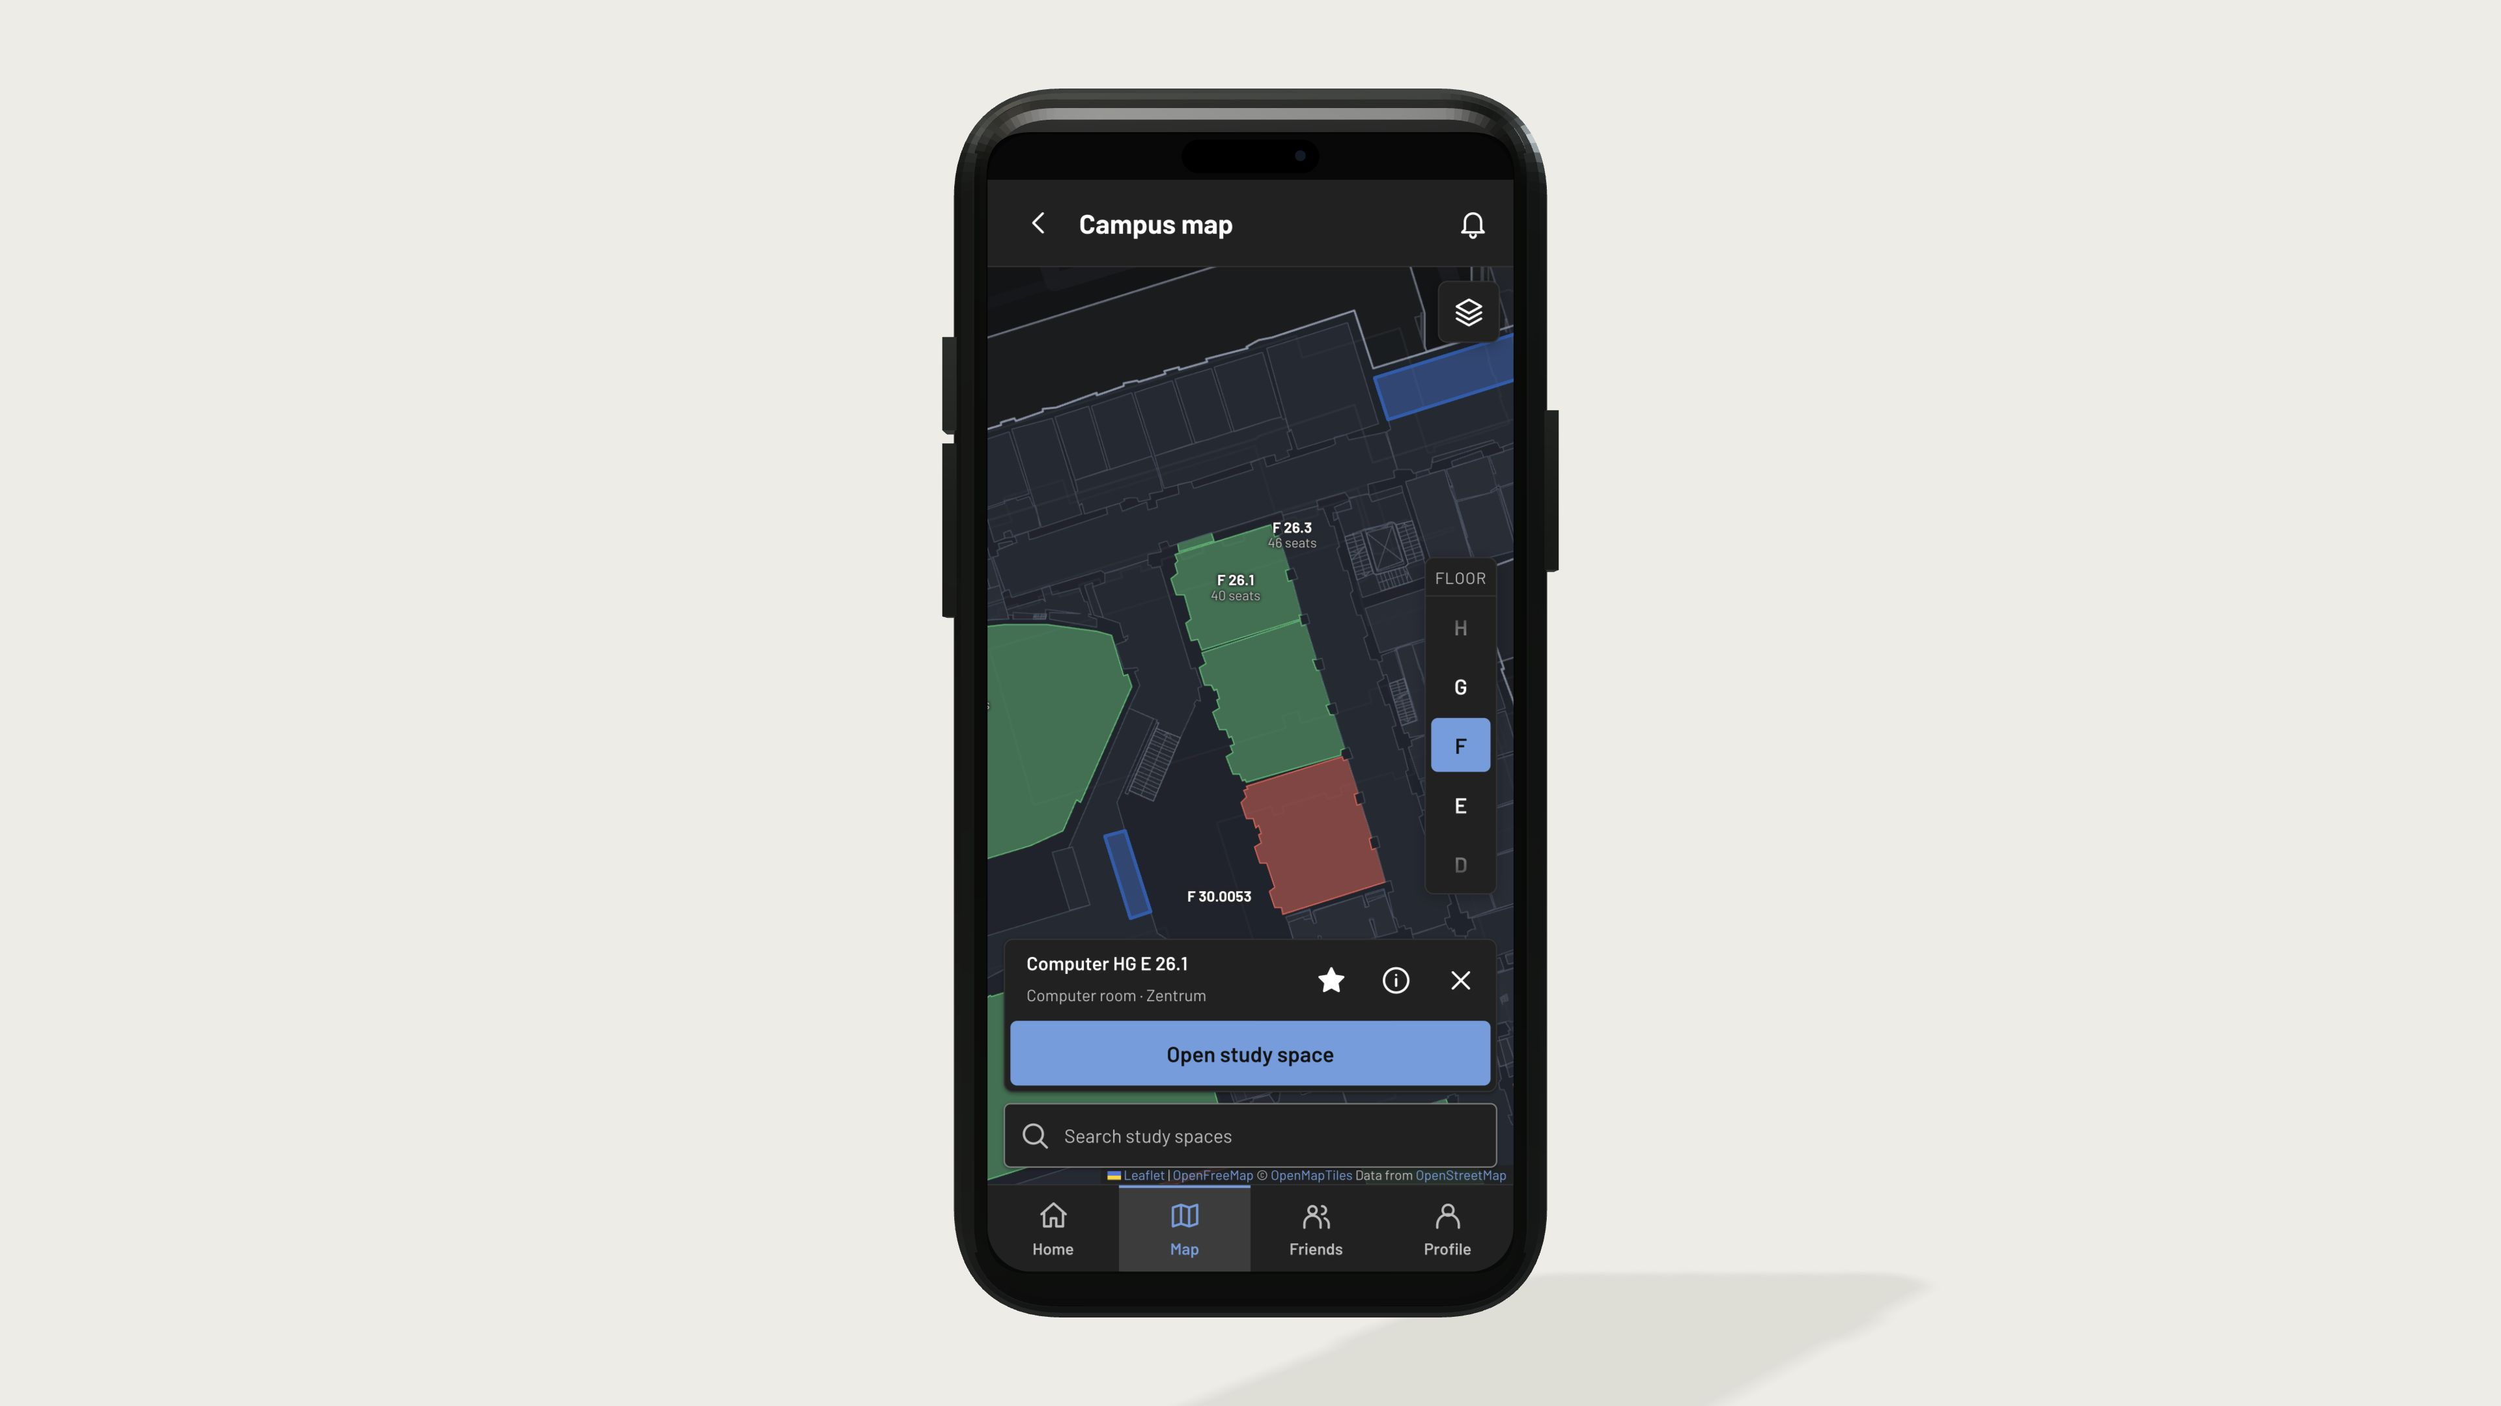
Notes:
See workspaces across ETH and explore the floors in 3D.

Slide 10
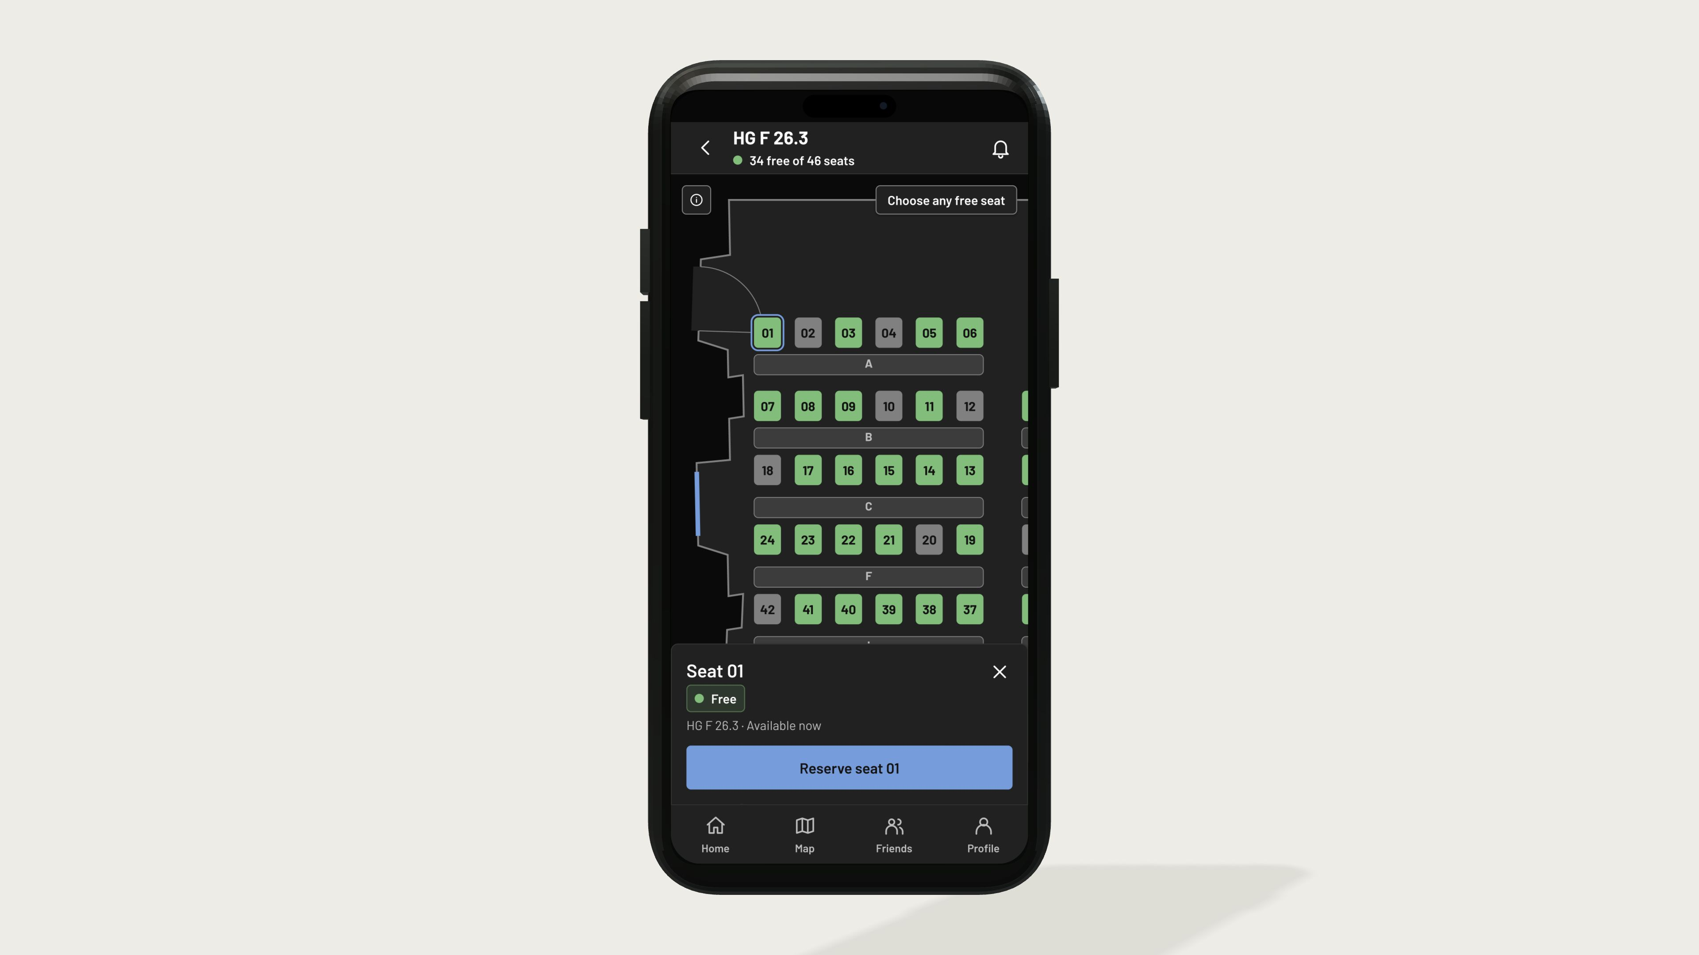
Notes:
Pick a free seat in the room layout.

Slide 11
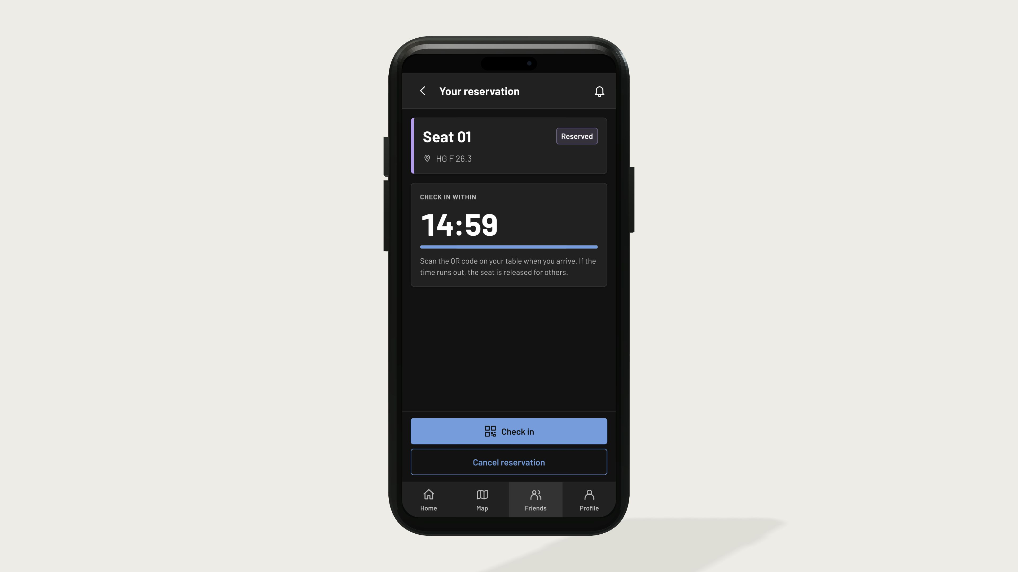
Notes:
The seat is held while you go there. Check in before the reservation expires.

Slide 12

Notes:
The live demonstration moves to the teammate's phone and camera feed.

Slide 13
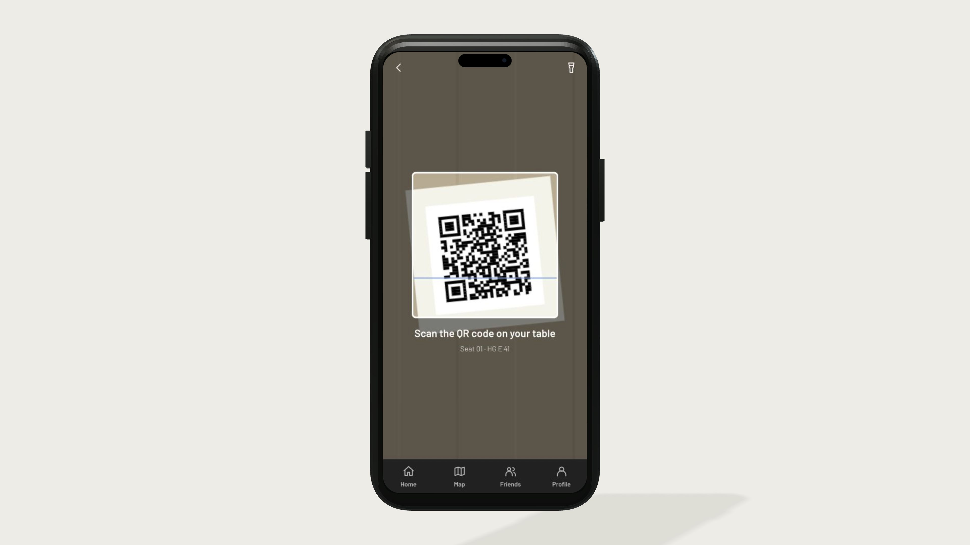
Notes:
Each seat has its own QR code. Scanning the matching code confirms arrival and starts the session.

Slide 14
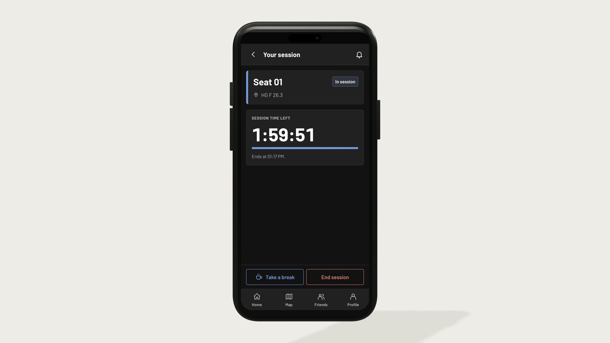
Notes:
The check-in starts the study session. The seat is now yours.

Slide 15
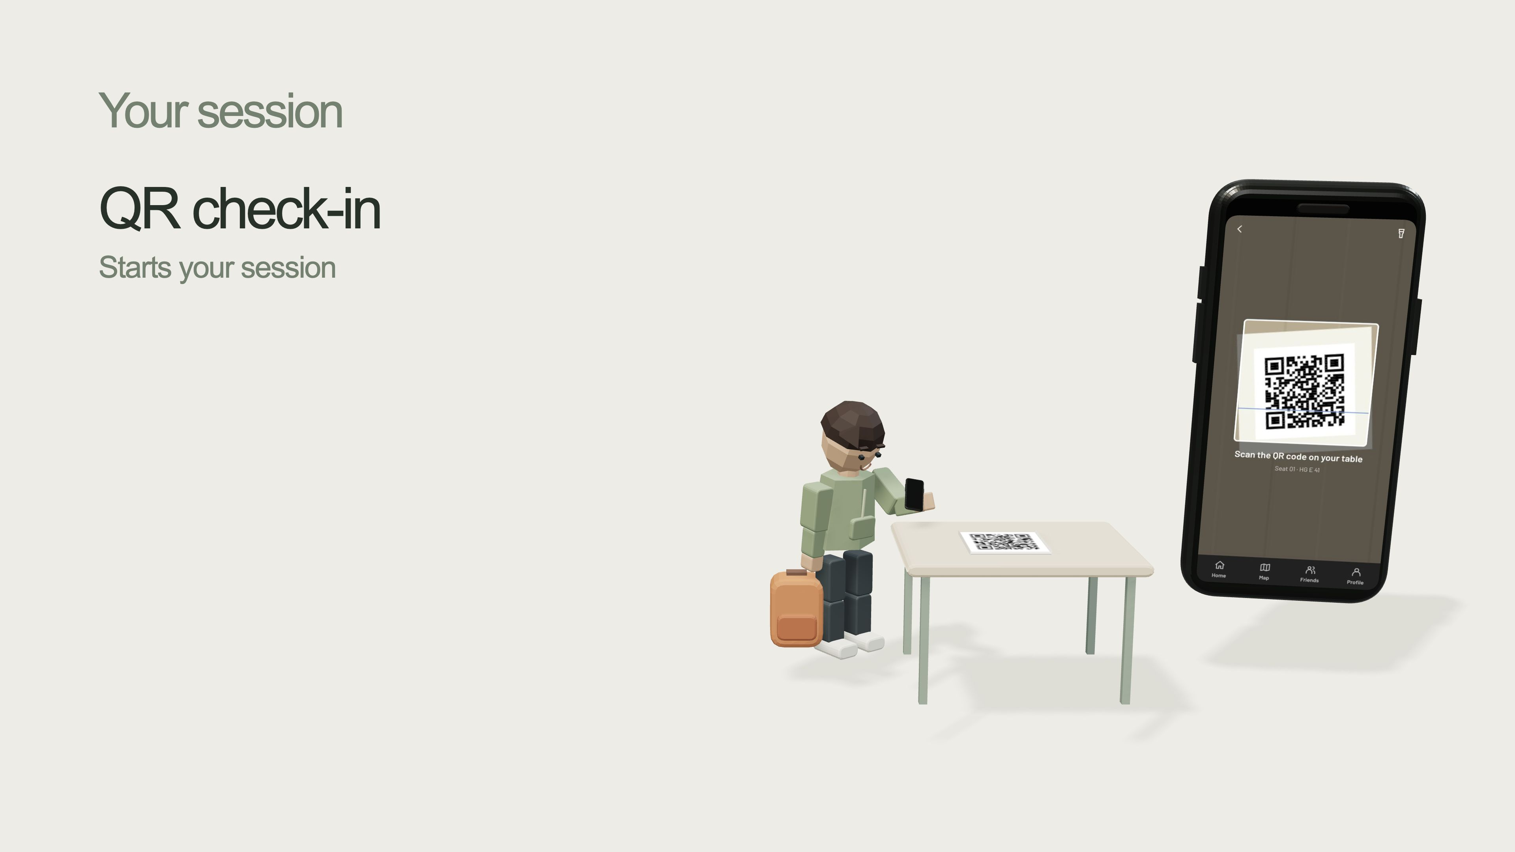
Notes:
QR check-in starts the session when the student reaches the seat.

Slide 16
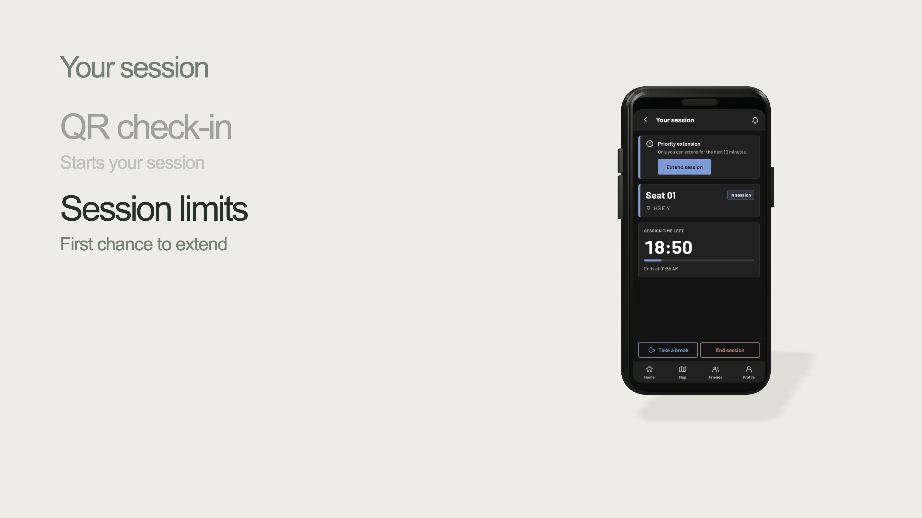
Notes:
Sessions are limited. The current student gets the first chance to extend.

Slide 17
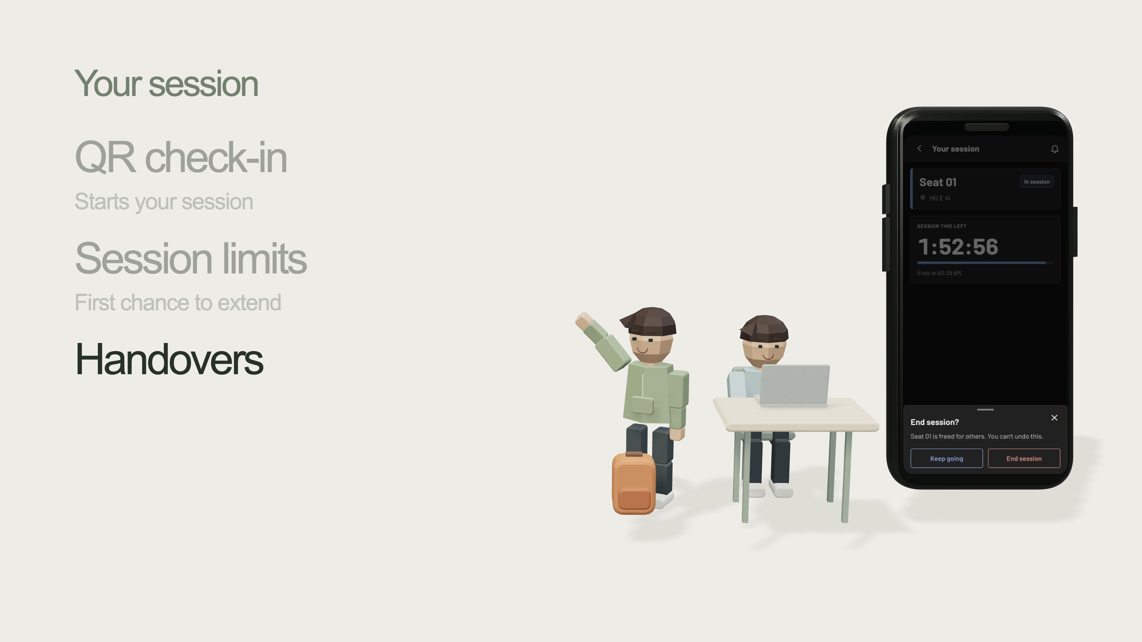
Notes:
A handover helps the next student take over the seat.

Slide 18
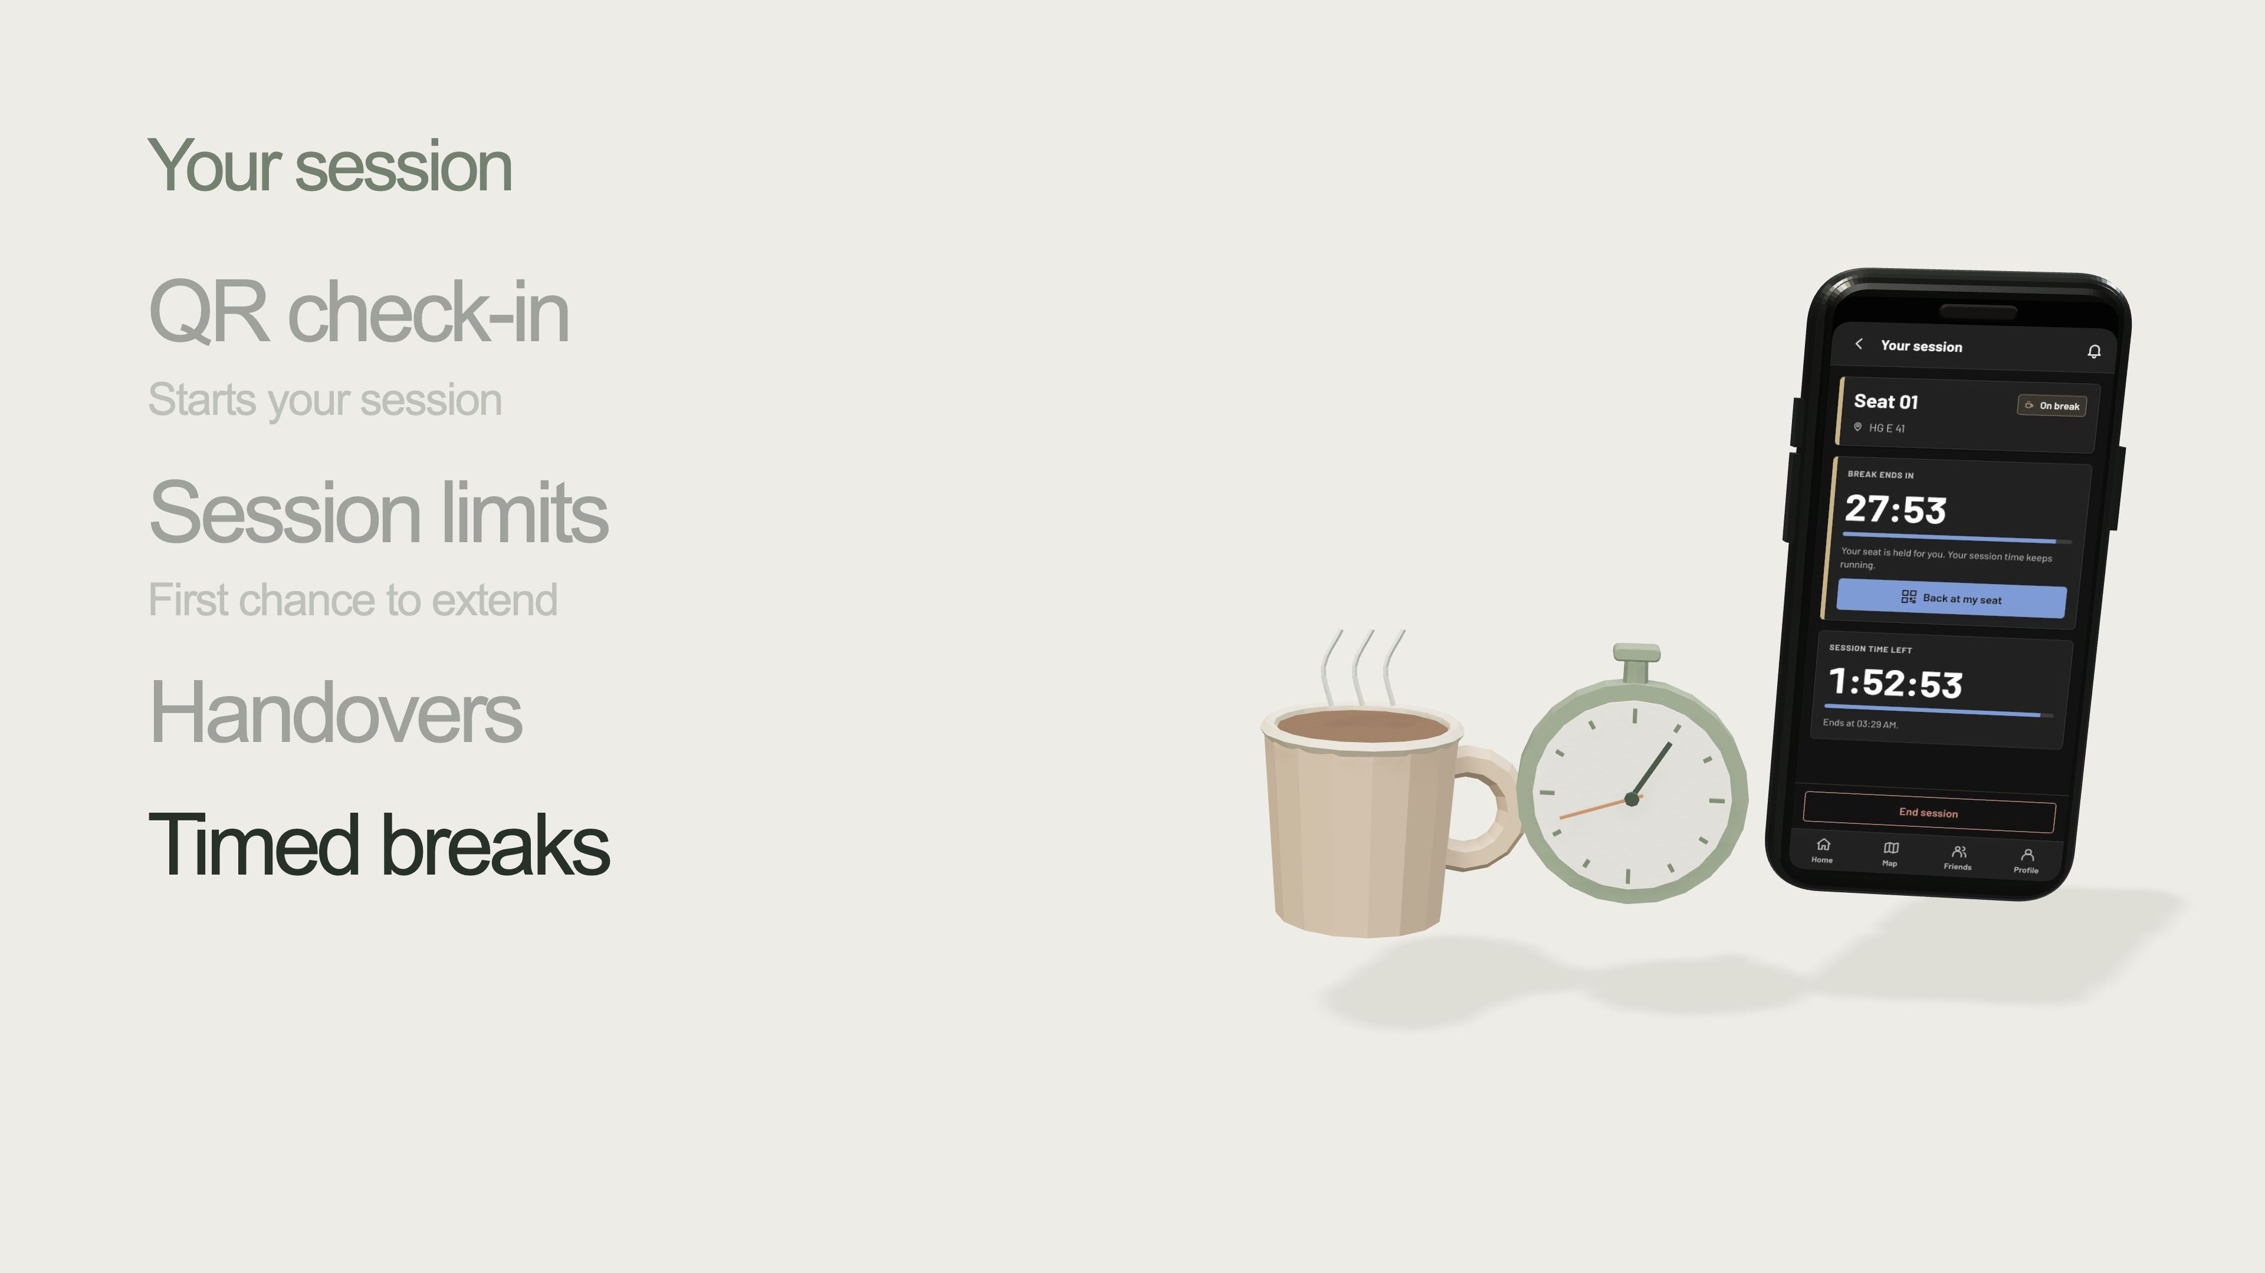
Notes:
A timed break lets you get a coffee without holding the seat indefinitely.

Slide 19
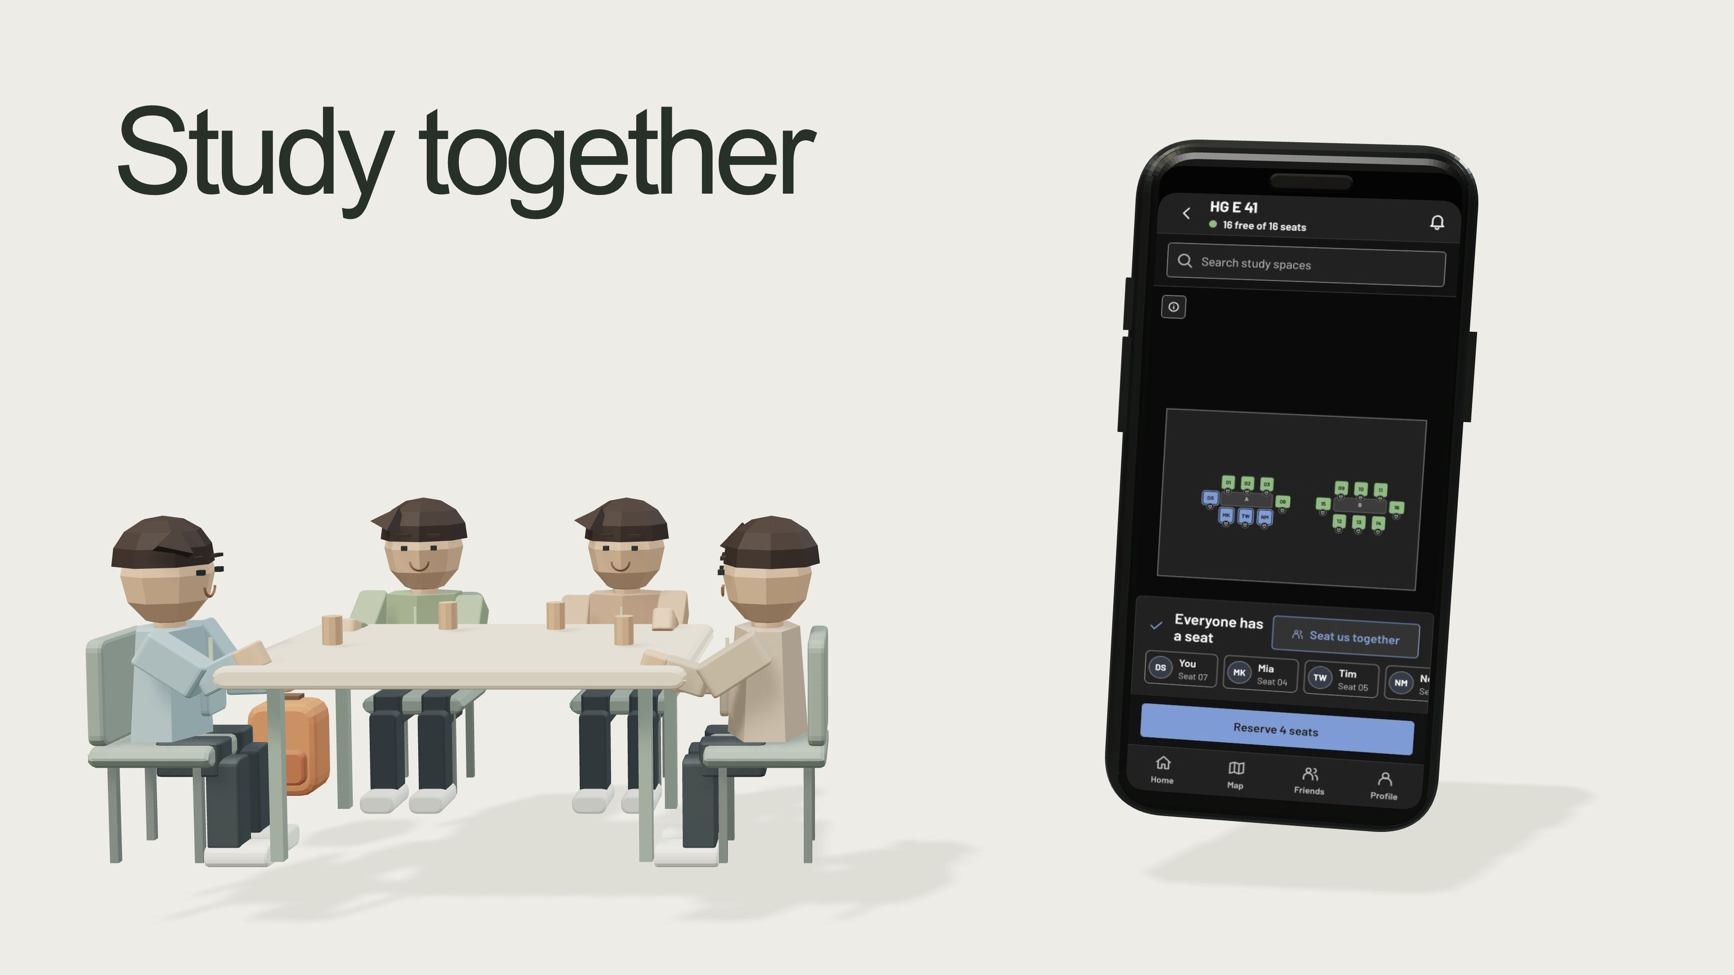
Notes:
Create a study group and find seats together with friends.

Slide 20
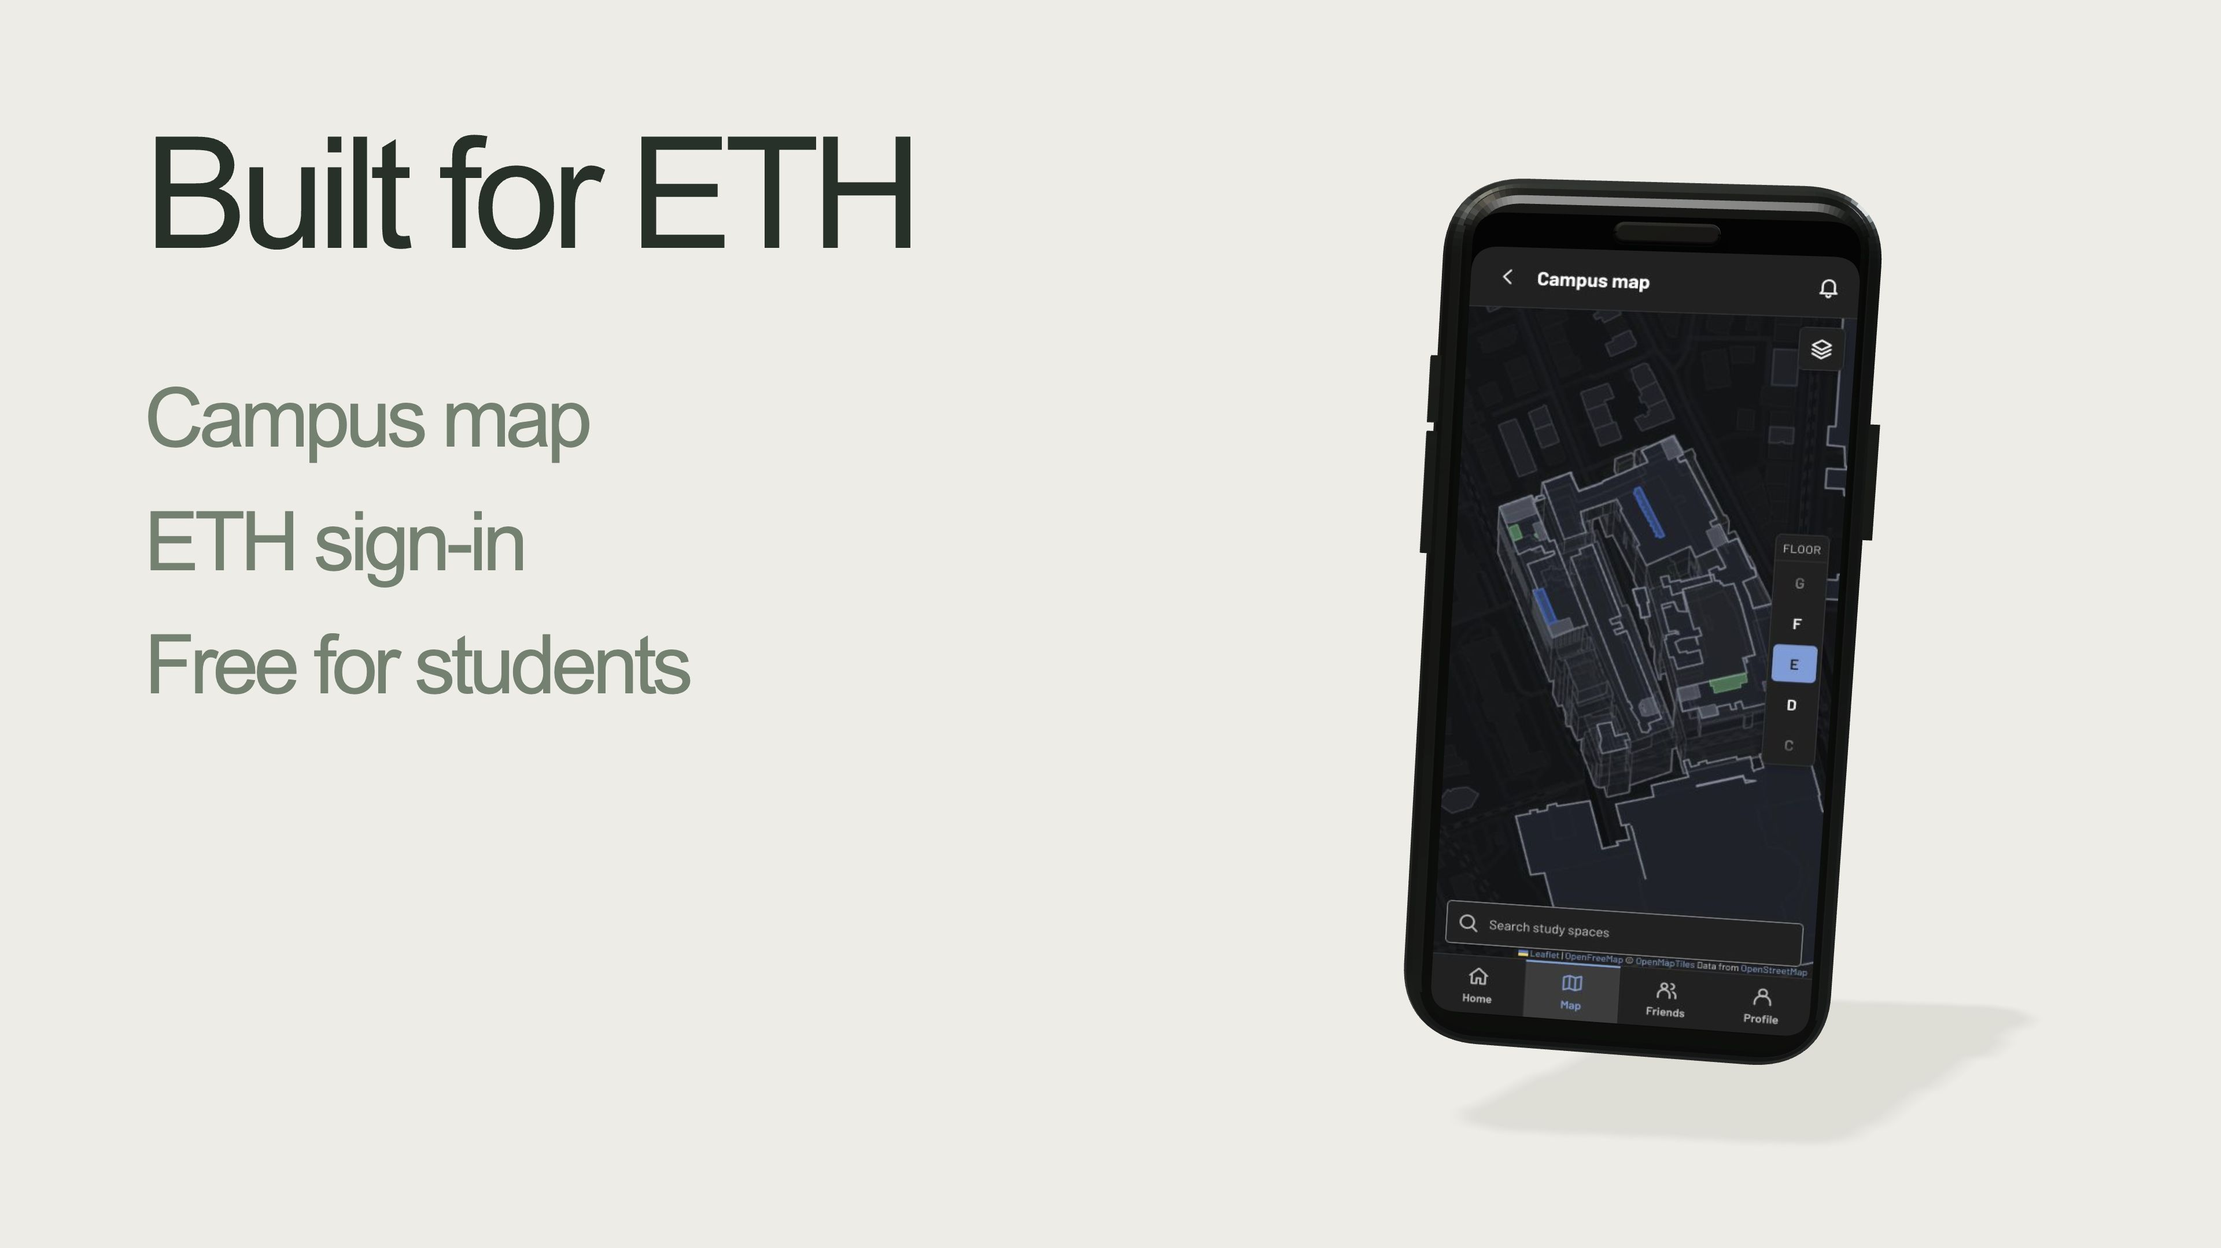
Notes:
ETH sign-in, campus-specific access and a 3D campus map. Free for students. University administration makes the system official and authoritative.

Slide 21
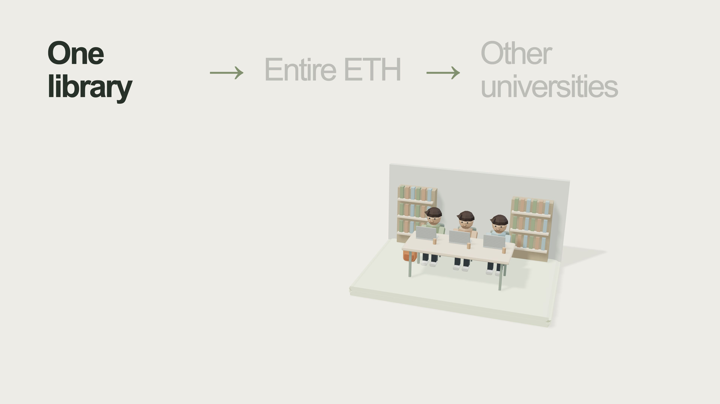
Notes:
Start with a pilot in one library.

Slide 22
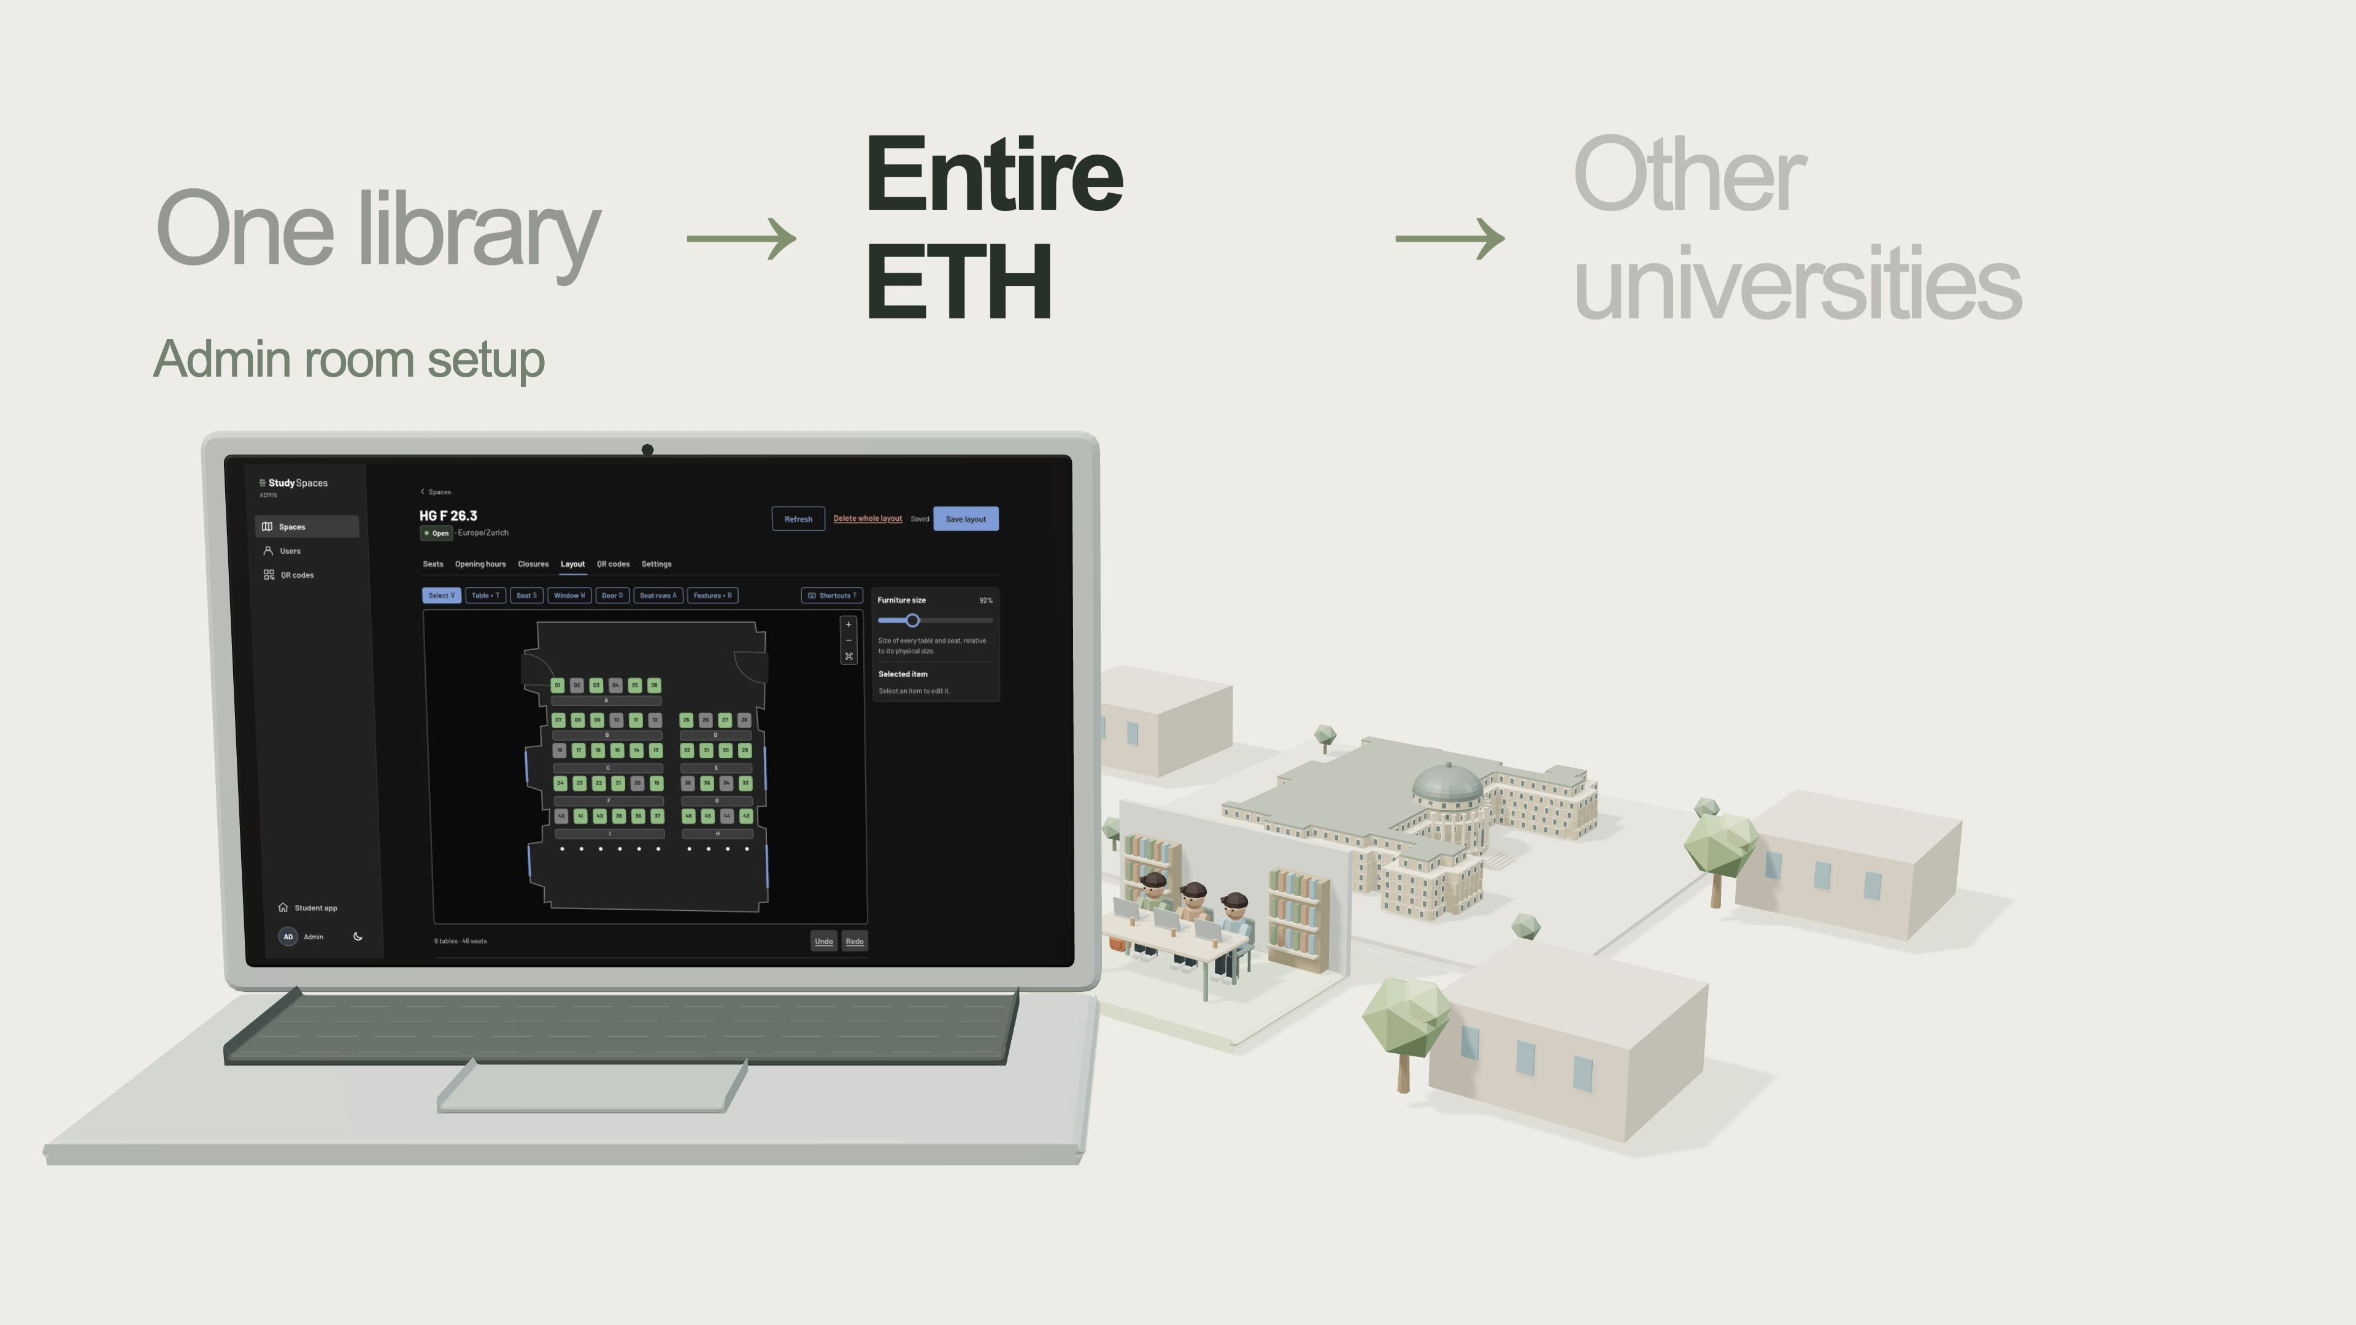
Notes:
Admins map rooms and seats in the admin panel. Expand the pilot across ETH.

Slide 23
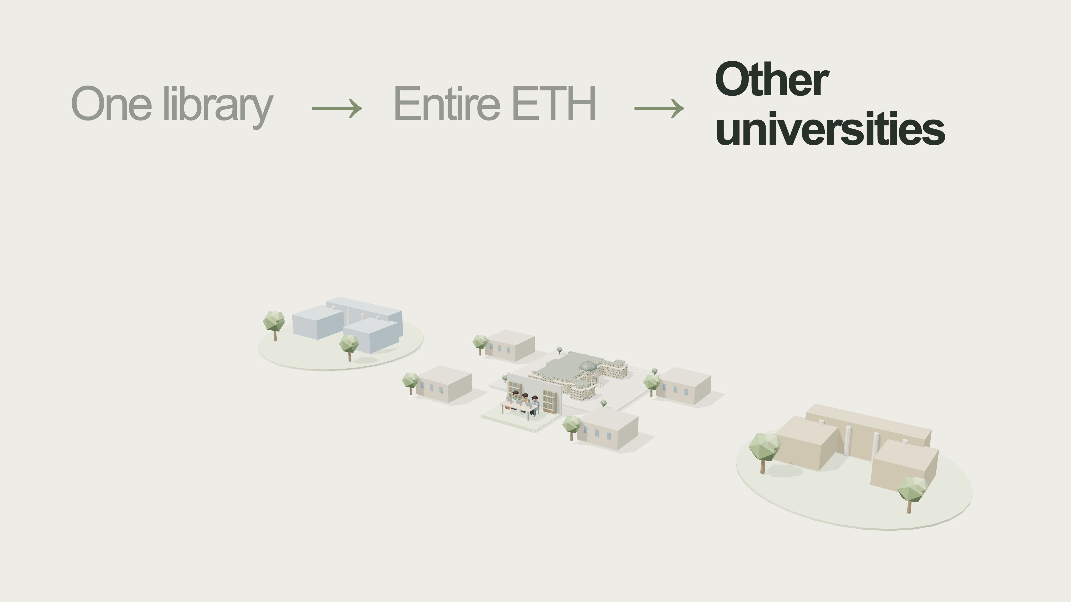
Notes:
The system can work at other universities. Each university makes it official and authoritative.

Slide 24
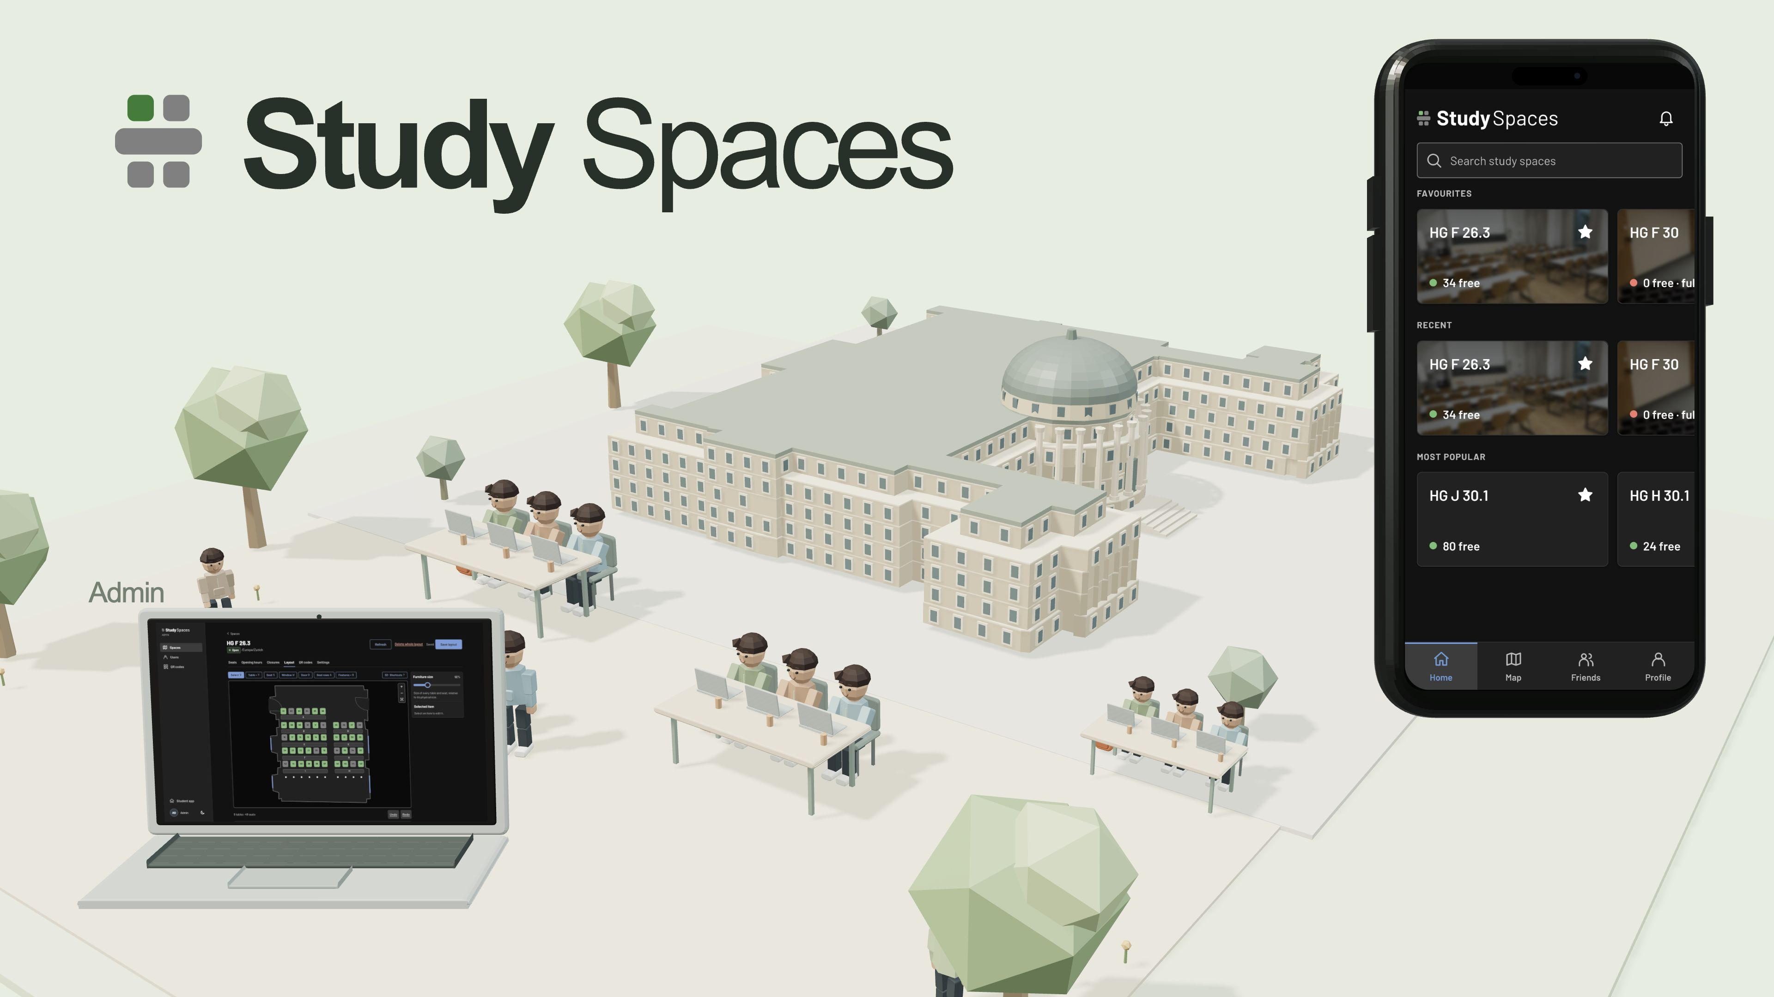
Notes:
Less stress and less wandering. More time studying, together.

