Slide 1
COMP1110 Group Project Group thu11g
Tim James, Rebecca Gibson, Nicholas Dale

Slide 2
Summary
Nicholas Dale (u6430146)
JavaFX
Drag and drop
Tim James (u6947396)
Class structuring
Game logic
Game solution
Rebecca Gibson (u6982060)
Game logic
JavaFX

Slide 3
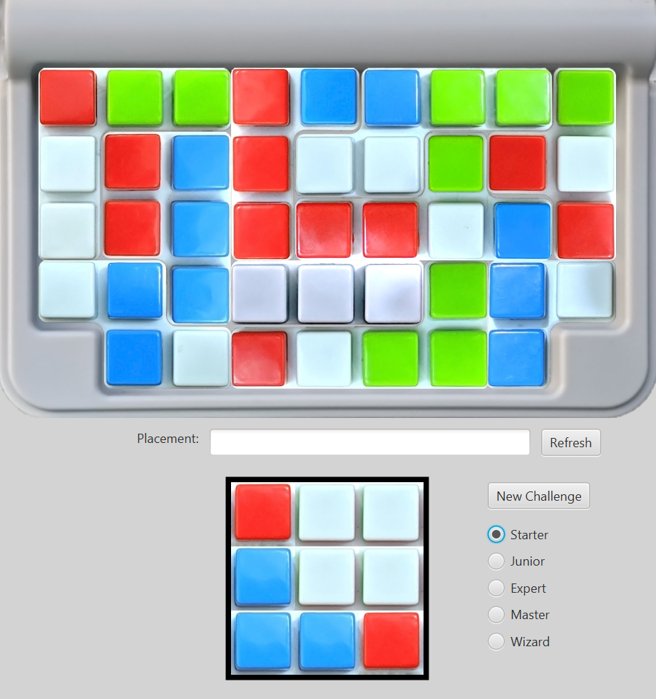
Our Game

Slide 4
Questions?

