Slide 1
COMP1110 Group Project Group thu11g
Tim James, Rebecca Gibson, Nicholas Dale

Slide 2
Summary
Nicholas Dale (u6430146)
JavaFX
Drag and drop
Tim James (u6947396)
Class structuring
Game logic
Game solution
Rebecca Gibson (u6982060)
Game logic
JavaFX

Slide 3
Our approach
Created enum classes for certain aspects of the game tiles:
Direction, Shape, State
Created Tile class that utilized all enums
Created ‘virtual’ game board array
Useful for game logic and implementation of game

Slide 4
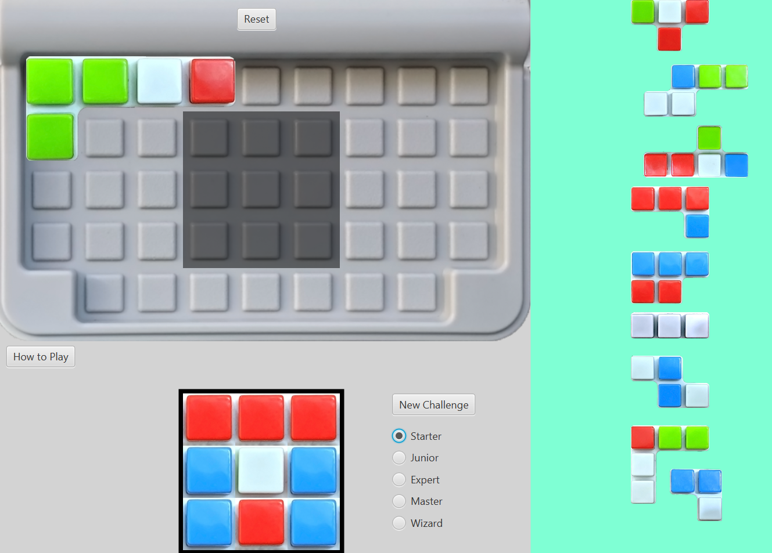
Our Game GUI

Slide 5
Usability
Rotations via R key and scrolling
Clicking to remove pieces
Scaling tiles upon selection

Slide 6
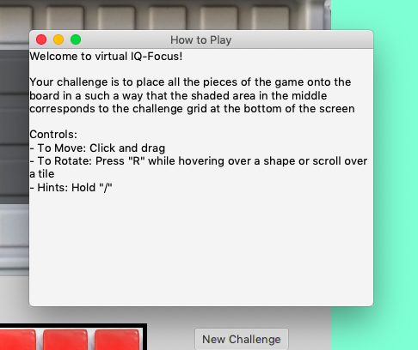

Additional Features
Reset Board functionality
How to play instructions

Slide 7
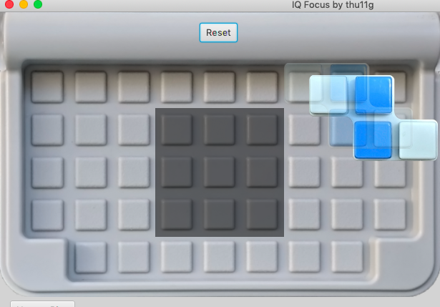
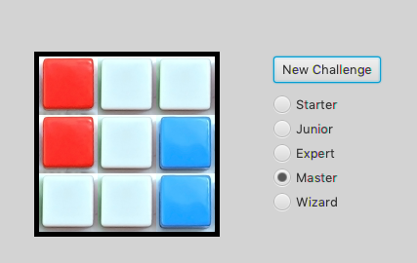
Additional Features
Drag and drop preview
Difficulty selection

Slide 8
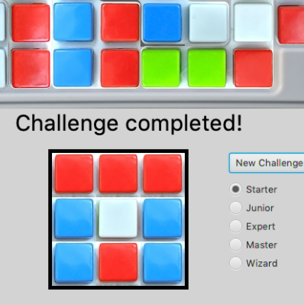
Additional Features
Challenge completed feedback

Slide 9
Questions?

